Slide 1
Shell Scripts
POSTECH MLLab
Seungjoon Lee

Slide 2
Outline
Definition of shell / shell scripts
Why shell scripts?
Shell scripts basics
Examples for ML experiments

Slide 3



Shell
Definition
A computer program that exposes an operating system's services to a human user or other programs.
User
shell
OS

Slide 4

Shell Scripts
Definition
A file made by a bunch of commands that can be readable by a shell.
File
shell
OS

Slide 5
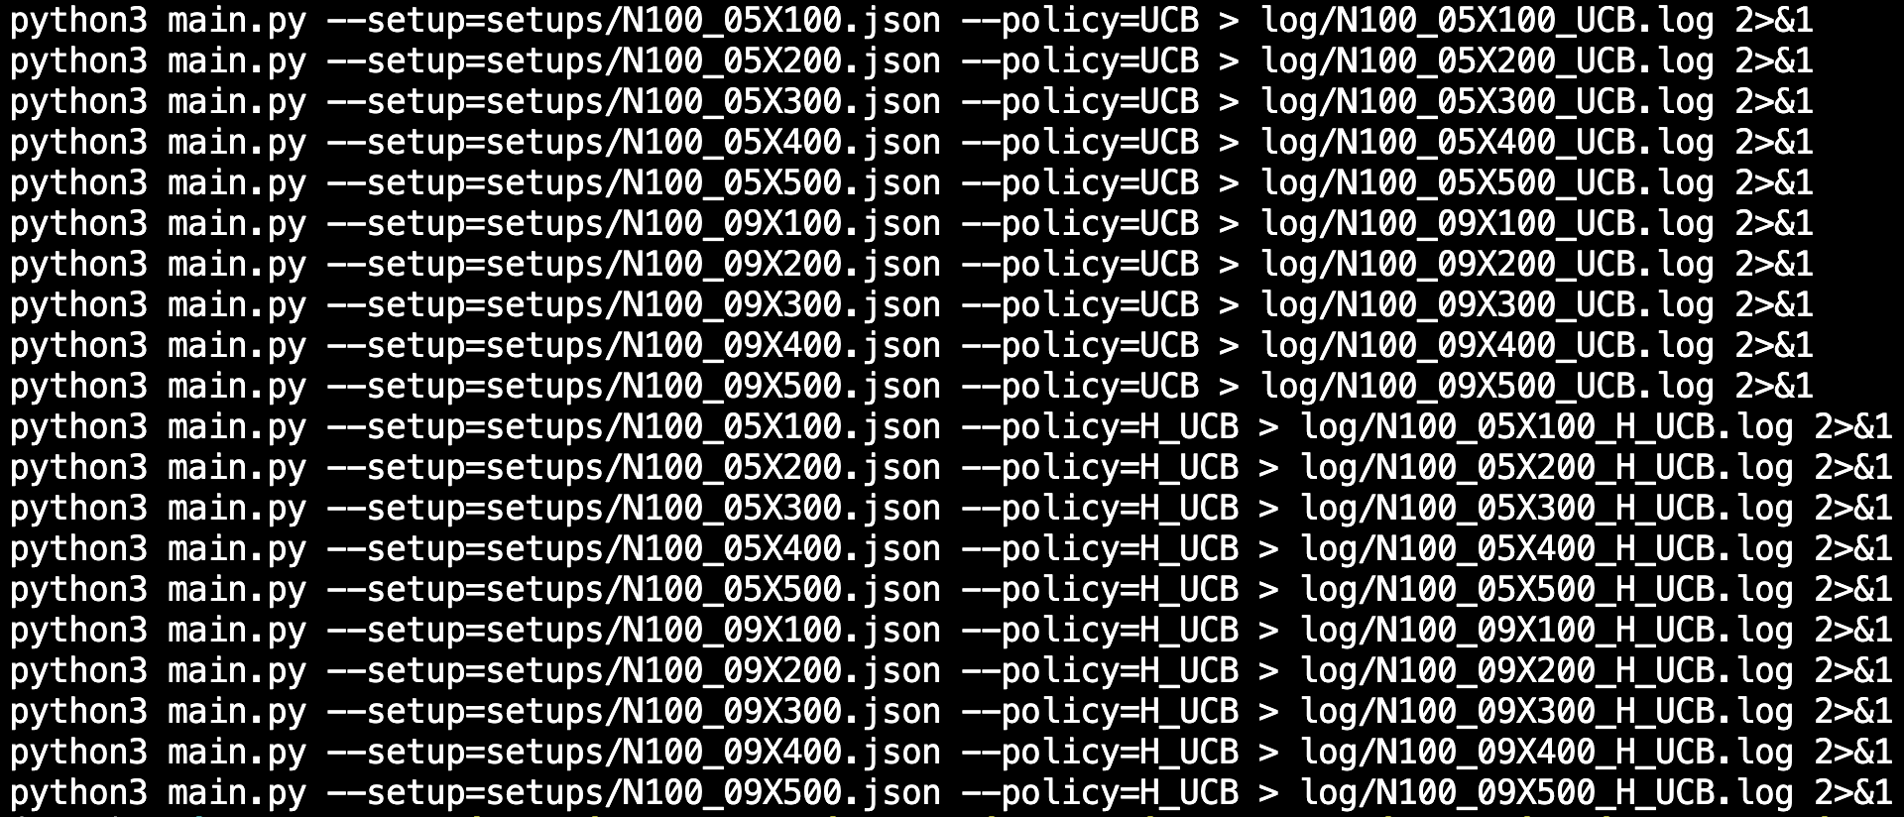

Why Shell Scripts?
Automate!
the repetitive running of similar commands, and
the sequential execution of commands with dependency.

Slide 6
What Can We Do With Shell Scripts?
Running hundreds of same commands with different arguments.
Generating config files of experiments and running experiments with them.
Pipelining commands.

Slide 7
Shell Scripts Basics

Slide 8
Exercise Materials
Online bash shell IDE:
https://www.jdoodle.com/test-bash-shell-script-online/
Github of example scripts:
https://github.com/SlyJabiru/shell-script-examples

Slide 9
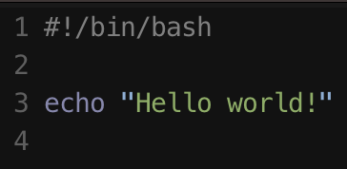
Shebang (#!)
Shebang (#!) specifies the type of shell which runs the written scripts.
Shebang = hash (#) + Bang (!)
`#!/bin/bash` should be on the top of the scripts to use bash shell.

Slide 10
Variable
`variable_name=variable_value`
Eg)
VAR1="Zara Ali”
VAR2=100
Spaces should not be next to equal signs (=).

Slide 11
Loop
arr=("element1" "element2" "element3") # declare
for i in "${arr[@]}” # loop over items
do
echo "$i” # echo the item. You can use value of variables using $
done

Slide 12
More Rules?
Google for more bash shell rules!

Slide 13
Examples for ML Experiments

Slide 14
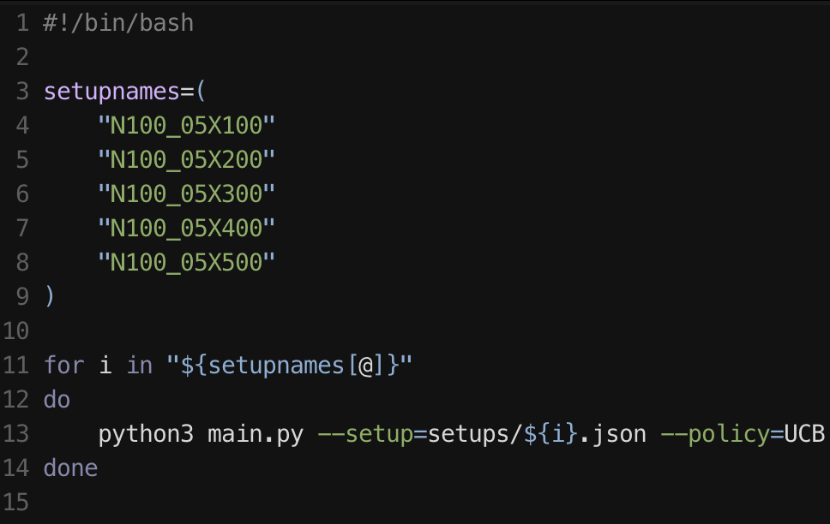
Running Hundreds of Commands
‘main.py’ gets (1) setup json file (2) policy algorithm.

Slide 15
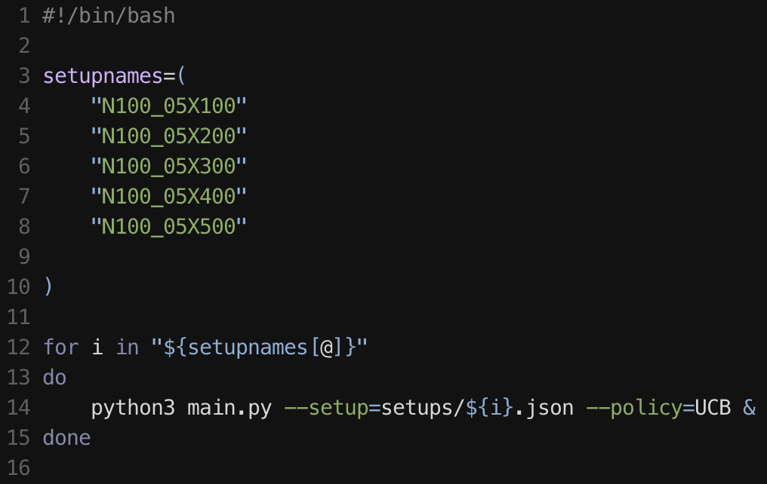
Running Hundreds of Commands Simultaneously
& makes a process run in background.

Slide 16
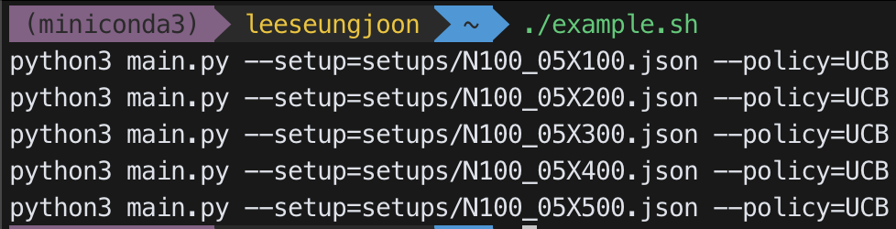
Running Hundreds of Commands – Text Example
Check the output using the example below!
#!/bin/bash
setupnames=(
"N100_05X100"
"N100_05X200"
"N100_05X300"
"N100_05X400"
"N100_05X500"
)
for i in "${setupnames[@]}"
do
echo "python3 main.py --setup=setups/${i}.json --policy=UCB"
done
example.sh
The output of example.sh

Slide 17
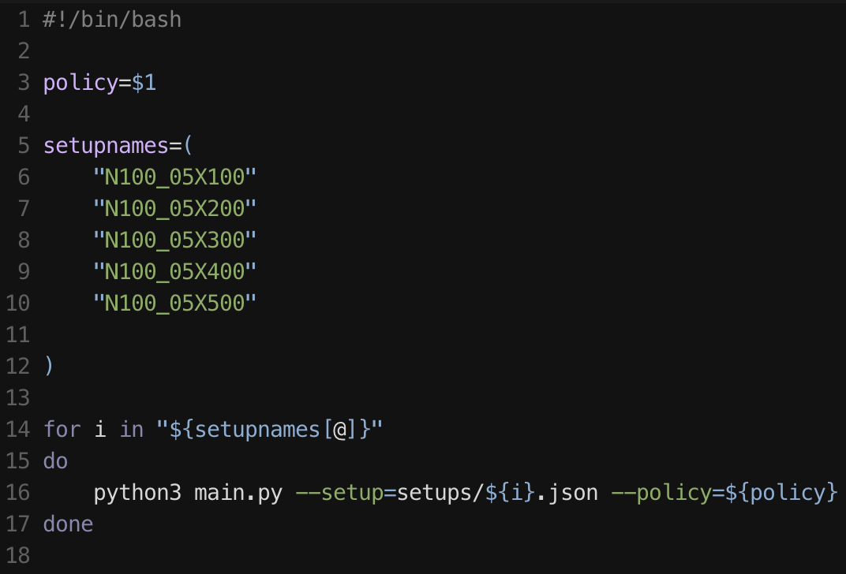
Running Commands with Different Arguments
You can feed arguments to shell scripts.
run_args.sh

Slide 18
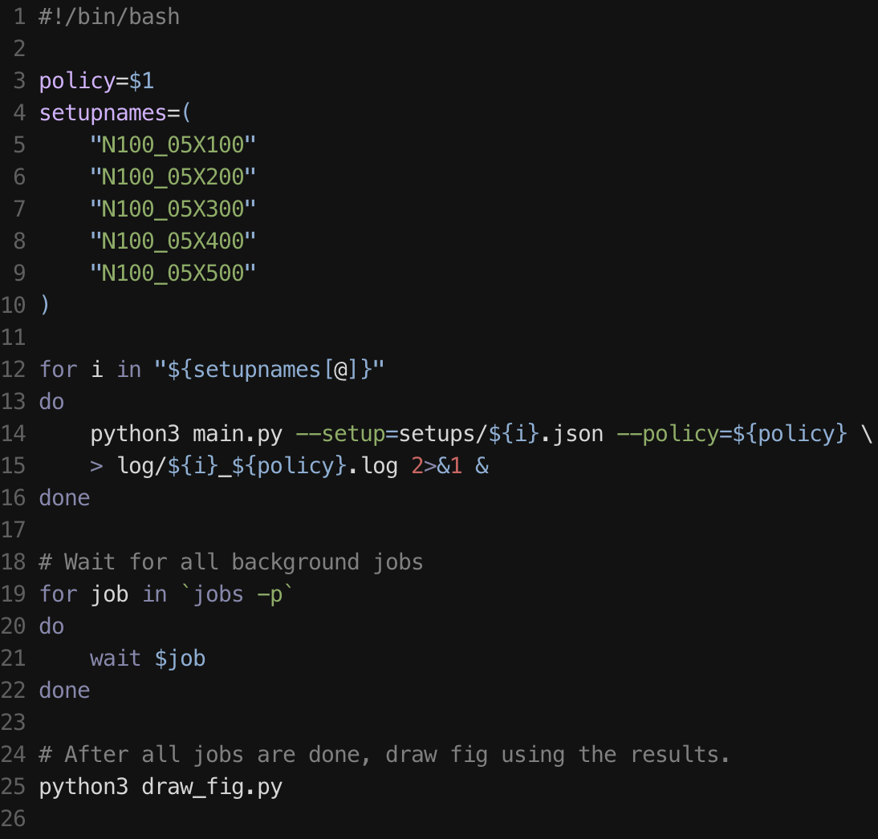
Pipelining Commands
You can pipeline commands using foreground / background process and wait properly.

Slide 19
Pipelining Commands
You can pipeline commands using foreground / background process and wait properly.
`foo > a.log` write the stdout of foo into a.log.

Slide 20
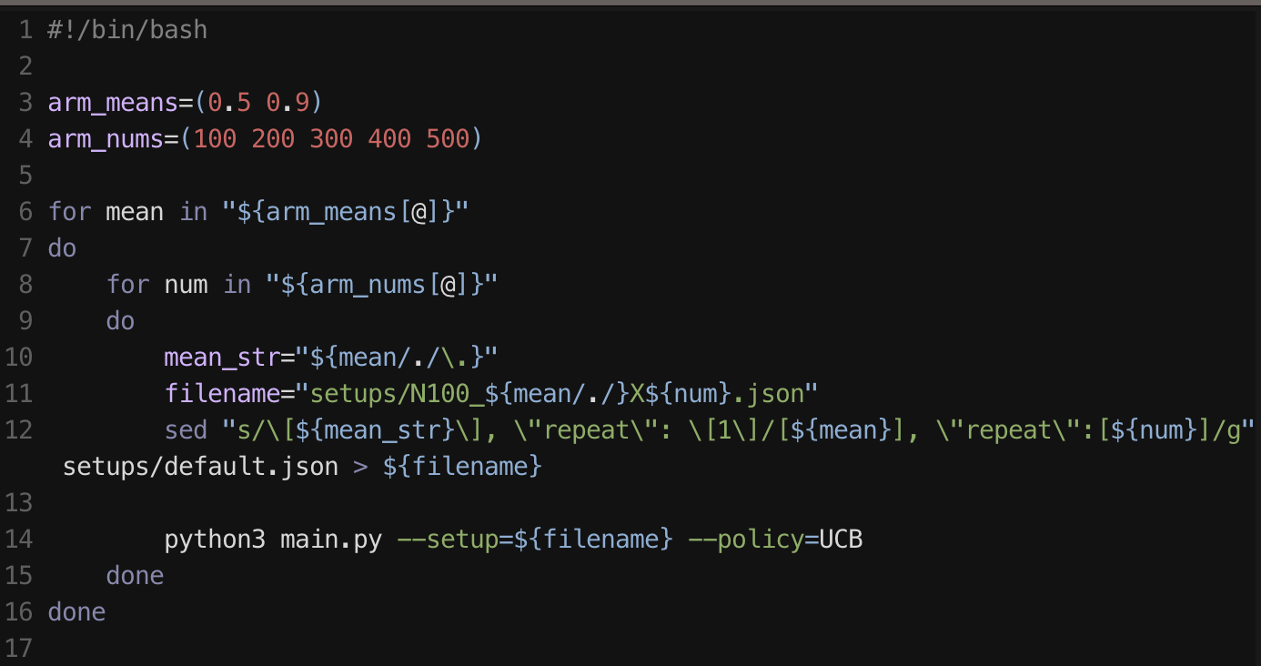
Generating Config Files of Experiments (Advanced)
Above script makes new config files by changing default.json and then runs experiments.

Slide 21
Takeaway Messages
Shell script is a file with commands that can be readable by a shell.
With shell scripts, you can automate typing bothering commands!
Materials: https://github.com/SlyJabiru/shell-script-examples

