Slide 1
Applied Data Science
Correlation between a neighborhood real estate price and its surrounding venues

Slide 2
Introduction
The main goal will be exploring the neighbourhoods of New York City to extract the correlation between the real estate value and its surrounding venues.
The target audience for this report are:
Potential buyers who can roughly estimate the value of a house based on the surrounding venues and the average price.
Houses sellers who can optimize their advertisements.

Slide 3
Data Description
The dataset will be composed of the following two primary sources:
CityRealty which provides the neighbourhoods average prices.
FourSquare API which provides the surrounding venues of a given coordinate.

Slide 4
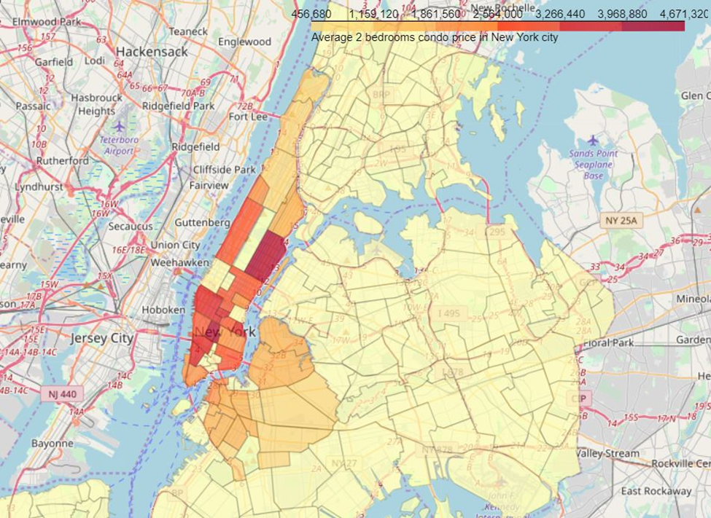
Methodology
First insight using visualization
Linear Regression
Principal Component Regression (PCR)

Slide 5
Results
Even though the result seems to be improved after applying a more sophisticated method, the model is still not suitable for the dataset.
Explanations for the reduced model can be:
The real estate price is hard to predict.
The data is incomplete (small sample size, missing deciding factors).
Machine learning techniques are chosen or applied poorly.

Slide 6
Discussion
The real challenge is constructing the dataset:
Usually, the needed data isn’t publicly available.
When combining data from multiple sources, inconsistent can happen. Moreover, lots of efforts are required to check, research and change the data before the merge.
For data obtained through API calls, different results are returned with a different set of parameters and different point of time. Many trial and error runs are required to get the optimal result.
After the dataset has been constructed, lots of research and analysis are needed to decide whether the data should be kept as is or be transformed by normalization or standardization.

Slide 7
Conclusion
Unfortunately that the analysis couldn’t produce a precise model or showing any strong coefficient correlation for any venue type. However, we can still get some meaningful and logical insights from the result.

