Slide 1
Distributed Text Analysis on Husky
Jiayi WU
1155046964

Slide 2
Outline
Introduction
TF-IDF Review
Word2vec

Slide 3
Introduction
Text Analysis
Husky

Slide 4
Introduction – Text Analysis
A process of extracting interesting and non-trivial information from unstructured text documents
Importance and complexity
80% of a company’s information is contained in text documents
Text data are inherently unstructured and fuzzy
Notes:
As the most natural form of storing information is text, text mining is believed to have a commercial potential higher than that of data mining. In fact, a recent study indicated that 80% of a company’s information is contained in text documents. Text mining, however, is also a much more complex task (than data mining) as it involves dealing with text data that are inherently unstructured and fuzzy. Text mining is a multidisciplinary field, involving information retrieval, text analysis, information extraction, clustering, categorization, visualization, database technology, machine learning, and data mining.

Slide 5
Introduction – Text Analysis
Document-based intermediate form
(each entity represents a document)
Clustering
Categorization
Visualization
…
Text
Concept-based intermediate form
(each entity represents an object or concept of interests)
Predictive Modeling
Associative Discovery
Visualization
…
Text Refining
Knowledge Distillation
Notes:
A text mining framework. Text refining converts unstructured text documents into an intermediate form (IF). IF can be document-based or concept-based. Knowledge distillation from a document-based IF deduces patterns or knowledge across documents. A document-based IF can be projected onto a concept-based IF by extracting object information relevant to a domain. Knowledge distillation from a concept-based IF deduces patterns or knowledge across objects or concepts.
Clustering: Descriptors are sets of words that describe the contents within the cluster. K-means can be used.
Concept-based: word vectors

Slide 6
Introduction – Text Analysis
Application:
monitoring and analysis of online plain text sources such as Internet news, blogs, etc. for national security purposes
Bioinformatics company PubGene AS, a search engine for biomedical texts
Big corpus Distributed Text Analysis
Notes:
Security applications
Biomedical applications
Software applications
Online media applications
Marketing applications
Sentiment analysis
Academic applications

Slide 7
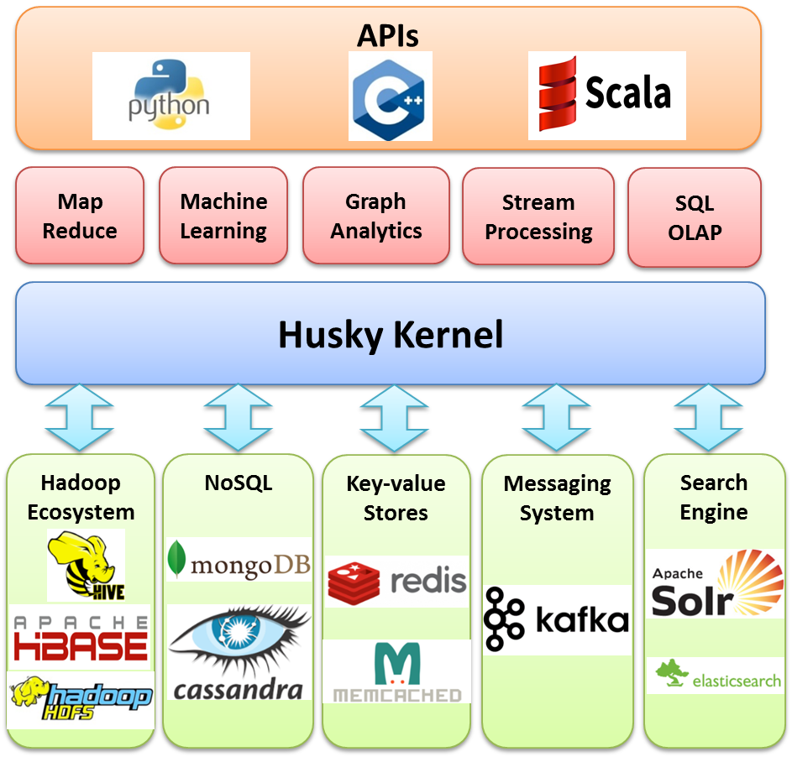
Platform - Husky
Notes:
Structur
Husky is an efficient platform for distributed text analysis algorithms. Figure 2.1 shows
its basic structure. It is built on a cluster of machines and each machine may run multiple
workers. Each worker manages a partition of data.

Slide 8
Platform - Husky
Object lists:
store data
globalize: evenly distributed and visible to all workers
Master-worker architecture
master: coordinate the workers
workers: do computations
Notes:
Feature
Husky supports different types of objects and the objects are organized into object lists.
Usually, the data is stored in the objects. The object list could be local without any
global synchronization but could also be globalized which enables the object list to be
evenly distributed and visible to all workers. Globalization of course has some commu-
nication costs and thus is only used when necessary.
The Husky is of master-worker architecture. The master's main job is to coordinate
the workers while the computations are done on workers.

Slide 9
Platform - Husky
Aggregator
store information that is shared by every worker
update local copy
merge to the global copy
Notes:
Features
An aggregator stores information that is shared by every
worker. Each worker has a local copy of all aggregators and can update its local copy.
The local copies are merged to update the global copy after each round or whenever the
synchronization function is called. This feature is critical for the parameter updating in
machine learning.

Slide 10
TF-IDF Review
Algorithm
Performance

Slide 11
TF-IDF
Term Frequency–Inverse Document Frequency (TF-IDF)
How important a word is to a document in a corpus
Input: Corpus
Output: Word Values
Usage: how relevant a document is to a user query
similarity between documents
Notes:
TF-IDF is one of the most widely used algorithm in text analysis. It is a statistics reflecting how important a word is to a document in a corpus in text analysis. Naturally, it could be used by search engine to determine how relevant a document is to a user query. Also, it could be combined with cosine similarity to determine the similarity between documents
Value of each word in each document

Slide 12
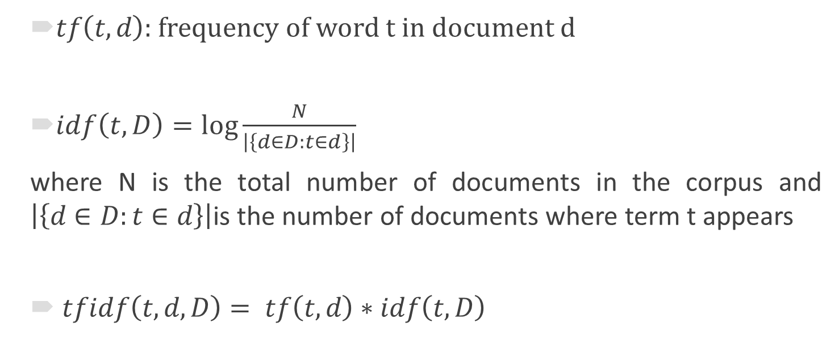
TF-IDF Calculation
$tf\left(t,d\right)$: frequency of word t in document d
$idf\left(t,D\right)=\log{\frac{N}{\left|\left\{d∈D:t∈d\right\}\right|}}$
where N is the total number of documents in the corpus and $\left|\left\{d∈D:t∈d\right\}\right|$is the number of documents where term t appears
$tfidf\left(t,d,D\right)= tf\left(t,d\right)∗idf\left(t,D\right)$
Notes:
TF-IDF is the product of to term frequency (TF) and inverse document frequency (IDF).
Idf: meatures how much information the word provides
The more documents it appears in, the less value it will have

Slide 13
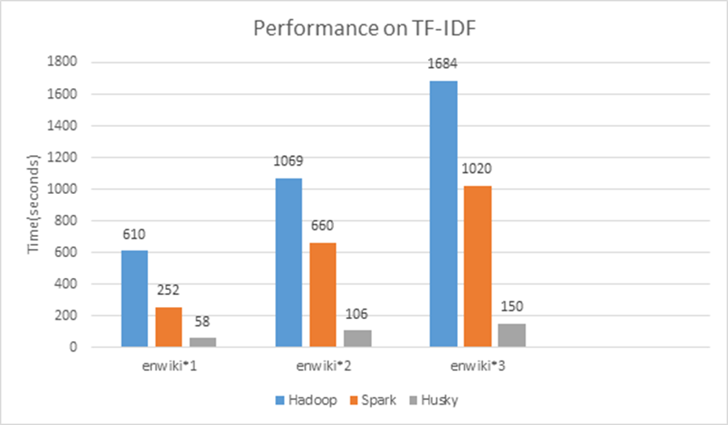
Performance
Test dataset: English Wikipedia corpus (10.4G), containing over 4.8 million documents and 1.7 billion terms
Notes:
The test dataset is the English Wikipedia corpus, denoted by "en-wiki * 1", which contains over 4.8 million documents and 1.7 billion terms. I also tested heavier workloads by duplicating "enwiki * 1" by 2 and 3 times, denoted by "enwiki * 2" and "enwiki * 3".
Spark is 39% to 58% faster than Hadoop, but Husky is even around 5 times faster than Spark. The advantage is more signiﬁcant when the datasets get larger.

Slide 14
Binding to the Python Library
Enable users to easily run the algorithm with python on Husky.
Provides a function to load data from MongoDB while users could also use other functions to load data from any source.
Preprocess the PyHusky list with many different operators, such as map, reduce or other Husky operators
Call the calculation function which will automatically call the C++ library and return the result
further deal with the result with any operator.
Notes:
The binding of the C++ code to the Python library of Husky is also
provided.

Slide 15
Word2vec
Backgound
Model
Training Algorithm
Distributed Algorithm
Implementation
Performance

Slide 16
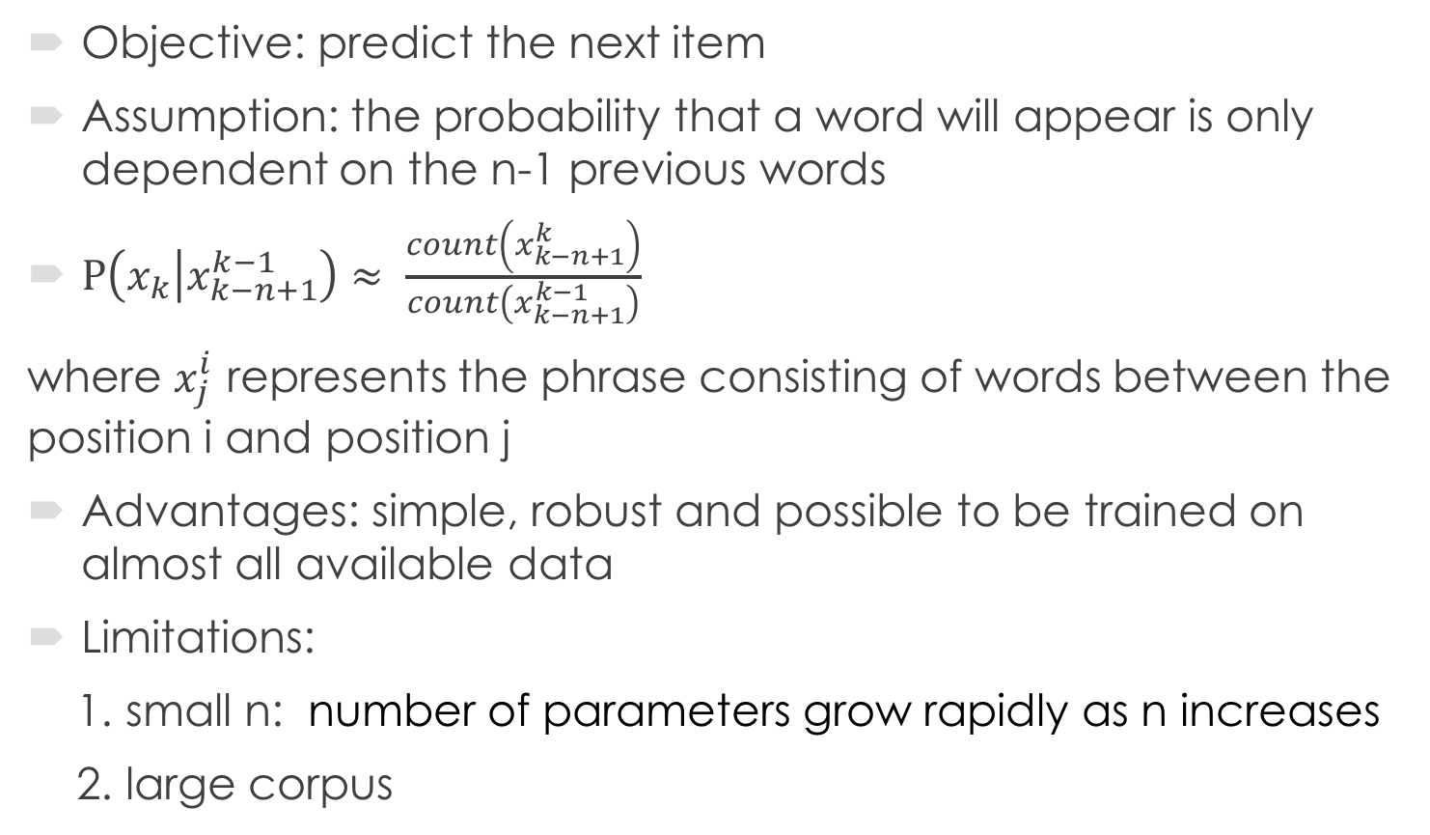
Background - n-gram Model
Objective: predict the next item
Assumption: the probability that a word will appear is only dependent on the n-1 previous words
$P\left(x_{k} | x_{k−n+1}^{k−1}\right)≈ \frac{count\left(x_{k−n+1}^{k}\right)}{count\left(x_{k−n+1}^{k−1}\right)}$
where $x_{j}^{i}$ represents the phrase consisting of words between the position i and position j
Advantages: simple, robust and possible to be trained on almost all available data
Limitations:
1. small n: number of parameters grow rapidly as n increases
2. large corpus
Notes:
The n-gram model used for statistical language modeling is widely used for predicting the next item. The model is based on the assumption that the probability that a word will appear is only dependent on the n-1 previous words.
This model is simple, robust and possible to be trained on almost all available data (trillions of words). However, the simplicity also causes some limitations. The model contains a lot of parameter and the number of parameters grow rapidly as n increases. So, in practical, n is usually defined as one or two which limits the accuracy. What’s more, even n is small, the model requires a large corpus to train so many parameters. So, though n-gram model is widely used in natural language processing, it has some limitations. (For example, the existing corpora for many languages contain only a few billions of words or less, which is not sufficient to get reliable parameters of n-gram model. )In this case, n-gram model is of course not a good choice and the neural network models introduced later will be more suitable. However, the main assumption of n-gram model still affects the neural network models a lot.

Slide 17
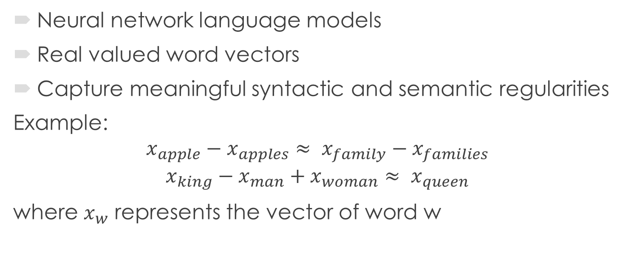
Background - Word Representation
Neural network language models
Real valued word vectors
Capture meaningful syntactic and semantic regularities
Example:
$$x_{apple}−x_{apples}≈ x_{family}−x_{families}$$
$$x_{king}−x_{man}+x_{woman}≈ x_{queen}$$
where $x_{w}$ represents the vector of word w
Notes:
To get more reliable model to predict words, neural network language models have appeared and achieved outstanding results. In these models, words are represented by real valued vectors which are used as the inputs. After finishing training the model, the product is not only the model to predict words, but also the word vectors. One important conclusion is that the word vectors not only can be used to get the similarity of words but also capture meaningful syntactic and semantic regularities [5]. For example, if $x_{w}$ represents the vector of word w, $x_{apple}−x_{apples}≈ x_{family}−x_{families}$and $$x_{king}−x_{man}+x_{woman}≈ x_{queen}.$$
This feature is later used in neural network model to train word vectors.

Slide 18
Background – Word2vec
Input: corpus
Output: word vectors
Usages: find similarity words
capture syntactic and semantic regularities

Slide 19
Background – Word2vec
Word2vec is known as a group of models that are used to produce word representations.
It uses either continuous bag-of-words (CBOW) or continuous skip-gram (Skip-gram) model architecture.
The usual training algorithms is the hierarchical softmax and negative sampling.
The first implementation is the open-source project of Google in 2013 (https://code.google.com/archive/p/word2vec/).
Notes:
This is a relatively new algorithm and there are not many big projects using the algorithm. However, there are some interesting things we can do by this algorithm. I will show some so that we can get an idea about how the algorithm could be used.

Slide 20
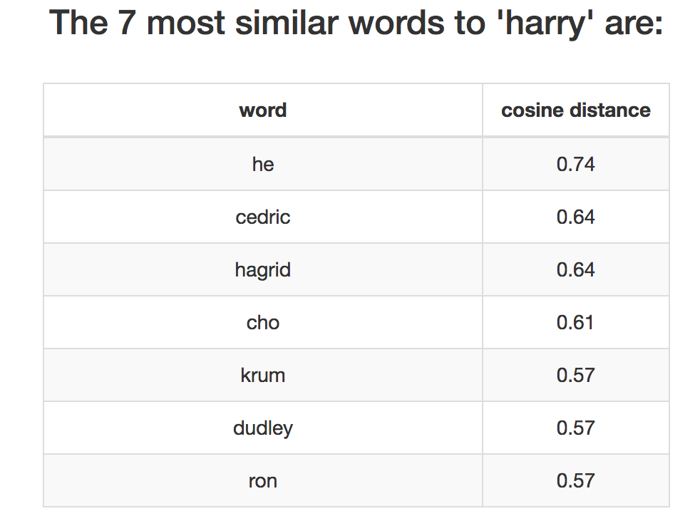
Interesting Projects
7 most similar words from the Harry Potter series
Referencing to (www.zareenfarooqui.com/w2v)
Notes:
Most of the similar words of “Harry” are the first names of his friends.

Slide 21
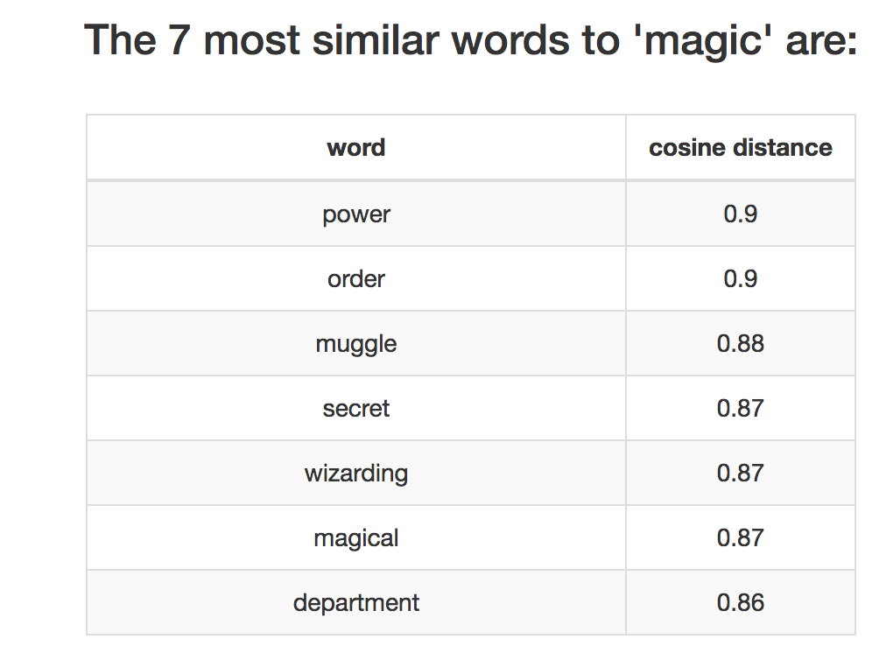
Interesting Projects
7 most similar words from the Harry Potter series
Referencing to (www.zareenfarooqui.com/w2v)
Notes:
The input data is small so the word vector won’t be very accurate. But the result could help understand the book.

Slide 22
Other Usages
Clustering
Mobile applications recommendation
Input of deep neural network for sentiment analysis on movies

Slide 23
CBOW Model
Continuous bag-of-words model
Objective: learning distributed representations of words
Maximize the accuracy while minimize the computational complexity
Input: previous and future words
Output: prediction to the current word
Notes:
Reference (not included in presentation)
N: the number of words in the context
V: the size of the vocabulary
D: the size of word vector
Training Complexity: $Q=N×D+D ×V$
the training complexity is proportional to O = E × T × Q,
where E is number of the training epochs, T is the number of the words in the training set and Q is deﬁned further for each model architecture. Common choice is E = 3 − 50 and T up to one billion.
In the output layer, a binary tree is used to represent the vocabulary, so the number of output units that need to be evaluated can go down to around $\log_{2}\left(V\right).$

Slide 24
CBOW Model
INPUT
PROJECTION
OUTPUT
W(t-2)
W(t-1)
AVERAGE
W(t)
W(t+1)
W(t+2)
Notes:
This is the structure of CBOW. As shown in the picture, at the projection layer, all words get projected into the same position so the order of words is ignored. In the output layer, a binary tree is used to represent the vocabulary, so the number of output units that need to be evaluated can go down to around $\log_{2}\left(V\right).$

Slide 25
Skip-gram Model
Continuous Skip-gram Model
Objective: learning distributed representations of words
Maximize the accuracy while minimizing the computational complexity
Input: current word
Output: words within a certain range
Notes:
The main difference between CBOW and Skip-gram is that CBOW predicts a word based on its context, while Skip-gram works on word classification with another word near it. The input is the current word, while the output is our prediction to words within a certain range before and after the current word.
Reference (not included in presentation)
C: the maximum distance of the words
V: the size of the vocabulary
D: the size of word vector
Training Complexity :$Q=C ×\left(D+D ×V\right)$
if we choose C = 5, for each training word, we will select randomly a number R in range < 1; C >, and then use R words from history and R words from the future of the current word as correct labels. This will require us to do R × 2 word classiﬁcations, with the current word as input, and each of the R + R words as output.

Slide 26
Skip-gram Model
INPUT
PROJECTION
OUTPUT
W(t-2)
W(t-1)
W(t)
W(t+1)
W(t+2)

Slide 27
CBOW and Skip-gram
Advantages (compared to usual neural net language model):
Lower computational complexity
High dimensional word vectors
Larger data set
Better results on both syntactic and semantic tasks
Notes:
For reference,
Feedforward Neural Net Language Model (NNLM) Q = N × D + N × D × H + H × V V->log(V)
Recurrent Neural Net Language Model (RNNLM) Q = H × H + H × V V->log(V)
Has hidden layer

Slide 28
CBOW and Skip-gram
Comparisons:
CBOW works slightly better on syntactic tasks.
Skip-gram works much better on semantic tasks.
CBOW needs less training time.

Slide 29
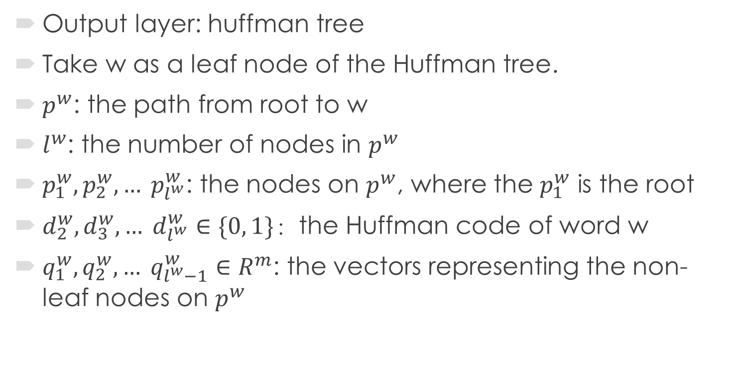
Training Algorithm - Hierarchical Softmax
Output layer: huffman tree
Take w as a leaf node of the Huffman tree.
$p^{w}$: the path from root to w
$l^{w}$: the number of nodes in $p^{w}$
$p_{1}^{w}, p_{2}^{w}, … p_{l^{w}}^{w}$: the nodes on $p^{w}$, where the $p_{1}^{w}$ is the root
$d_{2}^{w}, d_{3}^{w}, … d_{l^{w}}^{w}∈\{0, 1\}$：the Huffman code of word w
$q_{1}^{w}, q_{2}^{w}, … q_{l^{w}−1}^{w}∈R^{m}$: the vectors representing the non-leaf nodes on $p^{w}$
Notes:
Hierarchical softmax is one of the training algorithm, the output layer follows the original CBOW and softmax models, i.e., a binary tree is used to represent the vocabulary. This is main advantage of hierarchical softmax as it evaluate log(W) nodes instead of W nodes in the neural network. Here, I use Huffman tree to minimize the average number of output units that need to be evaluated for each input. To make the algorithm easier to understand, I will omit some mathematical details. But if you would like to know the calculation process, we can still talk about it in the q&a ssession.

Slide 30






Hierarchical Softmax – Skip-gram
$$v(w)$$
Input Layer
Projection Layer
$$v(w)$$
$$q_{1}^{w}$$
24
Output Layer
15
$$q_{2}^{w}$$
9
$d_{2}^{w}$ = 0
the
7
2
$d_{3}^{w}$ = 1
Sample: (w, Context(w))
good
algorithm
Notes:
The probability that a word will get 0 as Huffman code on this branch is just the logistic regression function.

Slide 31

Hierarchical Softmax – Skip-gram
Objective function:
$$L= \sum_{t=1}^{T}{log}p(Context(w)|w)$$
where $$p\left(Context\left(w\right) | w\right)= \prod_{u∈Context(w)}{p(u|w)}$$
and $$p\left(u | w\right)=\prod_{j=2}^{l^{u}}{p(d_{j}^{u}|v\left(w\right),}q_{j−1}^{w})$$

Slide 32
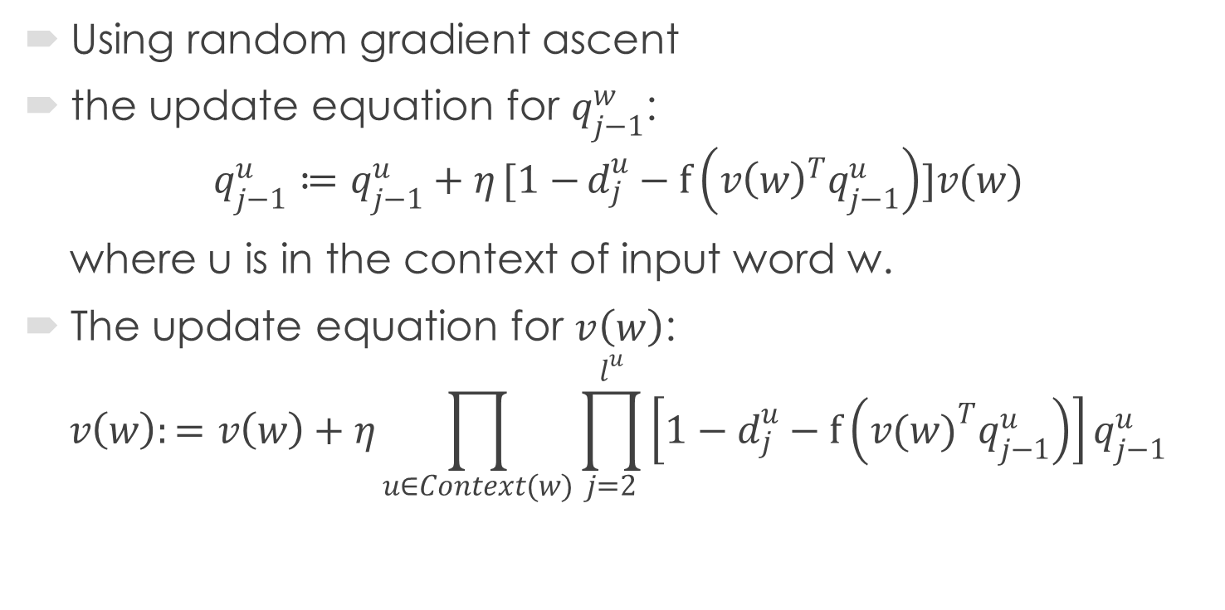
Hierarchical Softmax - Skip-gram
Using random gradient ascent
the update equation for $q_{j−1}^{w}$:
$$q_{j−1}^{u}≔q_{j−1}^{u}+η[1−{d_{j}^{u}−f\left({v\left(w\right)}^{T}q_{j−1}^{u}\right)]v(w)}$$
where u is in the context of input word w.
The update equation for $v\left(w\right)$:
$$v\left(w\right):=v\left(w\right)+η\prod_{u∈Context(w)}{\prod_{j=2}^{l^{u}}{\left[1−d_{j}^{u}−f\left({v(w)}^{T}q_{j−1}^{u}\right)\right]}}q_{j−1}^{u}$$

Slide 33

Hierarchical Softmax - Skip-gram
pseudo code for update process:
$For u∈Context\left(w\right):$
e = 0
$For j=2:l^{w}:$
$q=f\left({v(w)}^{T}q_{j−1}^{u}\right)$
$g= η\left(1−d_{j}^{u}−q\right)$
$e :=e+gq_{j−1}^{u}$
${ q}_{j−1}^{u} ≔q_{j−1}^{u}+gv(w)$
$v\left(w\right)≔v\left(w\right)+e$

Slide 34




Hierarchical Softmax - CBOW
$$v({Context\left(w\right)}_{1})$$
$$v({Context\left(w\right)}_{2})$$
$$v({Context\left(w\right)}_{2c})$$
…
Input Layer
Average
Projection Layer
$$x(w)$$
$$q_{1}^{w}$$
24
Output Layer
15
$$q_{2}^{w}$$
9
$d_{2}^{w}$ = 0
the
7
2
$d_{3}^{w}$ = 1
Sample: (Context(w), w)
good
algorithm
Notes:
The main idea of hierarchical softmax is that for each word w in the vocabulary of the corpus, it has a unique way from root to the corresponding node. Each branch is treated as a logistic regression.
The probability that a word will get 0 as Huffman code on this branch is just the logistic regression function.

Slide 35
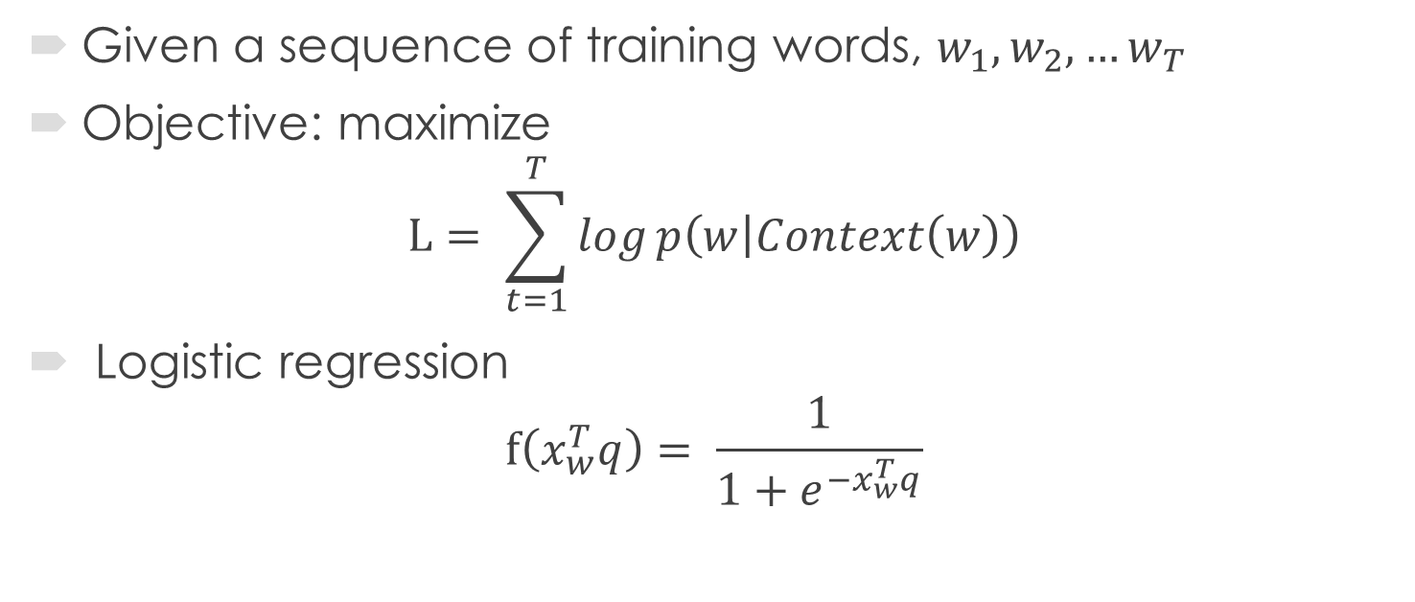
Hierarchical Softmax - CBOW
Given a sequence of training words, $w_{1}, w_{2}, …w_{T}$
Objective: maximize
$$L= \sum_{t=1}^{T}{log}p\left(w | Context\left(w\right)\right)$$
Logistic regression
$$f\left(x_{w}^{T}q\right)= \frac{1}{1+e^{−x_{w}^{T}q}}$$
Notes:
The objective of CBOW model is to maximum the probability of find the current word according to the its context. So we have this objective function.

Slide 36
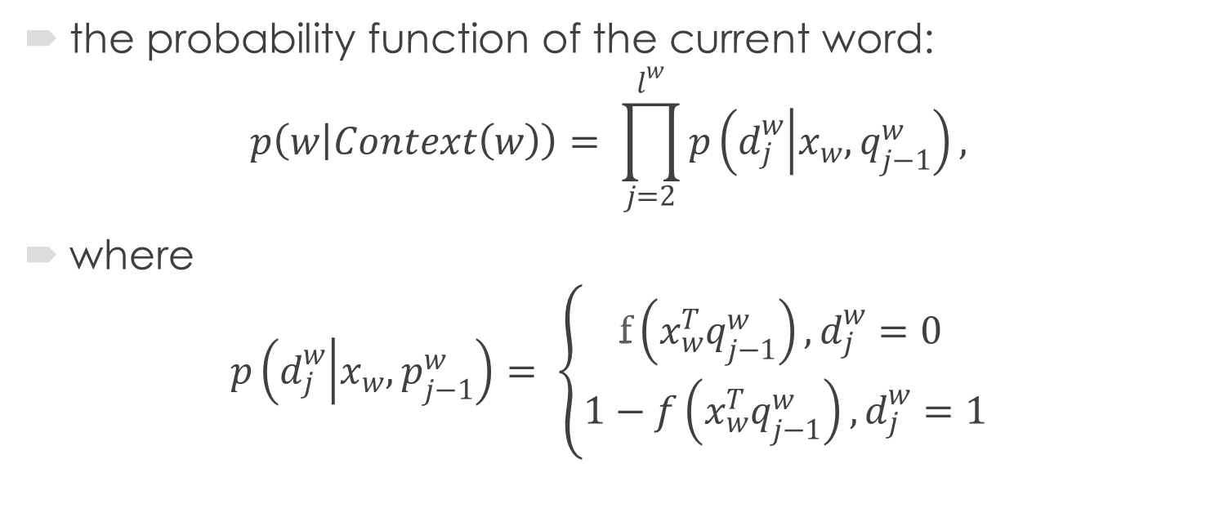




Hierarchical Softmax - CBOW
the probability function of the current word:
$$p\left(w | Context\left(w\right)\right)= \prod_{j=2}^{l^{w}}{p\left(d_{j}^{w} | x_{w}, q_{j−1}^{w}\right)},$$
where $p\left(d_{j}^{w} | x_{w}, p_{j−1}^{w}\right)= \left\{\begin{aligned}f\left(x_{w}^{T}q_{j−1}^{w}\right),d_{j}^{w}=0 \\ 1−f\left(x_{w}^{T}q_{j−1}^{w}\right),d_{j}^{w}=1\end{aligned}\right.$
$$q_{1}^{w}$$
24
15
$$q_{2}^{w}$$
9
$d_{2}^{w}$ = 0
the
7
2
$d_{3}^{w}$ = 1
good
algorithm

Slide 37
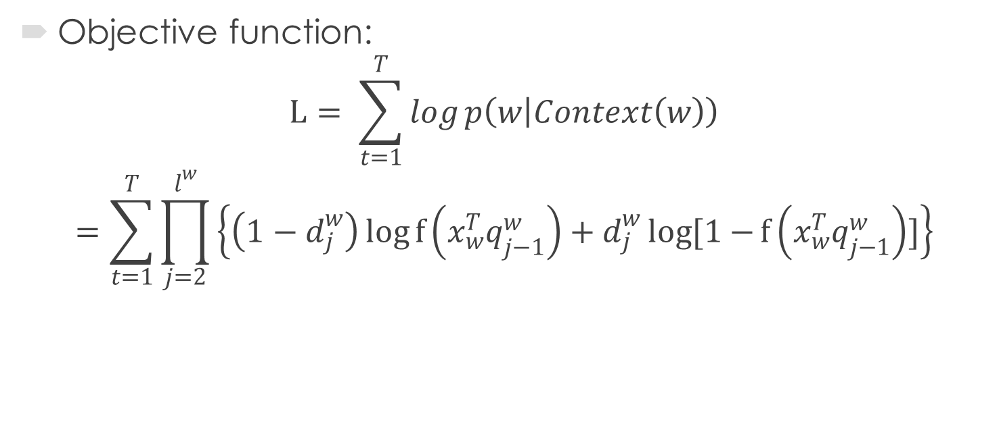
Hierarchical Softmax - CBOW
Objective function:
$$L= \sum_{t=1}^{T}{log}p\left(w | Context\left(w\right)\right)$$
$$=\sum_{t=1}^{T}{\prod_{j=2}^{l^{w}}{\left\{\left(1−d_{j}^{w}\right)\log{f\left(x_{w}^{T}q_{j−1}^{w}\right)}+d_{j}^{w}log[1−{f\left(x_{w}^{T}q_{j−1}^{w}\right)}]\right\}}}$$

Slide 38
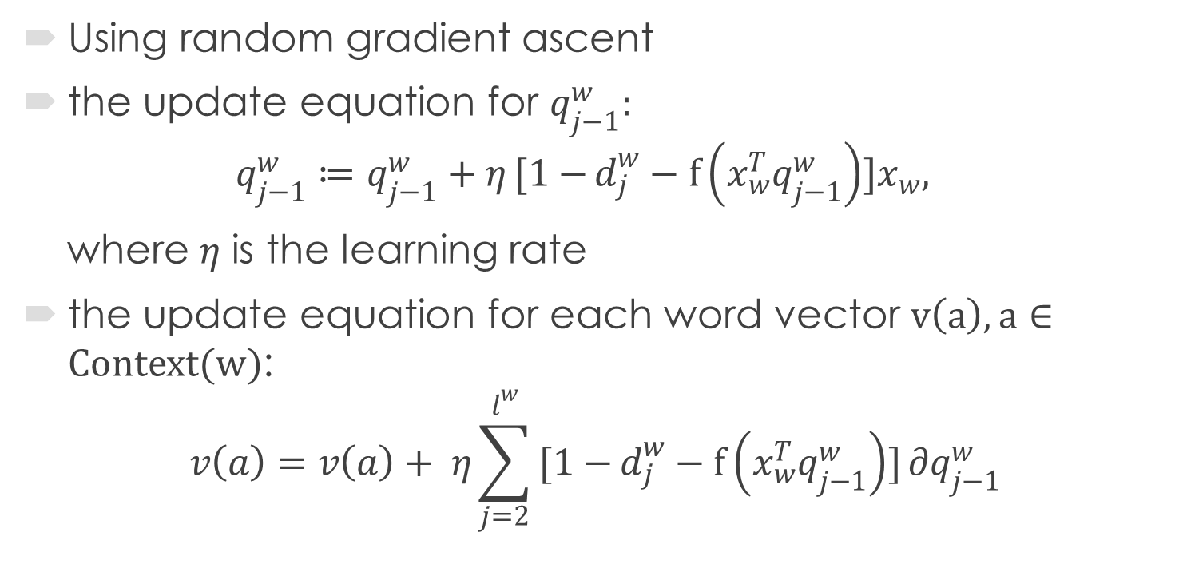
Hierarchical Softmax - CBOW
Using random gradient ascent
the update equation for $q_{j−1}^{w}:$
$$q_{j−1}^{w}≔q_{j−1}^{w}+η[1−{d_{j}^{w}−f\left(x_{w}^{T}q_{j−1}^{w}\right)}]x_{w},$$
where $η$ is the learning rate
the update equation for each word vector $v\left(a\right), a∈Context(w)$:
$$v\left(a\right)=v\left(a\right)+ η\sum_{j=2}^{l^{w}}{[1−{d_{j}^{w}−f\left(x_{w}^{T}q_{j−1}^{w}\right)}]∂q_{j−1}^{w}}$$
Notes:
Then use random gradient ascent, we can get the update function for the non-leaf nodes representations and current word vector.

Slide 39

Hierarchical Softmax - CBOW
pseudo code for update process:
e = 0
$x_{w}= \sum_{u∈Context(w)}{v(u)}$
$For j=2:l^{w}$:
$q=f\left(x_{w}^{T}q_{j−1}^{w}\right)$
$g= η\left(1−d_{j}^{w}−q\right)$
$e=e+gq_{j−1}^{w}$
${ q}_{j−1}^{w}≔q_{j−1}^{w}+gx_{w}$
$For u∈Context\left(w\right)$:
$v\left(u\right)≔v\left(u\right)+e$

Slide 40
Negative Sampling
The main difference is that for each word in context, hierarchical softmax finds a path to get the parameters and the negative sampling defines a sample of words to find parameters.
Negative sample set of word w: NEG(w)
Each word has two vectors. One is the word vector and the other is the parameter vector.
Notes:
There are k negative samples for each data sample. Our experiments indicate that values of k in the range 5–20 are useful for small training datasets, while for large datasets the k can be as small as 2–5.
The main difference is that for each word in context, hierarchical softmax finds a path to get the parameters and the negative sampling defines a sample of words to do this.
How to get a negative sample for a word? Basically, the words appearing more often will be more likely to be selected. We define a noise distribution here. The function is from the open-source project. The word with a bigger length value will be more likely to be selected. Similar to hierarchical softmax, we still need to have two classes for each word. If it is the word we are looking for, then it is regarded as the positive class.

Slide 41
Distributed Algorithm – Basic Idea
Model: skip-gram
Sample form: (w, context(w))
Training algorithm: hierarchical softmax
Train the parameters separately on each partition of samples
Average the sets of parameters
Repeat the training process for more than once
Notes:
To implement it in a distributed way, the main task is to train the parameters parallel. The samples in form (w, Con-
text(w)) can be got from the documents and thus they can be thought as being divided
into partitions. They are used to train the parameters separately on each partition of
the samples. Now several sets of parameters are calculated. Next step is to average the
sets of parameters. The method obviously lower the quality of word vectors but the
problems could be solved by repeat the training process for more than once.

Slide 42
Distributed Algorithm
Preprocessing:
Source data -> document list
Step 1:
Execute distributed word count
Store the count result in the aggregator
Notes:
In the rst round of computing, a simple distributed word count for all
words in the corpus is executed and the count result is stored in the aggregator which
can be shared by all workers.

Slide 43
Distributed Algorithm
Step 2:
Build a local Huffman tree according to the count result
Leaf nodes parameters: randomly initialized
Non-leaf nodes parameters: zero vector
Note, the node parameters need to keep same on all machines, so the parameters of the leaf nodes are initialized on worker 0 and then are copied to huffman trees of other machines by an aggregator.
Notes:
Then one random worker builds a local Human tree according to the count result and
each node has a parameter vector. The parameters of non-leaf nodes are initialized as
zero vectors while the parameters of leaf nodes are initialized as random vectors. The
vector size is set to be 100 by default while it can be reset by users. Then the Human
tree will be copied to other workers by storing the vectors in an aggregator.

Slide 44
Distributed Algorithm
Step 3 (training):
Define aggregator for the parameters of the nodes to collect different training results from each worker
Train the parameters locally in batches
Train in batches:
need time to aggregate
lower the number of iterations
accelerate the total training time for large data set
Notes:
An aggregator for the parameters of all the nodes is needed here to collect different training results from each worker. The aggregator stored the parameters in the order of in-order traversal and will be updated for each batch. Here, the documents could be trained
in batches in order to lower the number of iterations and accelerate the total training
time. The number of batches is set to 1 by default but resetting it to a larger number is
strongly recommended for large data sets. Also the number of iterations is set to 0 by
default while if users need more accurate result or the data set is not so big, they can
reset the variable.

Slide 45
Distributed Algorithm
Step 3 (training):
Local training process:
Find the locations of all the word nodes
Update local parameters of the nodes
Note: According to the original algorithm design, the location of a word node is foundd by searching the huffman tree. An important optimization here is to use an unordered map to store the address of leaf nodes and search the words in the map.
Notes:
Training each batch of data is a round of computation. In each round, each document
in the batch first finds the locations of all the word nodes. Then for each word in the
document, the local parameters of the nodes are updated according to the update process as introduced in the algorithm. After each round, the aggregator will merge the
local parameters by taking average and update the parameters of the nodes on the tree
by the global parameter vectors in the aggregator. The implementation can provide the
function for user to check how close two words are, what are the closest words to one
word and the relationship between words.

Slide 46
Distributed Algorithms – Word2vec
Step 4:
Merge the local parameters by taking average
Update the node parameters of each worker
Repeat the process
Users could check how close two words are, what are the closest words to one word or do whatever they want to the word vectors
Notes:
2

Slide 47
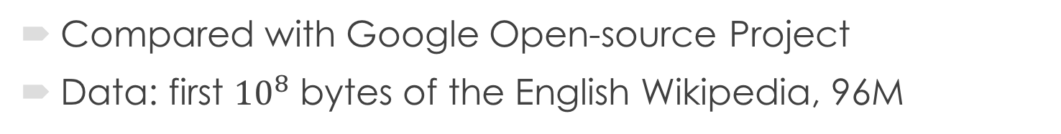
Performance
Compared with Google Open-source Project
Data: first ${10}^{8}$ bytes of the English Wikipedia, 96M
 | Google Open Source Project | Husky
Number of Total Threads | 10 | 10
Number of Machines | 1 | 3
Number of Iterations | 3 | 3
Running Time | 7m0s | 4m10s

Slide 48
Performance
Compared with Google Open-source Project
Closest words of “windows”
 | Google Open Source Project | Husky
1st | microsoft | microsoft
2st | xp | operating
3st | desktop | versions
4st | bsod | software
5st | os | xp

Slide 49
Performance
Compared with Google Open-source Project
Closest words of “graduate”
 | Google Open Source Project | Husky
1st | undergraduate | undergraduate
2st | postgraduate | university
3st | undergraduates | enrolled
4st | diplomas | postgraduate
5st | faculty | doctoral

Slide 50
Performance
Compared with Google Open-source Project
Closest words of “english”
 | Google Open Source Project | Husky
1st | hiberno | language
2st | welsh | libarary
3st | ize | reading
4st | french | scottish
5st | antidisestablishmentarianism | historical

Slide 51
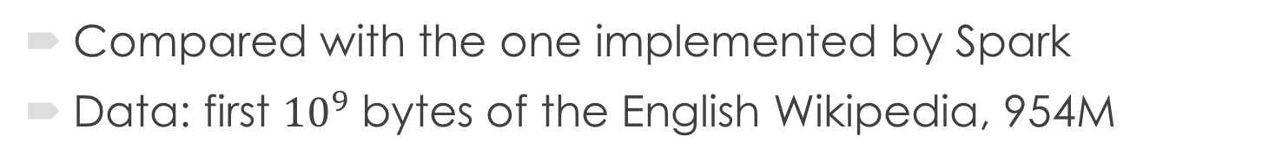
Performance
Compared with the one implemented by Spark
Data: first ${10}^{9}$ bytes of the English Wikipedia, 954M
 | Spark | Husky
Number of Total Threads | 320 | 320
Number of Machines | 20 | 20
Number of Iterations | 1 | 1
Running Time | 58m2s | 5m15s

Slide 52
Performance
Compared with Google Open-source Project
Closest words of “windows”
 | Spark | Husky
1st | doors | server
2st | roof | microsoft
3st | pavement | audio
4st | ceiling | collection
5st | wolls | browser
Notes:
Here we could see a limitation of the algorithm. It is hard to represent two meanings of a word.

Slide 53
Performance
Compared with Google Open-source Project
Closest words of “graduate”
 | Spark | Husky
1st | undergraduate | student
2st | postgraduate | weekly
3st | faculty | hospital
4st | bachelor | newspapers
5st | enrolled | faculty

Slide 54
Performance
Compared with Google Open-source Project
Closest words of “english”
 | Spark | Husky
1st | spelling | french
2st | bolded | german
3st | pronunciation | italian
4st | italicised | spanish
5st | IPA | language

Slide 55
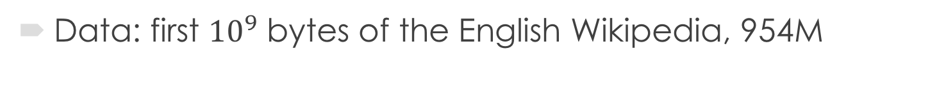
Performance
Data: first ${10}^{9}$ bytes of the English Wikipedia, 954M
 | Husky
Number of Total Threads | 320
Number of Machines | 20
Number of Iterations | 30
Running Time | 2h

Slide 56
Performance
Closest words of “windows”
 | 5th Iteration | 10th Iteration | 20th iteration | 30th Iteration
1st | microsoft | microsoft | microsoft | microsoft
2st | xp | xp | xp | xp
3st | server | linux | linux | os
4st | os | mac | os | linux
5st | unix | os | unix | beos

Slide 57
Performance
Closest words of “graduate”
 | 5th Iteration | 10th Iteration | 20th iteration | 30th Iteration
1st | undergraduate | undergraduate | undergraduate | undergraduate
2st | faculty | faculty | postgraduate | postgraduate
3st | student | postgraduate | faculty | faculty
4st | postgraduate | student | enrolled | enrolled
5st | preparatory | enrolled | students | diploma

Slide 58
Performance
Closest words of “english”
 | 5th Iteration | 10th Iteration | 20th iteration | 30th Iteration
1st | translation | translation | hiberno | hiberno
2st | language | welsh | language | language
3st | welsh | yiddish | yiddish | yiddish
4st | italian | language | welsh | welsh
5st | yiddish | speaking | speaking | speaking

Slide 59
Conclusion
During this project, I have learned core concepts and algorithms on text analysis. The design and implementation of distributed TF-IDF and Word2vec has been finished and the python library operator is also provided. The test results is satisfying on both the training time and accuracy.

Slide 60
Reference
[1] Y. Bengio, R. Ducharme, P. Vincent. A neural probabilistic language model. Journal of Machine Learning Research, 3:1137-1155, 2003.
[2] Tomas Mikolov, Kai Chen, Greg Corrado, and Jeffrey Dean. Efﬁcient estimation of word representations in vector space. ICLR Workshop, 2013.
[3] T. Mikolov, M. Karaﬁ´at, L. Burget, J. Cernock´y, S. Khudanpur. Recurrent neural network based language model, In: Proceedings of Interspeech, 2010.
[4] Tomas Mikolov, Ilya Sutskever, Kai Chen, Greg S Corrado, and Jeff Dean. 2013b. Distributed representations of words and phrases and their compositionality. In Proceedings of NIPS.
[5] Tomas Mikolov, Wen-tau Yih and Geoffrey Zweig. Linguistic Regularities in Continuous Space Word Representations. In Proceedings of the 2013 Conference of the North American Chapter of the Association for Computational Linguistics (NAACL 2013), pages 746–751, Atlanta, US.
[6] A.H. Tan. Text-mining: the state of the art and the challenges. In proceedings of the PAKDD 1999 Workshop on Knowledge Discovery from Advanced Databasesvol. 8 (1999, April), pp. 65–70.
[7]H. C. Wu, R. W. P. Luk, K. F. Wong & K. L. Kwok. Interpreting TF-IDF term weights as making relevance decisions. ACM T. Inform. Syst. 26, doi: Artn (2008).10.1145/1361684.1361686.
[8]F. Yang and J. Li and J. Cheng, Husky: Towards a More Efficient and Expressive Distributed Computing Framework. PVLDB, Volume 9, Number 5, Pages 420-431, 2015. (VLDB 2016)

