Slide 1
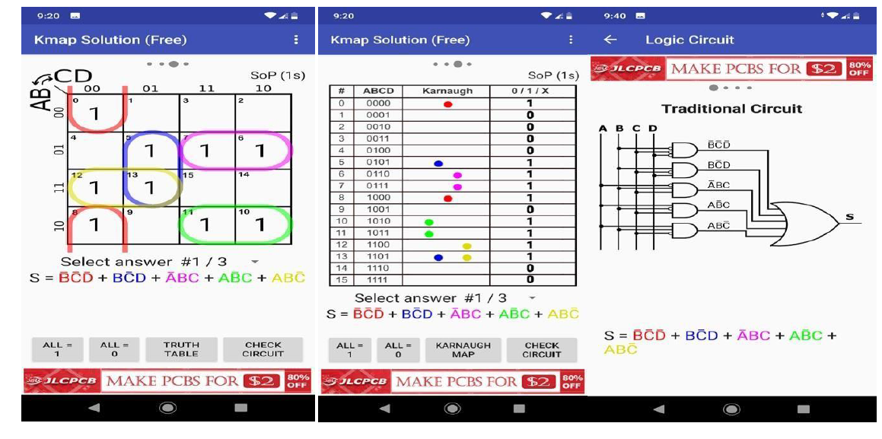
How to solve for logic expression ?

Slide 2
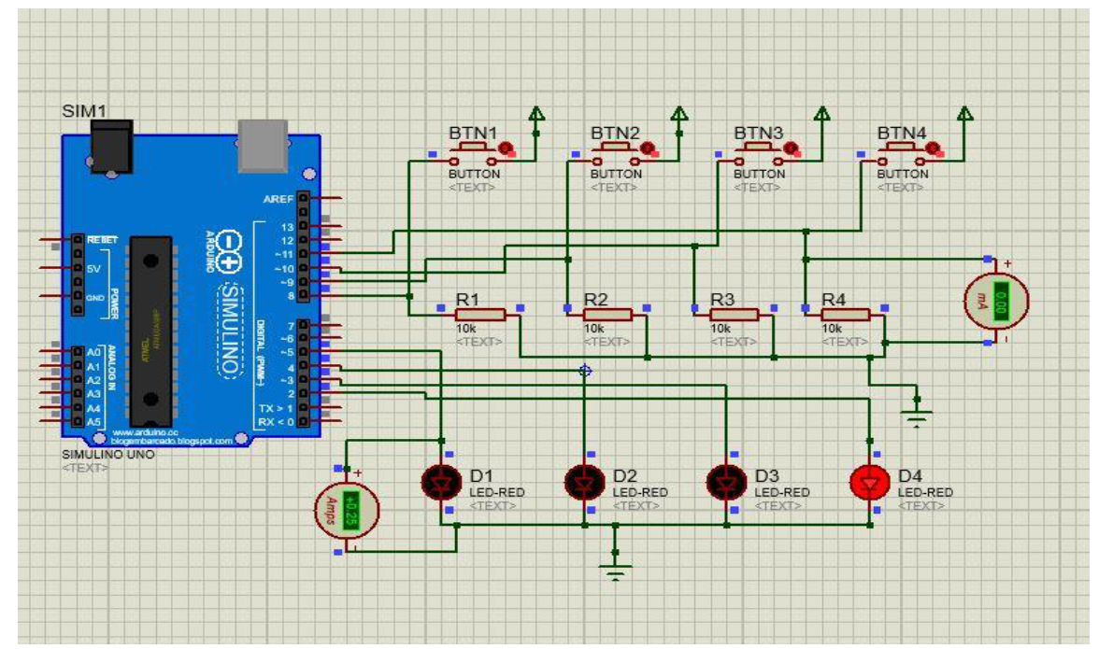
Example input-output interfacing to arduino board in proteus

Slide 3
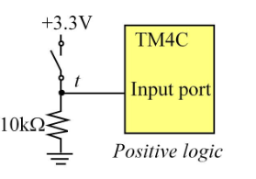
VCC is sometimes known as VDD
Case- Input high : 1
Current flow I through external resistor: VCC /R
Battery power consumption : VCC*I
Case-Input low: 0
Microcontroller port input leakage current I =20 micro ampere
Battery power consumption : VCC*I
VCC
R
https://electronics.stackexchange.com/questions/393863/problems-with-input-leakage-current-in-a-microcontroller

Slide 4
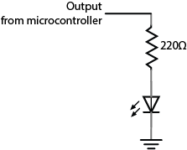
VCC is sometimes known as VDD
VCC
Case- Output high : 1
Current flow I through external resistor: VCC /R
Battery power consumption : VCC*I
Case-Input low: 0
Current flow I through external resistor I =0 micro ampere
Battery power consumption : VCC*I
R
LED

Slide 5
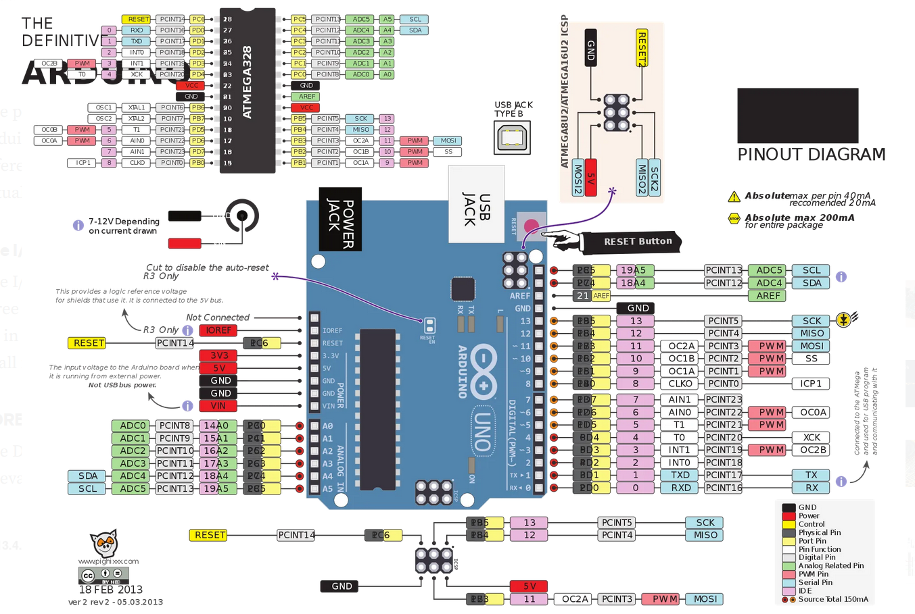
Pin diagrams

Slide 6
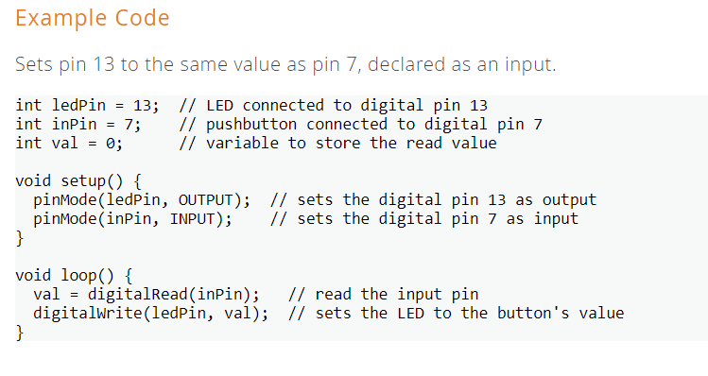
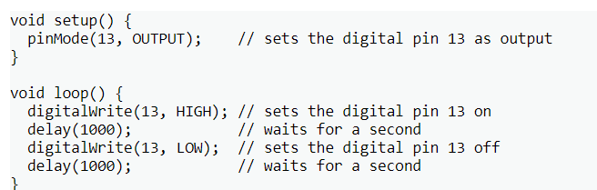
Arduino hints for pin assignment and pin read (using built in functions
https://www.arduino.cc/reference/en/language/functions/digital-io/digitalread/
https://www.arduino.cc/reference/en/language/functions/digital-io/digitalwrite/

Slide 7
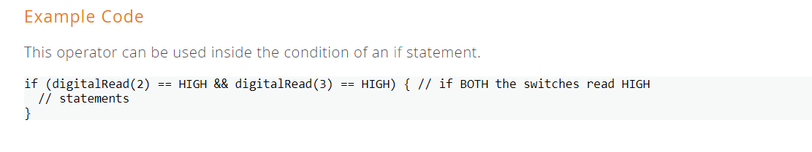
Arduino hints for pin assignment and pin read (using built in functions
https://www.arduino.cc/reference/en/language/structure/boolean-operators/logicaland/

Slide 8
Arduino hints for pin assignment and pin read (using register level programming

Slide 9
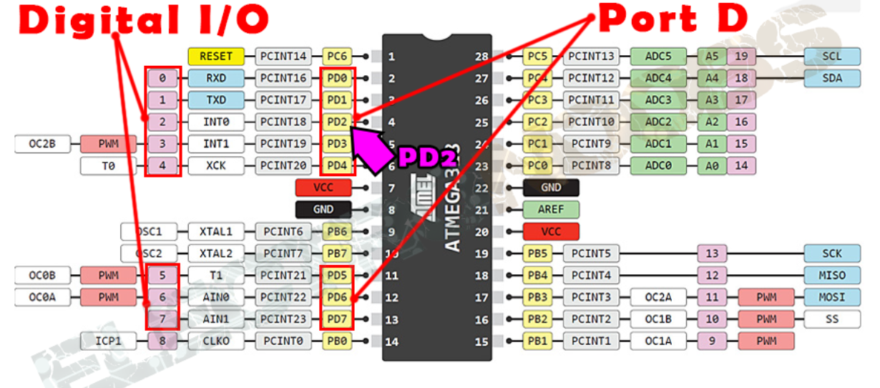
Arduino hints for pin assignment and pin read (using register level programming

Slide 10
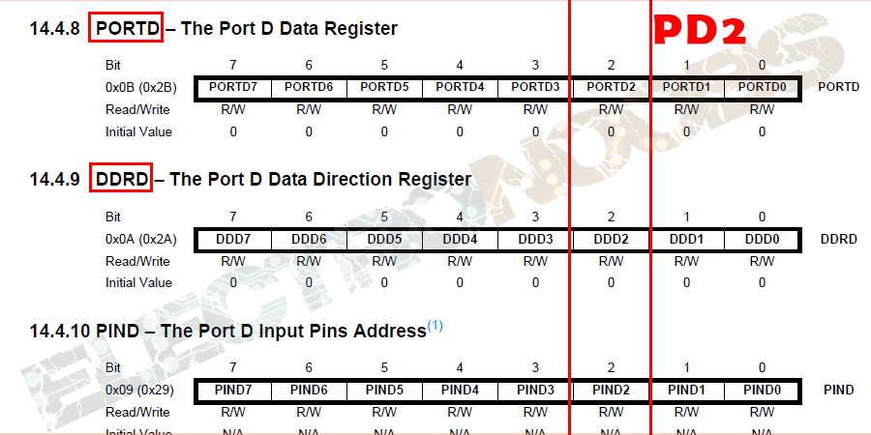
Arduino hints for pin assignment and pin read (using register level programming

Slide 11
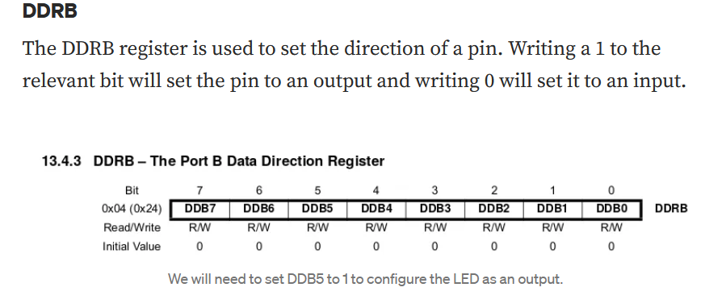
Arduino hints for pin assignment and pin read (using register level programming

Slide 12
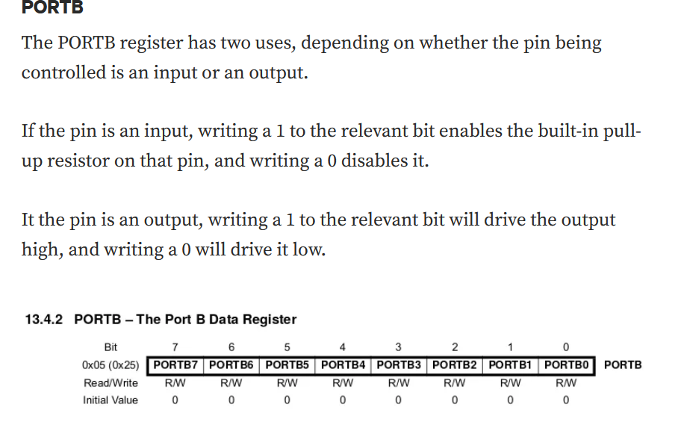
Arduino hints for pin assignment and pin read (using register level programming

Slide 13
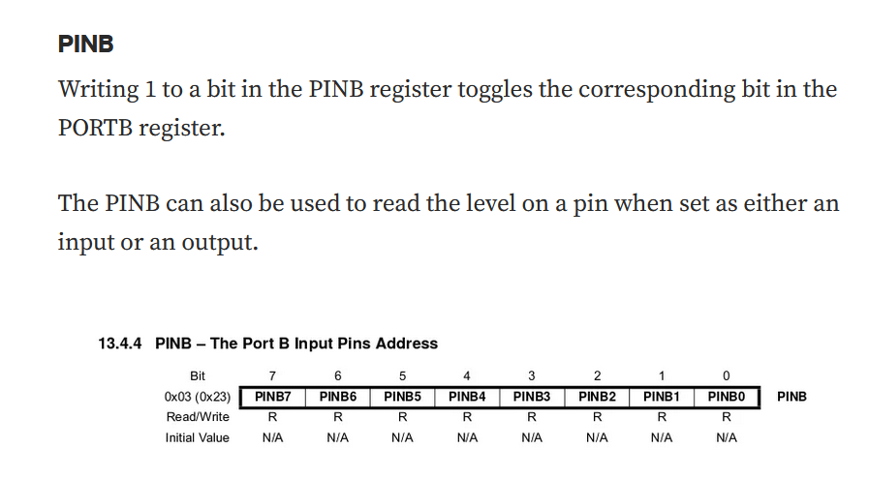
Arduino hints for pin assignment and pin read (using register level programming
const byte switchPin = 8;
void setup()
{
Serial.begin(9600);
pinMode(switchPin,INPUT_PULLUP);
}
//****************** END of setup() *******************
void loop()
{
//Get D8 on a UNO
byte x = PINB & B000001;
Serial.println(x,BIN);
delay(500);
}

Slide 14
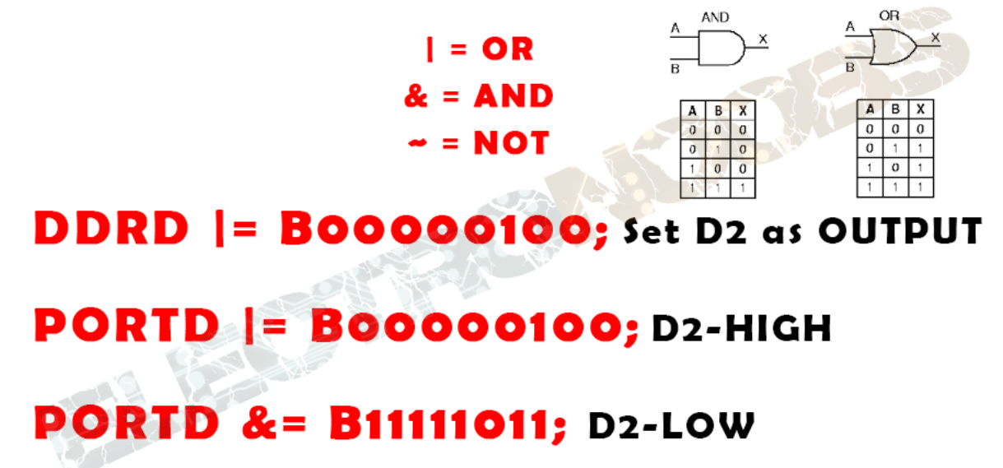
Arduino hints for pin assignment and pin read (using register level programming

Slide 15
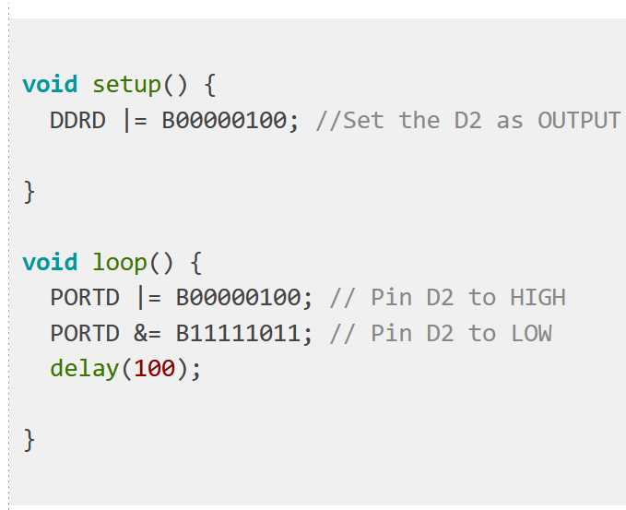
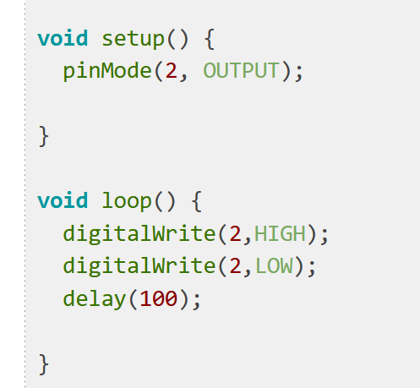
Arduino hints for pin assignment and pin read (using register level programming
Side by side comparison

Slide 16
Loading Hex file into arduino in proteus
1.
Adding arduino library
https://maker.pro/arduino/projects/how-to-simulate-arduino-projects-using-proteus
2.
Loading hex file in proteus environment
https://www.instructables.com/How-to-Simulate-Arduino-in-Proteus/

Slide 17
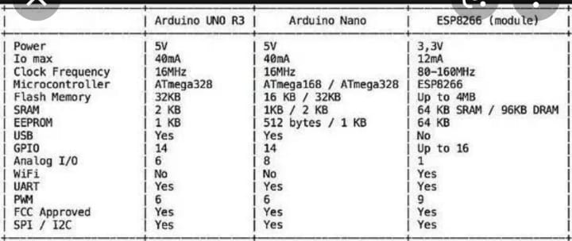
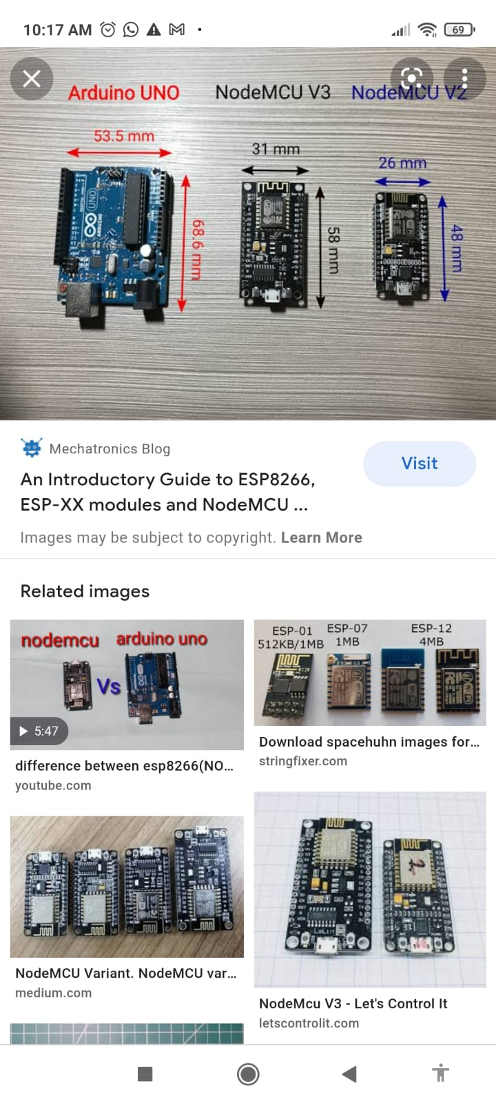
Comparison among boards

Slide 18
Tasks to be covered
1. Group formation link
https://docs.google.com/spreadsheets/d/1nj99CnDQLup6d4v8O4bDrUrwrjq2Ycl4BxUiTrU12bE/edit?usp=sharing
A group can have maximum 4-6 students.
2. Repeat from group 1 , if all groups are occupied
3. The submission will contain a single pdf with cover page filled up with all details and google drive link to video showing the operation (at least 5 cases) in proteus using virtual terminal

Slide 19
Tasks to be covered
The encryption table group wise is to be implemented in two different ways. A detailed flow chart is to be designed before any coding.
Using arduino default read write functions
Using register level alternatives for the same.
Target is to compare the following for each case in tabular form:
Program memory size
Variable memory size
Program execution time ( for switch reading and LED lighting) in proteus
5. Final report should answer the following questions specifically: (mandatory) for each board
-what is the clock frequency of the microcontroller used ?
- what is the data bus width of the microcontroller used ?
- what is the size of your hex file generated ? Attach the hex codes in your report.
-Can the project be implemented by using interrupt ?
-Is the main routine required to be an infinite loop ? provide explanation in favor of your answer
- Is there any difference between level triggered and edge triggered operation for the given project ?
-Is the project referring encryption or decryption from input to output ?
6. The project will focus on comparison of at least two different boards. i.e at least two different comparison tables will be generated where each table compares between default like programming and register level programming for a single type of board
7. Results analysis for each table is mandatory highlighting the hardware differences where applicable

Slide 20
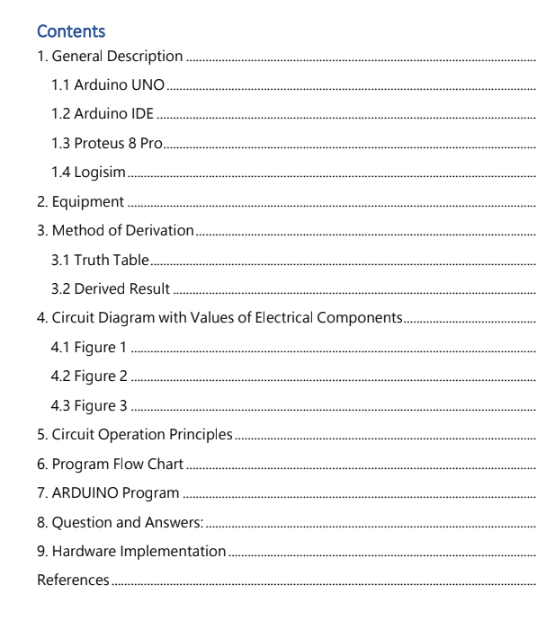
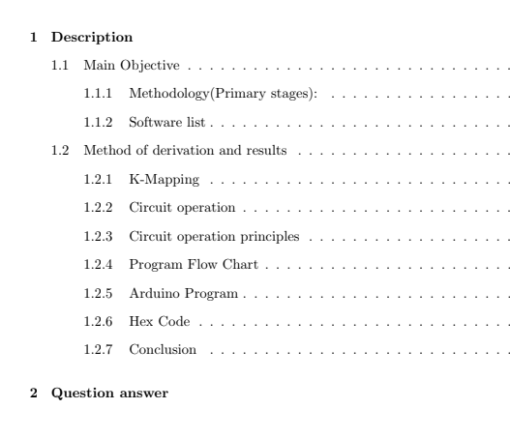
Tentative Sections to be covered in report

Slide 21
Supporting links and materials
https://www.youtube.com/watch?v=d_wzOU88qcA
http://electronoobs.com/eng_arduino_tut12.php
https://sam-mundayhall.medium.com/advanced-arduino-programming-led-blink-part-1-ccaaabfcefe2
https://www.arduino.cc/
Uploaded class lectures recorded in the classroom on projects

