Slide 1
RNN & LSTM Networks

Slide 2
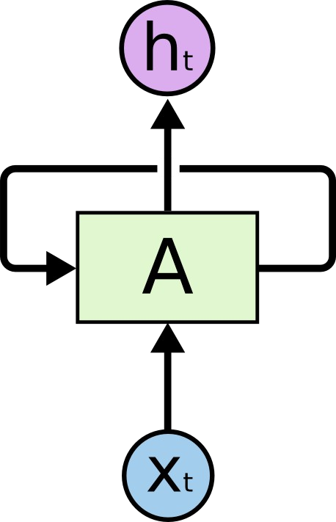
Recurrent Neural Networks

Slide 3
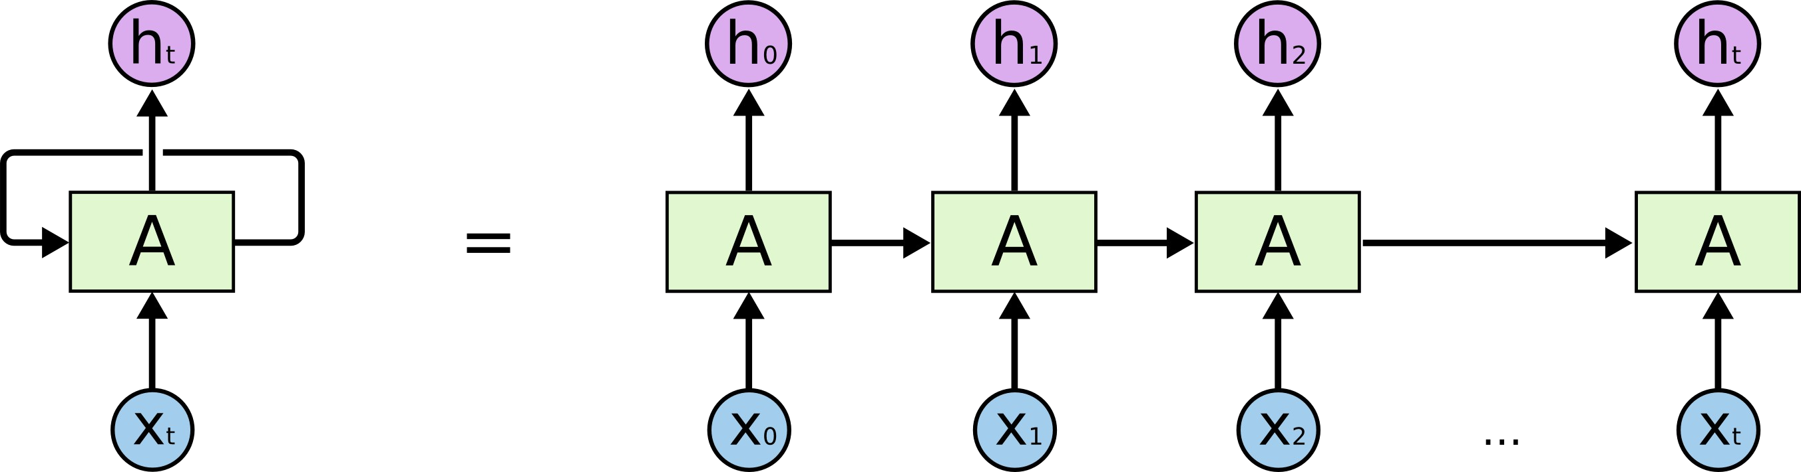
An unrolled recurrent neural network

Slide 4
The Problem of Long-Term Dependencies

Slide 5
RNN short-term dependencies
Language model trying to predict the next word based on the previous ones
the clouds are in the sky,
h₀ h₁ h₂
h₃
h₄
A
A
A
A
A
x₀
x₁
x₂
x₃
x₄

Slide 6
RNN long-term dependencies
Language model trying to predict the next word based on the previous ones
I grew up in India…. I speak fluent Hindi.
h₀ h₁ h₂
^{h}t −1
h_{t}
A
A
A
A
A
x₀
x₁
x₂
^{x}t −1
x_{t}

Slide 7
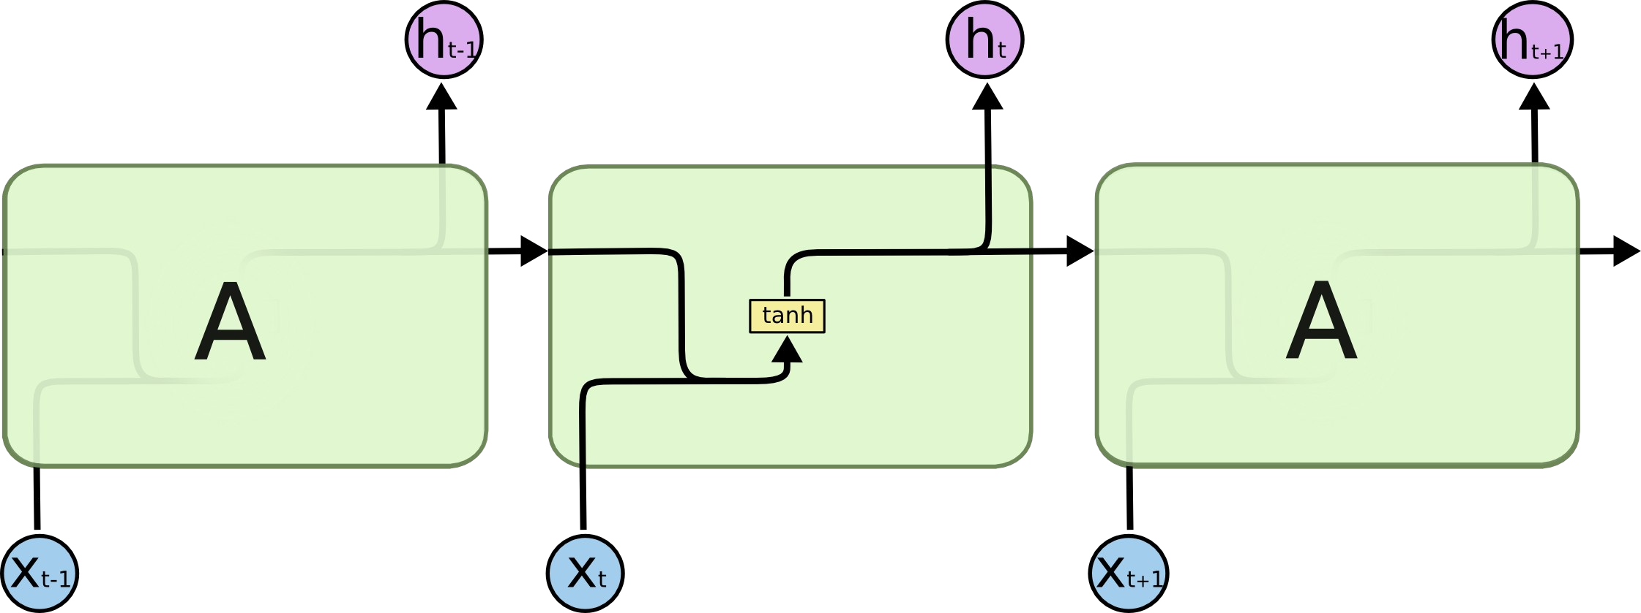
Standard RNN

Slide 8
Backpropagation Through Time (BPTT)

Slide 9
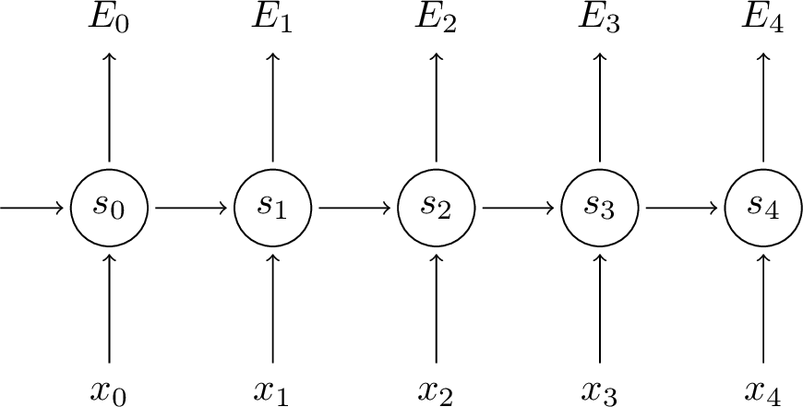
RNN forward pass
s_{t} =tanh(Ux_{t} +Ws_{t −1})
y^_{t} =softmax( Vs_{t} )
V V V W W
U U U
V
V
W
W
W
E( y , ^y)=−∑ E_{t} ( y _{t} , y^_{t} )
U
U
t

Slide 10
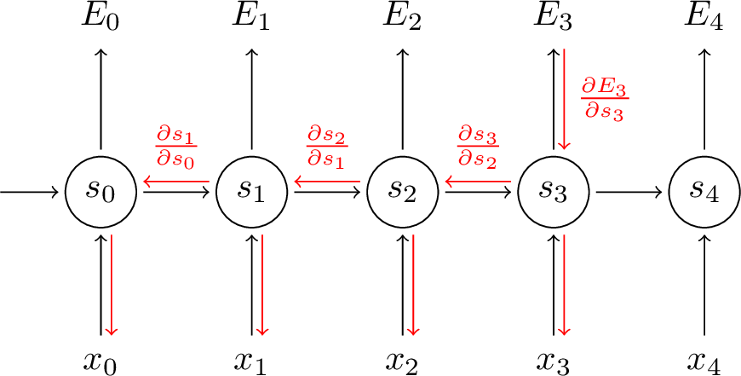
Backpropagation Through Time
∂ E _{=∑} ^{∂ E}t
∂ W ∂ W
t
∂ E₃ ₌∂ E₃ ∂ y^₃ ∂ s₃
∂ W ∂ y^₃ ∂ s₃ ∂ W
But s₃ =tanh(Ux_{t} +Ws₂)
S_3 depends on s_2, which depends on W and s_1, and so on.
3
∂ E₃ ∂ E₃ ∂ y^₃ ∂ s₃ ∂ s_{k}
∂ W ^{=∑} ∂ y^ ∂ s ∂ s ∂ W
k=0
3 3
k

Slide 11
The Vanishing Gradient Problem
3
∂ E₃ ∂ E₃ ∂ y^₃ ∂ s₃ ∂ s_{k}
∂ W ^{=∑} ∂ y^
∂ s₃ ∂ s_{k} ∂ W
k=0
3
3 _{=∑} 3 3
( )
∂ E
3
∂ E ∂ y
^
3
∂ s ∂ s
∏
j
k
∂ W ∂ y^₃ ∂ s₃
j=k +1 ^{∂ s} j−1
∂ W
k=0
Derivative of a vector w.r.t a vector is a matrix called jacobian 2-norm of the above Jacobian matrix has an upper bound of 1
tanh maps all values into a range between -1 and 1, and the derivative is bounded by 1
With multiple matrix multiplications, gradient values shrink exponentially
Gradient contributions from “far away” steps become zero
Depending on activation functions and network parameters, gradients could explode instead of vanishing
●
●
●
●
●
●

Slide 12
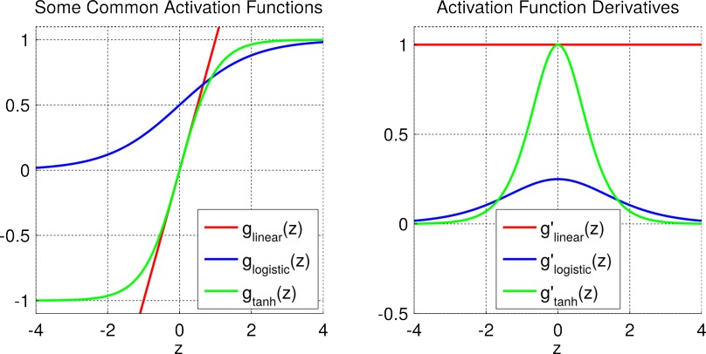
Activation function

Slide 13
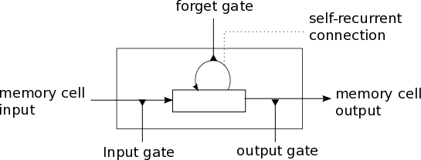
Basic LSTM

Slide 14
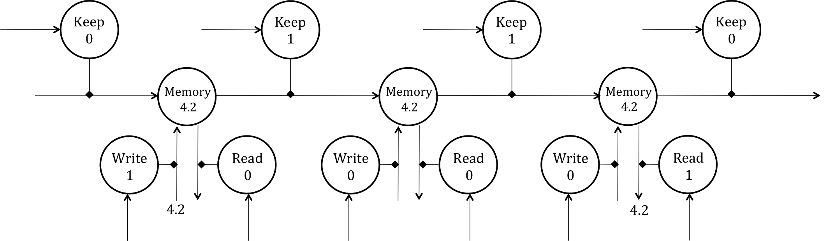
Unrolling the LSTM through time

Slide 15
Constant error carousel
s_{t} =tanh (Ux_{t} +Ws_{t −1})
C_{t}⋅o_{t}
o_{t}
Replaced by
Π
~ ( t )
t t c
C =C ⋅
i + C
t − 1
Π
Edge to next time step
i_{t}
~
Edge from previous time step
(and current input)
C
t
Weight fixed at 1

Slide 16
Input gate
●
Use contextual information to decide
●
Store input into memory
Protect memory from overwritten by other irrelevant inputs
●
C_{t}⋅o_{t}
o_{t}
Π
~
(t )
C =C ⋅
i +C
t t c
t −1
Π
Edge to next time step
i _{t}
~
Edge from previous time step
(and current input)
C
t
Weight fixed at 1

Slide 17
Output gate
●
Use contextual information to decide
●
Access information in memory Block irrelevant information
●
C_{t}⋅o_{t}
o_{t}
Π
~
(t )
C =C ⋅
i +C
t t c
t −1
Π
Edge to next time step
i _{t}
~
Edge from previous time step
(and current input)
C
t
Weight fixed at 1

Slide 18
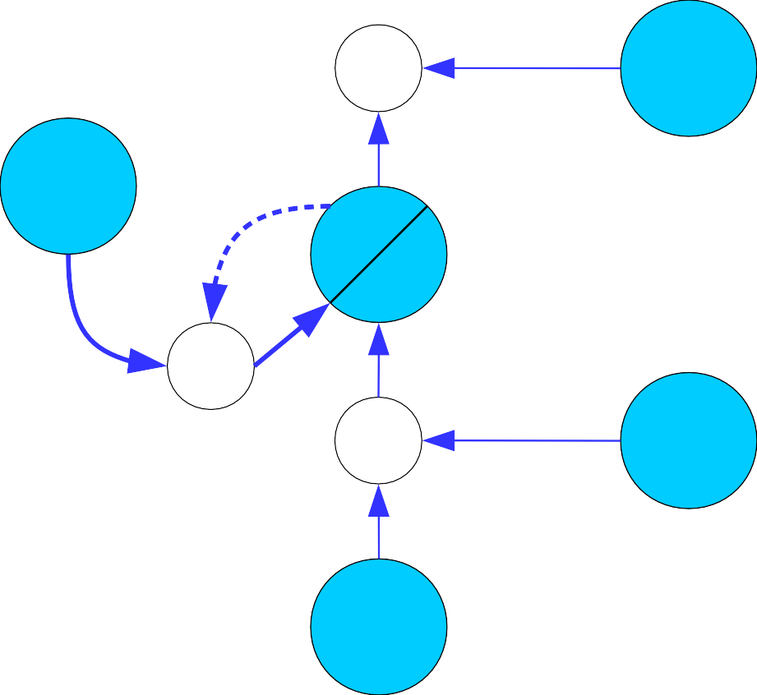
Forget or reset gate
C_{t}⋅o_{t}
o_{t}
f _{t}
Π
~
(t )
C =C ⋅
i +C ⋅f
t t c
t −1 t
Π
Π
Edge to next time step
i_{t}
~
Edge from previous time step
(and current input)
C
t
Weight fixed at 1

Slide 19

LSTM with four interacting layers

Slide 20
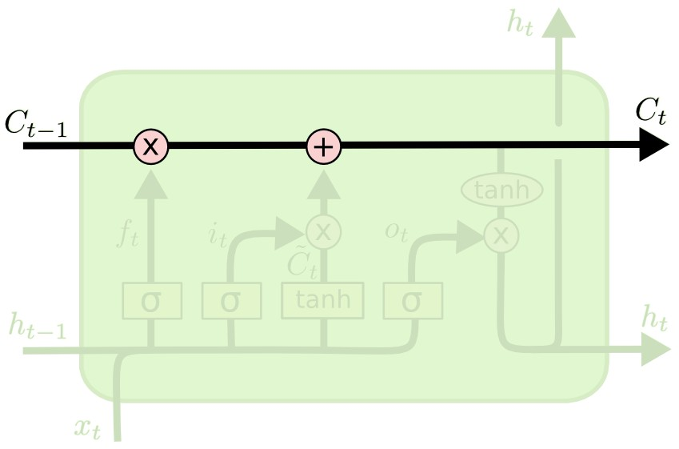
The cell state

Slide 21
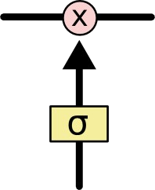
Gates
sigmoid layer

Slide 22
Step-by-Step LSTM Walk Through

Slide 23
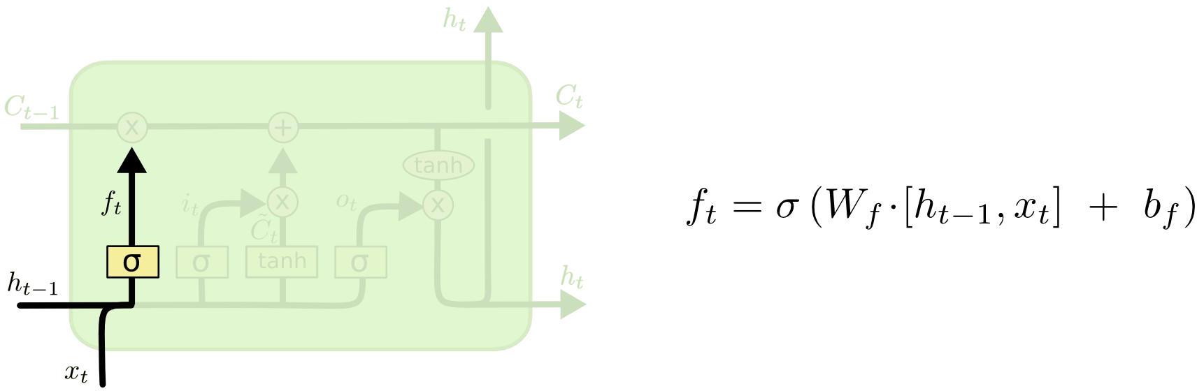
Forget gate layer

Slide 24
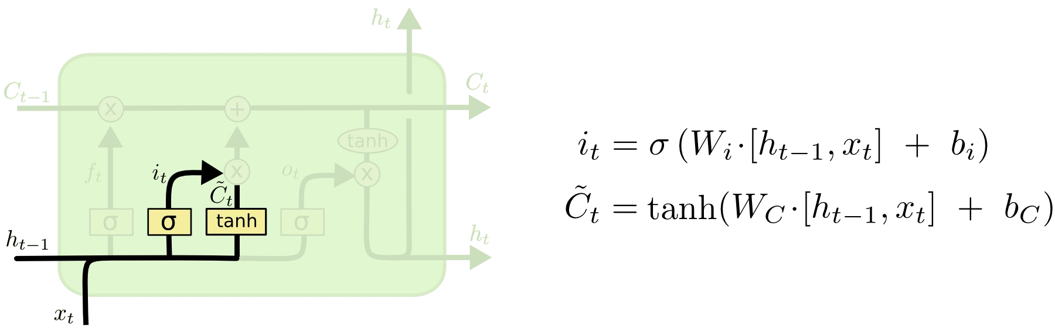
Input gate layer

Slide 25
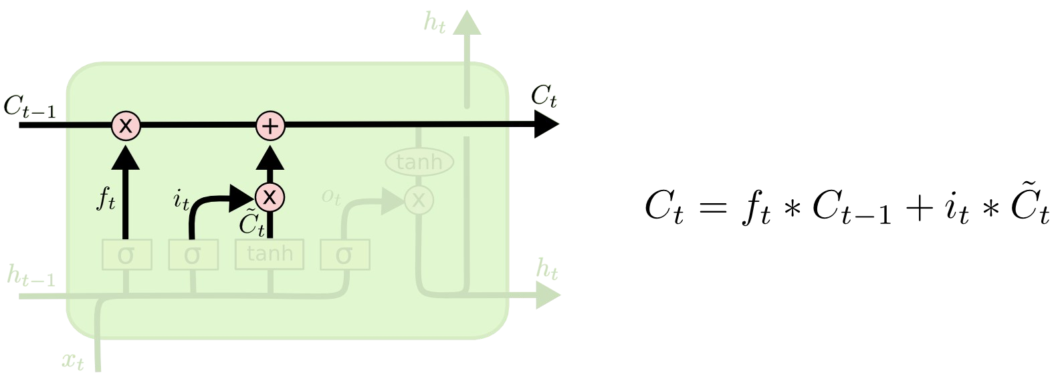
The current state

Slide 26
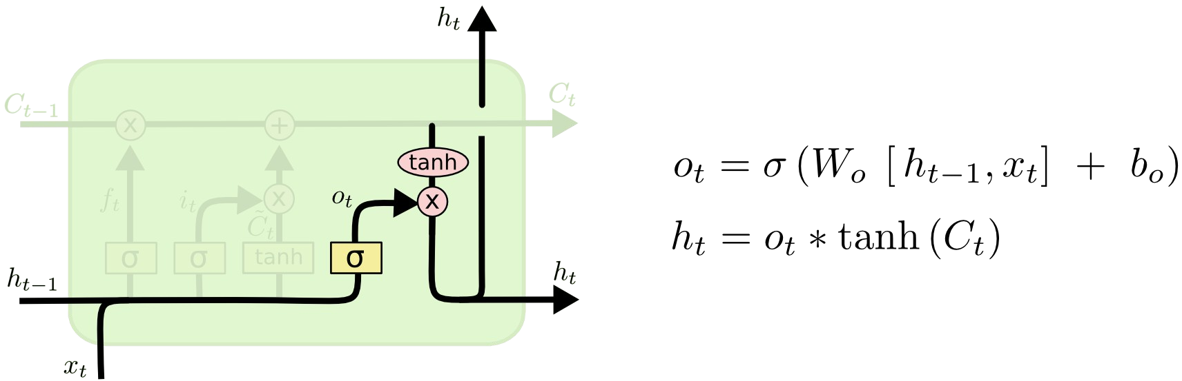
Output layer

