Slide 1
Breast Cancer Risk Prediction using XGBoost and Random Forest Algorithm

Slide 2
Presented By
Name
S M Arafat Rahman
Sheikh Shemanto Afridi
Anika Hassan Mysha
Sajeeb Karmoker
ID
2019-2-60-094
2019-1-60-241
2017-1-60-097
2019-1-60-095

Slide 3
Introduction
Introduction
Breast cancer is the type of cancer that is extensive among women worldwide and it is a prevalent cause of death.
Adult women are the primary patients of breast cancer who have already reached or are approaching menopause.
Low survival rates in less developed countries due to lack of early detection and inadequate diagnosis and treatment for late-stage disease.
14.3% of all cancer deaths in developing countries are due to breast cancer.
Early prediction of breast cancer can reduce risk and increase awareness, using two popular ML approaches: Random Forest (RF) and Extreme Gradient Boosting (XGBoost).

Slide 4
Objective
Introduction
Predict the risk of breast cancer using XGBoost and Random Forest.
Compare the performance of XGBoost and Random Forest algorithms in terms of accuracy, sensitivity, specificity.
Identify the most important features in predicting the risk of breast cancer.
Evaluate the potential of machine learning algorithms in improving breast cancer diagnosis and treatment.

Slide 5
Related Works
Machine learning based performance development for diagnosis of breast cancer
B. Bekta and S. Babur, “Machine learning based performance development for diagnosis of breast cancer”, in 2016 Medical Technologies National Congress (TIPTEKNO), Antalya, 2016, pp. 1-4.
This paper proposed a system for breast cancer prediction.
It utilized 139 features of patients and employed random forest, k-stars, and selective sensor neural network methods to predict breast cancer.
The results showed an accuracy of 61.85%.

Slide 6
Related Works
Using Machine Learning algorithms for breast cancer risk prediction and diagnosis
A. Bharat, N. Pooja and R. A. Reddy, “Using Machine Learning algorithms for breast cancer risk prediction and diagnosis”, in 2018 3rd International Conference on Circuits, Control, Communication and Computing (I4C), Bangalore, India, 2018, pp. 1-4.
This paper proposed a breast cancer prediction system that uses machine learning algorithms.
The machine learning algorithms used in this study were Support Vector Machine (SVM), Decision Tree (CART), Naive Bayes (NB), and k-Nearest Neighbors (kNN).
The outcome result showed an accuracy of 90.01%.

Slide 7
methodology
The process can be divided in the following sections:
Data Collection : The data was collected from the UCI Machine Learning Repository and contains 275 instances with 12 features and one class of breast cancer. The features list is shown in Table I with mean and standard deviation of each feature.
Data Preprocessing : Trimmed mean and mode are used to remove a small percentage of the largest and smallest values before calculating the average.
Data Training : Around 67% data had been used for training the model and 33% data to be used to test model.
Application of Algorithms : Two Ensemble ML algorithms has been implemented :
Random Forest (RF) : RF is a supervised classification algorithm that uses C4.5 or J48 as its classifier. It combines Bagging with random feature selection for decision trees, and is based on the number of trees in the forest.
Extreme Gradient Boosting (XGBoost) : XGBoost is a decision-tree-based ensemble ML algorithm used in gradient boosting, but it can be difficult to understand the next generation.

Slide 8
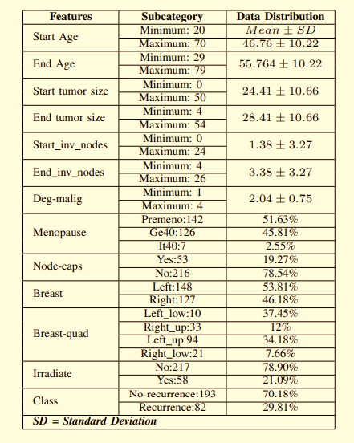
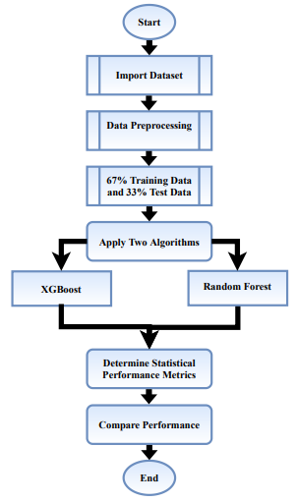
Methodology Cont.
TABLE I: Features List
Fig. 1: Work-flow of analysis

Slide 9
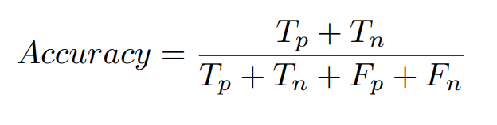
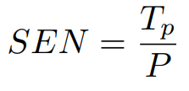
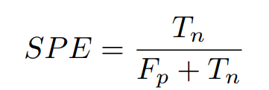
Outcome
The outcome of the analysis was analyzed based on a number of statistical metrics given below:
Accuracy :
Sensitivity (SEN) / TP Rate/ Recall :
Specificity (SPE)/ TN Rate :

Slide 10
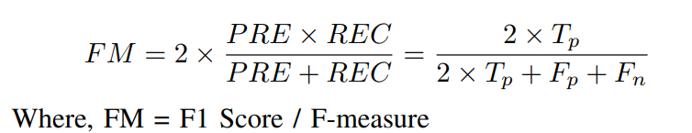
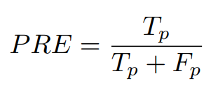
Outcome Cont.
F1 Score :
Precision (PRE) :
Here TP = True Positive, TN = True Negative, FP = False Positive and FN = False Negative.

Slide 11
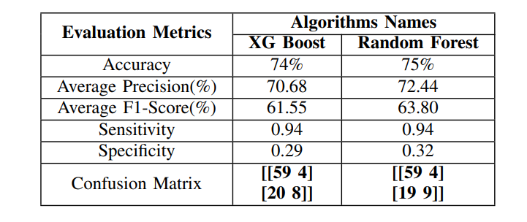
Outcome Cont.
TABLE II: Outcome of XGboost and Random Forest

Slide 12
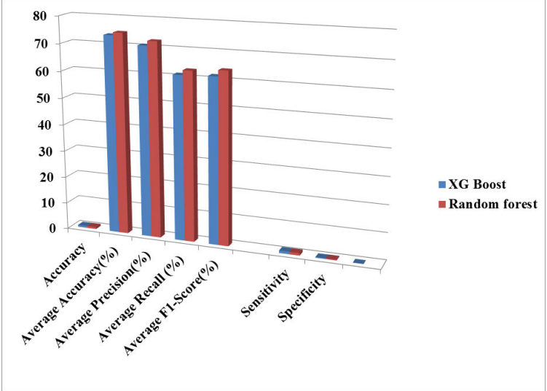
Outcome Analysis
Fig. 2: Bar-chart of performance parameters between XGBoost and Random Forest

Slide 13
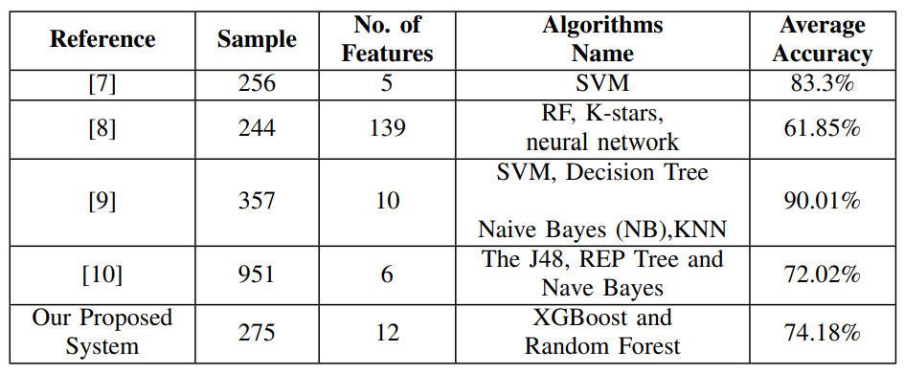
Outcome Analysis cont.
TABLE III: Comparison with Existing Systems

Slide 14
Outcome Analysis cont.
In Table II, the Random Forest algorithms showed the best result compare to XGboost.
Also in Fig.2 the Bar-chart of performance parameters between XGBoost and RF shows that RF has provided better result in average performance.
Table III compares our proposed system to existing systems based on accuracy, number of instances and attributes used.
The table clarify that our proposed system with Random Forest algorithm is better than the existing systems in terms of performance.

Slide 15
Conclusion
Most women in Bangladesh suffer from breast cancer due to their unconsciousness.
By applying the algorithms we have got accuracies for example 74.73% accuracy of Random forest and 73.63% accuracy for XGBoost.
We compared the results of our study with other existing systems and found that our system performed better than the existing system.

Slide 16
References
[1] M. Raihan, Muhammad Muinul Islam, Promila Ghosh, Shakil Ahmed Shaj, Mubtasim Rafid Chowdhury, Saikat Mondal, Arun More, “A Comprehensive Analysis on Risk Prediction of Acute Coronary Syndrome Using Machine Learning Approaches”, in 2018 21st International Conference of Computer and Information Technology (ICCIT), Dhaka, Bangladesh, 2018, pp. 1 - 6.
[2] “What Is Breast Cancer? — CDC”, CDC, 2020. [Online]. Available: https://www.cdc.gov/cancer/breast/basic info/what-is-breastcancer.htm. [Accessed: 01- Feb- 2020].
[3] “Breast Cancer”, Wikipedia, 2020. [Online]. Available: https://en.wikipedia.org/wiki/Breast cancer. [Accessed: 02- Feb2020].
[4] “Everything You Need to Know About Breast Cancer”, Healthline, 2020. [Online]. Available: https://www.healthline.com/health/breastcancer#prevention. [Accessed: 08- Feb- 2020].
[5] “Breast Cancer - Stages”, Cancer.Net, 2020. [Online]. Available: https://www.cancer.net/cancer-types/breast-cancer/stages. [Accessed: 08- Feb- 2020].
[6] A. JT, “Breast cancer in sub-Saharan African women”, PubMed - NCBI, 2020. [Online]. Available: https://www.ncbi.nlm.nih.gov/pubmed/7839882. [Accessed: 08- Mar- 2020].
[7] B. Majeed, H. T. Iqbal, U. Khan and M. A. Bin Altaf, “A Portable Thermogram based Non-contact Non-invasive Early Breast-Cancer Screening Device”in 2018 IEEE Biomedical Circuits and Systems Conference (BioCAS), Cleveland, OH, 2018, pp. 1-4.
[8] B. Bekta and S. Babur, “Machine learning based performance development for diagnosis of breast cancer”, in 2016 Medical Technologies National Congress (TIPTEKNO), Antalya, 2016, pp. 1-4.
[9] A. Bharat, N. Pooja and R. A. Reddy, “Using Machine Learning algorithms for breast cancer risk prediction and diagnosis”, in 2018 3rd International Conference on Circuits, Control, Communication and Computing (I4C), Bangalore, India, 2018, pp. 1-4.
[10] T. Padhi and P. Kumar, “Breast Cancer Analysis Using WEKA”in 2019 9th International Conference on Cloud Computing, Data Science & Engineering (Confluence), Noida, India, 2019, pp. 229-232.

Slide 17
Thank You!

