Slide 1

Vishwakarma Institute of Technology, Pune
An Electromyogram Based System for Detection of
Hook and Span Hand Grips
Author:
Madhusha Shete
Department of E&TC Engineering

Slide 2
Introduction
Literature Survey
Research Gap
Novelty
Methodology
Performance Evaluation
Advantages and Limitations
Conclusion
References
CONTENTS

Slide 3
INTRODUCTION
A technique for identification of significant hand movements
Electromyography based hand grip recognition system
EMG signals measure electrical current in muscles during contraction
Detection on the basis of classification of features extracted from EMG signal
Detection of hook and span hand grips

Slide 4
LITERATURE SURVEY

Slide 5
Paper 1: Convolutional Neural Network for Hand Gesture Recognition using 8 different EMG Signals
Paper 2: Exploring the relation between EMG sampling frequency and hand motion recognition accuracy
Identification of eight types of hand motions
The two electrodes placed on flexor carpi ulnaris and extensor carpi radialis
5-layered CNN architecture
Training accuracy – 99%
Sixteen bipolar electrodes placed between arm and elbow.
Signal frequency between 20Hz to 500 Hz.
Lowering the sampling frequency increases the performance of EMG-based hand motion detection.

Slide 6
Paper 3: Surface EMG hand gesture recognition system based on PCA and GRNN
Paper 4: R-CNN and wavelet feature extraction for hand gesture recognition with EMG signals
Detection of nine static grips
Signal characteristics namely root mean square RMS, ZC, SD and SSC were extracted.
Testing accuracy – 95.1%
Recognition time – 0.19 Sec
Muscle such as flexor digitorum superficialis and brachialis were included.
R-CNN classifier was implemented.
Features acquired from the wavelet power spectrum of EMG signals
Test accuracy – 96.48%

Slide 7
Paper 5: A Versatile Embedded Platform for EMG Acquisition and Gesture Recognition
Paper 6: The Virtual Trackpad: An EMG based hand gesture recognition system using an event-driven ANN
A hand grip recognition system for wearables.
Seven hand movements were performed by 4 subjects during data collection.
Classification was carried out using SVM.
Test accuracy – 92%
Grip detection in wireless virtual trackpad.
Extensor digitorum, flexor digitorum superficialis, flexor carpi ulnaris, and extensor carpi ulnaris
Data collected from 4 subjects
ANN model

Slide 8
RESEARCH GAP
High time complexity
Less efficient for poor signal quality
Limited feature extraction techniques
High cost solution

Slide 9
NOVELTY
Model is trained on precise data
Computationally simpler classification algorithms
Accurate detection of hook and span hand grips
Variety of feature extraction techniques
The experimental result showed the relevance of this system in the development of prosthetic hand

Slide 10
METHODOLOGY

Slide 11
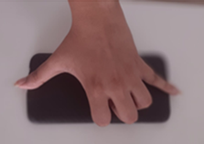

Input signal
Feature extraction
SYSTEM BLOCK DIAGRAM
Classification and detection of hook and span hand grip
Detection of span hand grip
Detection of hook hand grip

Slide 12
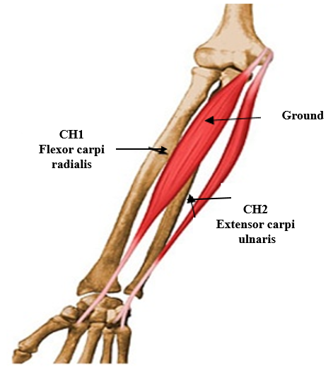
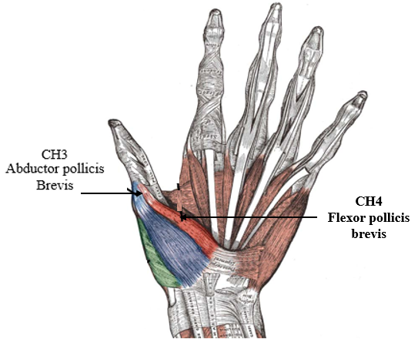
DATA ACQUISITION
Clarity medical EMG machine having 4 channels
Data recording of 8 subjects for two hand grips hook and span
The subjects performed two activities known as hook and span
Placement of electrodes on muscles having noticeable contraction while performing activities such as hook and span.

Slide 13
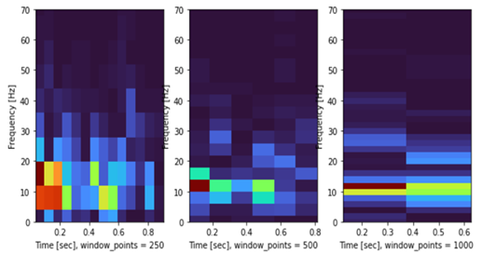
FEATURE EXTRACTION
Time-domain | variance, RMS, iEMG, MAV, LD, waveform length, average amplitude change, absolute standard deviation, ZC
Frequency-domain | frequency ratio, mean power, total power, mean frequency, median frequency, and peak frequency
Time-frequency domain | Wavelet transform
Time-domain, frequency-domain and time-frequency domain features
Frequencies ranging from 1 to 20 Hz
Windowing technique to create small subsets of data

Slide 14
Algorithm 1: Feature Extraction
Input – EMG signal
Output – Data containing feature vectors in time domain, frequency-domain and time-frequency domain.
extract_features () {
for all x in directory begin
a = bandstop_filter(x)
b = band_pass_filter(a)
signal = window(b, size=500)
t = time_features(signal)
f = frequency_features(signal)
tf = time_frequency(signal)
data = concatenate(t,f,tf)
window++
end for
return data
}
ALGORITHM

Slide 15
Implemented Classifiers:
Performance Metrics
Logistic regression
Decision Tree
Random Forest
KNN
AdaBoost
XGBoost
CLASSIFICATION
AND
ANALYSIS

Slide 16
PERFORMANCE EVALUATION
Sr. No | Classifier | Train Accuracy | Test Accuracy
1 | XGBoost | 100% | 89%
2 | Random Forest | 100% | 84.39%
3 | Decision Tree | 99.93% | 80.16%
4 | AdaBoost | 89.00% | 79.35%
5 | KNN | 81.35% | 73.35%
6 | Logistic regression | 72.65% | 71.42%
Precision | Recall | F1 Score | ROC
93% | 87% | 90% | 95%
92% | 84% | 88% | 93%
84% | 81% | 82% | 80%
84% | 76% | 80% | 88%
74% | 73% | 73% | 60%
79% | 69% | 73% | 78%

Slide 17
ADVANTAGES
LIMITATIONS
High accuracy: 89%
Cost efficient
Precise results
Computationally less complex
Detection of only two hand grips
Trained on limited data
High noise in signal may affect accuracy

Slide 18
Accurately classify the hook and span hand grips.
Time-domain, frequency-domain and time-frequency domain feature extraction.
The XGBoost classifier provided testing accuracy of 89% in the detection of hook and span hand grips.
The system can serve as a module for the development of prosthetic hands.
CONCLUSION

Slide 19
REFERENCES
J. O. Pinzon-Arenas, R. Jiménez-Moreno and J. E. Herrera-Benavides, "Convolutional Neural Network for Hand Gesture Recognition using 8 different EMG Signals," in XXII Symposium on Image, Signal Processing and Artificial Vision, 2019, pp. 1-5.
H. Chen, Y. Zhang, Z. Zhang, Y. Fang, H. Liu and C. Yao, "Exploring the relation between EMG sampling frequency and hand motion recognition accuracy," in IEEE International Conference on Systems, Man, and Cybernetics, 2017, pp. 1139-1144.
Qi, J., Jiang, G., Li, G. et al., “Surface EMG hand gesture recognition system based on PCA and GRNN,” in in International Conference on Neural Computing & Applications, vol.32, 2020, pp. 6343–6351.
Shanmuganathan, V., Yesudhas, H.R., Khan, M.S. et al., “R-CNN and wavelet feature extraction for hand gesture recognition with EMG signals,” in Neural Computing & Applications, vol.32, 2020, pp. 16723–16736.
S. Benatti et al., "A Versatile Embedded Platform for EMG Acquisition and Gesture Recognition," in IEEE Transactions on Biomedical Circuits and Systems, vol. 9, no. 5, pp. 620-630, 2015.
A X. Liu, J. Sacks, M. Zhang, A. G. Richardson, T. H. Lucas and J. Van der Spiegel, "The Virtual Trackpad: An Electromyography-Based, Wireless, Real-Time, Low-Power, Embedded Hand-Gesture-Recognition System Using an Event-Driven Artificial Neural Network," in IEEE Transactions on Circuits and Systems II: Express Briefs, vol. 64, no. 11, pp. 1257-1261, 2017.

Slide 20
THANKYOU

