Slide 1

Project Title : Keyphrase Extraction
PROJECT GUIDE TEAM MEMBERS:
Mr. MURTUZA BOHRA
SONAKSHI SHARMA 2018201090
VARUN BHATT 2018201086
AMAN RAJ 2018201085
MANIK LANGER 2018201092

Slide 2
INTRODUCTION
Keyphrase Extraction : A brief summary of a document.
A solution to organise, manage and retrieve documents.
Widely used in digital libraries and information retrieval.

Slide 3
MOTIVATION
Keyphrases in articles of journals assigned by authors.
Manual assignment is time consuming.
Retrieval of information in various fields, for e.g : medical.

Slide 4
OBJECTIVE
Extraction of “good phrases” of a document.
Understandable
Relevant
Good coverage

Slide 5
LITERATURE REVIEW
Article | Description | Findings
A straight forward method | Frequency based approach | Inefficient method
2) Supervised Approach(Turney, 1999) | Regards extraction as a classification task | A large training set is required.
3) Unsupervised Approach(Mihalcea and Tarau, 2004) | Graph based extraction | Inefficient relatedness calculation

Slide 6
METHODOLOGY
Candidate term selection
Calculation of term relatedness
Term clustering
From exemplar terms to keyphrases

Slide 7
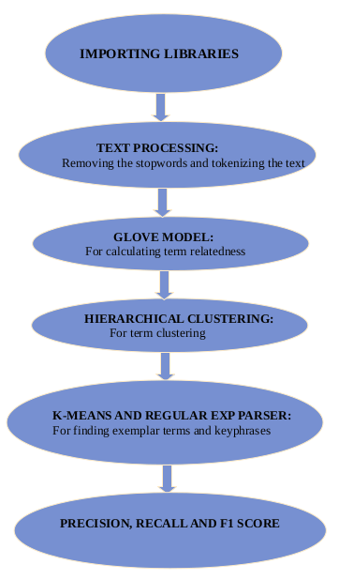

Slide 8
IMPLEMENTATION
Step 1 : Text Processing
Tokenizing
Stemming
Removing Stopwords

Slide 9
Step 2 : Find Term Relatedness
Word2Vec : Vector Representation of a word
CBOW (Continuous Bag Of Words)
Skip-Gram Model
2) Co-Occurence Matrix
Glove Model

Slide 10
Step 3 : Cluster Candidate Term on Relatedness
Hierarchical Clustering
Spectral Clustering
Step 4 : Finding Exemplar Terms
K-Mean Algorithm : To Find Mean of each cluster and obtain exemplar terms.

Slide 11
Step 5 : Finding Keyphrases
Chunking : Using Regular Expression
(JJ) ∗ (NN|NNS|NNP)+
Step 6 : Relatedness Measurements
Precision
Recall
F1 Measure

Slide 12
RESULTS AND OBSERVATIONS
1)Word2Vec with hierarchical clustering
where m= cluster number
n=Number of candidate terms
PARAMETERS | PRECISION | RECALL | F1-SCORE
m=(1/4)n | 0.13 | 0.32 | 0.19
m=(1/2)n | 0.22 | 0.26 | 0.24
m=(2/3)n | 0.30 | 0.27 | 0.28
m=(4/5)n | 0.36 | 0.26 | 0.30

Slide 13
2) Word2Vec with Spectral clustering
PARAMETERS | PRECISION | RECALL | F1-SCORE
m=(1/4)n | 0.18 | 0.42 | 0.25
m=(1/2)n | 0.31 | 0.36 | 0.34
m=(2/3)n | 0.40 | 0.35 | 0.38
m=(4/5)n | 0.46 | 0.33 | 0.39

Slide 14
3) Co-occurrence matrix for relatedness with Hierarchical clustering
Set value of w,window size in Word2Vec model = 10
PARAMETERS | PRECISION | RECALL | F1-SCORE
m=(1/4)n | 0.125 | 0.28 | 0.17
m=(1/2)n | 0.23 | 0.27 | 0.25
m=(2/3)n | 0.31 | 0.27 | 0.29
m=(4/5)n | 0.39 | 0.28 | 0.33

Slide 15
Calculating on w = 40
PARAMETERS | PRECISION | RECALL | F1-SCORE
m=(1/4)n | 0.13 | 0.31 | 0.19
m=(1/2)n | 0.21 | 0.25 | 0.23
m=(2/3)n | 0.31 | 0.27 | 0.29
m=(4/5)n | 0.38 | 0.27 | 0.32

Slide 16
Analysis and Discussion
Clustering-based method is both robust and effective for keyphrase extraction as an unsupervised method.
As the cluster number increases, more exemplar terms are identified from these clusters and more keyphrases will be extracted from the document.
Frequency word list is important for keyphrase extraction.

Slide 17
CONCLUSION AND FUTURE WORK
Check the feasibility of combining co-occurrence-based and Wikipedia-based relatedness for clustering.
Perform this method on other types of documents, such as long articles, product reviews and news.

Slide 18
REFERENCES
[1] Zhiyuan Liu, Peng Li, Yabin Zheng, Maosong Sun,”Clustering to Find Exemplar Terms for Keyphrase Extraction”
[2] Rada Mihalcea and Paul Tarau. 2004. Textrank: Bringing order into texts. In Proceedings of the 2004 Conference on Empirical Methods in Natural
Language Processing
[3]Peter D.Turney. 1999 “Learning to Extract Keyphrases from Text”. National Research Council Canada, Institute for Information Technology, Technical Report ERB-1057.
Links :
[4] https://www.youtube.com/watch?v=UqRCEmrv1gQ
[5] https://www.analyticsvidhya.com/blog/2017/06/word-embeddings-count-word2veec/

Slide 19


