Slide 1

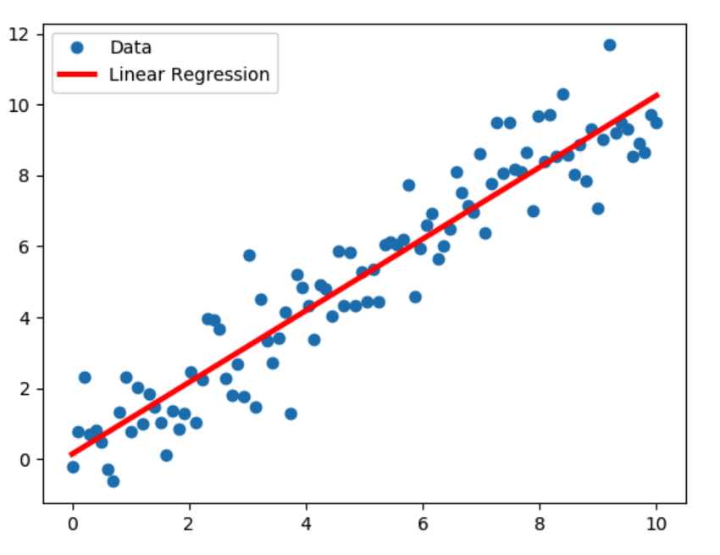
Linear Regression :
It’s a linear model to express the linear relationship between one input variable (or many) and an output variable

Slide 2
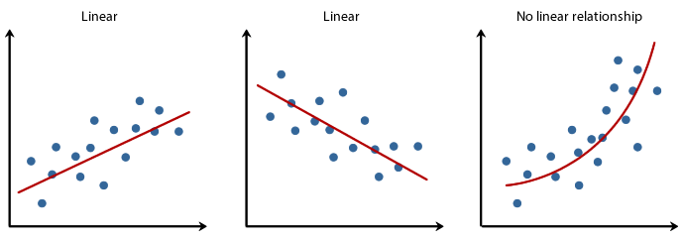
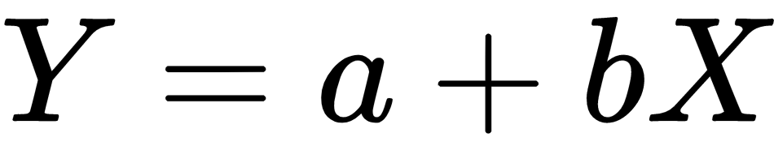

Slide 3
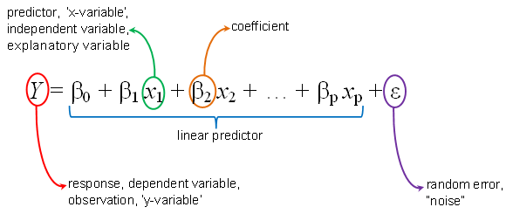
Our model :
In general :
One variable case :

Slide 4

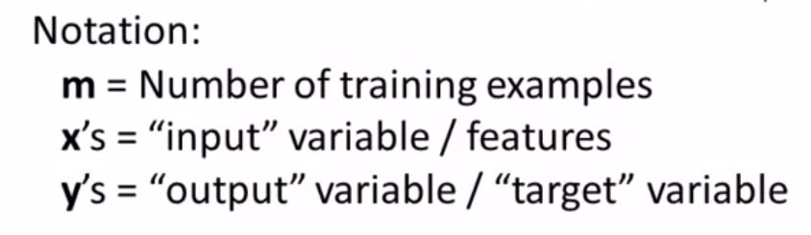
Cost function :

Slide 5
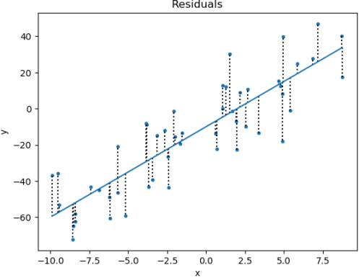
Cost function :

Slide 6
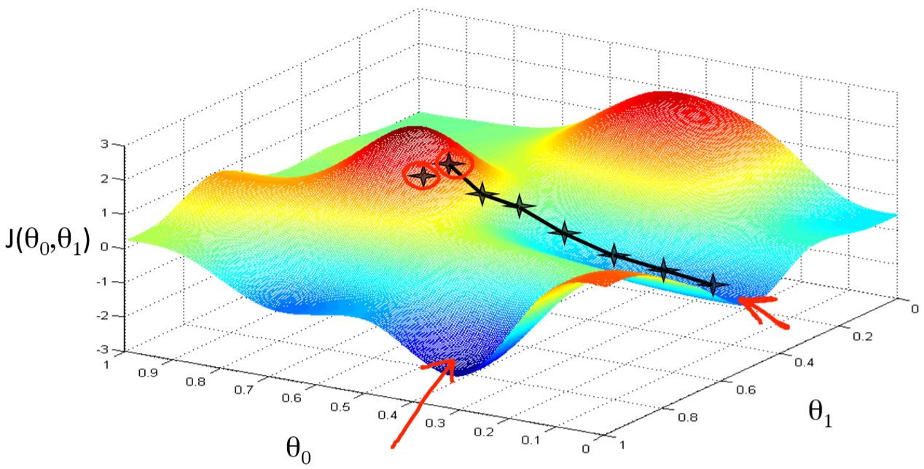
Gradient Descent:

Slide 7
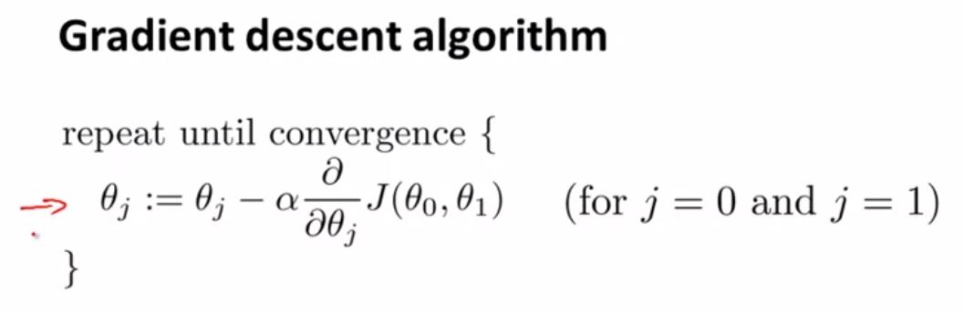
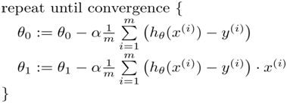
Gradient Descent:

Slide 8
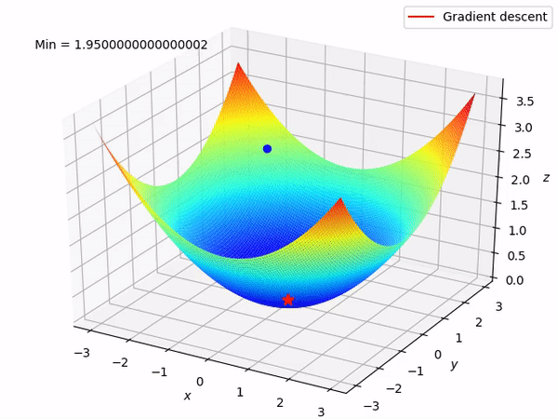
Gradient Descent:

Slide 9
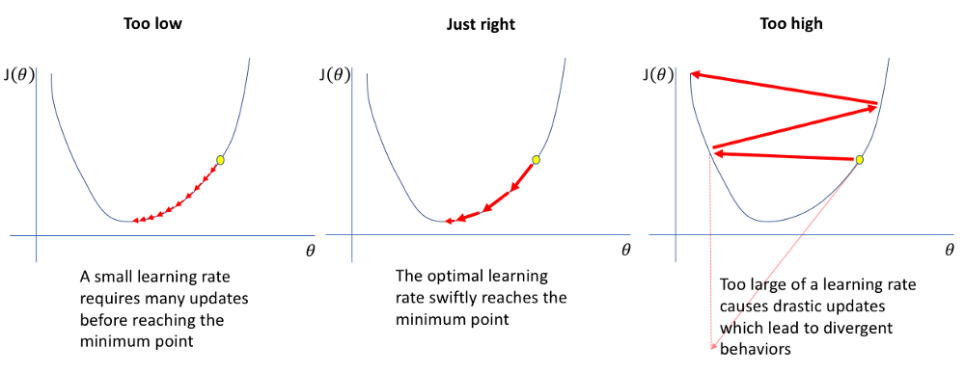
Learning rate :

Slide 10
Logistic regression :
Examples :
Is this email spam or not ?
Is this image for a cat or not ?
Is the produced machine in a factory defected or not ?
Is this transaction a fraudulent one or not ?

Slide 11
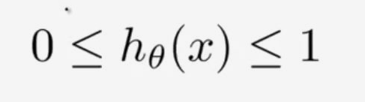

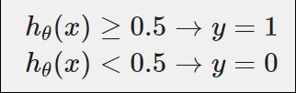
Our model :
We want :

Slide 12
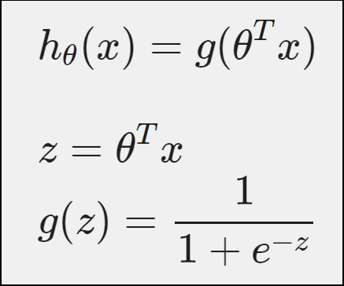
Our model :

Slide 13
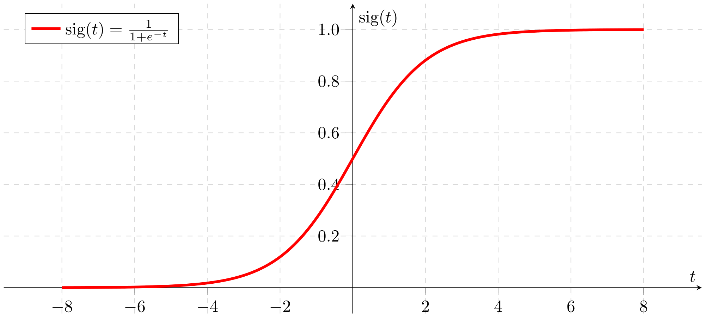
Sigmoid function :

Slide 14
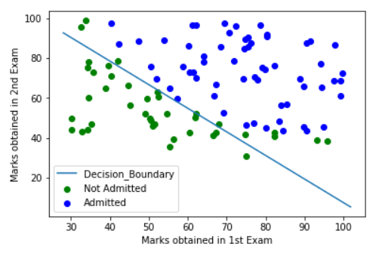

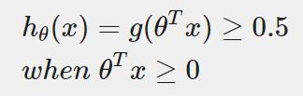
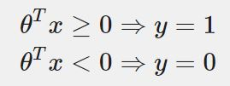
Decision boundry :

Slide 15
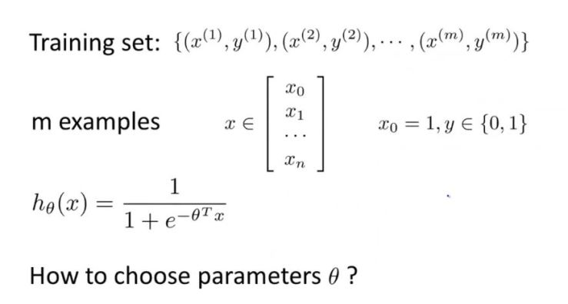
Logistic regression :

Slide 16

Cost function :
How can we minimize this function ?

Slide 17
Gradient Descent:

Slide 18
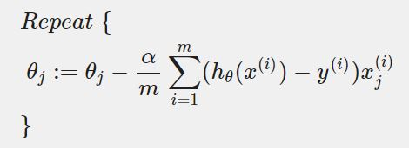
Gradient Descent:
Update rule in case of multiple variables :

Slide 19
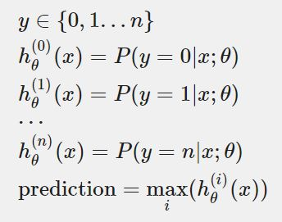
Multiclass classification :
Example :
- Is it a cat or a dog or a rabbit ?

Slide 20
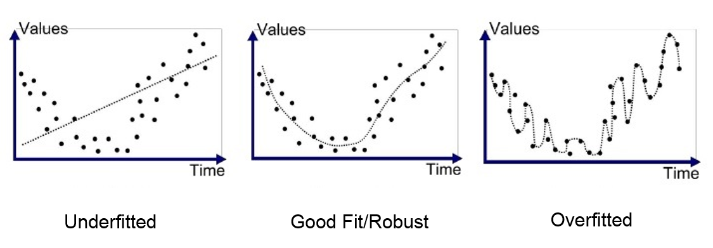
Overfitting vs underfitting :

