Slide 1
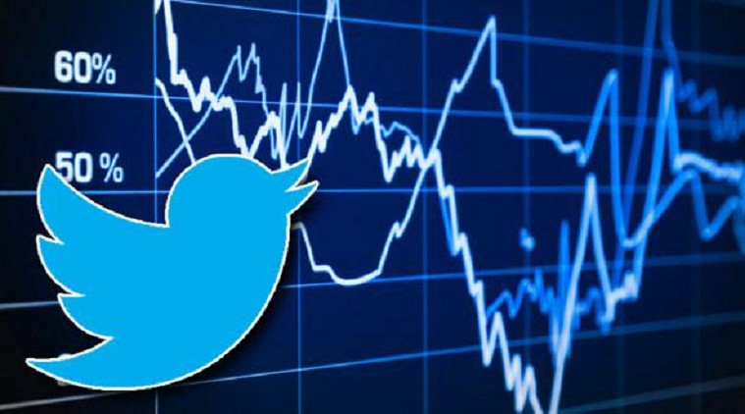
Sentiment Analysis on Stock Market using Twitter Data
Team Members
Gopi Krishna Sure, Sweety Makwana, Nikhil Rangineni, Gayathri Katukojwala

Slide 2
Introduction
Motivation
Twitter is a well-known place where traders and investors tweet about stocks
Tweets reveal sentiment – Positive, Negative and Neutral
AI technologies helps classify public sentiment to help predict the trend for stock market
Significance
As Abraham Lincoln said, “With public sentiment nothing can fail. Without it, nothing can succeed.”
Twitter data is linguistic and unstructured data which can be translated into structured and meaningful data using NLP models.
Tedious process for anyone to manually keep track of all the tweets and analyze
Objective
overcome the problems faced by traders
acquire pre-labeled Twitter data and historical data for stock market
Preprocess and clean data
Naïve Bayes algorithm

Slide 3
Background
[1]Go, Alec, Lei Huang, and Richa Bhayani. "Twitter sentiment analysis." Entropy 17 (2009): 252. This paper was presented in 2009 when Twitter was a new microblogging platform where users share their sentiments on any related topics including stock prices. They developed a machine learning algorithm to classify tweets for marketers and reviews for the company.
[2]Kouloumpis, Efthymios, Theresa Wilson, and Johanna Moore. "Twitter sentiment analysis: The good the bad and the omg!." Proceedings of the international AAAI conference on web and social media. Vol. 5. No. 1. 2011. This paper investigates usefulness of sentiment analysis on Twitter data as being inspired from other domains where strong link has been found between part-of-speech tagging and sentiment lexicons in other domains.
[3]Rakibul Hasan and Maisha Maliha . "Sentiment Analysis with NLP on Twitter Data.“ This paper was presented in 2019 to perform sentimental analysis on the twitter data using the bag of words and the TF-IDF vectorizer and achieved the 86 % of accuracy and the accuracy can be increased more by using the Tf-IDF vectorizer according to the authors.
[4]Rocha and Macedo.” Stock Price Prediction Using Neural Networks”. According to this paper the authors tested the Neural networks with 10 variations out of which 2 of them gave the best results with different hidden layers. They say that this is very important to predict the stock as that is the responsible for economic growth.

Slide 4
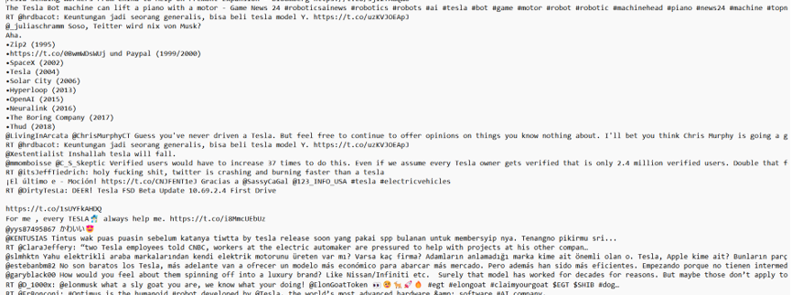
Dataset
Create dataset using live Twitter API
Search keywords: ‘Tesla’, ‘#TSLA’, and ‘YahooFinance and tesla’
Analyze and Preprocess before feeding the NLP model.

Slide 5
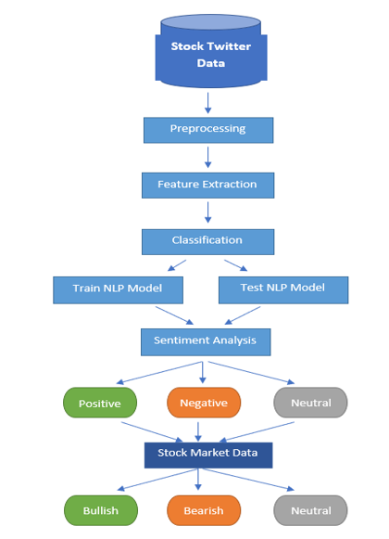
Model Diagram

Slide 6
Design of Features
Collect the dataset based on specific keywords related to a stock company from Twitter API
Preprocess the data to remove special characters, URLs, links, stopwords, lemmatize, etc.
Visualize and analyze Twitter data using “WordCloud”, Histogram, Unique words search, etc.
Build NLP model for sentiment analysis
classify Tweets using NLP model: Positive, Negative, Neutral
Provide speed and scalability for financial decision to make profit and minimize losses
Accuracy
Visualize stock price chart along with Twitter Sentiment Polarity to predict the trend of the stock

Slide 7
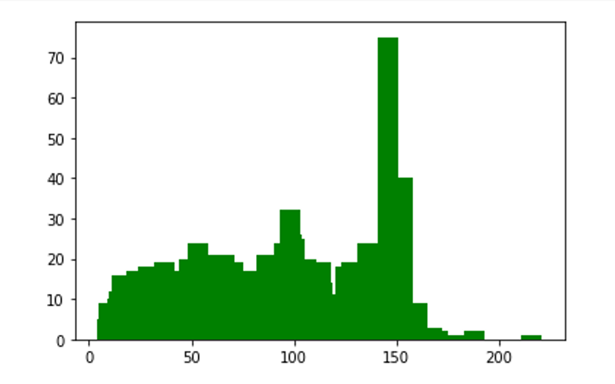
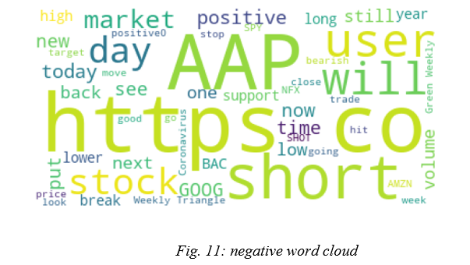
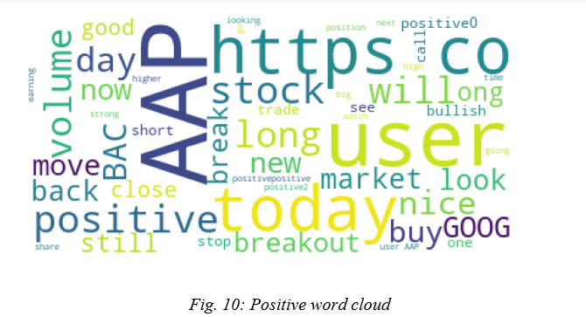
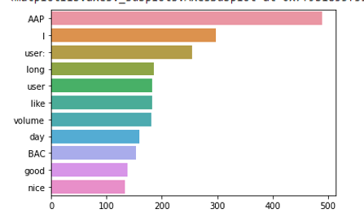
Analysis
WordCloud for positive and negative words
Frequency of Unique words for positive and negative words
Length and frequency of positive and negative Sentences

Slide 8
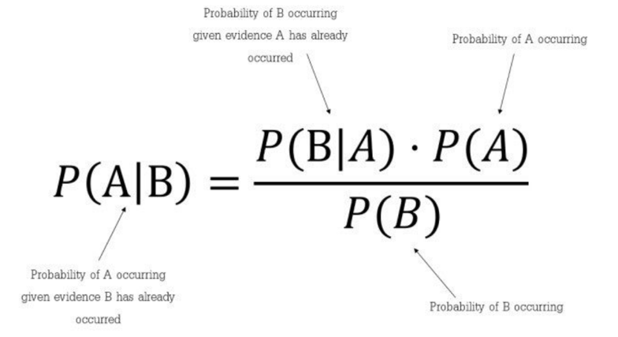
Naïve Bayes
We have used the naïve bayes algorithm in our project for the classification and the sentimental analysis part. Multinomial naïve bayes along with naïve bayes algorithm are used in the project.Naïve bayes is one of the algorithms that is based on the bayes theorem.

Slide 9
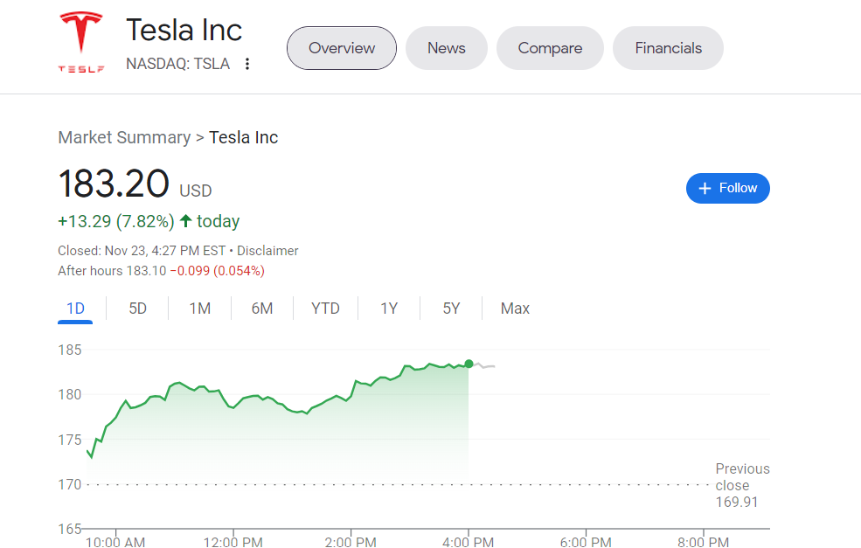
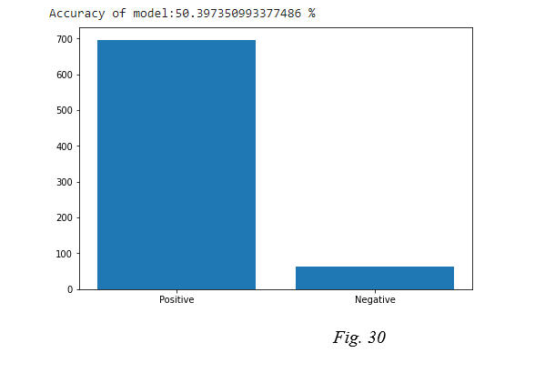
Results
Below graph shows there are more number of positive sentiment in the tweets which may indicate that the stock price may rise in the coming days or the next day.
The results may change when we use the whole twitter data for Tesla in the project and we may get more accurate results using the whole twitter stock data

Slide 10
References
https://www.kaggle.com/
https://finance.yahoo.com/
https://data.world/crowdflower/apple-twitter-sentiment
https://www.ncbi.nlm.nih.gov/pmc/articles/PMC7959635/
https://www.kaggle.com/datasets/ankurzing/sentiment-analysis-for-financial-news
https://monkeylearn.com/blog/sentiment-analysis-of-twitter/
Go, Alec, Lei Huang, and Richa Bhayani. "Twitter sentiment analysis." Entropy 17 (2009): 252.
Kouloumpis, Efthymios, Theresa Wilson, and Johanna Moore. "Twitter sentiment analysis: The good the bad and the omg!." Proceedings of the international AAAI conference on web and social media. Vol. 5. No. 1. 2011.
https://www.nltk.org/
https://developer.twitter.com/en/docs/twitter-api

