Slide 1
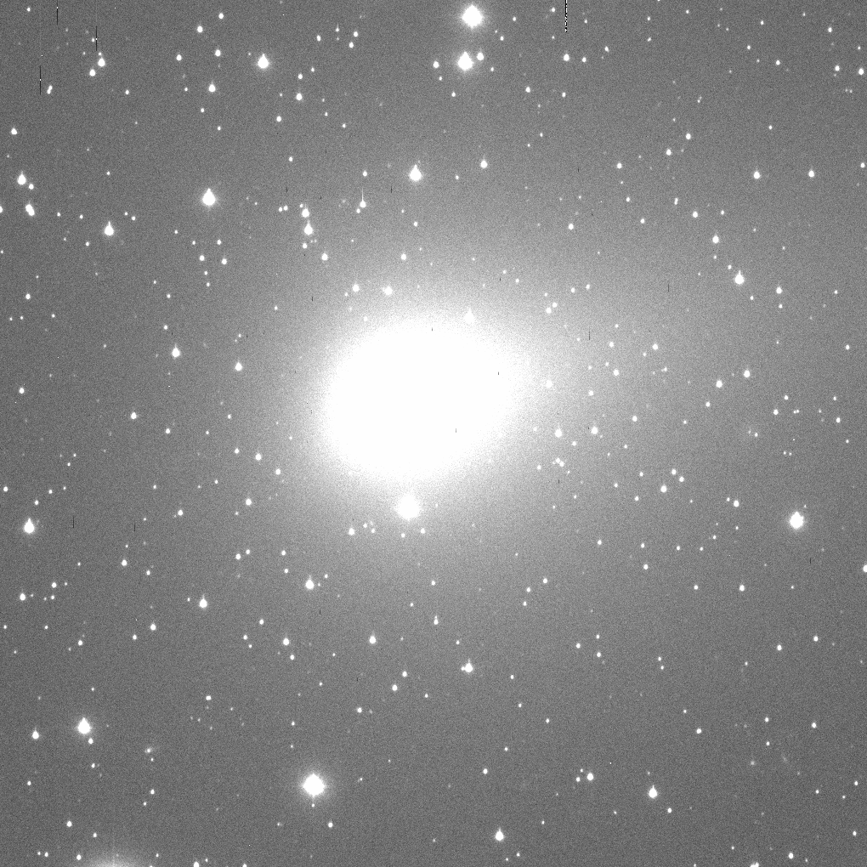
103P/Hartley on 2010 November 1
Aperture
Radius x y dx dy
pixels pixel pixel pixel pixel flux SNR Right Ascension Declination
5.0 457.93 547.74 0.07 0.07 571776.9 746.86 06 56 29.502 +11 48 57.64
4.9 457.93 547.74 0.07 0.06 561781.0 742.41 06 56 29.502 +11 48 57.64
4.8 457.92 547.75 0.07 0.06 554534.5 741.46 06 56 29.502 +11 48 57.64
4.7 457.91 547.74 0.07 0.06 537056.2 727.41 06 56 29.502 +11 48 57.64
4.6 457.90 547.73 0.07 0.06 527547.4 720.75 06 56 29.503 +11 48 57.63
4.5 457.89 547.72 0.07 0.06 516630.5 711.59 06 56 29.503 +11 48 57.63
4.4 457.87 547.72 0.06 0.06 508411.7 707.61 06 56 29.503 +11 48 57.63
4.3 457.86 547.69 0.06 0.06 493136.6 700.88 06 56 29.504 +11 48 57.62
4.2 457.86 547.70 0.06 0.06 486585.9 698.67 06 56 29.504 +11 48 57.62
4.1 457.82 547.70 0.06 0.05 467277.4 686.76 06 56 29.505 +11 48 57.62
4.0 457.82 547.69 0.05 0.05 455231.3 669.60 06 56 29.505 +11 48 57.62
3.9 457.80 547.67 0.05 0.05 444869.3 663.28 06 56 29.506 +11 48 57.61
3.8 457.81 547.67 0.05 0.05 430415.5 657.56 06 56 29.505 +11 48 57.61
3.7 457.81 547.67 0.05 0.05 420681.9 649.92 06 56 29.505 +11 48 57.61
3.6 457.80 547.66 0.05 0.05 407299.6 642.73 06 56 29.506 +11 48 57.60
3.5 457.79 547.65 0.05 0.05 393633.3 622.53 06 56 29.506 +11 48 57.60
3.4 457.76 547.64 0.05 0.05 378889.1 615.14 06 56 29.507 +11 48 57.59
3.3 457.74 547.63 0.05 0.05 367940.4 609.39 06 56 29.507 +11 48 57.59
3.2 457.70 547.61 0.04 0.04 353450.3 597.43 06 56 29.509 +11 48 57.58
3.1 457.71 547.60 0.04 0.04 339323.1 581.86 06 56 29.508 +11 48 57.58
3.0 457.71 547.60 0.04 0.04 333665.3 578.01 06 56 29.508 +11 48 57.58
2.9 457.71 547.60 0.04 0.04 320351.7 566.35 06 56 29.508 +11 48 57.58
2.8 457.71 547.60 0.04 0.04 312374.0 548.42 06 56 29.508 +11 48 57.58
2.7 457.67 547.57 0.04 0.04 282065.0 532.82 06 56 29.509 +11 48 57.56
2.6 457.67 547.57 0.04 0.04 272435.8 519.77 06 56 29.509 +11 48 57.56
2.5 457.67 547.55 0.04 0.04 258472.3 509.21 06 56 29.509 +11 48 57.55
2.4 457.67 547.53 0.04 0.04 247262.7 494.93 06 56 29.509 +11 48 57.54
2.3 457.63 547.53 0.03 0.03 223467.3 462.68 06 56 29.511 +11 48 57.54
2.2 457.62 547.52 0.03 0.03 212628.4 447.79 06 56 29.511 +11 48 57.54
2.1 457.62 547.52 0.04 0.04 205986.2 444.58 06 56 29.511 +11 48 57.54
2.0 457.60 547.50 0.03 0.04 187058.7 427.38 06 56 29.512 +11 48 57.53
1.9 457.60 547.50 0.03 0.04 180076.4 407.28 06 56 29.512 +11 48 57.53
1.8 457.60 547.50 0.04 0.04 171499.8 383.19 06 56 29.512 +11 48 57.53
1.7 457.60 547.50 0.04 0.04 164126.2 362.98 06 56 29.512 +11 48 57.53
1.6 457.59 547.50 0.04 0.04 149584.2 340.24 06 56 29.512 +11 48 57.53

