Slide 1
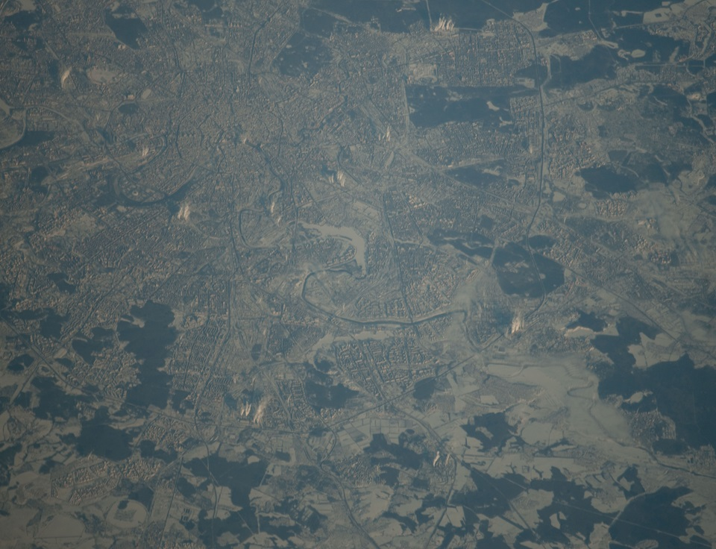
Russian astronomers for the International Asteroid Warning Network (IAWN)
5th IAWN Steering Group Meeting
30 January 2018 UNCOPUOS/OOSA Vienna, Austria
Boris Shustov
Institute of Astronomy, Russian Academy of Sciences

Slide 2
Russian astronomical centers are joining the IAWN
There is growing understanding of need for the international coordination of activities related to near-Earth objects, harmonizing the efforts directed at identification, follow-up observations and orbit prediction.
INASAN joined the IAWN in 2016.
Recently a number of astronomical centers in Russia have sent letters of intention to join the IAWN:

Slide 3
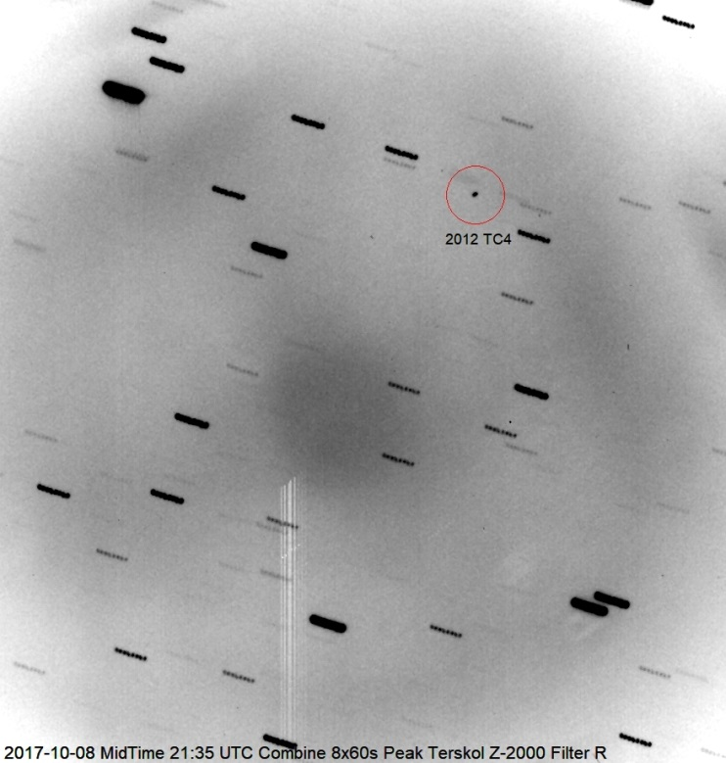
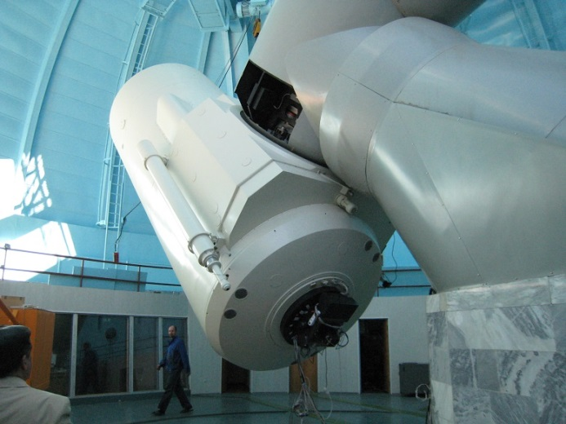
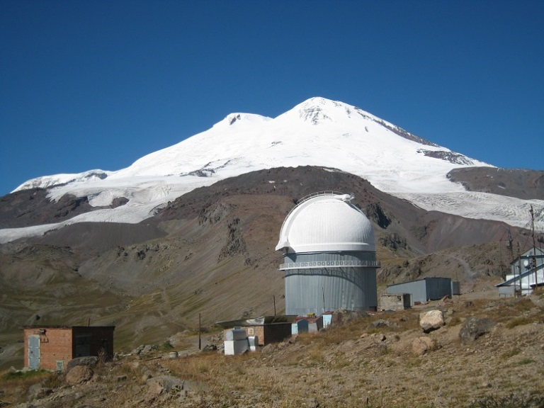
2012 TC₄: Observations in Terskol
2-m ZEISS telescope of INASAN – GAO NANU observatory in Terskol

Slide 4
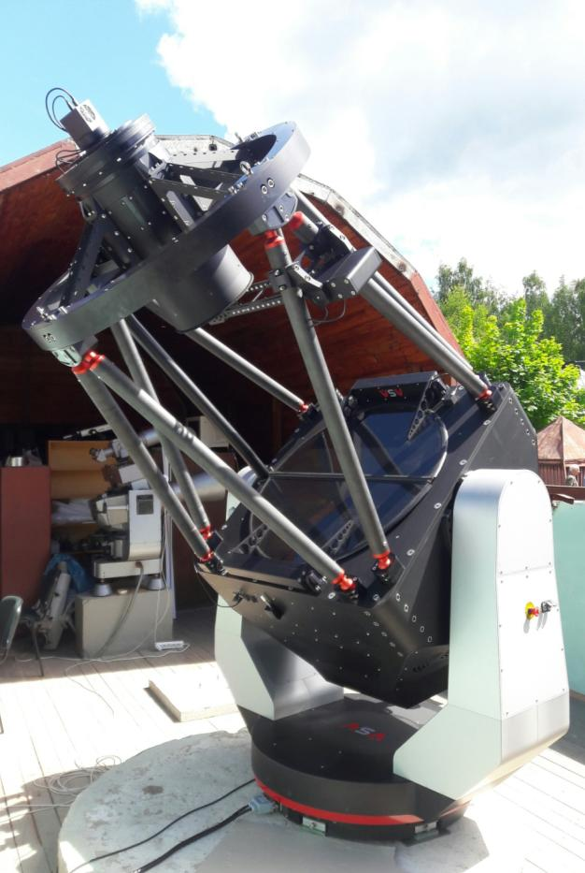
INASAN: 1-m telescope
AZ1000WF telescope is 1 m wide field survey telescope. Main telescope parameters are:
Aperture 1 m
Fast direct drive mount (10 deg/s)
Field of view 3 deg (130mm diagonal)
Designed for 10k x 10k CCD detector
Limiting magnitude 21.5^{m}
Half-sky survey in two days down to 20.5^{m}
The telescope is at commissioning phase now at Zvenigorod observatory (INASAN). First light was successfully obtained this summer.

Slide 5
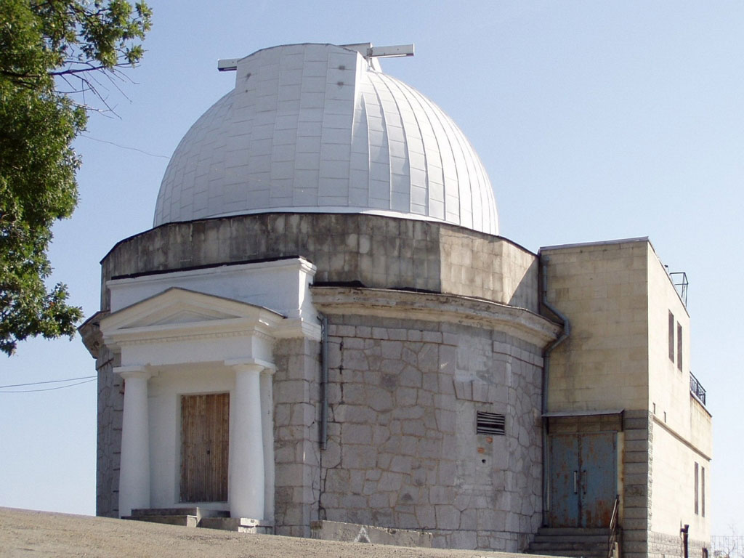
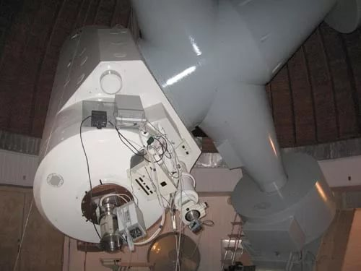
INASAN: 1-m telescope in Simeiz
Next year INASAN has plan to upgrade the old Zeiss-1000 telescope. The main idea is to put lens corrector in prime focus to increase the telescope field of view.
The main parameters of upgraded telescope:
Aperture 1 m
FoV 1 sq. deg
Limiting magnitude 20-21^{m}
Detector 4k x 4k CCD
Pixel scale 0.89 arcsec/pixel
Zeiss-1000 and AZ1000WF telescopes will operate together as part of INASAN’s optical telescope network.

Slide 6
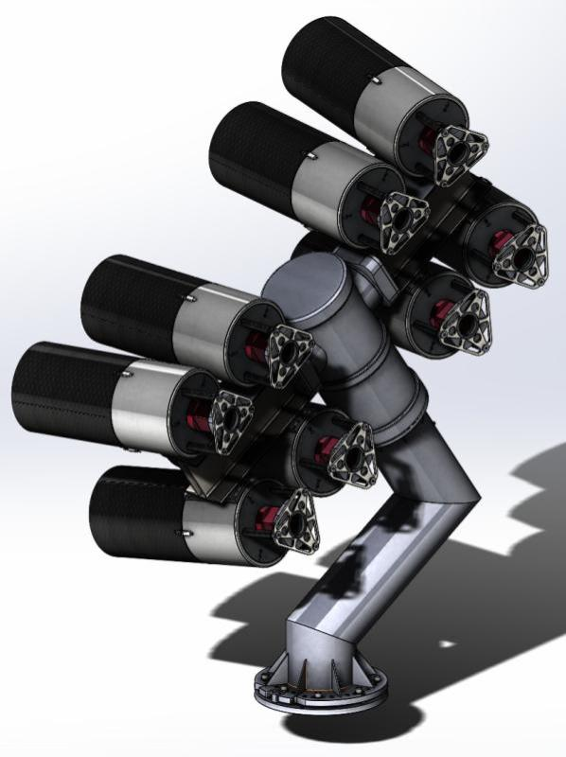
INASAN plans: Multiaperture telescope (8x25cm)
Parameter (8x telescope) | Value
Detector of single tube | CMOS GSENSE6060 BSI 6k x 6k 10 µm pixel
Format | 12k × 24k
Number of pixels, Mpixel | 298
Pixel scale, arcsec/pix | 5.2
FoV, deg | 17.6 × 35.2 *
FoV, sq. deg | 574
Readout time, s | 1
All-sky (20000 sq.deg) survey time** and limiting magnitude at best conditions
All-sky @ 10 s exposure | 10 min @ 18.3^{m}
All-sky @ 30 s exposure | 20 min @ 18.9^{m}
All-sky @ 100 s exposure | 1 h @ 19.4^{m}
8x VT-78d on
ASA DDM160 mount

Slide 7
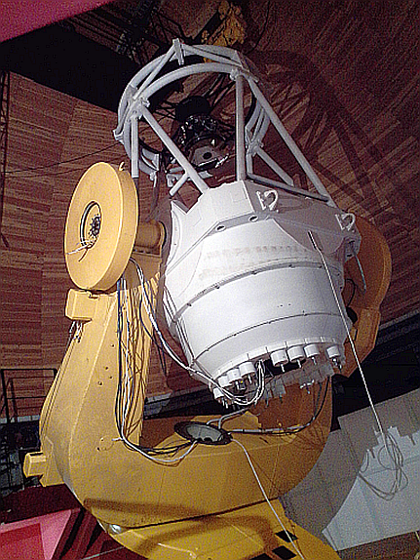
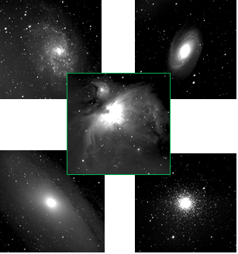
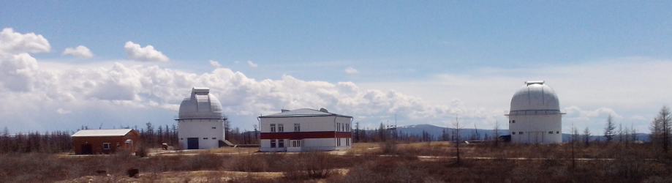
Irkutsk: AZT-33VM
Spectral range | 400-1100 nm
F | 5600 mm
focal ratio | 1:3,5
2ω | 2,80
2y’ | 277 mm

Slide 8
For campaings
SAO RAS – 6 m telescope
CrAO RAS – 2.6 m telescope and 0.8 m wide field telescope
Ural University (Ekaterinburg) – 1.2 m student telescope
Kazan University – 1.5 m telescope in Turkey
Networks of moderate class telescopes (still uncertain as it concerns the IAWN collaboration)
ISON – up to 3 telescopes (0.5 m class) for observations of asteroids and comets
MASTER – 0.4 m telescopes
8

Slide 9
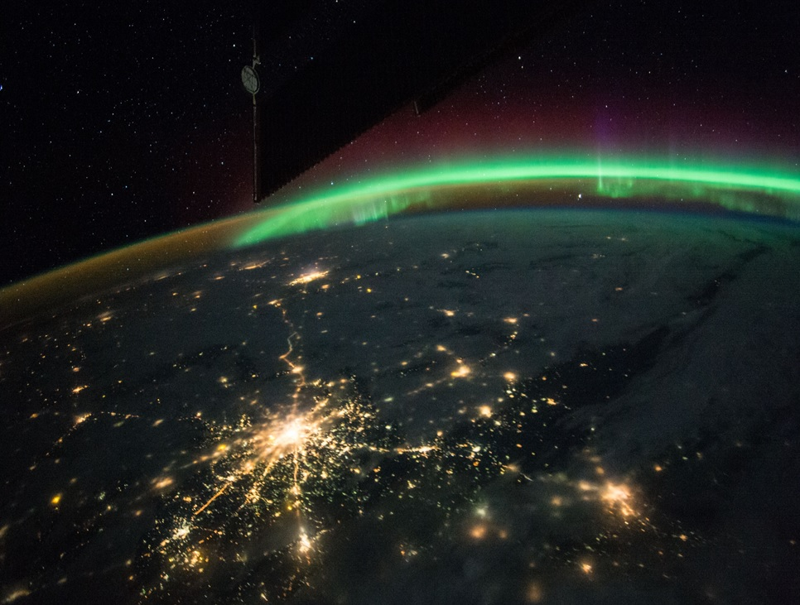
Thanks to all the colleagues
from IAWN TC4 Recovery campaign
for valuable experience!
Thanks to all of you for your attention!

