Slide 1
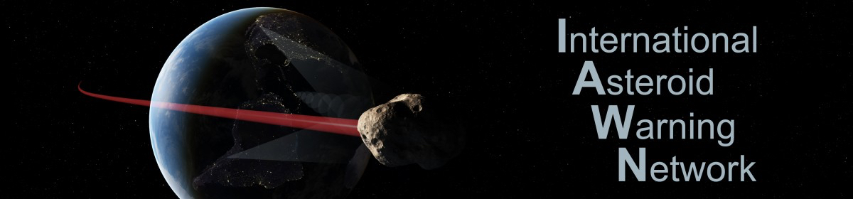
IAWN Information Processing and Data Flow
J. Bauer (SBN, UMD), T. SpahR (NEO Sciences), Elizabeth Warner (UMD), Tony Farnham (UMD), Andrei Mamoutkine (SBN, UMD), Laveena Dulani (SBN, UMD)

Slide 2
Several Small Bodies Node (SBN ) Developments Regarding IAWN
MPC-SBN integration activities (Tim Spahr)
IAWN Website Migration and Development (Elizabeth Warner)
IAWN observing campaign support activities (Tony Farnham)
Regarding the Flow of Information to/from IAWN

Slide 3
Key Entities
Minor Planet Center – CfA, Cambridge, MA, USA
Jet Propulsion Laboratory’s Center for Near Earth Object Studies (CNEOS – Home of Scout & Sentry)
ESA’s NEO Coordination Center (NEOCC)
NASA Planetary Data System’s Small Bodies Node at UMD (IAWN web site, MPC oversight)
NASA’s Planetary Defense Coordination Office and NEO Observation program
Observers, primarily, but not exclusively, NEO surveys (ground and space-based) and follow-up
IAWN Members
International Community

Slide 4
Key Entities
Observe
Observers, primarily, but not exclusively, NEO surveys (space and ground-based) and follow-up
Orient
Minor Planet Center – CfA, Cambridge, MA, USA
Jet Propulsion Laboratory’s Center for Near Earth Object Studies (CNEOS – Home of Scout & Sentry)
ESA’s NEO Coordination Center (NEOCC)
NASA Planetary Data System’s Small Bodies Node at UMD (IAWN web site, MPC oversite)
Decide and Act/Adapt
NASA’s Planetary Defense Coordination Office and NEO Observation program
IAWN Members
International Community, including UN (COPUOS), SMPAG

Slide 5
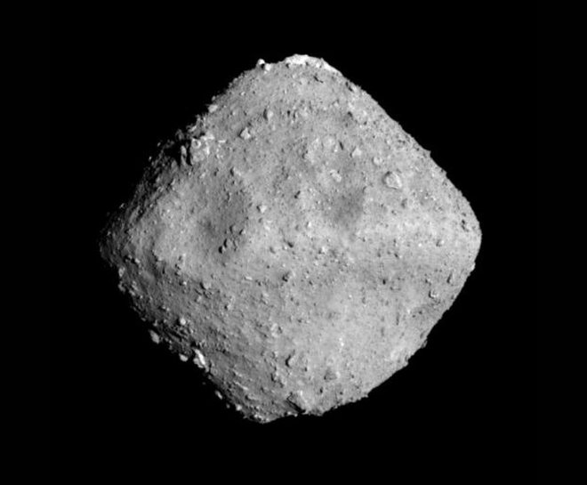
Observation and Processing
[Discovery & Initial] Observations
More Observations needed
NEOCC / Correct or Not?
Ingest by MPC
Maybe
Maybe
CNEOS / Scout (and MPC)
Future Close Approach?
No
NEOCP?
No
Yes
Monitor
Wait for Future Observations
Yes
Post!
IAWN
Impact Threat?
NEOCC/SMPAG
UN, PDCO

Slide 6
Some Details
MPC actually notifies IAWN of close-approachers
CNEOS has live mirror MPC database copy, but uses the webpage products
There is no regularized flow between organizations except the DB and CNEOS, and between MPC and SBN. Products are distributed via web page or subscription
Sentry triggers on MPECs

Slide 7
Role of IAWN Website
Accumulates information from other orienting entites to verify and notify the community (UN, SMPAG, and interested public) of Close Approach and Impact possibilities
Provides informed content explaining NEO Observations and Populations to the community
Provides a source of confirmed, reliable physical information about Close Approachers of particular interest

Slide 8
IAWN Website Landing Pages
Gives Latest information regarding particular objects and their physical characterization
Diameter, Rotation period, Orbital Parameter links (to MPCs and CNEOS), Absolute Magnitudes, albedo, light curve information
Start as addendum off the latest CA tables

Slide 9
Discussion Topics
More formalized data flows between organizations?
Landing Pages?
Linking to CNEOS products in present tables (and landing pages)?
Posting ALL NEO close approaches (not just recent discoveries)?
Need to confirm and incorporate Criteria from report…

