Slide 1
IAWN.net and the IAWN Campaigns
G. Bauer, E. Warner, T. Farnham (UMD), T. Spahr (NEO Sciences), V. Reddy (U of A), M. Kelley (NASA HQ)

Slide 2
Current Operations at SBN
Most of Staff is research, and working remotely.
Regular meetings by Zoom, remote access to work stations.
Regular operations and development continues relatively unabated.
IAWN support work continues.

Slide 3

IAWN Member feeds

Slide 4
IAWN Member feeds

Slide 5

IAWN.net continues to post new content from members…

Slide 6
IAWN.net continues to post new content from members…
Please send us your news highlights!!

Slide 7
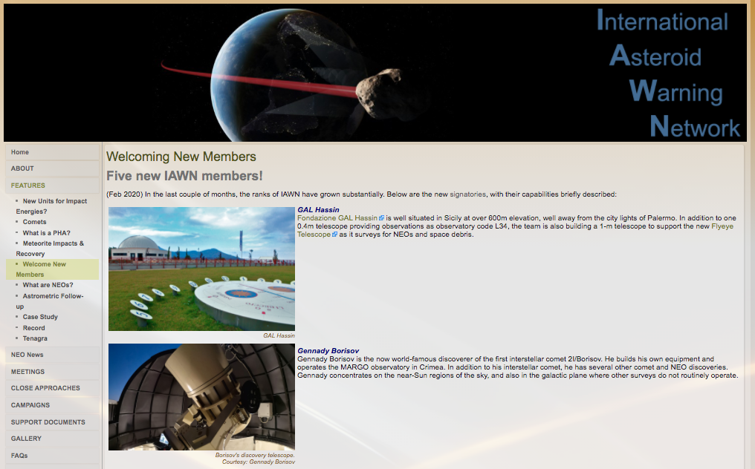

Slide 8
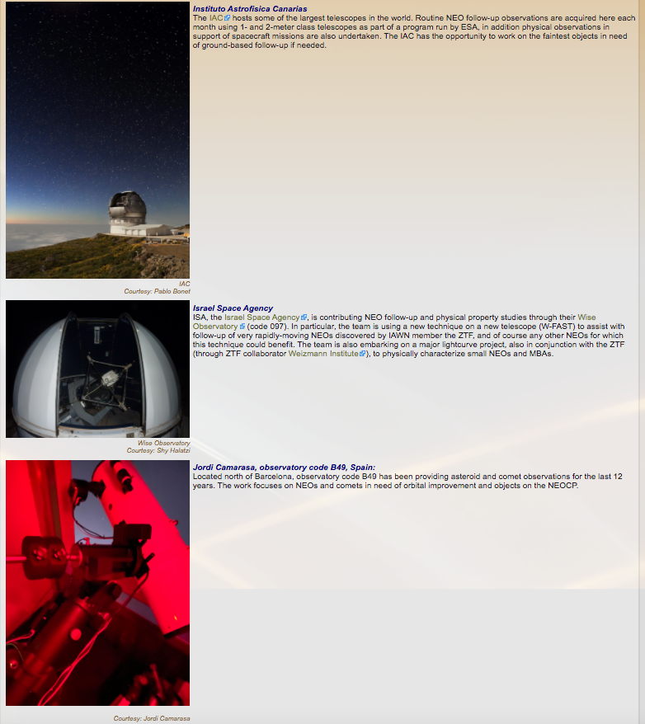
New Member highlights as well…

Slide 9
Apophis Planetary Defense Campaign
NASA PDCO Lead: Mike Kelley
PDS Small Bodies Node Lead: Gerbs Bauer (University of Maryland)
Campaign Lead: Vishnu Reddy (University of Arizona)

Slide 10
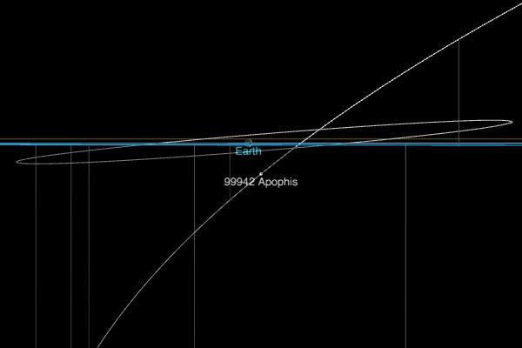
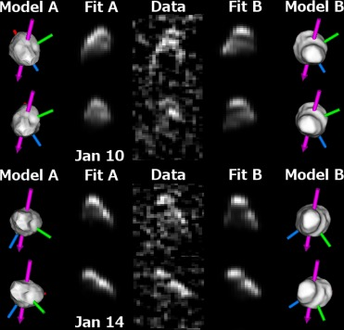
99942 Apophis, 2029 Close Approach
2029-04-14 11:00 UTC
Brozovic et al 2018

Slide 11
Apophis
Interesting object due to impact risk following its discovery
These risks have been largely eliminated by additional observations
Size: 450x170 meters; Rotation period: ~30.4 hours (tumbling)
Closest approach on April 13, 2029 at a distance of 31,000 km
Spacecraft mission concepts and extended missions have been proposed.

Slide 12
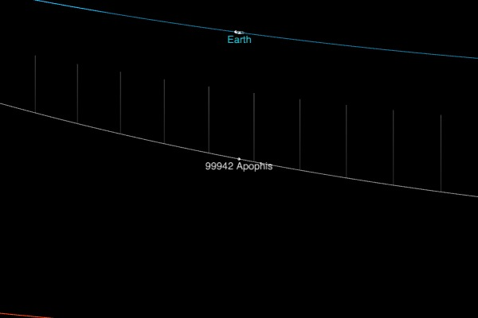
99942 Apophis, 2021 Close Approach
2029-03-06 01:00 UTC

Slide 13
Apophis
Interesting object due to impact risk following its discovery
These risks have been largely eliminated by additional observations
Size: 450x170 meters; Rotation period: ~30.4 hours (tumbling)
Closest approach on April 13, 2029 at a distance of 31,000 km
Spacecraft mission concepts and extended missions have been proposed.
Has a close flyby of the Earth in March 06 2021 (CA dist ~0.11 AU).
Makes for an iconic target for global planetary defense exercise.

Slide 14
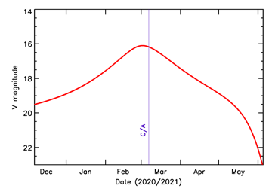
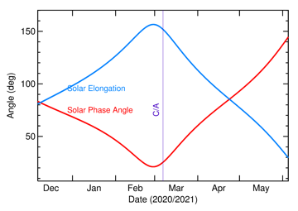
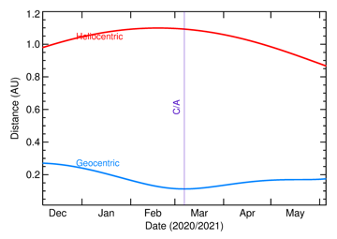
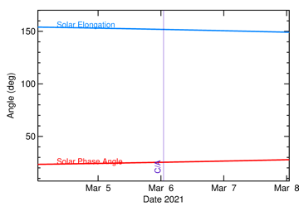
Courtesy T. Farnham

Slide 15
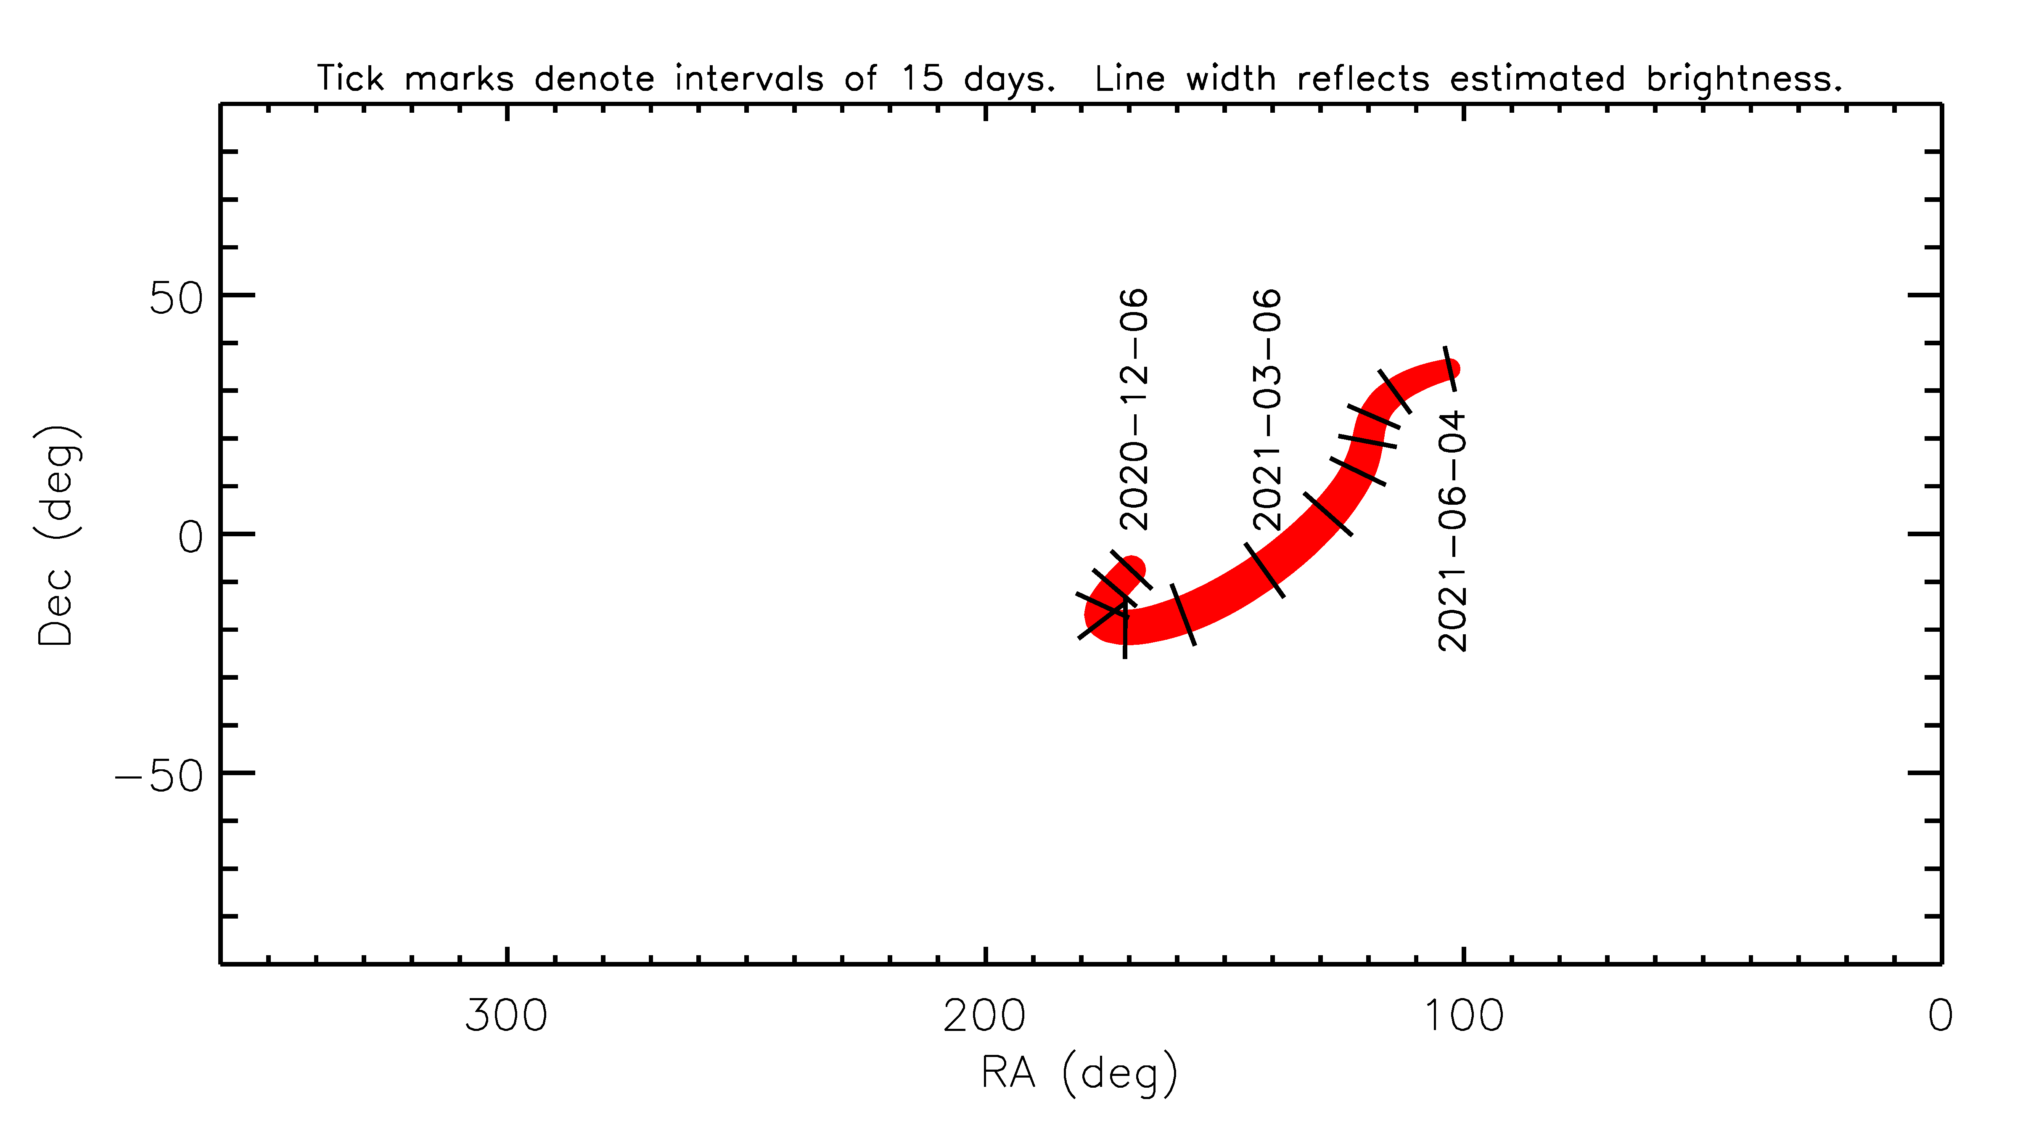
Accessible to mid-latitude observatories
Chile
MKO

