Slide 1
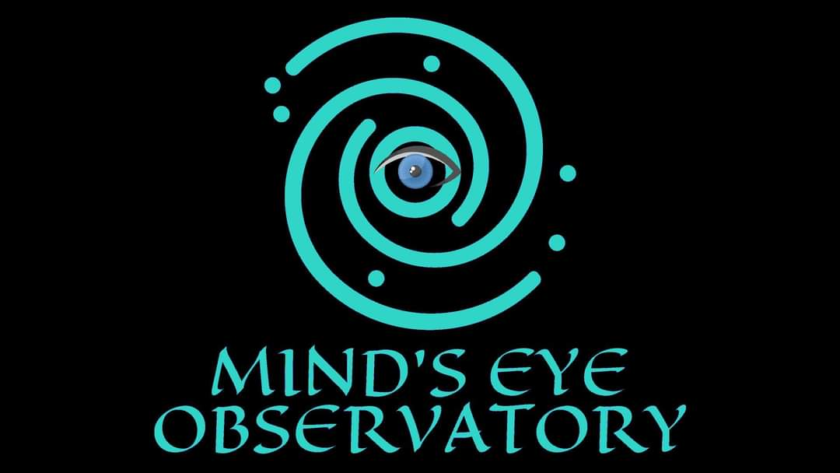

Slide 2
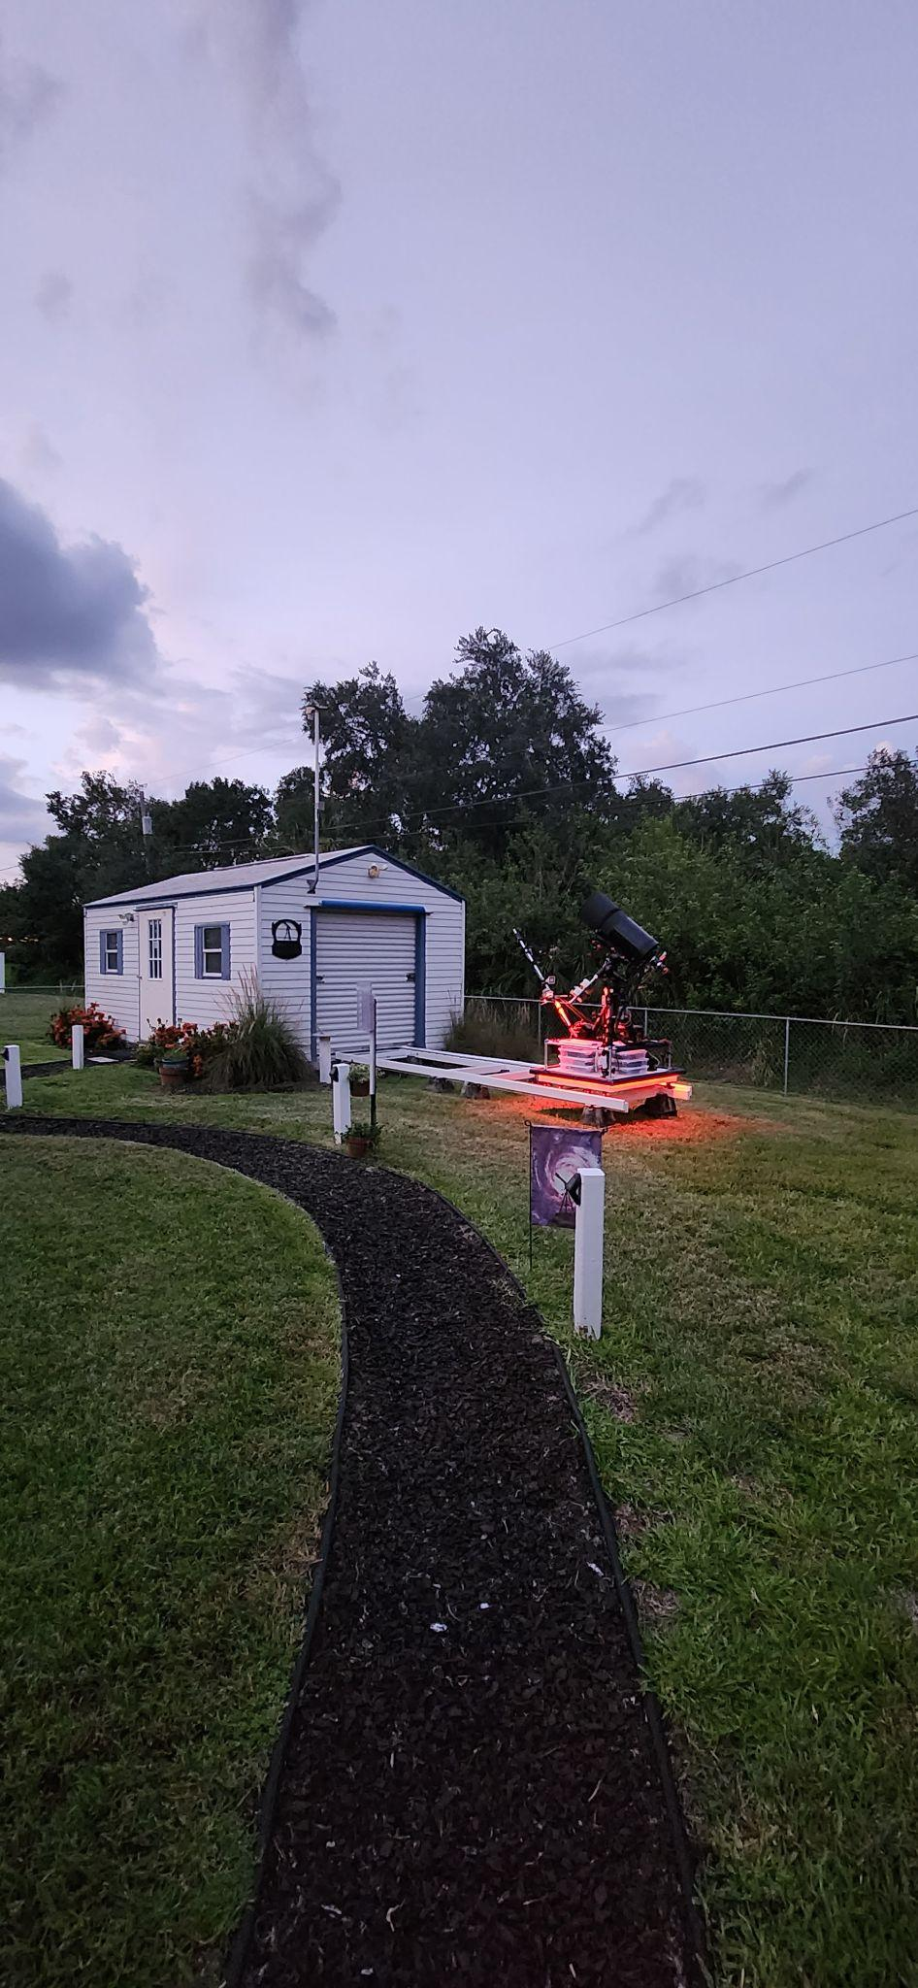
MPC (W42)
Mind's Eye Observatory (MEO) is a Private Astronomical, Satellite, and Meteorological Observatory established in 2019 and located adjacent to the St. Sebastian River Preserve in Florida, USA. We enjoy Bortle class 5 skies.
Mind's Eye Observatory Near Earth Object Survey (MEONEOS) is an independent research program that actively involves local students and is committed to sharing data, knowledge, and astronomical images, including Astrometry and Photometry. We focus on capturing scientifically rigorous images from which accurate data can be extracted and support planetary defense by tracking and reporting accurate astrometry of Near Earth Objects (NEO), which includes newly discovered objects, Potentially Hazardous Asteroids (PHA), and other minor planets.
We affectionately refer to our work as:
"Fun with Photons!"

Slide 3
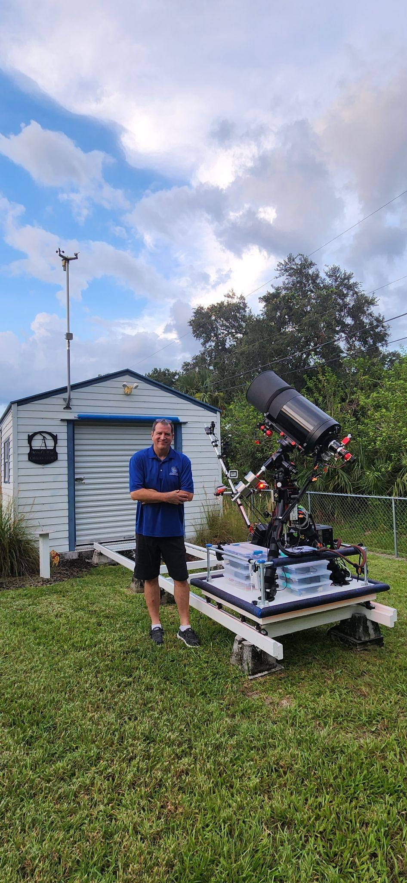
MEO’s Novel Instrument Trolley
The instrument trolley system is a very cost effective solution. It is securely housed in a stock climate-controlled building. The internal temperature is optimized to match the outside air temperature when the observatory is opened, ensuring minimal cool-down time and swift setup for observations throughout the year.
The trolley is designed to move effortlessly on a set of precision-bearing U wheels along circular tracks, facilitating repeatable polar alignment. Deployment of the trolley is a matter of seconds, and the instruments are positioned away from any heat-absorbing foundations and structures which could otherwise impact local seeing conditions for the instruments.
This approach allows for many advantages including cost effectiveness. Two additional trolleys are currently under construction, allowing for multiple instruments to be operated at once with a minimum of expense.

Slide 4
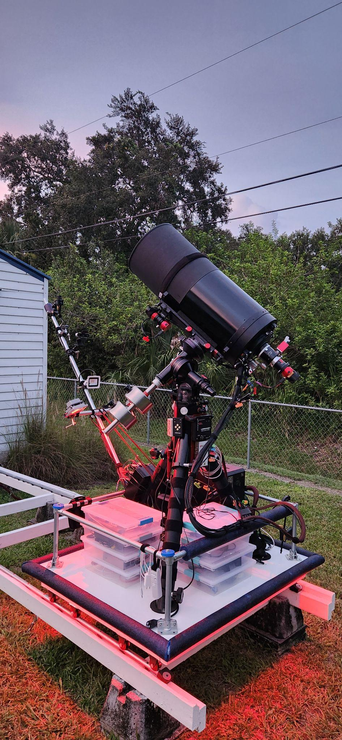
MEO’s Instruments
MEO currently employs two instruments: The primary is a modified 0.3 meter Schmidt-Cassegrain with active cooling and mirror scrubbing features, operating at F3.3 with a FOV of 0.673° . The secondary instrument is a 0.2 Schmidt-Cassegrain operating at prime focus F1.9 . Both are equipped with high Quantum Efficiency (Q.E.) cooled CMOS cameras.
The mount is a Losmandy G11 equatorial with an open-source drive system integrated for precise tracking. An autoguider is also employed.
In addition, we have a forward mast, affectionately referred to as the "selfie stick," which houses an All-sky camera and a webcam used to monitor the sky and trolley operations. There is also a GPS antenna for accurate time synchronization.
The instrument trolley and tracks are isolated from vibrations from the observatory itself.

Slide 5
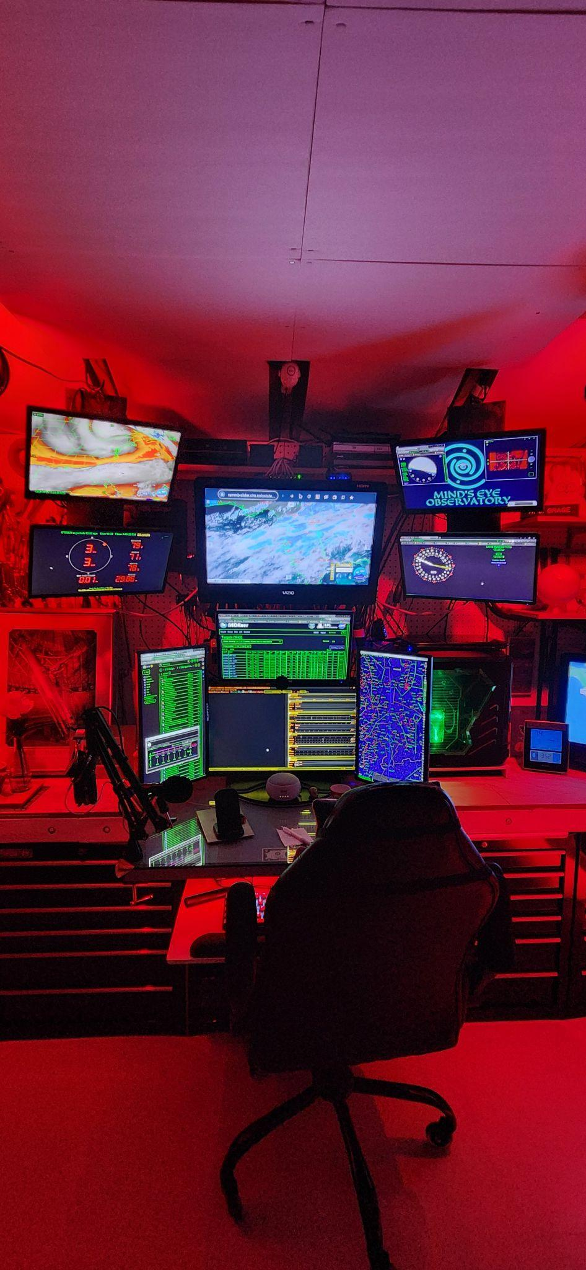
MEO’s “Cool” Room
Ensuring a comfortable observing environment is crucial for allowing concentration
on the work at hand. Climate controlled for the astronomer as well as the instruments.
Inside our facility, we have two computers located in the cool room. These computers are primarily dedicated to weather monitoring, reference information retrieval, and trolley status monitoring.
Additionally, there is another computer positioned on the trolley itself, responsible for mount control and imaging and synthetic tracking tasks.
Of course, we can't forget the most vital component of our setup - the coffee maker!

Slide 6
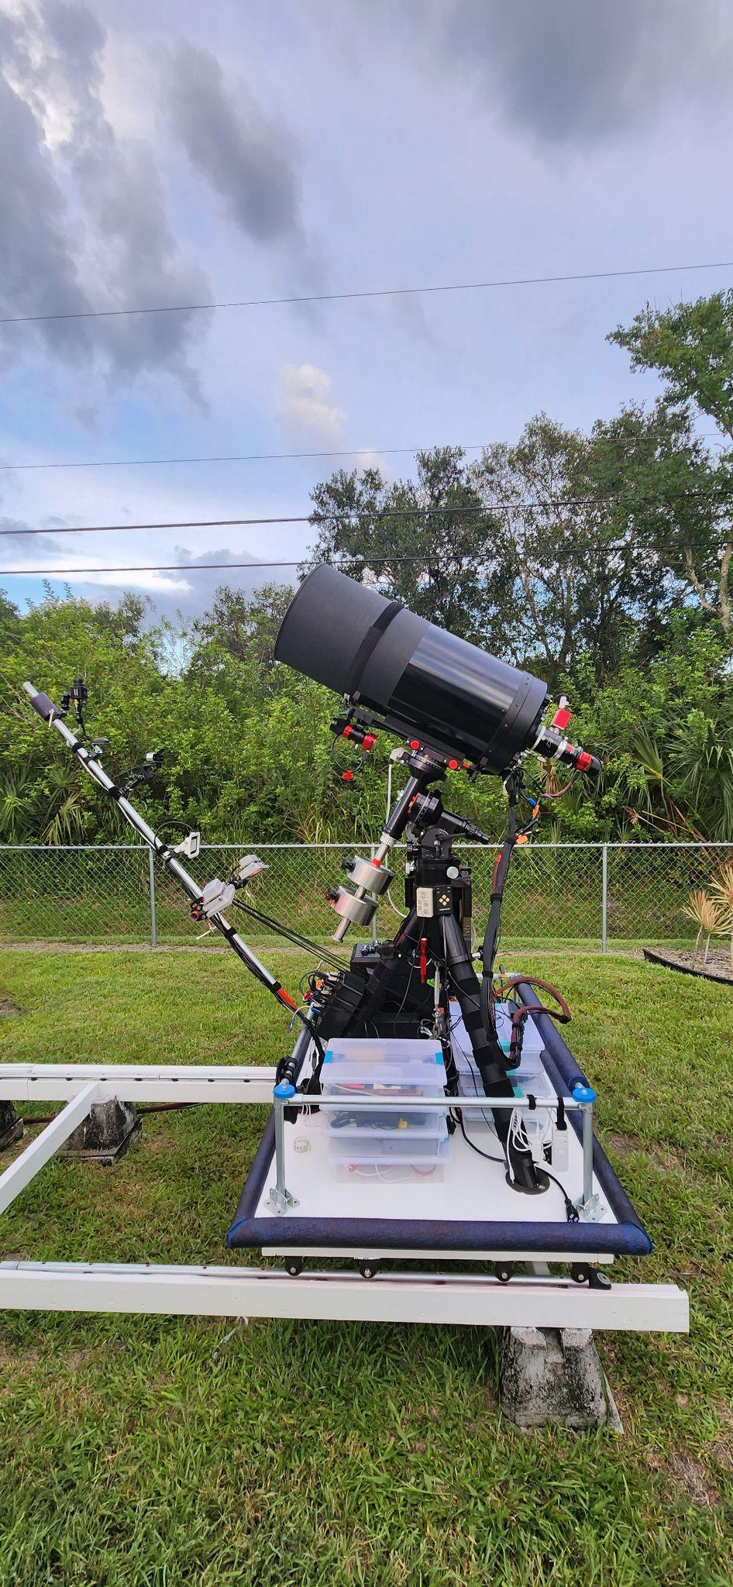
MEO’s Philosophy
MEO embarked on its journey into astrometry in response to a request from a graduate student at Embry-Riddle Aeronautical University in Daytona, Florida. The student sought assistance in satellite imaging to improve their positional awareness through simultaneous dual latitude observations. This collaboration resulted in the publication of a paper that documented the project's outcomes.
The central tenet of the project was the use of readily available off-the-shelf equipment, rather than investing in expensive custom tools. This approach enabled us to obtain the essential data required for enhancing situational awareness of Low Earth orbit satellites in a cost-effective and accessible manner.
We have continued to uphold this principle in our work, extending it to our observations of Minor planets.
Our guiding ethos is “achieve more with less” emphasizing efficiency and effectiveness in our endeavors.

Slide 7
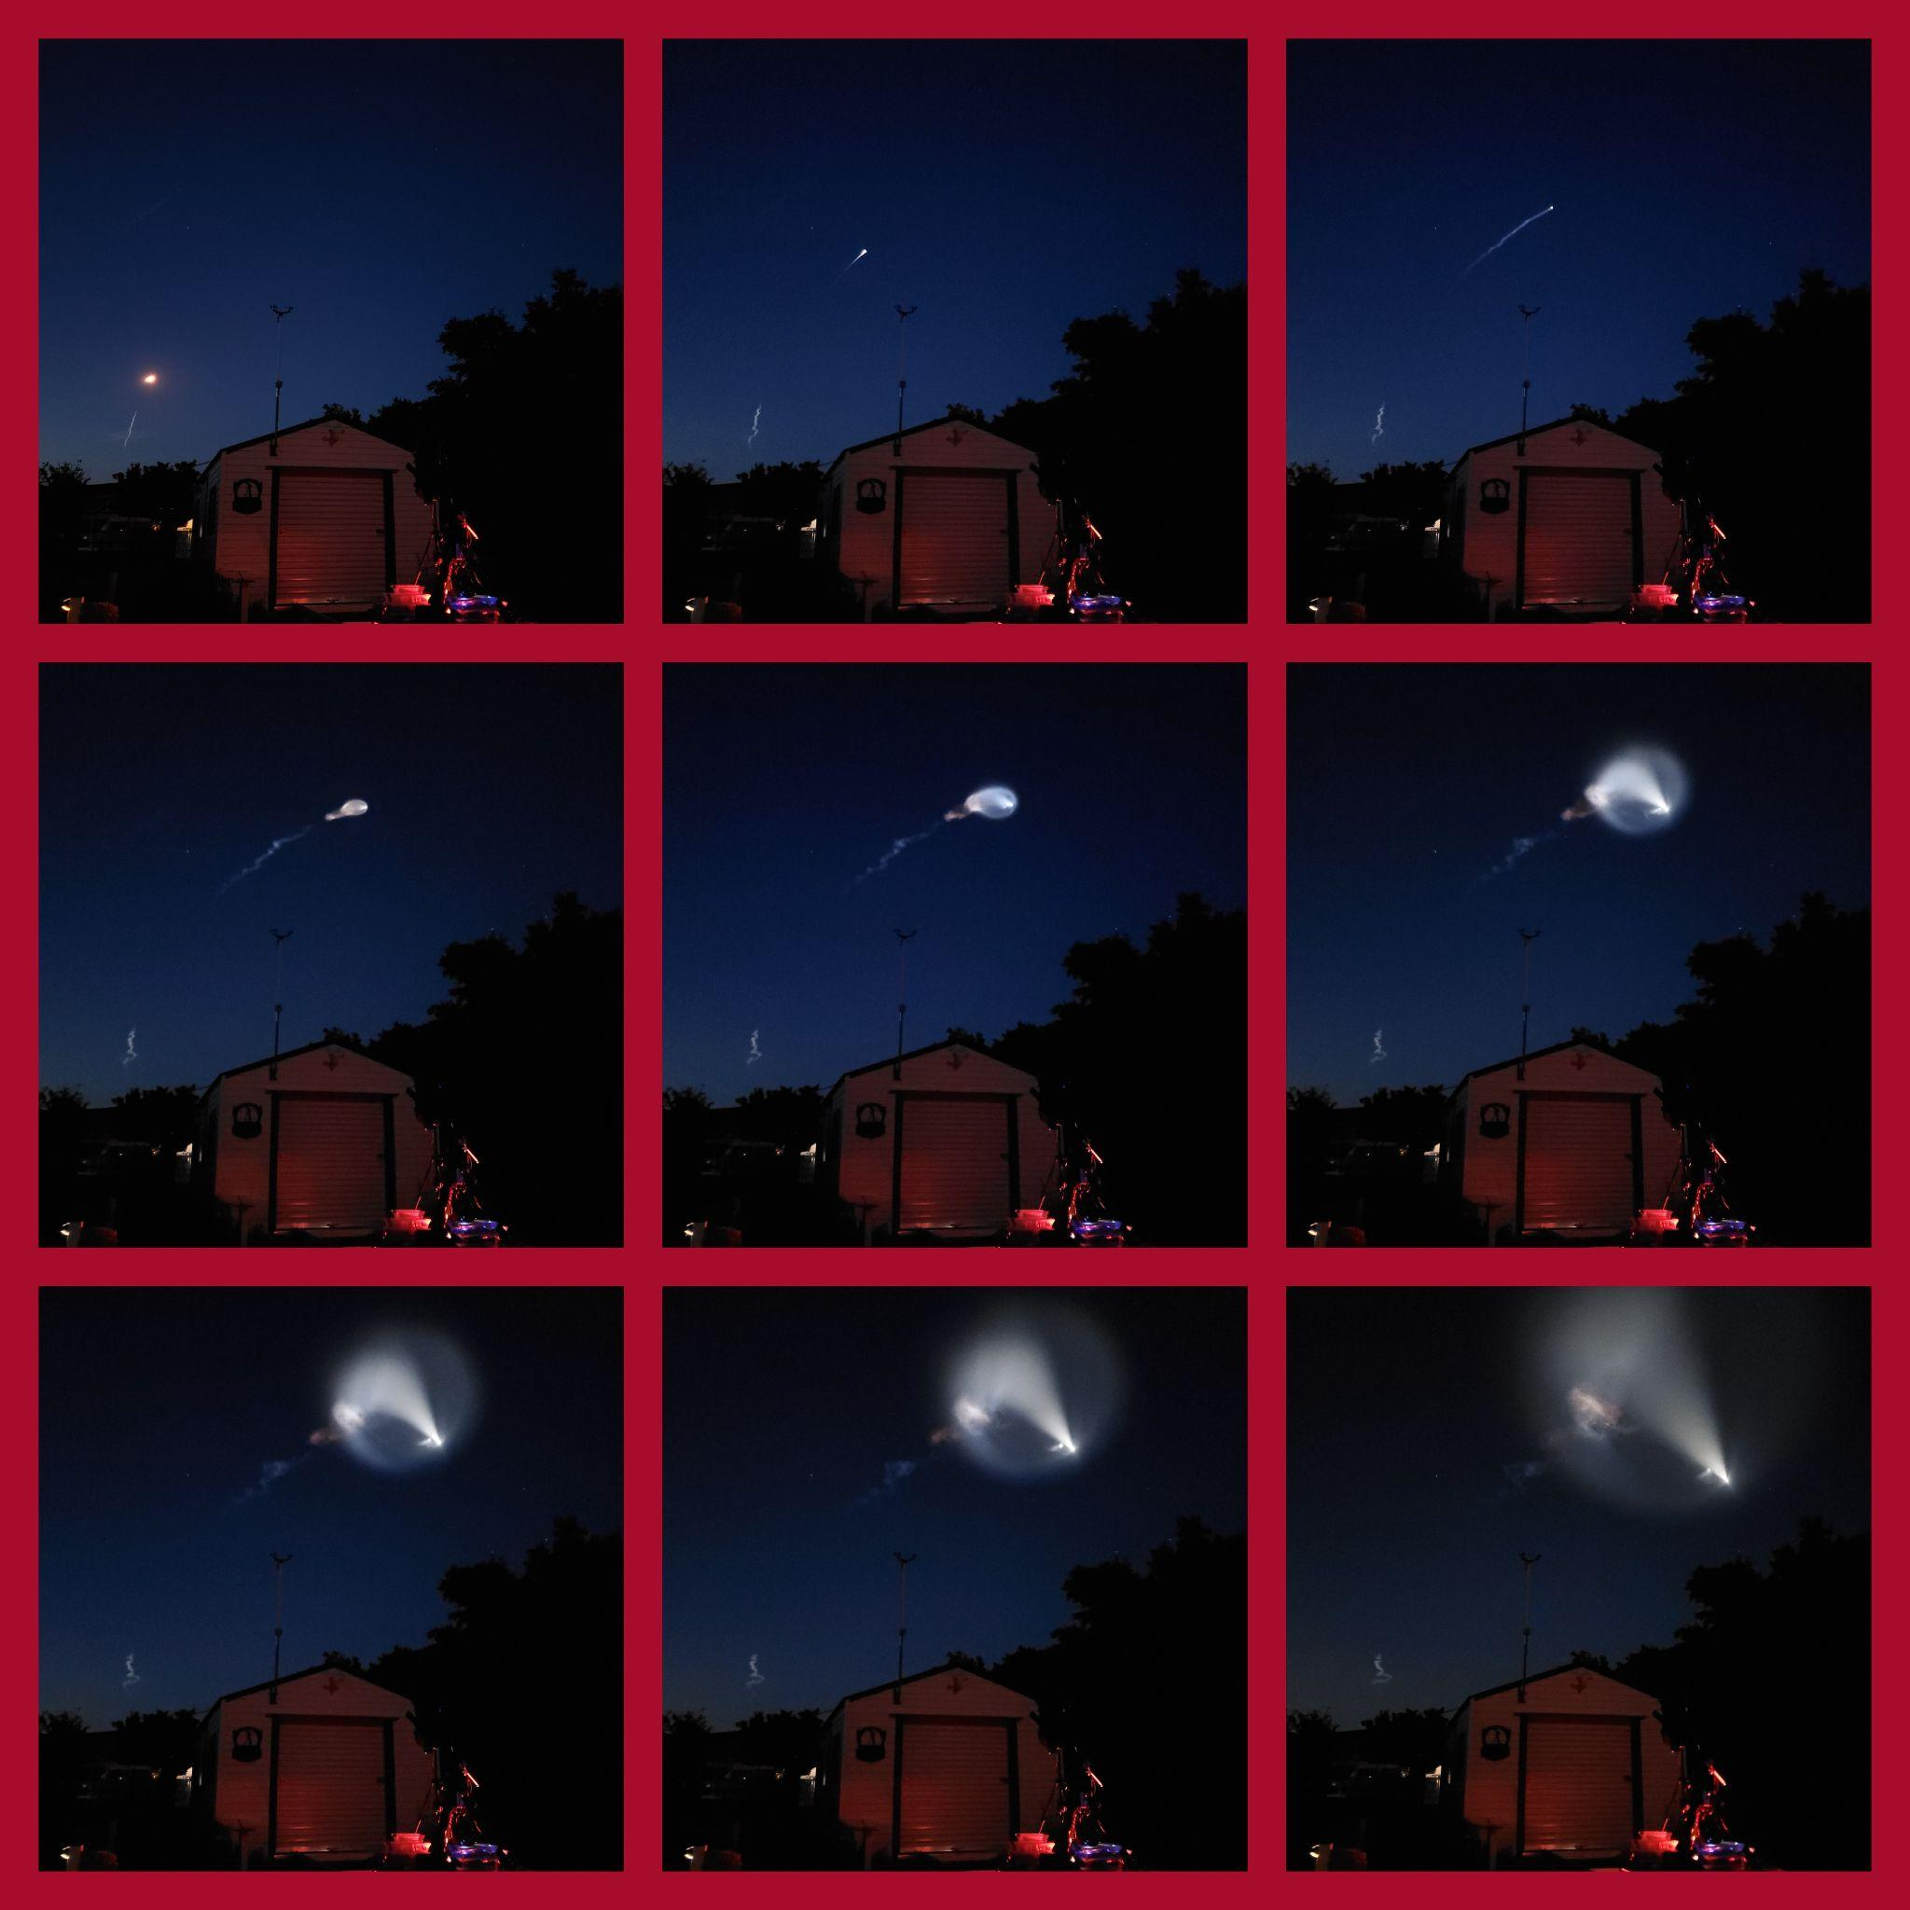
Frequent Rumbles & Booms!
MEO, located 45 miles south of the Kennedy Space Center in Cape Canaveral, Florida, enjoys a unique vantage point for observing nightly space launches and the accompanying sonic booms.
Summer weather adds additional rumbles and booms! MEO experiences its most favorable weather conditions during the winter months. Summer observing conditions are often contingent on the El Niño and La Niña cycles with a distinct wet season.
Typically, we benefit from exceptional seeing conditions, as the jet stream tends to remain well above our observatory site.

