Slide 1
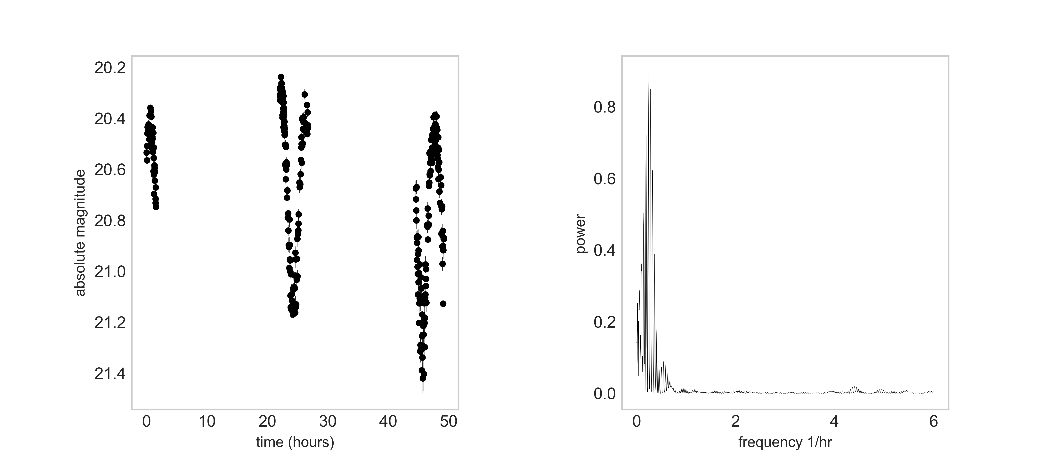
Australian Consortium for Planetary Defence (key locations / facilities below)
Capability: Doppler broadening and polarisation ratios with optical light curves and added astrometry for positional information.
The group had now become a consortium of JPL-NASA/CSIRO/UNSW/UTAS/UWA, offering a wide baseline RF and optical capability stretching from the west to East coast of Australia.
The consortium has two representatives (UWA and UNSW) joining the International Asteroid Warning Network (IAWN) (3) in 2023.
In 2022 a program of augmenting Southern Hemisphere radar observations with sub-metre-class optical apertures began. Initially with the UNSW Viper (C14 0.4m) and (0.5m) Falcon telescopes the group was joined by the University of Western Australia (UWA) providing the UWA (0.5m) Falcon Telescope and the Zadko 1m and C14 telescopes in Western Australia.

