Slide 1
Apophis Campaign(s)
Prof. Vishnu Reddy
IAWN Campaign Coordinator
Prof. Cristina Thomas
Observations Working Group Lead
IAWN Campaigns Team: Dr. Mike Kelley (NASA HQ), Dr. Gerbs Bauer (PDS-SBN/UMD), Elizabeth Warner (UMD), Dr. Tony Farnham (UMD)

Slide 2
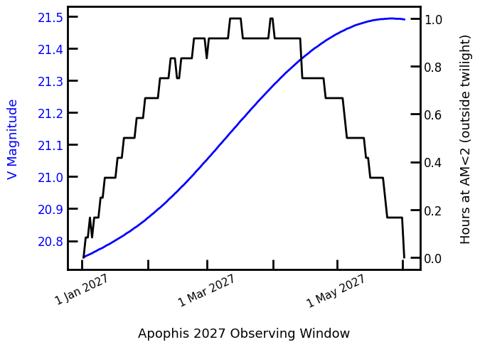
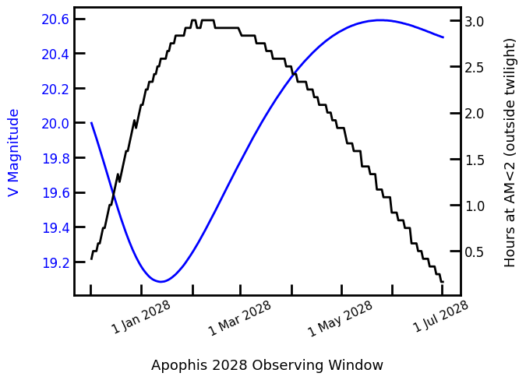
Campaign(s) Overview
Three broad opportunities to observe Apophis
2027 Apparition: 2027 February to April
2028 Apparition: 2027 December to 2028 June
2029 Apparition: 2029 January to April (Close Approach)
2027 and 2028 opportunities are restricted to large ground-based and space-based telescopes due to limiting magnitude and observing geometry. Focused science goals (lightcurves/visible spectra)
Pre-2029 Apparitions: IAWN will be coordinating these big glass/space telescopes focused observing efforts. Observers will self organize but will be supported by IAWN when they apply for telescope time. Scientific results from these efforts will be published independently by respective PIs with some coordination from IAWN.
The organizational structure for these efforts will be as follows:
NASA HQ POC: Mike Kelley
IAWN Campaign Coordinator: Vishnu Reddy
Observations Working Group Lead: Cristina Thomas

Slide 3
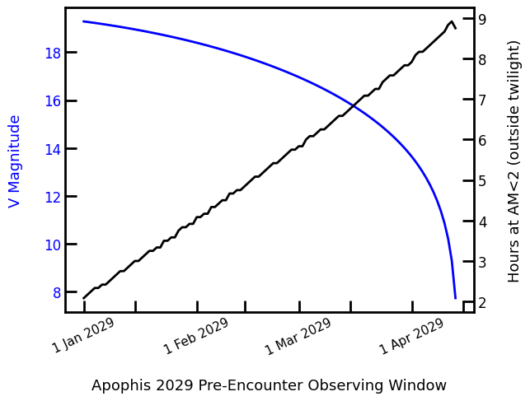
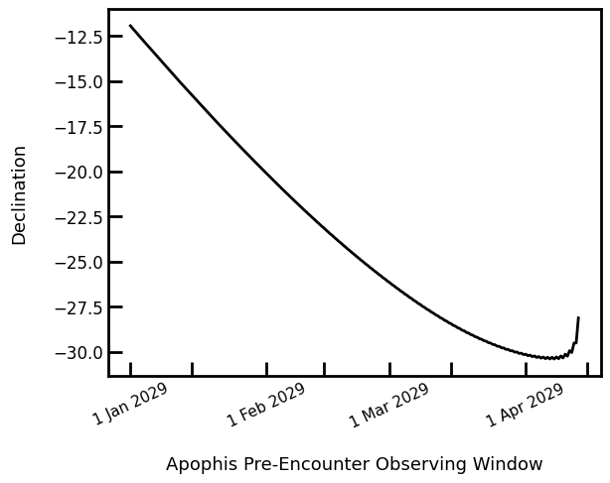
Campaign(s) Overview
2029 Close Approach will be primary focus for IAWN efforts
Exploring campaign focus options in coordination with all stakeholders.
Preliminary suggested options for IAWN 2029 campaign themes include:
Traditional IAWN campaign assuming Apophis is a newly discovered NEA. This would be similar to our 2021 campaign.
IAWN campaign focused on science with large ground-based and space-based telescopes. This would be similar to Pre-2029 apparition efforts.
IAWN campaign focused mostly on small telescopes (<1 meter aperture). Aligned towards International Year of Planetary Defense.
Other thoughts: Better coordination with PDC exercises if there is one planned around Apophis. Inputs from spacecraft rendezvous missions planned for Apophis.

Slide 4
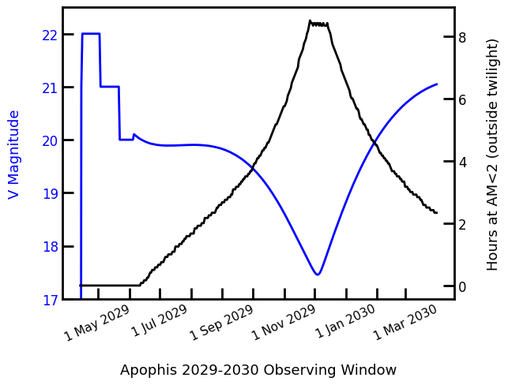
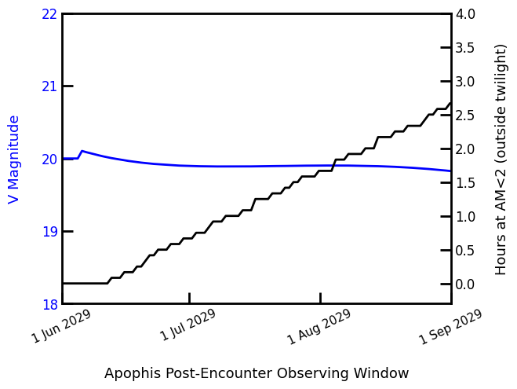
Campaign(s) Overview
2029 Close Approach will be primary focus for IAWN efforts
Exploring campaign focus options in coordination with all stakeholders.
Preliminary suggested options for IAWN 2029 campaign themes include:
Traditional IAWN campaign assuming Apophis is a newly discovered NEA. This would be similar to our 2021 campaign.
IAWN campaign focused on science with large ground-based and space-based telescopes. This would be similar to Pre-2029 apparition efforts.
IAWN campaign focused mostly on small telescopes (<1 meter aperture). Aligned towards International Year of Planetary Defense.
Other thoughts: Better coordination with PDC exercises if there is one planned around Apophis. Inputs from spacecraft rendezvous missions planned for Apophis.

