Slide 1




Small Bodies Node MPC Annex Update
https://sbnmpc.astro.umd.edu/
James (Gerbs) Bauer

Slide 2
MPCDB cloud distribution is fully operational
It uses AWS and Aurora failover capabilities.
No client intervention needed. Elastic 2 Server on front-end, so stable ipn.
Responds within failover time requirements.
Clients are voluntarily moving over the next several weeks. Those that do not will need to re-subscribe from scratch through the cloud service.
MPCDB open query tool prototyped and being tested by MUG members.

Slide 3
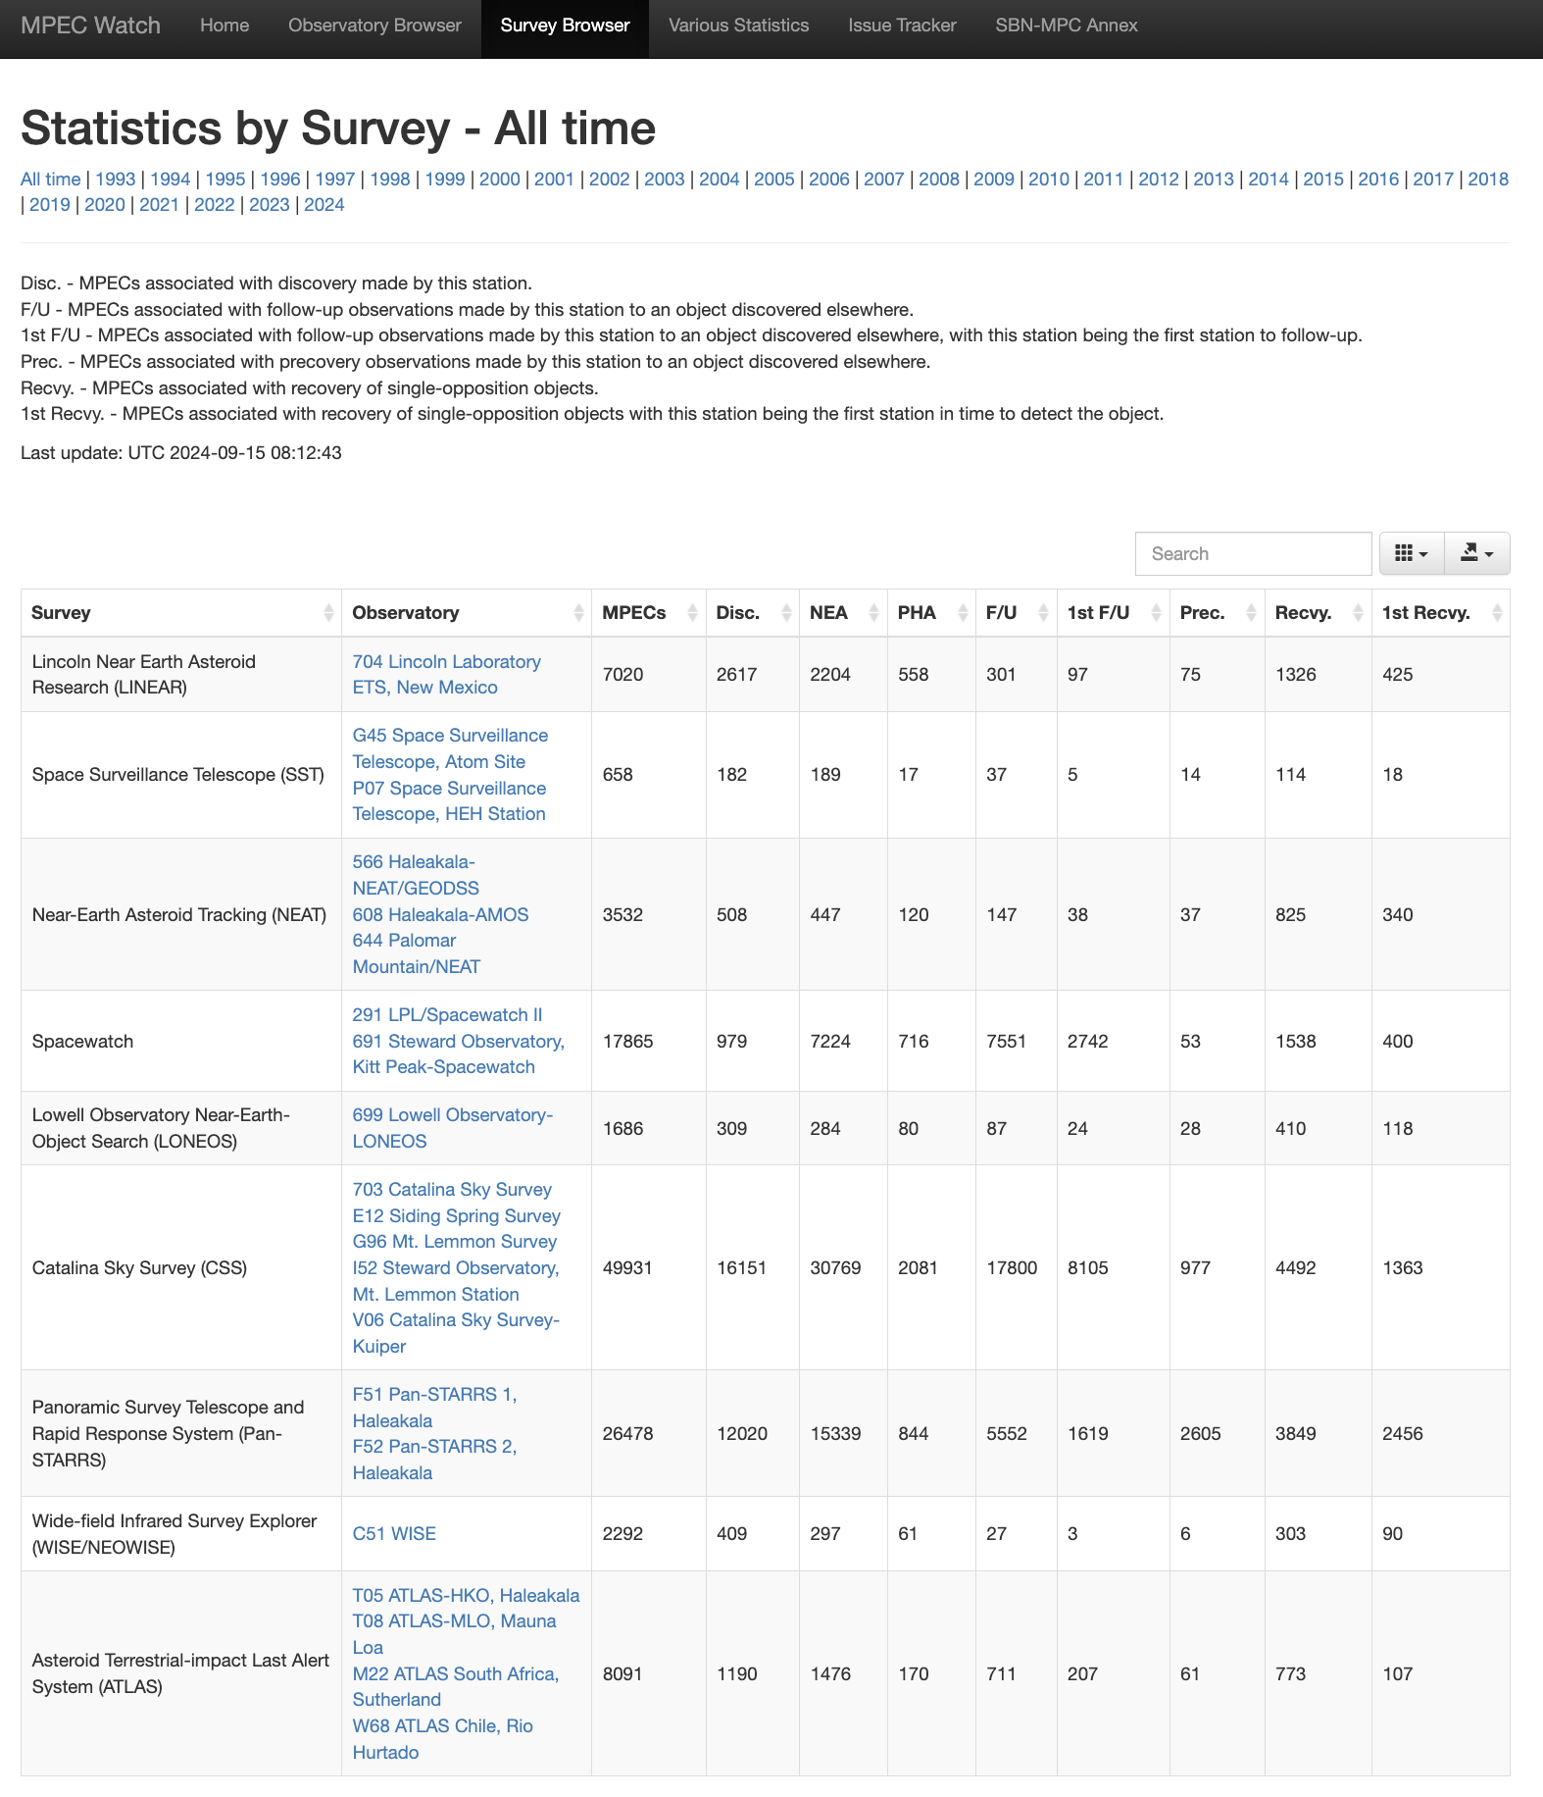
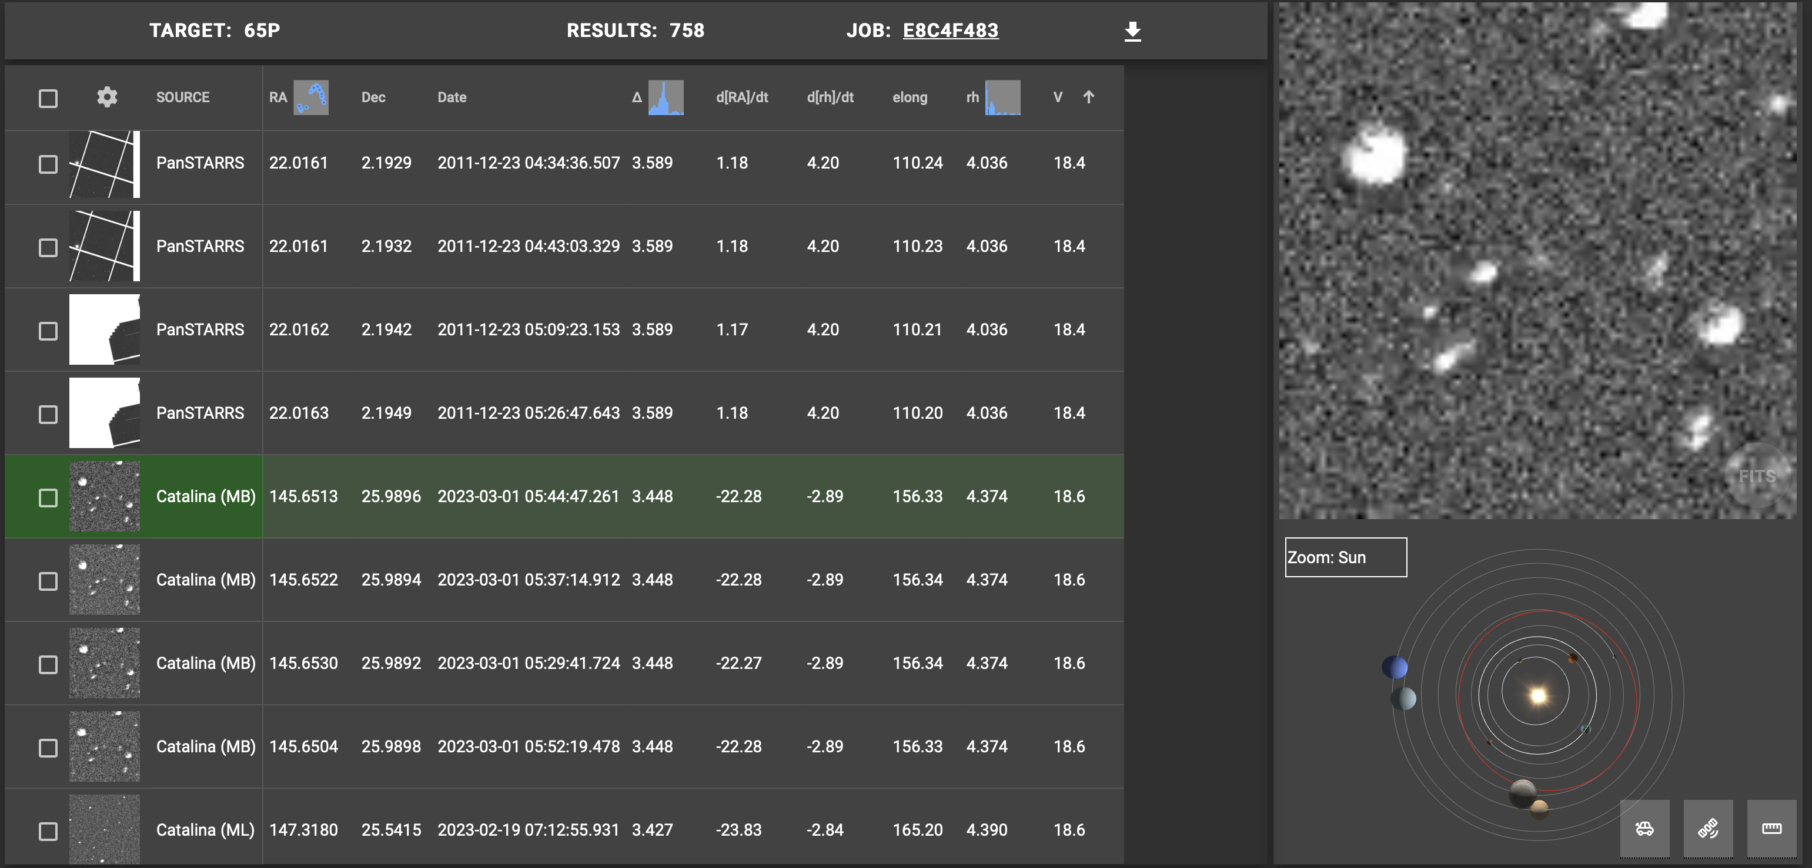
New and Near-Term
MPECWatch Survey Summary
Several CATCH improvements in the works, including Fixed Target (e.g. background stars) Cone searches, Catalog Star labels, final implementation of CSS/SW cutout servers, and orbit display for objects and observed positions along orbit.
Comet Discovery and Observations Statistics Pages are also being updated.

