Slide 1
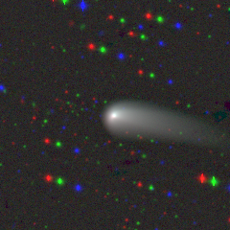
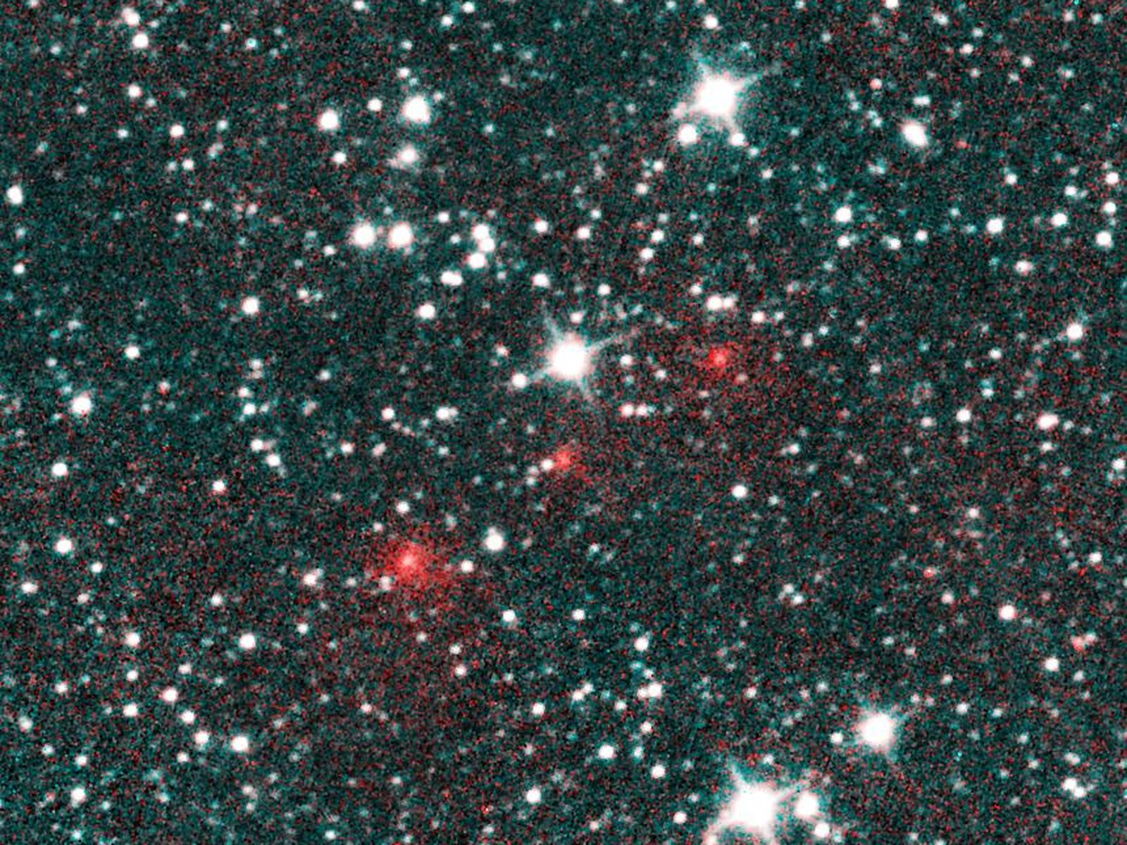
IAWN Comet Campaign
“Typical” Short-period comet
“Typical” Long-period comet
67P near 2021 perihelion, CSS from CATCH
C/2020 F3 NEOWISE discovery image
Comets are a challenge for astrometry, so we are planning an IAWN campaign:
At IAWN Fall 2024 meeting, introduced the problems with comet astrometry.
In the Summer, we will hold a workshop to discuss methods to improve comet astrometry, and announce the target.
In the Fall of 2025, we plan to conduct an observing campaign of a comet (TBA).

