Slide 1
SMPAG – The Space Mission Planning Advisory Group
Status Oct 2025
D. Koschny, SMPAG Chair on behalf of ESA
IAWN meeting, Oct 2025

Slide 2
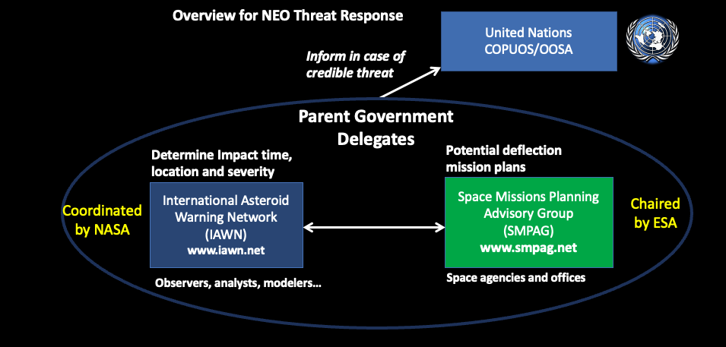
Reminder – Context

Slide 3
Reminder – Context
Criteria for SMPAG:
Within 50 years
Impact probability > 1 %
Size > 50 m

Slide 4
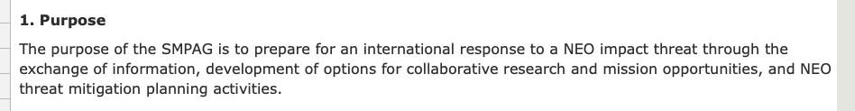

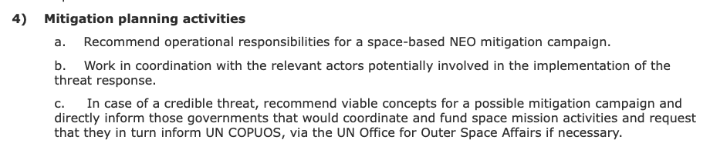
Relevant tasks of SMPAG
From the terms of reference (available at https://www.smpag.net):
….
….
Note: Interface to emergency response agencies is task of IAWN. SMPAG will just inform about their activities.

Slide 5
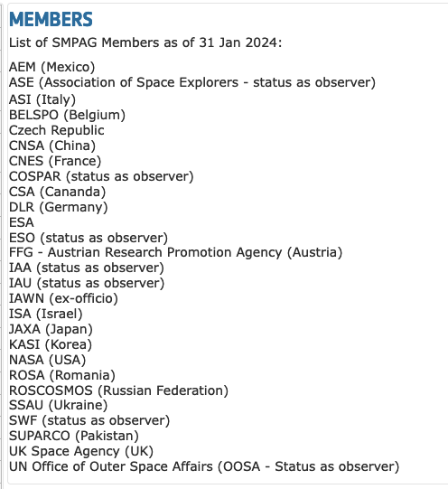
Members
Spain: applied for membership

Slide 6
Current activities include
Regular meetings twice per year – in Jan/Feb linked to UN COPUOS Scientific and Technical Subcommittee meetings
Next meeting: In a week from now, virtual
Exercise – participation in PDC 2025 exercise on a simulated asteroid impact threat
We had regular teleconferences once per week
Paper on lessons learned was submitted
To be continued
Considered 2024 YR4
UN COPUOS = United Nations Committee on the Peaceful Uses of Outer Space

Slide 7
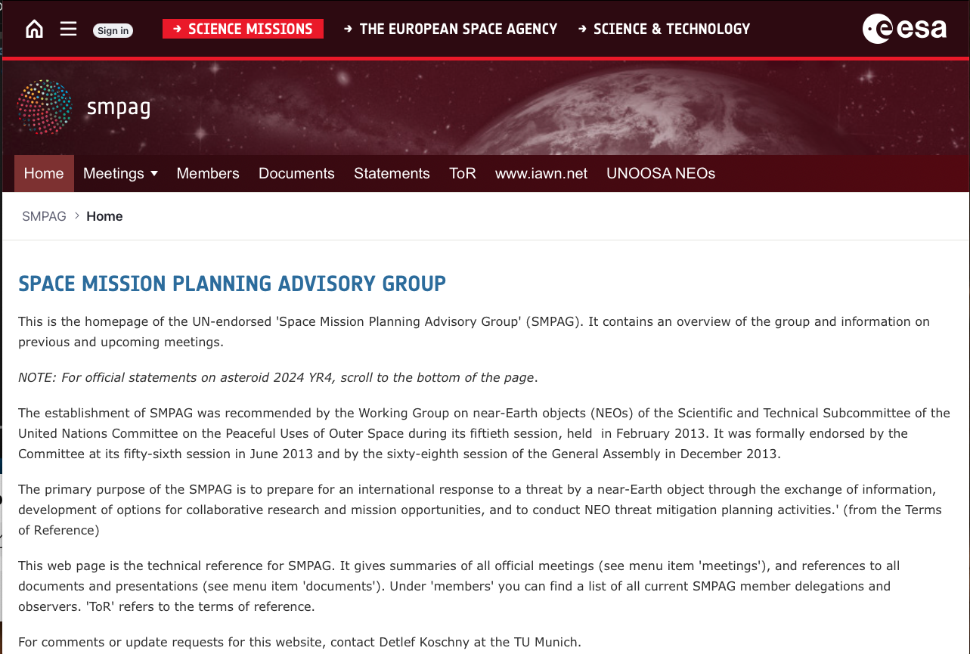
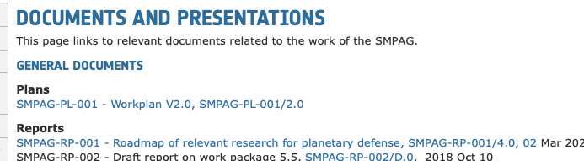
More info at http://smpag.net
In particular, see this menu item =>

