Slide 1
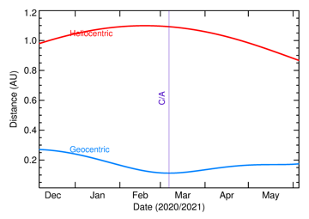
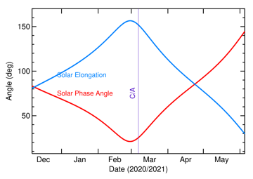
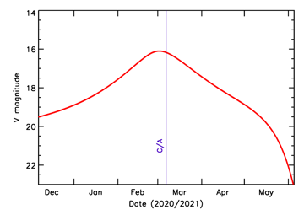
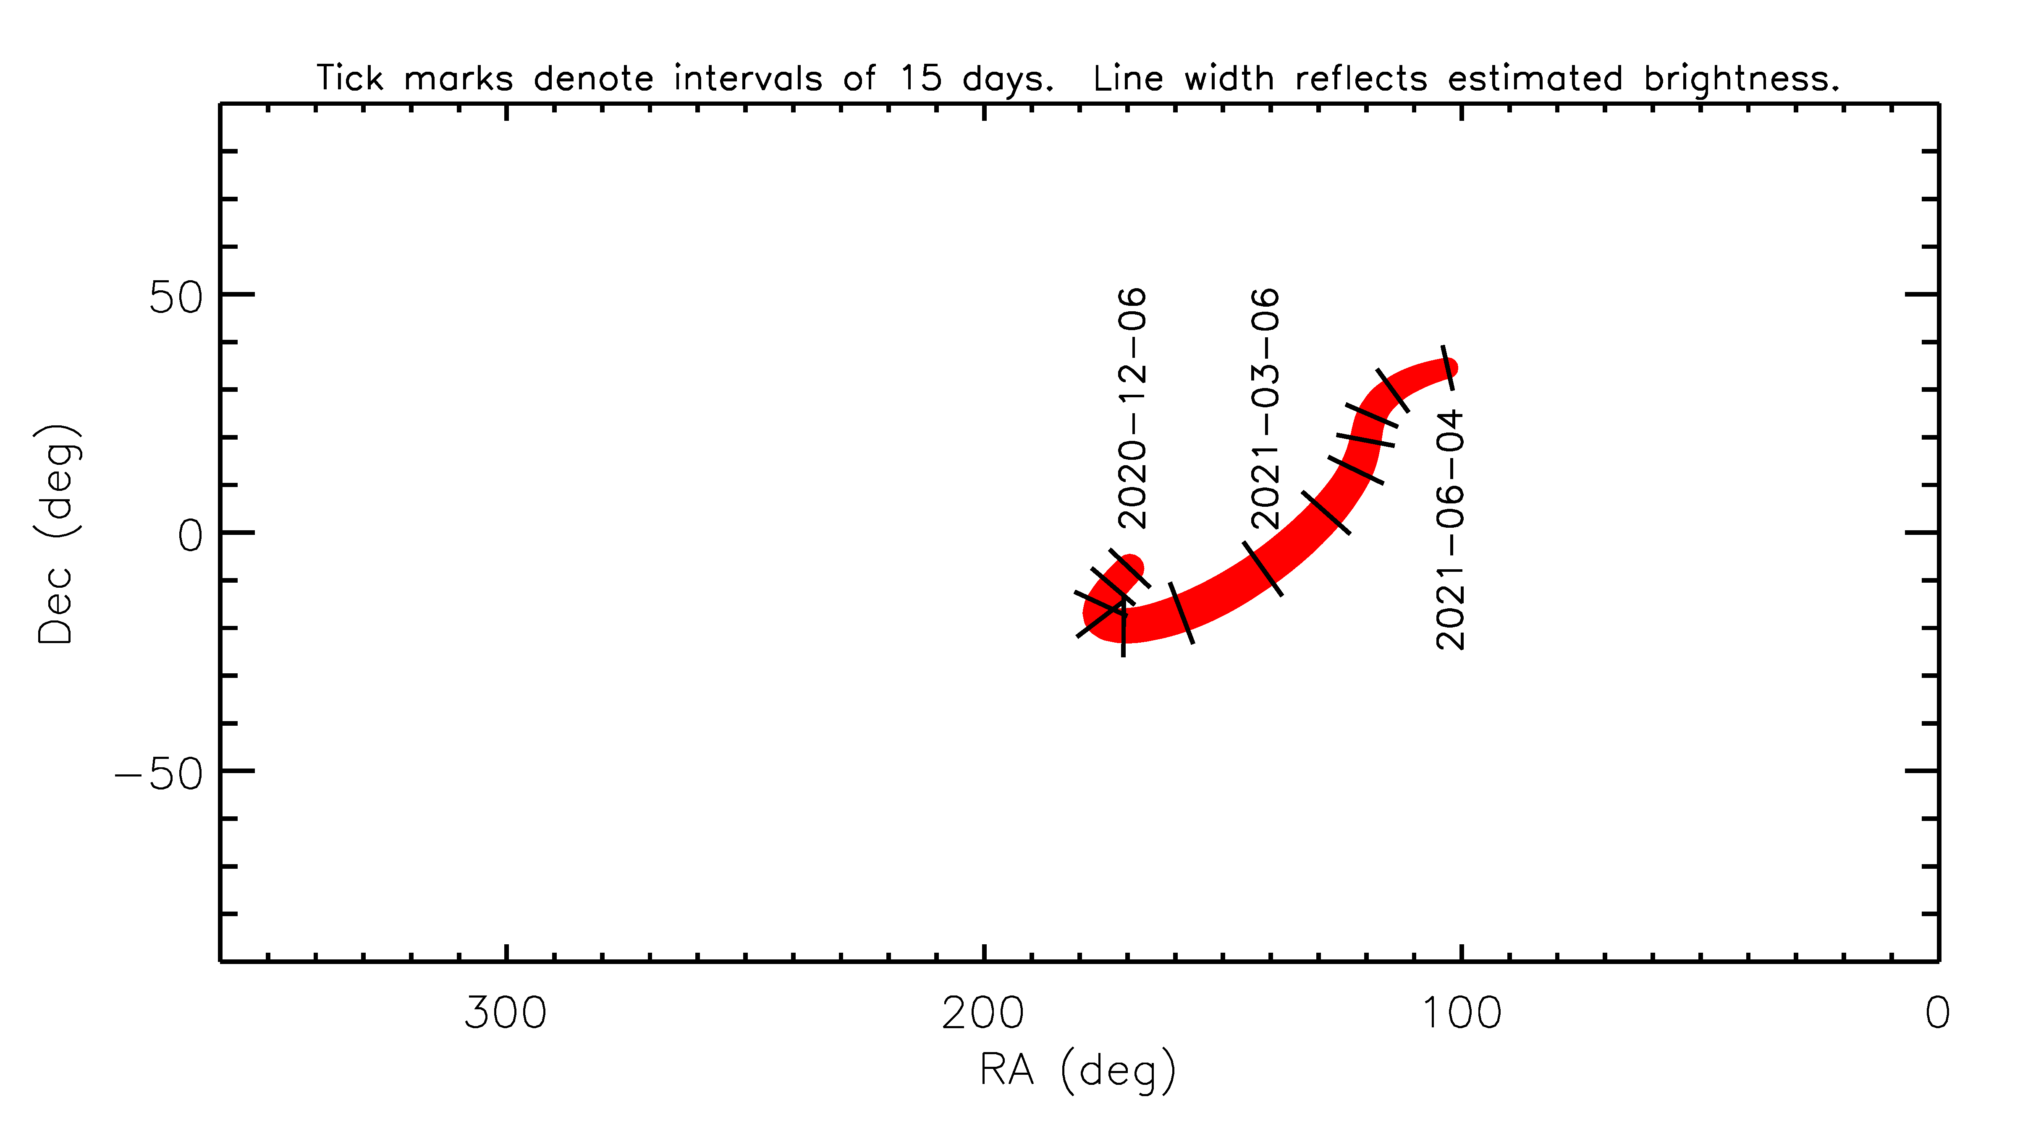
Apophis 2021: IAWN Planetary Defense Campaign
Has a close flyby of the Earth in March 06 2021 (CA dist ~0.11 AU).
Makes for an iconic target for global planetary defense exercise.
More details: http://iawn.net/obscamp/Apophis/
Campaign Coordinator: Vishnu Reddy
Accessible to mid-latitude observatories
From Hawaii
From Chile
Plots courtesy of T. Farnham

