Slide 1
International Asteroid Warning Network (IAWN): Brief Summary & Status of the Current Worldwide NEO Survey Effort
UNCOPUOS STSC Open Forum
18 February 2016
Vienna, Austria
Rob Landis
Planetary Science Division
NASA Headquarters

Slide 2

Origins of the NEO Issue (in the U.N.)
UNISPACE III (1999)
To improve the scientific knowledge of near and outer space by promoting coopertive activities in such areas as astronomy, space biology and medicine, space physics, the study of near-Earth objects (NEOs) and planetary exploration;
To improve the int’l coordination of activities related to near-Earth objects, harmonizing the efforts directed at identification, follow-up observations and orbit prediction, while at the same time giving consideration to developing a common strategy that would include future activities related to NEOs.
Action Team 14 (AT-14) established (2001); followed by terms of reference (2002)

Slide 3
Origins of the NEO Issue (in the U.N.) [con’t]
Mandate
Review the content, structure and organization of ongoing efforts in the field of NEOs;
Identify any gaps in the ongoing work where additional coordination is required and/or where other countries or organizations could make contributions;
Propose steps for the improvement of int’l coordination in collaboration with specialized bodies.
Open-ended membership: including intergovern-mental, governmental and non-governmental space-related institutions

Slide 4
AT-14, STSC, COPUOS, UN General Assembly
AT-14: Technical body, open-ended; composed of government and non-government experts (27 members; entities)
Works inter-sessionally
NEO Working Group established
– Prepared interim and final reports for STSC
STSC: considers NEOs; agenda item (74 Member States; Dec. 2013)
COPUOS considers report on NEOs of STSC and sets new mandate
Set multi-year work plans for STSC (2009 – 2011, 2012 - 2013)
The General Assembly endorses COPUOS report; sets new mandates for COPUOS, STSC and LSC (193 MS)

Slide 5
Recommendations – Int’l Response to NEO Impact Threat
Three overarching recommendations:
An International Asteroid Warning Network (IAWN) should be established
A Space Mission Planning Advisory Group (SMPAG) should be established
Framework, timeline and options for initiating & executing response activities);
An Impact Disaster Planning Advisory Group (IDPAG) should be established [not accepted by the working group on NEOs]
Inform the civil defense community of nature of impact disasters and incorporate that community into overall mitigation planning process

Slide 6
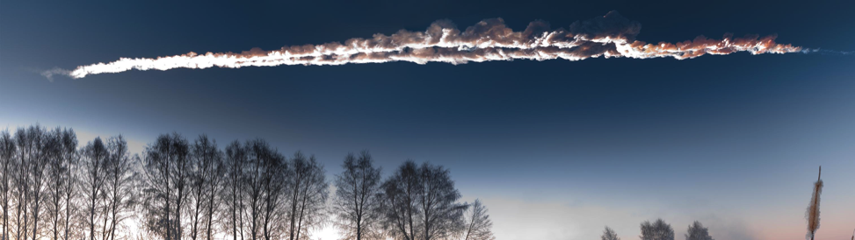
International Asteroid Warning Network
IAWN is established (2013) to create an international group of organizations involved in detecting, tracking, and characterizing NEOs. The IAWN is tasked with developing a strategy using well-defined communication plans and protocols to assist Governments in the analysis of asteroid impact consequences and in the planning of mitigation responses.

Slide 7
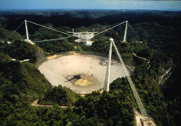
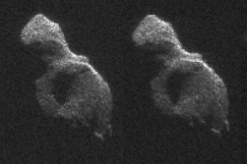
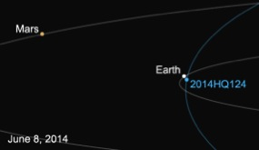
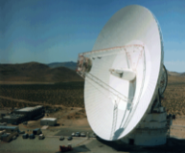
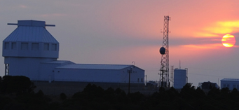




IAWN Charter
The international asteroid warning network (IAWN), open to contributions by a wide spectrum of organizations . . . be established by linking together the institutions that were already performing, to the extent possible, the proposed functions, including discovering, monitoring and physically characterizing the potentially hazardous NEO population and maintaining an internationally recognized clearing house for the receipt, acknowledgment and processing of all NEO observations … recommend criteria and thresholds for notification of an emerging impact threat.
Notes:
The international asteroid warning network (IAWN), open to contributions by a wide spectrum of organizations, should be established by linking together the institutions that were already performing, to the extent possible, the proposed functions, including discovering, monitoring and physically characterizing the potentially hazardous NEO population and maintaining an internationally recognized clearing house for the receipt, acknowledgment and processing of all NEO observations. Such a network would also recommend criteria and thresholds for notification of an emerging impact threat.

Slide 8
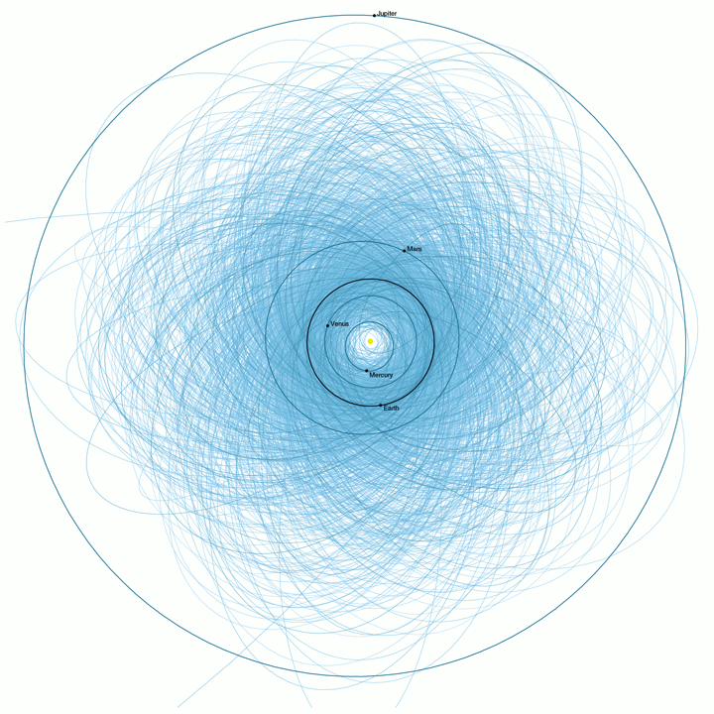
IAWN Functions
(a) To discover, monitor, and physically characterize the potentially hazardous NEO population using optical and radar facilities and other assets based in both the northern and southern hemispheres and in space;
(b) To provide and maintain an internationally recognized clearing house function for the receipt, acknowledgement and processing of all NEO observations;
(c) To act as a global portal, serving as the international focal point for accurate and validated information on the NEO population;
(d) To coordinate campaigns for the observation of potentially hazardous objects;
(e) To recommend policies regarding criteria and thresholds for notification of an emerging impact threat;
(f) To develop a database of potential impact consequences, depending on geography, geology, population distribution and other related factors;
(g) To assess hazard analysis results and communicate them to entities that should be identified by Member States as being responsible for the receipt of notification of an impact threat in accordance with established policies;
(h) To assist Governments in the analysis of impact consequences and in the planning of mitigation responses.

Slide 9
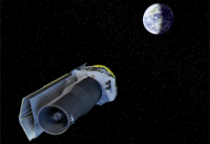
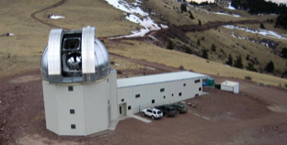
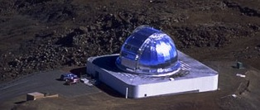
IAWN Steering Committee
Steering Committee Membership
Sergio Camacho (UNCOPUOS)
Lindley Johnson (NASA Hq)
Boris Shustov (INASAN)
Giovanni Valsecchi (INAF-IAPS/NEODyS)
Patrick Michel (Observatoire de la Côte d'Azur)
Alan Harris (DLR)
Detlef Koschny (ESA/ESTEC)
Paul Chodas (JPL)
Three (3) Steering Committee Meetings to Date

Slide 10

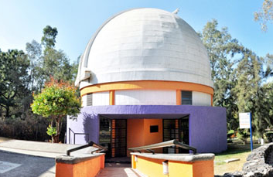
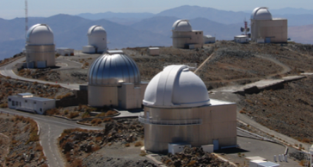



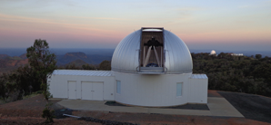
Signatories to IAWN
European Southern Observatory
(ESO)
National Institute of
Astrophysics, Optics & Electronics
Peter Birtwhistle (amateur follow-up observer, United Kingdom)
Korean Astronomy Space Science Institute (KASI)
and, NASA

Slide 11

NASA’s Planetary Defense Coordination Office
This new office was recently established at NASA HQ to coordinate planetary defense-related activities across NASA as well as coordinate both U.S. interagency and international efforts and projects to address and plan response to the asteroid impact hazard. In so doing, the Planetary Defense Coordination Office dovetails with the needs, goals, and objectives of IAWN.
Mission Statement:
To lead national and international efforts to:
Detect any potential for significant impact of planet Earth by natural objects
Appraise the range of potential effects by any possible impact
Develop strategies to mitigate impact effects on human welfare
Hic Servare Diem
… vos sunt grata

Slide 12
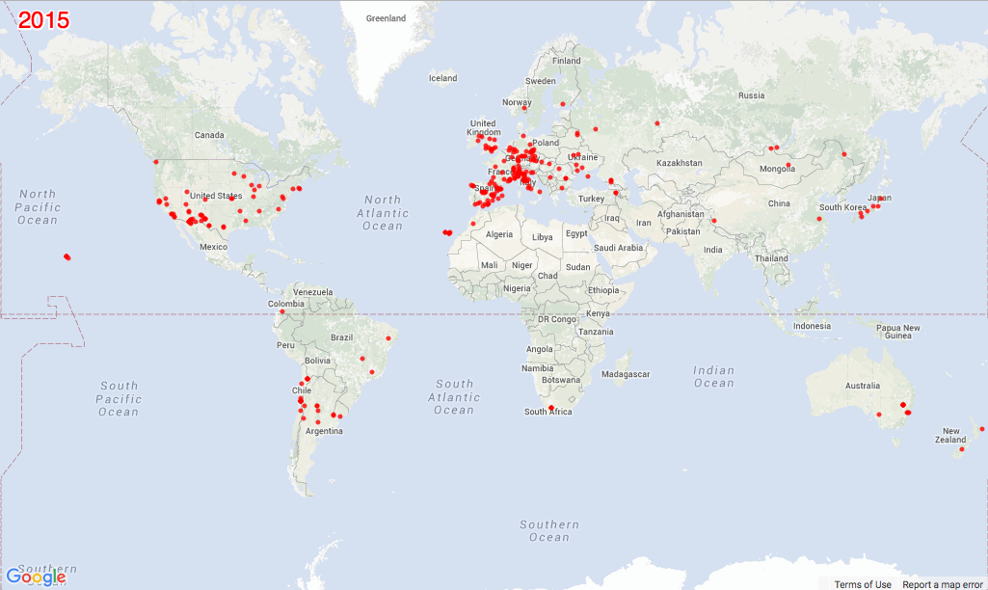
Worldwide Observing Network
Received ~20.6 Million Observations from 39 countries in 2015
(and one in space!)

