Slide 1
IAWN Rapid Characterization Campaign: 2023 DZ2
Vishnu Reddy (IAWN Campaign Coordinator)
Michael Kelley (NASA PDCO)
Davide Farnocchia (JPL CNEOS)
Gerbs Baur, Elizabeth Warner, Tony Farhnam (UMD/NASA PDS SBN)

Slide 2
Overview
On March 16, 2023, the Minor Planet Center announced the discovery of near-Earth asteroid 2023 DZ2 by joint Romanian-Spanish team Para-SOL (MPC Code 950).
Observers: O. Vaduvescu, F. Barwell, K. Jhass, M. Popescu, C. de la Fuente Marcos, R. de la Fuente Marcos. Measurers C. Boldea, D. Bertesteanu, O. Vaduvescu, M. Popescu, M. Stanescu, M. Predatu, L. Curelaru.
The asteroid is headed for a close approach within half the lunar distance from the Earth on March 25, 2023. Based on its absolute magnitude H=23.7, the expected size of 2023 DZ2 is in the range 50 m to 110 m.

Slide 3
Overview
This close approach represents an ideal opportunity for an IAWN rapid response characterization campaign - an IAWN campaign to exercise the capability of the planetary defense community to collect observations and physically characterize the object on a very short notice.
Characterization: Size, Shape, Albedo, Composition, Rotation Period, binary nature.
Observing Window: Monday March 20, 2023, at 13:00 UTC and ends on Monday March 27, 2023, at 13:00 UTC. Characterization data collected only during this window will be used for the campaign.

Slide 4
Logistics
There will be three telecons during this limited observing window to discuss the results of the campaign as they become available.
The first kickoff teleconference will be held on Tuesday March 21, 2023, at 1300 UTC. The second teleconference will be held on Thursday March 23, 2023, at 1300 UTC and the final closeout teleconference will be held on Monday March 27, 2023, at 1300 UTC. Teleconferences will be for 1-hour duration.
Volunteer working group leads will coordinate various results for dissemination during telecons. Tentative List of WGs: Photometry, Spectroscopy, Thermal Modeling, Radar.
Working Group Leads: Please email your reduced observations to WG leads
Photometry: Tyler Linder (tlinder34@gmail.com)/Nick Erasmus(nerasmus@saao.ac.za)
Spectroscopy: Cristina Thomas (Cristina.Thomas@nau.edu)
Thermal Modeling: Joe Masiero (jmasiero@ipac.Caltech.edu)
Radar: Lance Benner (lance.benner@jpl.nasa.gov)

Slide 5
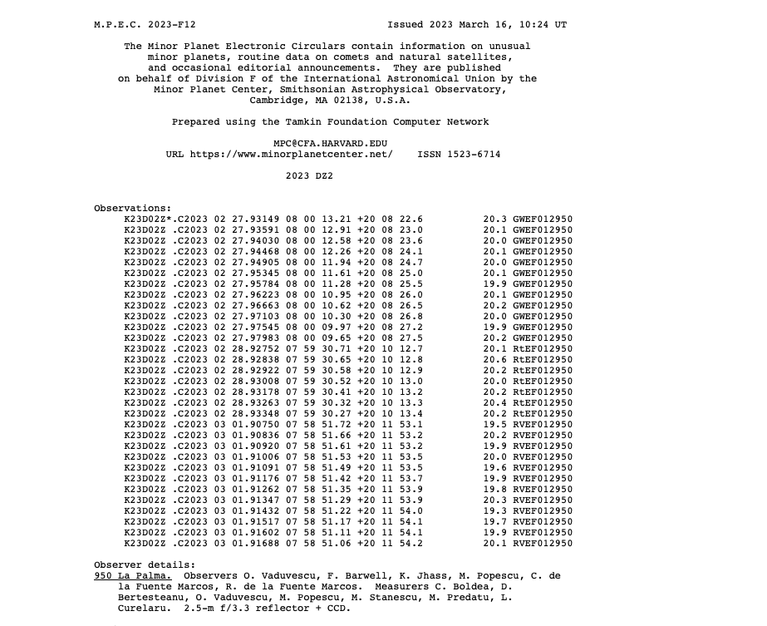

Slide 6
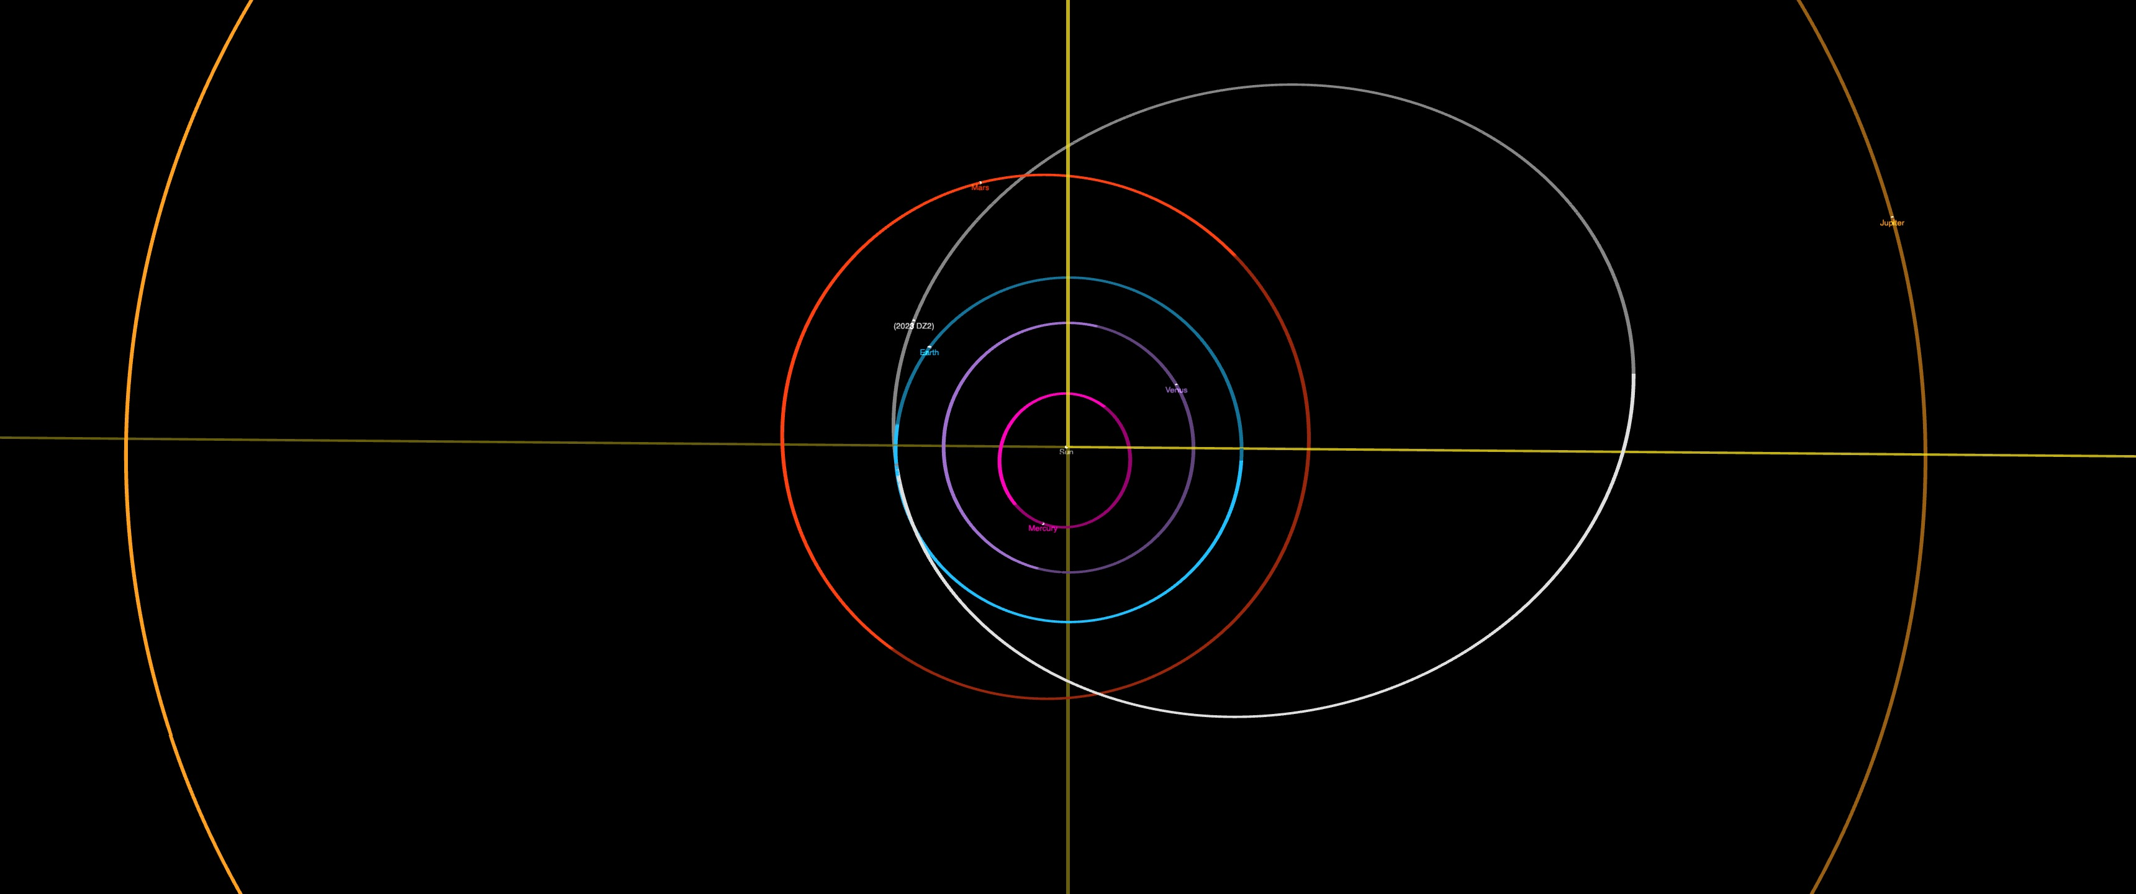
2023 DZ2
q = 0.99 au
e = 0.54
a =2.16 au
i = 0.08°
P =3.16 yr

Slide 7
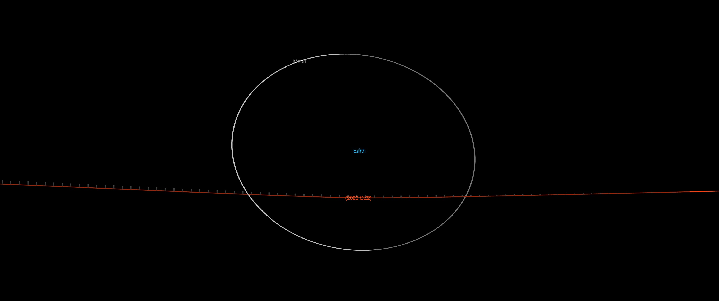
0.45 LD
2023 Mar 25 19:50 UTC
7.8 km/s
H = 23.98
40 m – 100 m
Once per decade close approach

Slide 8
CSS and PS precoveries

Slide 9
Torino Scale = 1
CSS and PS precoveries

Slide 10
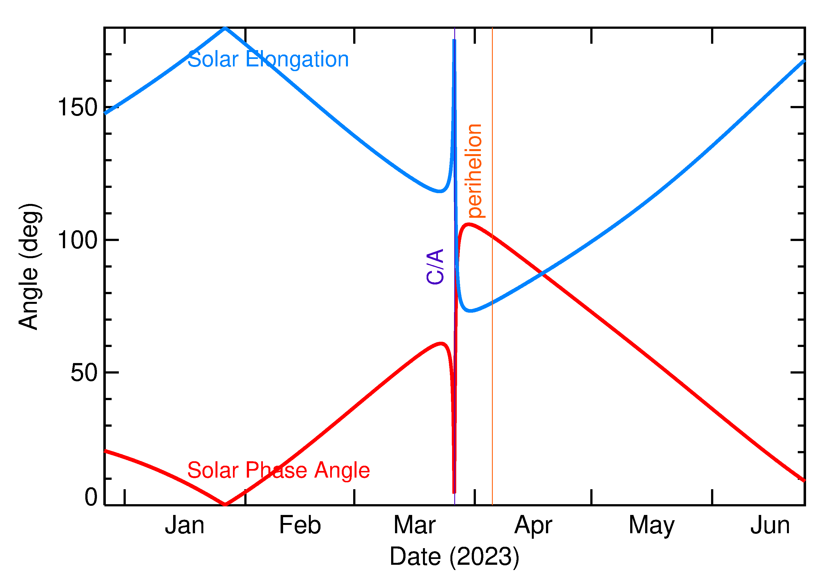

Slide 11
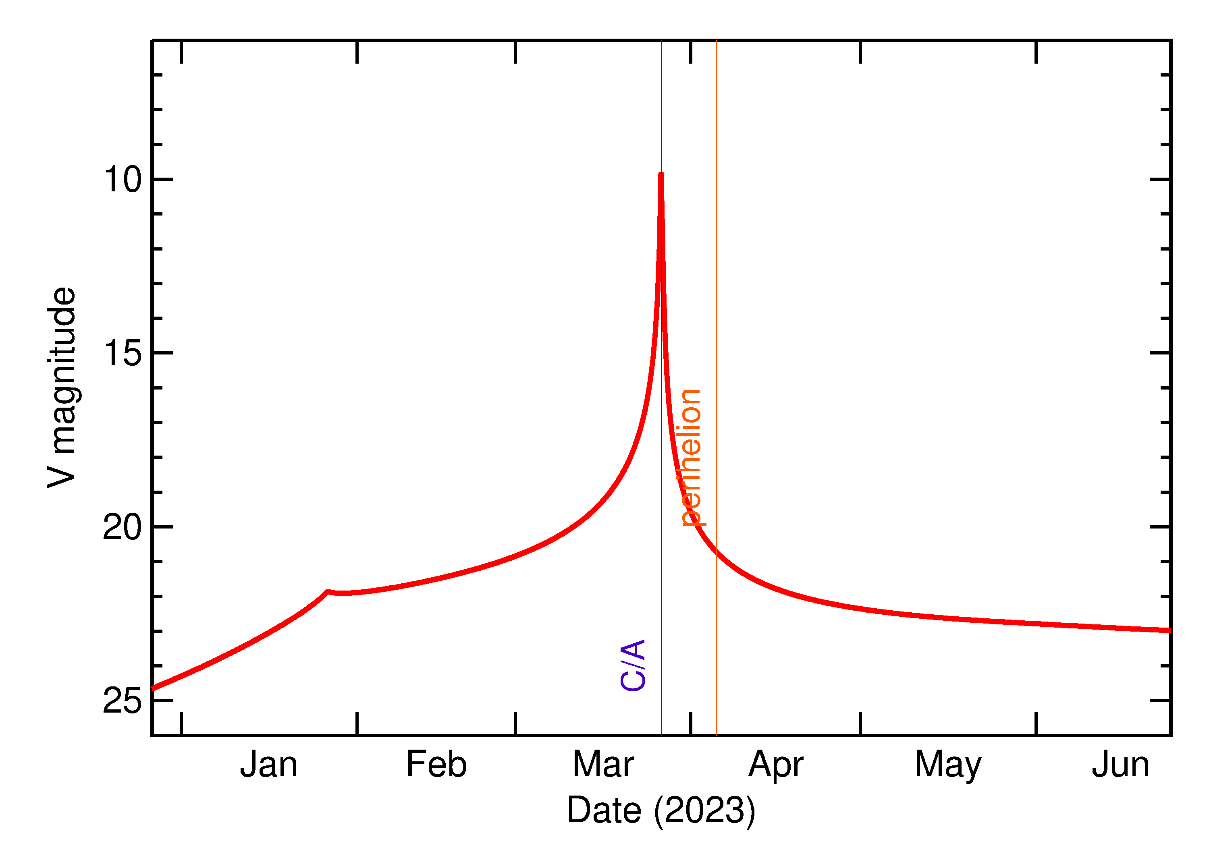

Slide 12
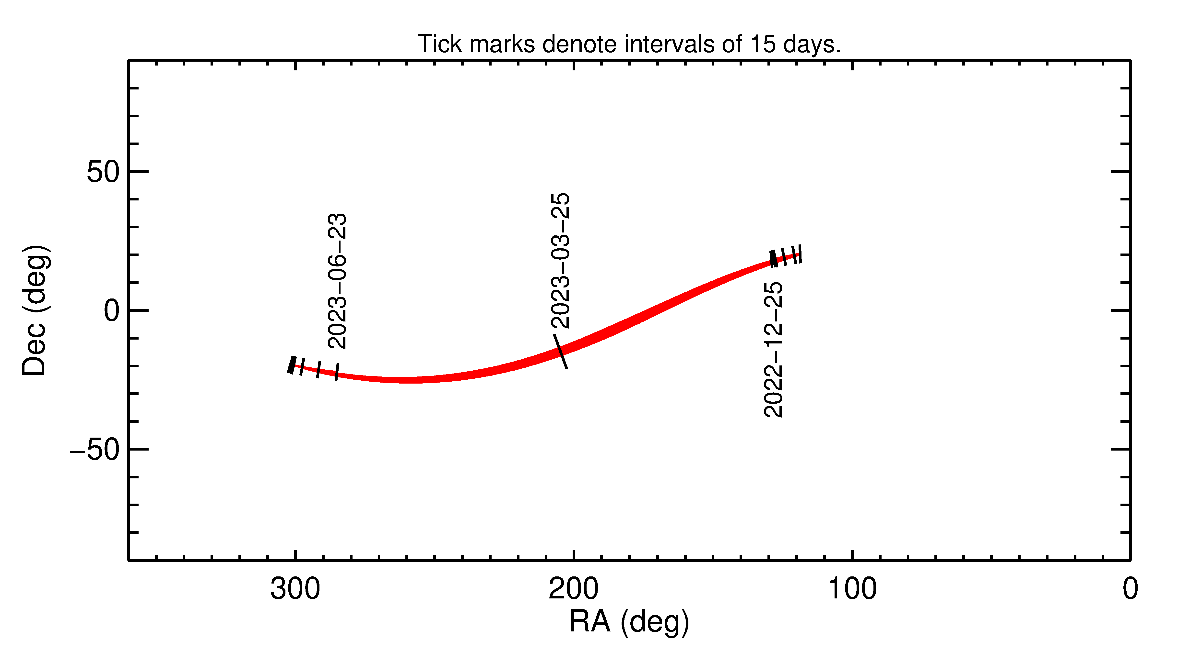

Slide 13
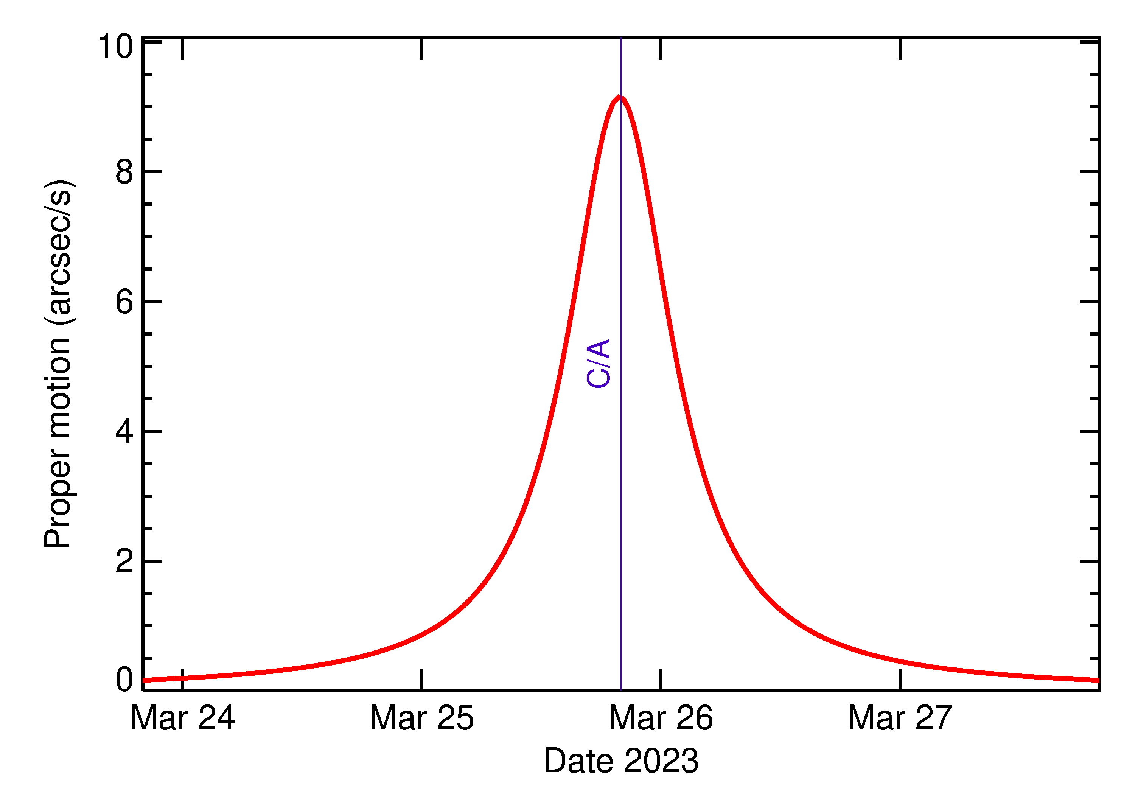

Slide 14
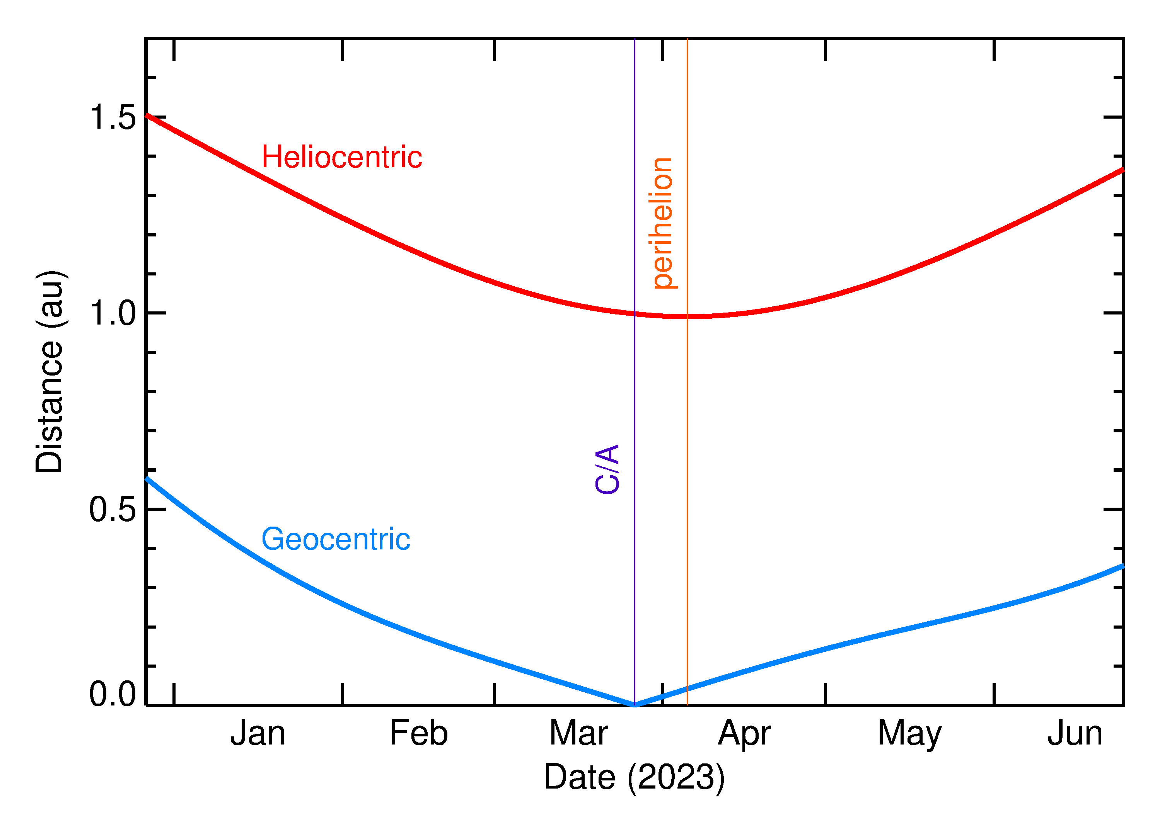

Slide 15
