Slide 1
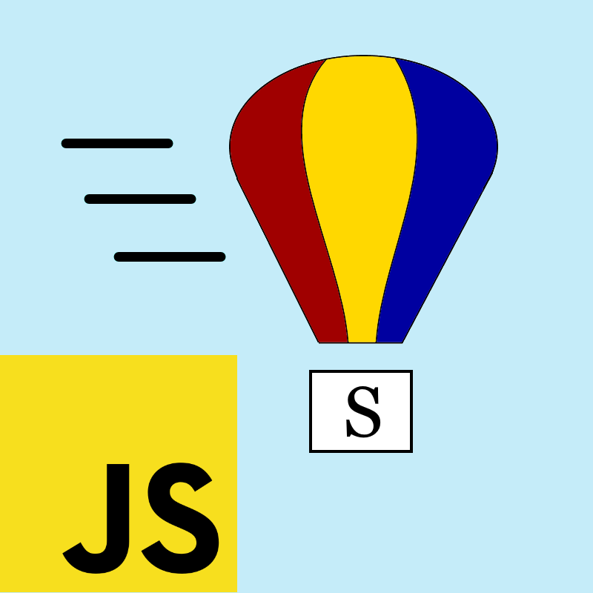

SmallJS Back to elegance
Open sourced on: github.com/Small-JS/SmallJS
Notes:
The colorful air balloon is of course a reference to the BYTE Magazine August 1981 edition about Smalltalk-80,
as you have probably already noticed. ;-).

Slide 2
What is SmallJS?
Transpiler from Smalltalk to efficient, lightweight JavaScript.
JS code runs in all browsers and Node.js.
Smalltalk-80 language syntax support
Class and method names like familiar JS.
Source file based (not image based).
Development in Visual Studio Code IDE
With syntax coloring and step debugging!
JS libraries already encapsulated in ST:
Browser: Document, Window, HTML elements, events, CSS, streams.
Node.JS: HTTP server, Express, 3 databases.
Examples, including a webshop client + server app template.
Notes:
Databases: Postgres, MariaDB and MySQL.

Slide 3
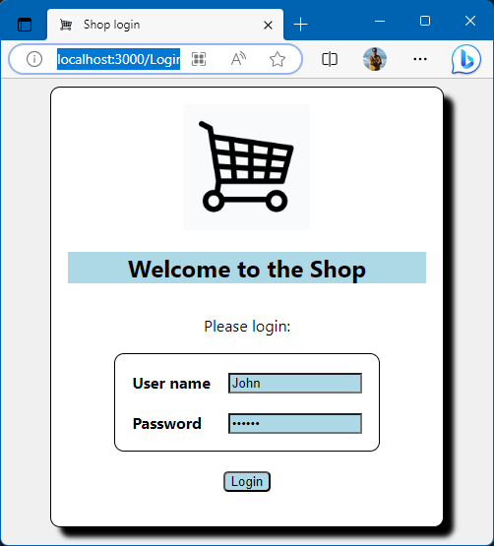
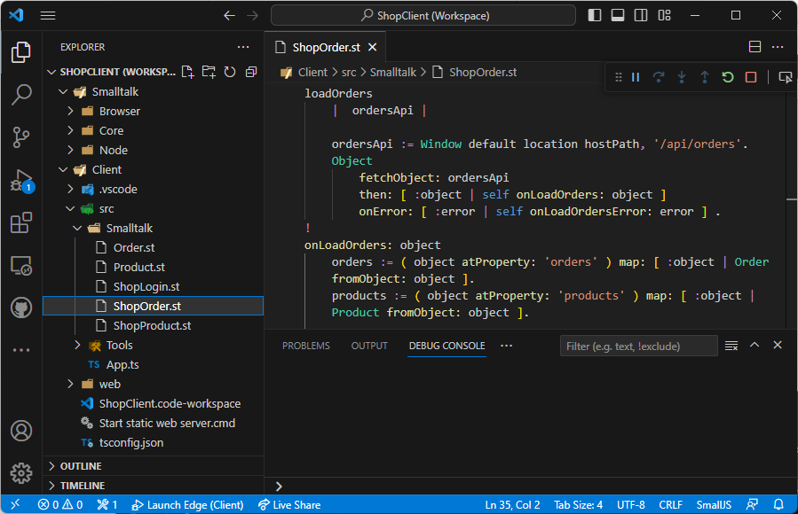
How does it look?
Notes:
The pop-left contains the ST base library (image).
Below that the example shop client, in a separate project.
ST source code on the right, methods loadOrders and onLoadOrders (part).
Live demo possible...

Slide 4
Why use SmallJS?
The Smalltalk language syntax fits on a postcard
Objects all the way down
Customizable on every level. Need to add a complex number type? Easy.
Well defined behaviors
Integers are really integers. Controlled type conversions.
Uses familiar JS names and functionality
Easily mix and match JS libraries with ST
Notes:
So why should I use SmallJS i.s.o. TypeScript? (don’t use bare JS ;-)

Slide 5
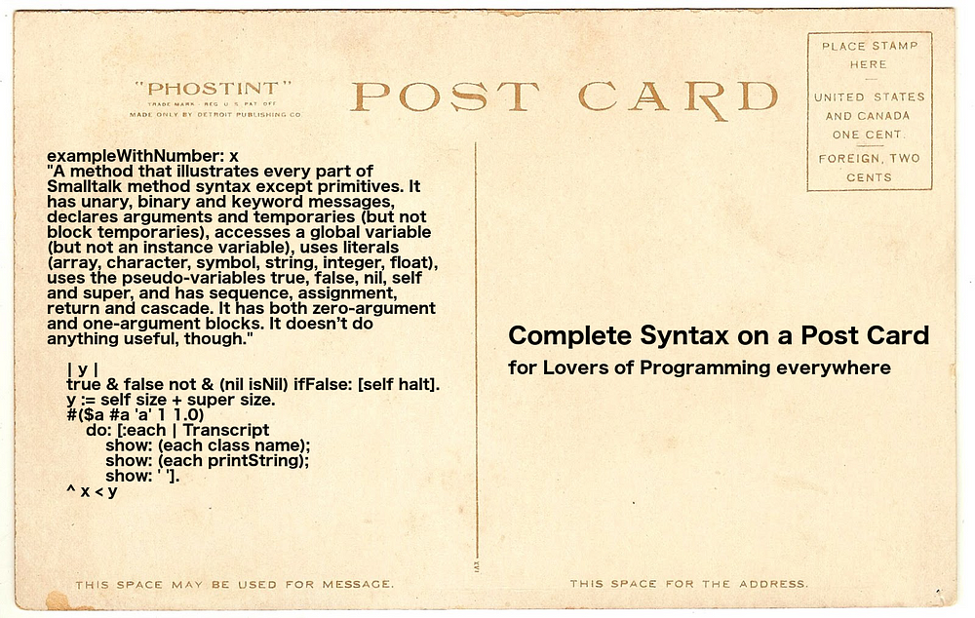
Smalltalk syntax on a postcard
Notes:
That the syntax fits on a postcard is actually true.
The quarter on the lower left contains the complete syntax.

Slide 6
Example ST vs JS
SmallJS JavaScript
Code:
squared ^ self * self.
Call with > result:
10 squared > 100
1.5 squared > 2.25
( 1 / 3 ) squared > ( 1 / 9 )
99999999 squared > right answer, BigInt
‘s’ squared > error, stops
> Number is a base class for Integer, Float, Fraction and BigInt, but not String.
Code:
NumUtil.squared( n ) { return n * n; }
Call with > result:
NumUtil.squared( 10 ) > 100
NumUtil.squared( 1.5 ) > 2.25
NumUtil.squared( 1 / 3 ) > 0.1111111111111
NumUtil.squared( 99999999 ) > wrong answer, float
NumUtil.squared( ‘s’ ) > NaN, continues
> No (safe) integers, no fractions, BigInt not integrated, error prone type coersion.
Notes:
Smalltalk advantages
More elegant calling and reuse.
Preserves fractions.
Automatic big int use.
Signals error after illegal use i.s.o. unwanted coercion.

Slide 7
What about my new JS/TS features?
ST implementation of JS/TS language features.
Feature | ST solution
functional programming | Don't use state vars. Use array iterators.
interface | Abstract base class
Record, tuple | Class with only getters
decorator | Pass anonymous function (block)
static | Class method
private | No getter method
variable argument list | Array
optional argument | Extra 1-line method
import / export | Automatic
async / await | Implemented, unfortunately...
type checking | Build IDE type inferencing (not yet)
The philosophy is that retaining simplicity
is worth some extra lines of encapsulated code.
Notes:
For async / wait it is not possible to work around it with a simpler concurrency method: block fork.
The basic design fix is that the *caller* should decide async execution, not the *callee*.

Slide 8
SmallJS vs traditional Smalltalks (E.g.: Pharo, Dolphin, Cincom, Squeak)
File-based (not image-based)
Easy source control in clear hierarchy. IDE safely separate from code. Modular class loading iso unsafe image stripping. Can use rich and familiar IDE (VSCode).
Run anywhere
One language for front-end and back-end apps in all browsers and Node.js. So also runs on mobile devices.
Integrates smoothly with the rich JS ecosystem
Typically 1 line of interfacing code per encapsulated JS method.
ST can call JS and vice versa.
Newly available JS features and libraries can be integrated quickly.

Slide 9
SmallJS trade-offs
ST is dynamically typed
An IDE enhancement cloud help here.
And optional typing like TS is an idea...
No namespaces (yet)
Tiny community
Notes:
Type inferencing via VSCode IDE needs language server.
Dolphin Smalltalk implemented namespaces recently.
Community: That’s what you guys could help with. ☺
And you can use SmallJS incrementally next to TS.

Slide 10
SmallJS summary
Uses the elegant and safe Smalltalk language!
Integrates tightly with JS.
Familiar JS class and method names.
Use with your favorite IDE.
Incremental use possible, mix and match.

Slide 11

Any questions?
github.com/Small-JS/SmallJS

