Slide 1
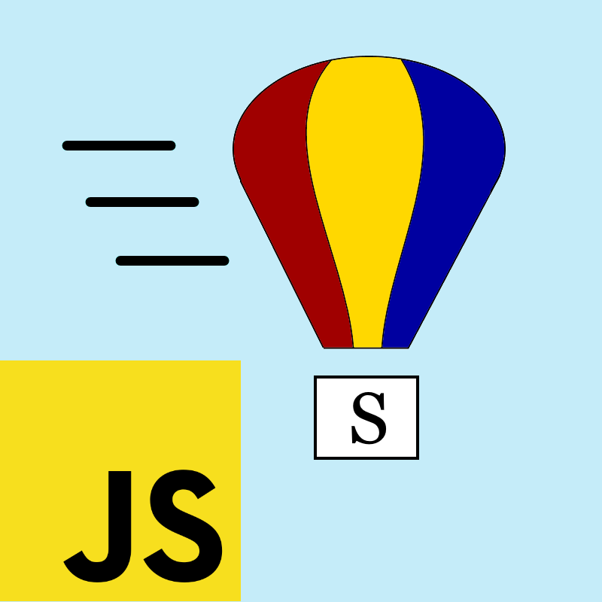
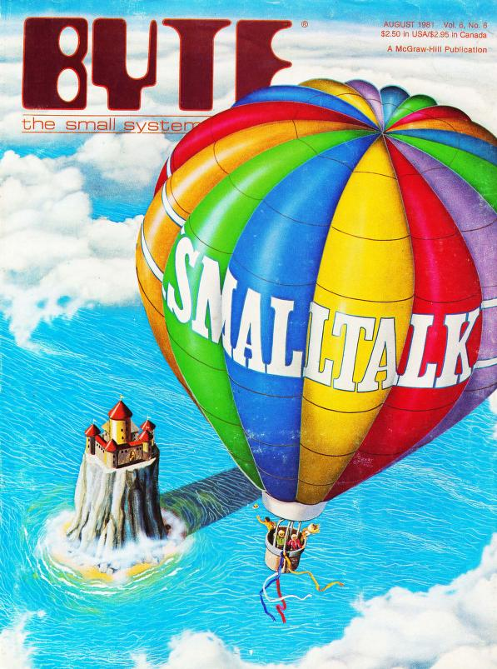
SmallJS Back to elegance
by:
Richard Ronteltap
Website: small-js.org
Notes:
Note to UKSTUG audence: This presentation is geared towards JS developers, try to look at it form that point of view.
The colorful air balloon is of course a reference to the BYTE Magazine August 1981 edition about Smalltalk-80. I also own a physical copy. :-))

Slide 2



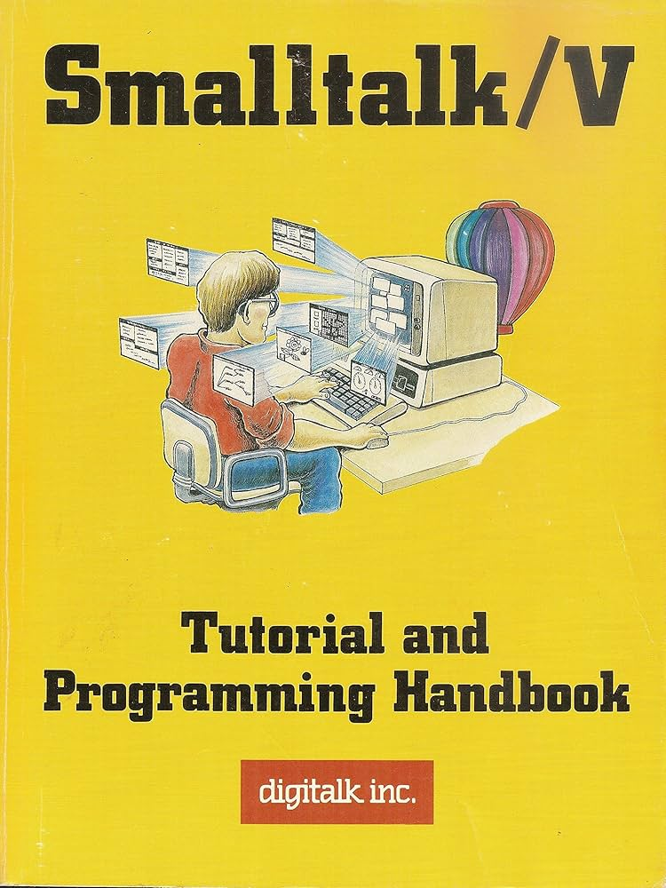


About the author
My name is Richard Ronteltap (Yes, that is a strange last name, even here :)
Live in Amsterdam, The Netherlands
Studied Computer Science at the University of Amsterdam where I met my wife (she insisted I say this :), where I work as an IT department head.
My CS thesis in '93 was on OO databases, with a query optimizer written in Smalltalk-80.
I also discovered: Smalltalk/V, Dolphin, Pharo, ...
Notes:
Started computing early 80-ties, back in the BBS days... Developed the new biggest Dutch BBS called NEABBS in C on Unix clone called Xenix.
Started my career as a developer, in OO languages like C++.

Slide 3
Why make SmallJS?
Develop modern apps in ST, specifically web apps, using the same language for the front-end and the back-end.
Promote the elegant Smalltalk language specifically to JS, PHP and Ruby devs, who don't know what they're missing... :)
Looked at: Amber Smalltalk, PharoJS, Seaside But though it could be more JS native and integrated.
And a separate IDE and a modular image don't seem so bad...
Notes:
So SmallJS is targeted more at JS des than ST devs.
But for ST devs, like here, it should be interesting, especially you want:
- Native JS development.
- Full debugging capabilities.
Rest of presentation is ST form a JS point of view.
Try to keep that in mind.

Slide 4
What is SmallJS?
Transpiler from Smalltalk to efficient, lightweight JavaScript.
JS code runs in modern browsers and in Node.js.
Smalltalk-80 language syntax support
Class and method names like familiar JS.
Source file based (not image based).
Development in Visual Studio Code IDE
With syntax coloring and step debugging!
Built-in unit-testing and GUI-testing (browser).
Playground available (local or small-js.org).
Free and open source.

Slide 5
SmallJS libraries
Core (common)
Basic ST classes, full ST magnitude hierarchy.
Events, streams, fetch.
Browser
Document, Window, HTML elements, Canvas 2D, CSS, web workers.
Lightweight HTML components for SPAs.
Node.js
HTTP server, Express, worker threads, File.
Databases: SQLite, Postgres, MariaDB and MySQL with an ORM.
AI: OpenAI, Deepseek, 2 more soon..
Desktop app support: Electron, NodeGui
Example projects to kick-start using the above.
Notes:
Number hierarchy includes classes: Fraction, BigInt, Date and Point.
Not all JS libraries are *fully* implemented,
but making them (more) complete is easy to do.

Slide 6
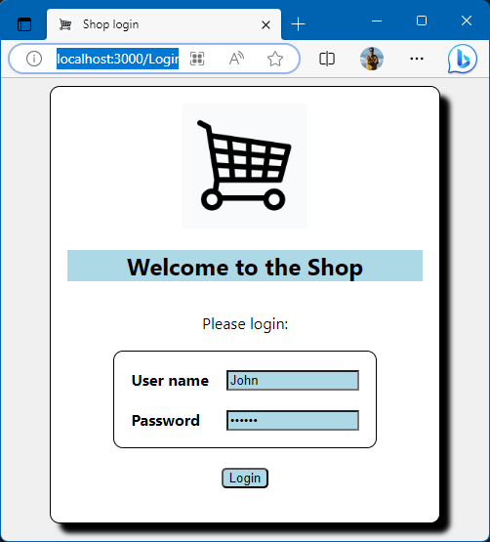
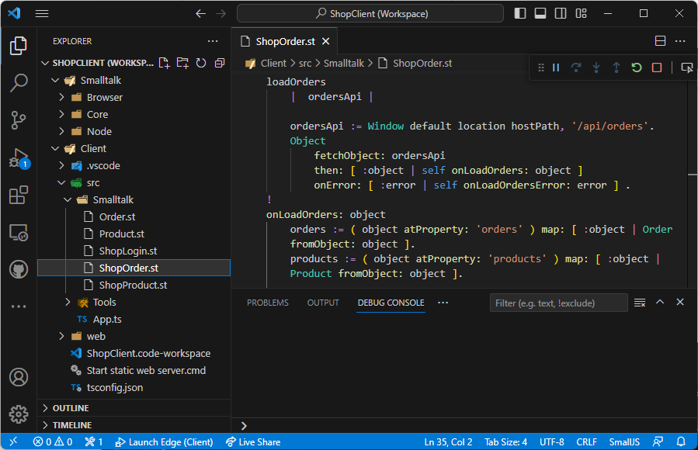
How does it look?
Notes:
The pop-left contains the ST base library (image).
Below that the example shop client, in a separate project.
ST source code on the right, methods loadOrders and onLoadOrders (part).
Live demo's later.

Slide 7
Why use SmallJS?
The Smalltalk language syntax fits on a postcard
Objects all the way down
Customizable on every level. Need to add a complex number type? Easy.
Well defined behaviors, compared to JS.
Integers are really integers. Controlled type conversions.
Uses familiar JS names and functionality
Easily mix and match JS libraries with ST
Notes:
So why should I use SmallJS i.s.o. TypeScript? (don’t use bare JS ;-)

Slide 8
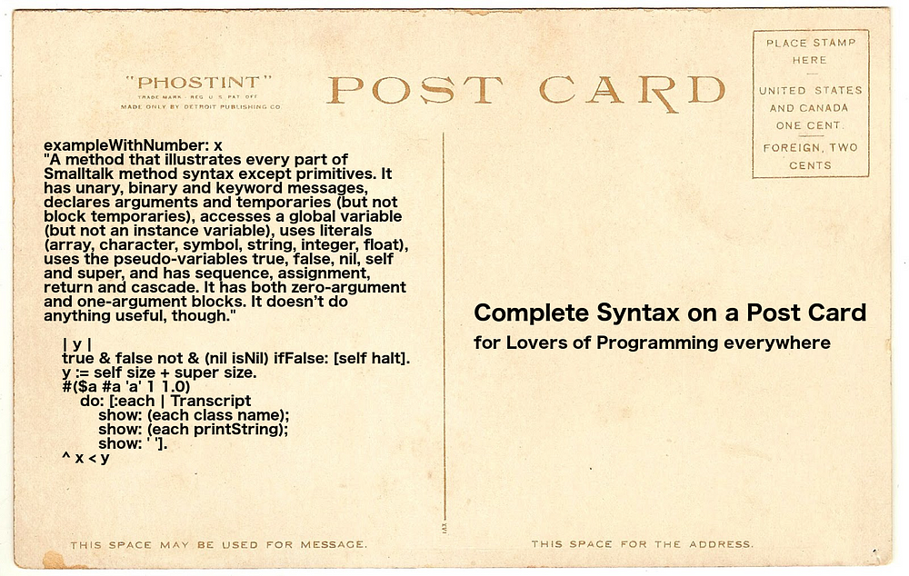
Smalltalk syntax fits on a postcard
Notes:
That the syntax fits on a postcard is actually true.
The quarter area on the lower left contains the complete syntax.

Slide 9
Example ST vs JS
SmallJS JavaScript
Code:
squared ^ self * self.
Call with > result:
10 squared > 100
1.5 squared > 2.25
( 1 / 3 ) squared > ( 1 / 9 )
99999999 squared > right answer, BigInt
‘s’ squared > error, stops
> Number is a base class for Integer, Float, Fraction and BigInt, but not String.
Code:
NumUtil.squared( n ) { return n * n; }
Call with > result:
NumUtil.squared( 10 ) > 100
NumUtil.squared( 1.5 ) > 2.25
NumUtil.squared( 1 / 3 ) > 0.1111111111111
NumUtil.squared( 99999999 ) > wrong answer, float
NumUtil.squared( ‘s’ ) > NaN, continues
> No (safe) integers, no fractions, BigInt not integrated, error prone type coersion.
Notes:
Smalltalk advantages
More elegant calling and reuse.
Preserves fractions.
Automatic big int use.
Signals error after illegal use i.s.o. unwanted coercion.

Slide 10
What about my new JS/TS features?
ST implementation of JS/TS language features.
Feature | ST solution
functional programming | Don't use state vars. Use array iterators.
interface | Abstract base class
Record, tuple | Class with only getters
decorator | Pass anonymous function (block)
static | Class method
private | No getter method
variable argument list | Array
optional argument | Extra 1-line method
import / export | Automatic
async / await | Implemented, unfortunately...
type checking | Build IDE type inferencing (not yet)
The philosophy is that retaining simplicity
is worth some extra lines of encapsulated code.
Notes:
For async / wait it is not possible to work around it with a simpler concurrency method: block fork.
The basic design fix is that the *caller* should decide async execution, not the *callee*.

Slide 11
SmallJS vs traditional Smalltalks (E.g.: Pharo, Dolphin, Cincom, Squeak)
File-based (not image-based)
Easy source control in clear hierarchy. IDE safely separate from code.
Modular class loading iso unsafe image stripping.
Can use rich and familiar IDE (VSCode).
Run anywhere
One language for front-end and back-end apps in all browsers and Node.js. So also runs on mobile devices.
Integrates smoothly with the rich JS ecosystem
Typically 1 line of interfacing code per encapsulated JS method.
ST can call JS and vice versa.
Newly available JS features and libraries can be integrated quickly.
Notes:
Now things gets tense... :-)

Slide 12
SmallJS trade-offs
ST is dynamically typed
An IDE enhancement cloud help here.
And optional typing like TS is an idea...
No namespaces (yet)
Tiny community :-)
Notes:
Type inferencing via VSCode IDE needs language server.
Dolphin Smalltalk implemented namespaces recently.
Community: That’s what you guys could help with. ☺
And you can use SmallJS incrementally next to TS.

Slide 13
SmallJS summary
Elegant and safe Smalltalk language!
Integrates tightly with JS.
Familiar JS class and method names.
Use with your favorite IDE.
Incremental use possible, mix and match.

Slide 14
Live demo's (basic) with code inspection
Basic example apps:
App | Notes
Counter | Standard minimal web app.
Todo | Todo list web app with CRUD operations, sorting and multi-language support.
Balls | Colorful bouncing balls, using the HTML Canvas 2D API, which is fully supported.
Shop | Basic web shop front-ends, traditional and as SPA and back-end, with database support on SQL ORM mapper.
Notes:
Which ones to you want to see?
We can look at the code too.
Let's start with Todo maybe...
- Show build system with automated GUI test.
- Show code and debugging with breakpoints.

Slide 15
Live demo's (advanced) with code inspection
Advanced example apps:
App | Notes
Benchmark | Number crunching in SmallJS for: primes, Fibonacci, Pi
WebWorkers | True multithreading using the Web Workers API. (Node worker threads are also supported)
Electron | Platform independent desktop app based on Electron (when you don't care about memory usage and complexity :)
NodeGui | Platform independent desktops app based on NodeGui/QT (when you do care about memory usage and simplicity)
Pharo | SmallJS front-end with Pharo back-end using Zinc and API call. (So quite basic on both sides)
Notes:
Which ones to you want to see?
We can look at the code too.

Slide 16

Any questions?
Website: small-js.org

