Slide 1



OAHU RESTAURANT FINDER
CS-401: SOFTWARE ENGINEERING & DESIGN
CALVIN SMALL
VLAD TOMUTIO
ASHLEY SOFIA ALFARO
JAYCE PASCUA

Slide 2

INTRODUCTION
No matter who we are, we all enjoy having a good meal. With so many options, sometimes the choice of what to have prevents us from getting something we love. To aid users in choosing from various local options, we made this app.

Slide 3
THE MODELS
01
02
03
RESTAURANTS
REVIEWS
PREFERENCES
A directory of all restaurants in Oʻahu. You can filter by location and select a specific restaurant to view more details.
Where you can view reviews for all restaurants. You can sort them by rating or alphabetically.
You can select multiple preferences, and it will return the restaurant that fits all of them (if one exists).

Slide 4
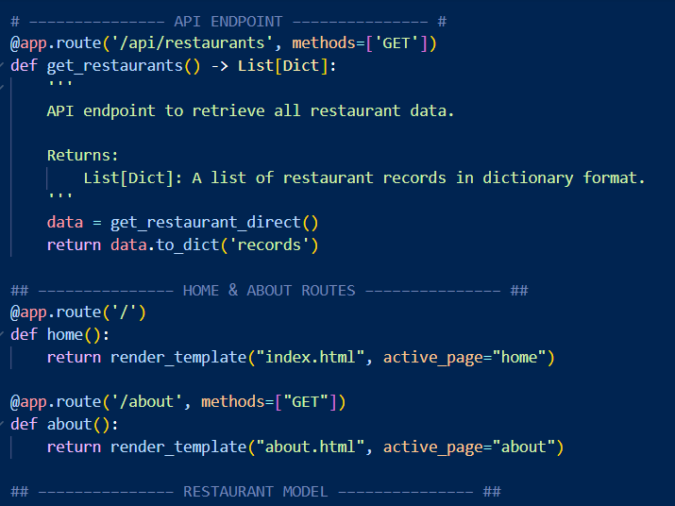
API
Our API runs off of Flask and Python and supports the entire application’s endpoints as well as several background functions

Slide 5
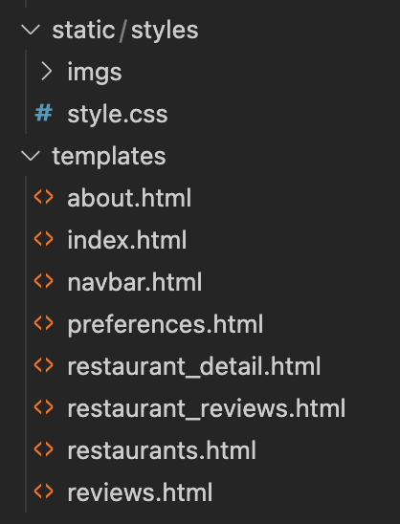
FRONT-END
Built using HTML, CSS (Bootstrap), and Flask templates
Dynamic content rendered using Jinja
Organized into separate templates with a shared navbar
Card-based UI for displaying restaurant and review information
Interactive filtering
Consistent styling across pages

Slide 6
CHALLENGES
Data Gathering: Yelp API
Code Collaboration: Pushing and pulling from GitHub and dealing with merge conflicts
Learning New Languages Some Javascript and Jinja2 were needed for this project

Slide 7
WEBSITE DEMO
http://127.0.0.1:5000/

Slide 8
THANK YOU

