Slide 1
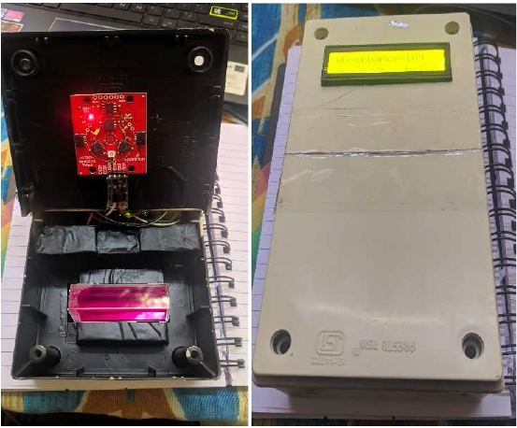
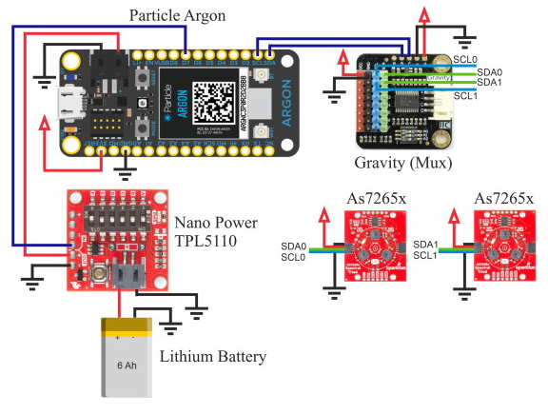
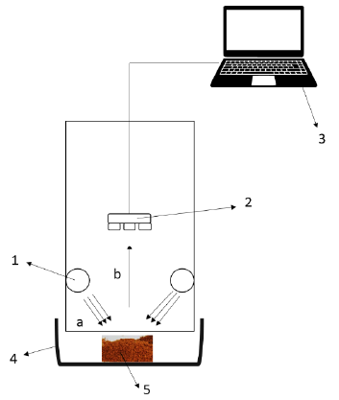
目的: 量測過錳酸鉀 (KMnO₄)
校準方法: 回歸分析
特點: 輕量化
文獻: Daurai, B., Ramchiary, S. S., & Gogoi, M. (2023, March). Comparison of Sparkfun TRIAD AS7265x spectroscopy sensor device with a Spectrophotometer for qualitative and quantitative analysis. In 2023 4th International Conference on Computing and Communication Systems (I3CS) (pp. 1-3). IEEE.
目的: 檢測室內/室外太陽光譜
特點: 輕量化、IOT
文獻: Botero-Valencia, J. S., & Valencia-Aguirre, J. (2021). Portable low-cost IoT hyperspectral acquisition device for indoor/outdoor applications. HardwareX, 10, e00216.
目的: 檢測椰子糖的純度 (添加蔗糖)
分類方法:倒傳遞類神經網路 (BPNN)
特點: 輕量化
文獻: Sulistyo, S. B., Sudarmaji, A., Kuncoro, P. H., & Haryanti, P. (2023, January). Design and performance test of portable spectrometer using AS7265x multispectral sensor for detection of adulterated cane sugar in granulated coconut sugar. In AIP Conference Proceedings (Vol. 2586, No. 1, p. 060016). AIP Publishing LLC.

Slide 2
