Slide 1
K Nearest Neighbors
Dynamic Time Warping
Class A
Class B
k = 5
 |  | Signal 1
 | Data | 2 | 5 | 7 | 4 | 1 | 5 | 9
Signal 2 | 6 | 4 | 5 | 11 | 16 | 19 | 20 | 22
 | 1 | 5 | 8 | 8 | 10 | 10 | 12 | 13
 | 8 | 6 | 11 | 9 | 8 | 10 | 14 | 15
 | 7 | 8 | 9 | 13 | 11 | 9 | 10 | 10
 | 5 | 13 | 8 | 15 | 17 | 13 | 11 | 13
 | 3 | 14 | 12 | 11 | 13 | 13 | 13 | 12
 | 1 | 17 | 20 | 12 | 13 | 17 | 19 | 17
2
8
4
Dynamic
Time
Warping
1
3
9
5
6
7

Slide 2
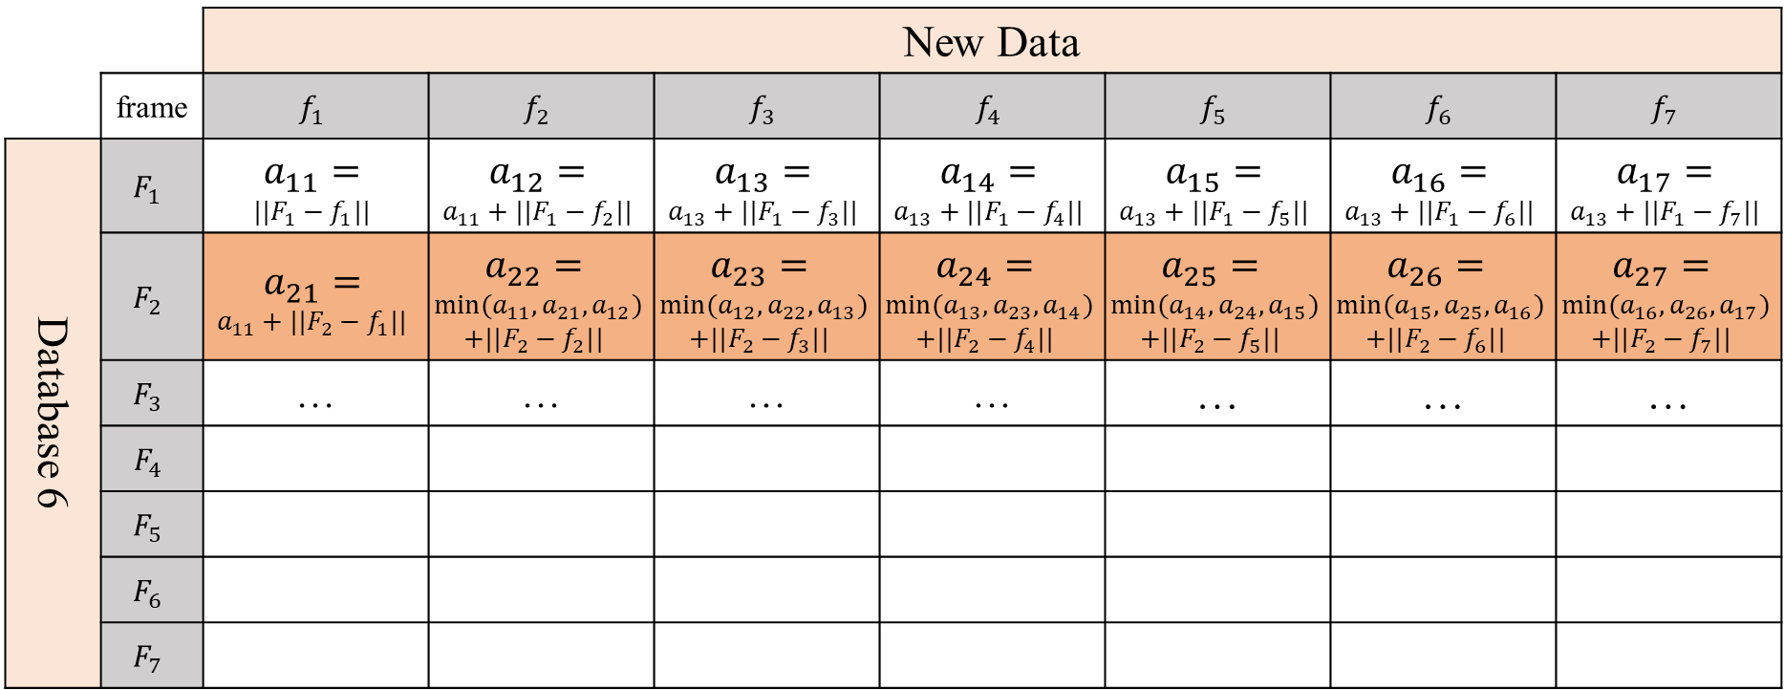
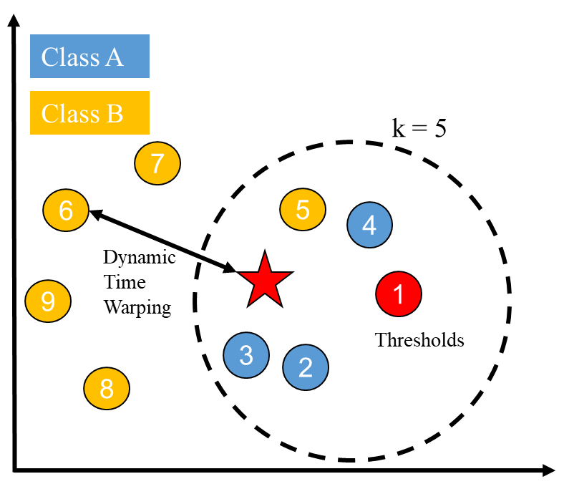
K Nearest Neighbors
Dynamic Time Warping
Class A
Class B
k = 5
7
6
5
4
Dynamic Time Warping
9
1
3
Thresholds
2
8
(a) K Nearest Neighbors
(b) Dynamic Time Warping

Slide 3
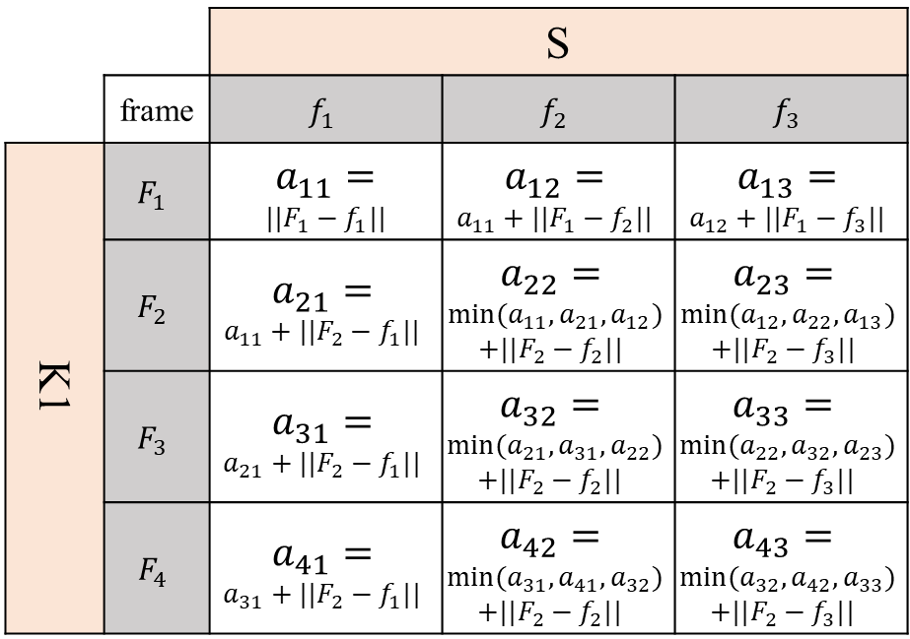
 |  | S
 | frame | $$f_{1}$$ | $$f_{2}$$ | $$f_{3}$$
K1 | $$F_{1}$$ | $a_{11}=$ $$||F_{1}−f_{1}||$$ | $$a_{12}=$$ $$a_{11}+||F_{1}−f_{2}||$$ | $$a_{13}=$$ $$a_{12}+||F_{1}−f_{3}||$$
 | $$F_{2}$$ | $$a_{21}=$$ $$a_{11}+||F_{2}−f_{1}||$$ | $$a_{22}=$$ $${min⁡(a}_{11},a_{21},a_{12})$$ $$+||F_{2}−f_{2}||$$ | $$a_{23}=$$ $${min⁡(a}_{12},a_{22},a_{13})$$ $$+||F_{2}−f_{3}||$$
 | $$F_{3}$$ | $$a_{31}=$$ $$a_{21}+||F_{2}−f_{1}||$$ | $$a_{32}=$$ $${min⁡(a}_{21},a_{31},a_{22})$$ $$+||F_{2}−f_{2}||$$ | $$a_{33}=$$ $${min⁡(a}_{22},a_{32},a_{23})$$ $$+||F_{2}−f_{3}||$$
 | $$F_{4}$$ | $$a_{41}=$$ $$a_{31}+||F_{2}−f_{1}||$$ | $$a_{42}=$$ $${min⁡(a}_{31},a_{41},a_{32})$$ $$+||F_{2}−f_{2}||$$ | $$a_{43}=$$ $${min⁡(a}_{32},a_{42},a_{33})$$ $$+||F_{2}−f_{3}||$$

Slide 4
Mel Frequency
Inverse Mel Frequency
(a) MF 128 Scales [100 4000]
(b) IMF 19 Scales [4000 8000]
(c) CMF 147 Scales

Slide 5
(a) MF 128 Scales [100 4000]
(b) MF 128 Scales [100 8000]
(c) Spectrogram - Strolling
(a) Spectrogram - Strolling
(b) MF 128 Scales [100 4000]
(c) MF 128 Scales [100 8000]

Slide 6
(a)Triangular filterbank structure of MFCC
(b)Triangular filterbank structure of IMFCC

Slide 7









(a) Voiced Sound
(b) Voiceless Sound
$$F_{1}$$
$$F_{2}$$
$$F_{5}$$
$$F_{3}$$
$$F_{4}$$
(c) Voiced and Voiceless Sound
(c) Silent Sound
$$F_{7}$$
$$F_{8}$$
$$F_{6}$$
$$F_{9}$$

Slide 8







(a) Voiced Sound
(b) Voiceless Sound
$$F_{1}$$
$$F_{2}$$
$$F_{3}$$
$$F_{1}$$
$$F_{2}$$
(c) Voiced and Voiceless Sound
$$F_{2}$$
$$F_{3}$$
$$F_{1}$$
$$F_{4}$$

Slide 10
同人同詞

Slide 11
不同人同詞

Slide 12
 | Accuracy | Precision | Recall | F1-Measure
MFCC | 78.75 | 86.41 | 80.83 | 83.53
IMFCC | 73.75 | 85.75 | 72.71 | 78.69
LFCC | 86.39 | 89.46 | 90.21 | 89.83
FFCC | 91.67 | 95.65 | 91.67 | 93.62
 | Glee | Sleep | Rave | Serve | Stock | Stop | Unknown
Glee | 91.25 % | 0 | 0 | 0 | 0 | 0 | 8.75 %
Sleep | 0 | 93.75 % | 0 | 0 | 0 | 0 | 6.25 %
Rave | 0 | 0 | 92.5 % | 0 | 0 | 0 | 7.5 %
Serve | 0 | 0 | 0 | 92.5 % | 0 | 0 | 7.5 %
Stock | 0 | 0 | 0 | 0 | 90 % | 1.25 % | 8.75 %
Stop | 0 | 0 | 0 | 0 | 0.25 % | 90 % | 7.5 %
Unknown | 0 | 0 | 0 | 0 | 2.08 % | 6.25 % | 91.67 %

Slide 13
 | Glee | Sleep | Rave | Serve | Stock | Stop
MFCC | 86.67 | 85 | 75 | 79.17 | 77.5 | 69.17
IMFCC | 76.67 | 76.67 | 74.17 | 74.17 | 76.67 | 64.17
LFCC | 94.17 | 90.83 | 83.33 | 86.67 | 82.5 | 80.83
FFCC | 94.17 | 95.83 | 95 | 95 | 85.83 | 83.33
EER (%) | MFCC | LFCC | IMFCC | FFCC
20 speakers, 10 keywords | 22.95 | 25.57 | 36.08 | 17.42
30 speakers, 10 keywords | 23.02 | 27.79 | 39.52 | 19.15
40 speakers, 10 keywords | 23.65 | 27.9 | 40.2 | 20.07
50 speakers, 10 keywords | 27.64 | 30.59 | 40.23 | 22.24

Slide 14
EER (%) | MFCC | LFCC | IMFCC | FFCC
Normalized 20 speakers, 10 keywords | 22.95 | 25.57 | 36.08 | 17.42
Unnormalized 20 speakers, 10 keywords | 24.95 | 27.8 | 37.87 | 20.2

Slide 15
Data Set | Sub Set | Command | # Males # Females | Samples | Total
(a).RSR2015: 50 speakers, 10 keywords | Training Set | 10 | 24 24 | 5 | 2,400
 | Testing Set A | 10 | 1 1 | 9 | 180
 | Testing Set B | 10 | 24 24 | 4 | 1,920
(b).RSR2015: 40 speakers, 10 keywords | Training Set | 10 | 19 19 | 5 | 1,900
 | Testing Set A | 10 | 1 1 | 9 | 180
 | Testing Set B | 10 | 19 19 | 4 | 1,520
(c).RSR2015: 30 speakers, 10 keywords | Training Set | 10 | 14 14 | 5 | 1,400
 | Testing Set A | 10 | 1 1 | 9 | 180
 | Testing Set B | 10 | 14 14 | 4 | 1,120
(d).RSR2015: 20 speakers, 10 keywords | Training Set | 10 | 9 9 | 5 | 900
 | Testing Set A | 10 | 1 1 | 9 | 180
 | Testing Set B | 10 | 9 9 | 4 | 720
(e).SPW: 20 speakers, 6 keywords | Training Set | 6 | 14 2 | 5 | 480
 | Testing Set A | 6 | 2 2 | 10 | 240
 | Testing Set B | 6 | 14 2 | 5 | 480

Slide 16
 | 2/22(大陸) | 2/23(大陸) | 2/24(香港) | 2/25(香港) | 2/26(香港)
早上 |  |  |  | 海洋公園
中午 | 到香港 出發到珠海 | 家裡吃飯 | 吃家附近
下午 | 益健茶樓 圓明園 買菜 | 華發商都 | 回香港 馬場
晚上 | 珠海夜市 | 華發商都/ 海納牛肉火鍋（全牛肉） | 銅鑼灣(燉奶)

