Slide 1
8
7
6
5
4
3
value
2
1
0
0 1 2 3 4 5 6 7 8 9 10 11 12 13 14 15 16
frame index

Slide 2
8
7
6
5
4
3
value
2
1
0
0 1 2 3 4 5 6 7 8 9 10 11 12 13 14 15 16
frame index

Slide 3




8
7
6
$$B_{3}^{1}$$
5
4
3
$$B_{2}^{1}$$
value
$$B_{4}^{1}$$
2
1
0
$$B_{1}^{1}$$
0 1 2 3 4 5 6 7 8 9 10 11 12 13 14 15 16
frame index

Slide 4
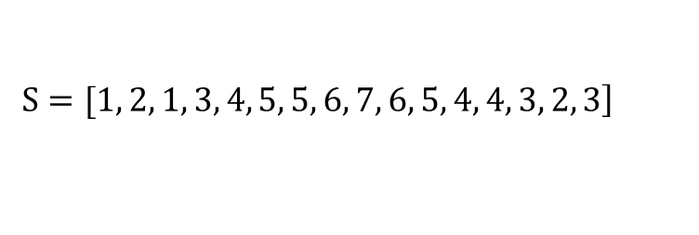

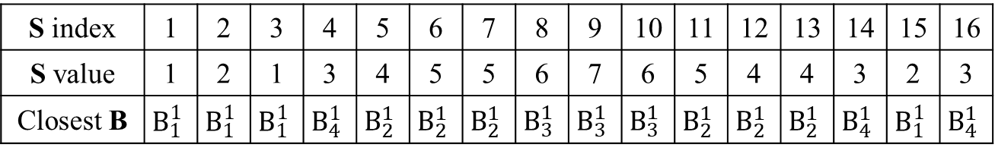



1 1 1 4 2 2 2 3 3 3 2 2 2 4 1 4
$$\left.S=[1, 2, 1, 3, 4, 5, 5, 6, 7, 6, 5, 4, 4, 3, 2, 3\right]$$
S index | 1 | 2 | 3 | 4 | 5 | 6 | 7 | 8 | 9 | 10 | 11 | 12 | 13 | 14 | 15 | 16
S value | 1 | 2 | 1 | 3 | 4 | 5 | 5 | 6 | 7 | 6 | 5 | 4 | 4 | 3 | 2 | 3
Closest B | $$B_{1}^{1}$$ | $$B_{1}^{1}$$ | $$B_{1}^{1}$$ | $$B_{4}^{1}$$ | $$B_{2}^{1}$$ | $$B_{2}^{1}$$ | $$B_{2}^{1}$$ | $$B_{3}^{1}$$ | $$B_{3}^{1}$$ | $$B_{3}^{1}$$ | $$B_{2}^{1}$$ | $$B_{2}^{1}$$ | $$B_{2}^{1}$$ | $$B_{4}^{1}$$ | $$B_{1}^{1}$$ | $$B_{4}^{1}$$
8
7
6
$$B_{3}^{2}$$
5
4
3
$$B_{2}^{2}$$
value
2
1
0
$$B_{4}^{2}$$
$$B_{1}^{2}$$
0 1 2 3 4 5 6 7 8 9 10 11 12 13 14 15 16
frame index

Slide 5
1 1 1 4 2 2 2 3 3 3 2 2 2 4 1 4
$$\left.S=[1, 2, 1, 3, 4, 5, 5, 6, 7, 6, 5, 4, 4, 3, 2, 3\right]$$
S index | 1 | 2 | 3 | 4 | 5 | 6 | 7 | 8 | 9 | 10 | 11 | 12 | 13 | 14 | 15 | 16
S value | 1 | 2 | 1 | 3 | 4 | 5 | 5 | 6 | 7 | 6 | 5 | 4 | 4 | 3 | 2 | 3
Closest B | $$B_{1}^{1}$$ | $$B_{1}^{1}$$ | $$B_{1}^{1}$$ | $$B_{4}^{1}$$ | $$B_{2}^{1}$$ | $$B_{2}^{1}$$ | $$B_{2}^{1}$$ | $$B_{3}^{1}$$ | $$B_{3}^{1}$$ | $$B_{3}^{1}$$ | $$B_{2}^{1}$$ | $$B_{2}^{1}$$ | $$B_{2}^{1}$$ | $$B_{4}^{1}$$ | $$B_{1}^{1}$$ | $$B_{4}^{1}$$
8
7
6
$$B_{3}^{2}$$
5
4
3
$$B_{2}^{2}$$
value
2
1
0
$$B_{4}^{2}$$
$$B_{1}^{2}$$
0 1 2 3 4 5 6 7 8 9 10 11 12 13 14 15 16
frame index

Slide 6
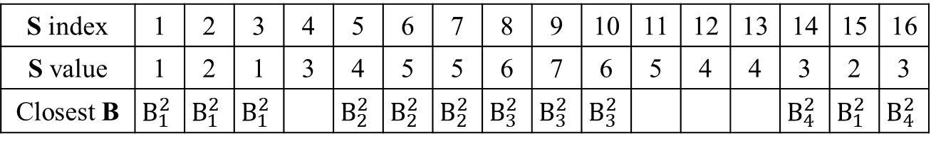
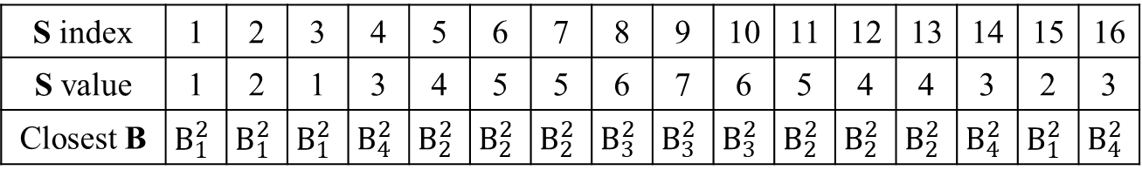
1 1 1 4 2 2 2 3 3 3 2 2 2 4 1 4
1 1 1 4 2 2 2 3 3 3 2 2 2 4 1 4
$$\left.S=[1, 2, 1, 3, 4, 5, 5, 6, 7, 6, 5, 4, 4, 3, 2, 3\right]$$
S index | 1 | 2 | 3 | 4 | 5 | 6 | 7 | 8 | 9 | 10 | 11 | 12 | 13 | 14 | 15 | 16
S value | 1 | 2 | 1 | 3 | 4 | 5 | 5 | 6 | 7 | 6 | 5 | 4 | 4 | 3 | 2 | 3
Closest B | $$B_{1}^{2}$$ | $$B_{1}^{2}$$ | $$B_{1}^{2}$$ | $$B_{4}^{2}$$ | $$B_{2}^{2}$$ | $$B_{2}^{2}$$ | $$B_{2}^{2}$$ | $$B_{3}^{2}$$ | $$B_{3}^{2}$$ | $$B_{3}^{2}$$ | $$B_{2}^{2}$$ | $$B_{2}^{2}$$ | $$B_{2}^{2}$$ | $$B_{4}^{2}$$ | $$B_{1}^{2}$$ | $$B_{4}^{2}$$
8
7
6
$$B_{3}^{2}$$
5
4
3
$$B_{2}^{2}$$
value
2
1
0
$$B_{4}^{2}$$
$$B_{1}^{2}$$
0 1 2 3 4 5 6 7 8 9 10 11 12 13 14 15 16
frame index
S index | 1 | 2 | 3 | 4 | 5 | 6 | 7 | 8 | 9 | 10 | 11 | 12 | 13 | 14 | 15 | 16
S value | 1 | 2 | 1 | 3 | 4 | 5 | 5 | 6 | 7 | 6 | 5 | 4 | 4 | 3 | 2 | 3
Closest B | $$B_{1}^{2}$$ | $$B_{1}^{2}$$ | $$B_{1}^{2}$$ |  | $$B_{2}^{2}$$ | $$B_{2}^{2}$$ | $$B_{2}^{2}$$ | $$B_{3}^{2}$$ | $$B_{3}^{2}$$ | $$B_{3}^{2}$$ |  |  |  | $$B_{4}^{2}$$ | $$B_{1}^{2}$$ | $$B_{4}^{2}$$

Slide 7
 | Predicted Positive | Predicted Negative
Actual True | True Positives, TP | False Negatives, FN
Actual False | False Positives, FP | True Negatives, TN
True Positives, TP | 將正類正確地預測為正類（真正）
False Positives, FP | 將負類錯誤地預測為正類（誤報）
False Negatives, FN | 將正類錯誤地預測為負類（漏報）
True Negatives, TN | 將負類正確地預測為負類（真負）
 | Accuracy | Precision | Recall | F1-Measure
CMF and CGF | 100 | 100 | 100 | 100
MFCC | 99.5 | 100 | 97.5 | 98.7
MMFCC | 95.3 | 82.1 | 97.5 | 89.1
GFCC | 99.3 | 100 | 96.3 | 98.1
PNCC | 98.8 | 96.3 | 97.5 | 96.9

Slide 8
Time domain
Frequency domain

Slide 9











Threshold
$$p_{1}$$
$$p_{2}$$
$$p_{3}$$
$$p_{4}$$
$$p_{5}$$
$$p_{6}$$
$$p_{7}$$
$$p_{8}$$
$$p_{9}$$
$$p_{10}$$
$$p_{n}$$

Slide 11
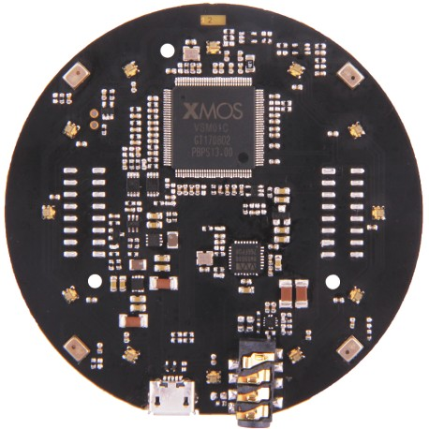
.
Angle: 90°
5M
MIC2
MIC1
Angle: 180°
Angle: 0°
MIC3
MIC4
Angle: 270°

