Slide 1

Fault Tolerance and Radiation Hardening for an Accelerated Computing Platform in Low Earth Orbit
James Roach
2019 CURO Symposium

Slide 2
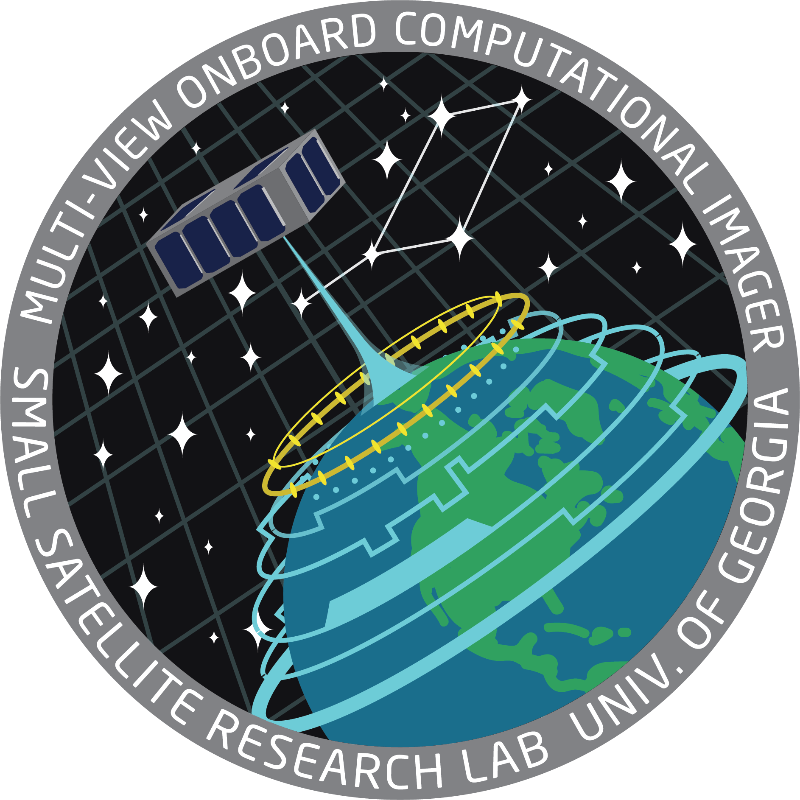



What is the UGA SSRL?
Student Run
Student Founded
Faculty Supported
NASA and UNP/AFRL funded
2 Cube Satellite Missions
54 Student Researchers

Slide 3
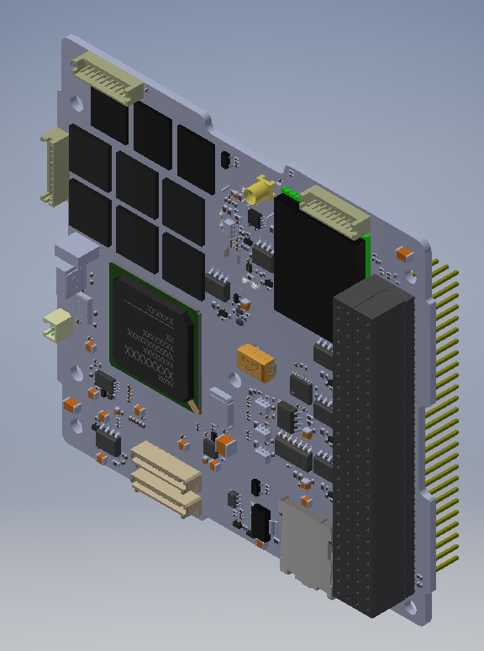
What Computers are in Space?
Low Powered
Radiation tolerant / mitigated
Typically 5-10 years behind the state of the art.
~ The size of 2 raspberry pis
This is a research area for the SSRL, Adapting better computers for space.

Slide 4
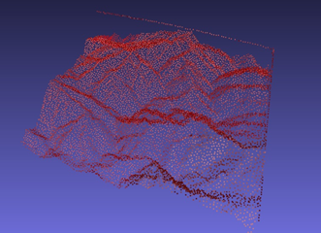
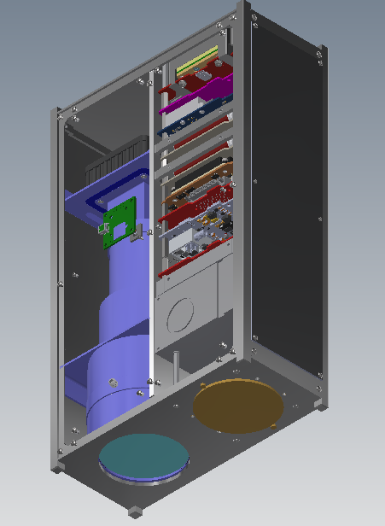
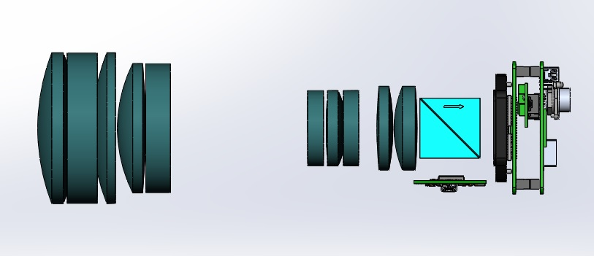


The MOCI Mission
Multiview Onboard Computational Imager
6U cube satellite in LEO
Goal is to generate 3D terrain models in near real-time
Removes the need for downlinking raw data
Flying an Nvidia Tegra X2i GPU SoC
Simulated computations of mountain ranges
Current MOCI optical layout
The MOCI satellite with front panel and UHF antenna removed
Notes:
Caleb

Slide 5
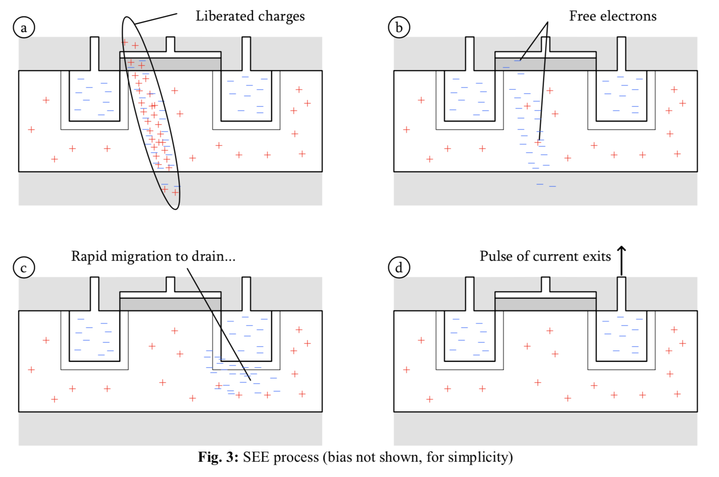
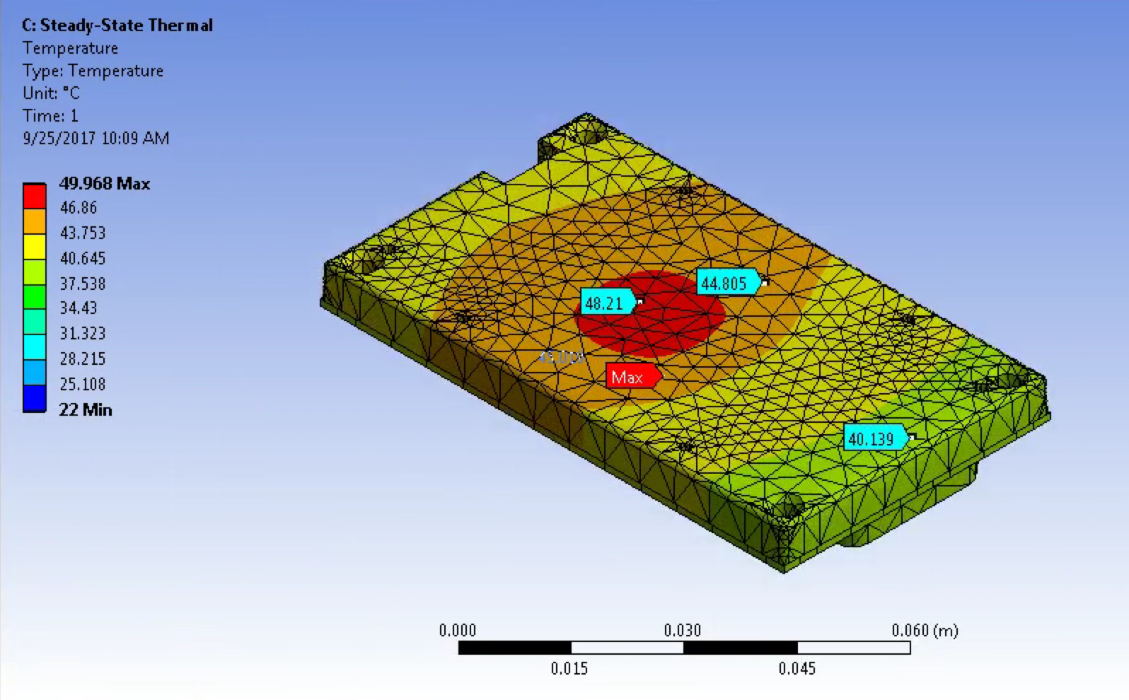
What is Hard About Putting a GPU into Space?
GPU’s get really hot
GPU’s use a lot of power
GPU’s are very susceptible to radiation damage
Notes:
Caleb

Slide 6
Strategies to Mitigate Radiation Damage?
Physical Shielding
Independent watchdog
Implementation of triple modular redundancy
Modifying the bootloader
Minimizing the Operating System
Computational checkpointing
Notes:
Caleb

Slide 7
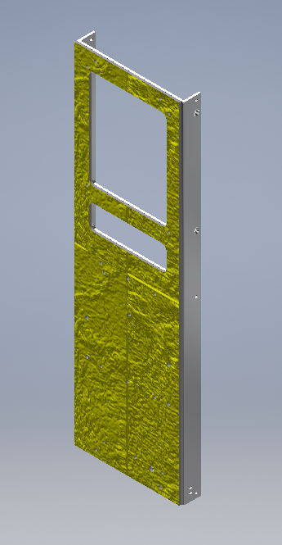
Physical Radiation Mitigation
Using Aluminized Kapton from Dunmore Aerospace Satkit
Working with JHU APL, using facilities at University of Washington to study effectiveness
Aluminum block around the TX2i helps with thermals and radiation
Aluminized Kapton shielding on a 3U face
Notes:
Caleb

Slide 8
Using On Board Computer as Controller for TX2i
Connects to TX2i via 500Kb/s TTL UART
OBC will act as ‘Master’ initiating all communications to the TX2i
API implemented on each side allowing for the OBC to send commands when needed and receive telemetry when requested
Upon detection of out of bounds behavior the OBC has the ability to hard reset the TX2i
Clyde Space OBC
Notes:
Caleb

Slide 9
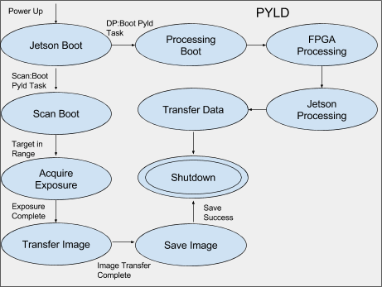
OBC as a Watchdog
OBC contains a Finite State Machine
updated via regular telemetry from the system
Will have the ability to hard or soft reset the TX2 upon detection of an anomalous state
IO is tested against simple checks to continue
Notes:
Caleb

Slide 10
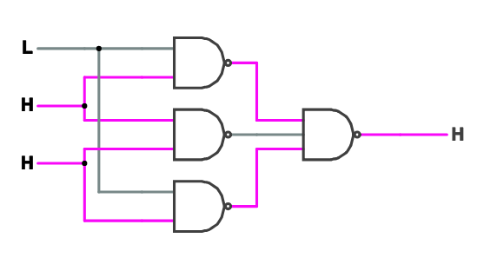
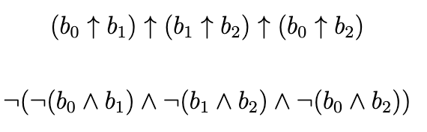
Triple Modular Redundancy (TMR)
Duplicate data thrice
3 NAND set to a NAND is a “majority” gate
A Single Event Upset (bit flip) does not affect data integrity
This can exist in hardware as well as software

Slide 11
Bootloader TMR
Using U-Boot to add custom boot time functionality to the TX2i
The principle of TMR safeguards against catastrophic OS corruption
3 identical OS images stored in memory, along with hashes of the images
Hashes used to determine if an image has been corrupted by radiation
Hash stored in triplicate to protect against hash corruption
If corruption is detected on all 3, bootloader will try to reconstruct a valid image
Uses principle of majority voting to determine which parts of the images are corrupted
Relies on unlikeliness of the exact same bit being corrupted on each image
-
-
Notes:
Caleb

Slide 12


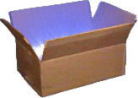
Minimizing the TX2i OS
The smaller the OS is the easier it is to store and the less likely it is to be corrupted
Ubuntu 16.04 LTS based
We will be using Busybox Jetson Root FS
Used to script FS generation and dependency population
Hardest parts are
maintaining all packages needed
maintaining CUDA compatibility
Notes:
Caleb

Slide 13
Block PTX checkpointing
Way of organizing how GPU code runs at a very low level
Can be used to implement TMR at the processing stage
Makes the execution much slower
When used with deterministic algorithms, it ensures the output is correct
B₀
B₁
B₂
TMR diagram at Block level
Notes:
Caleb

Slide 14

MOCI
Questions?

