Slide 1

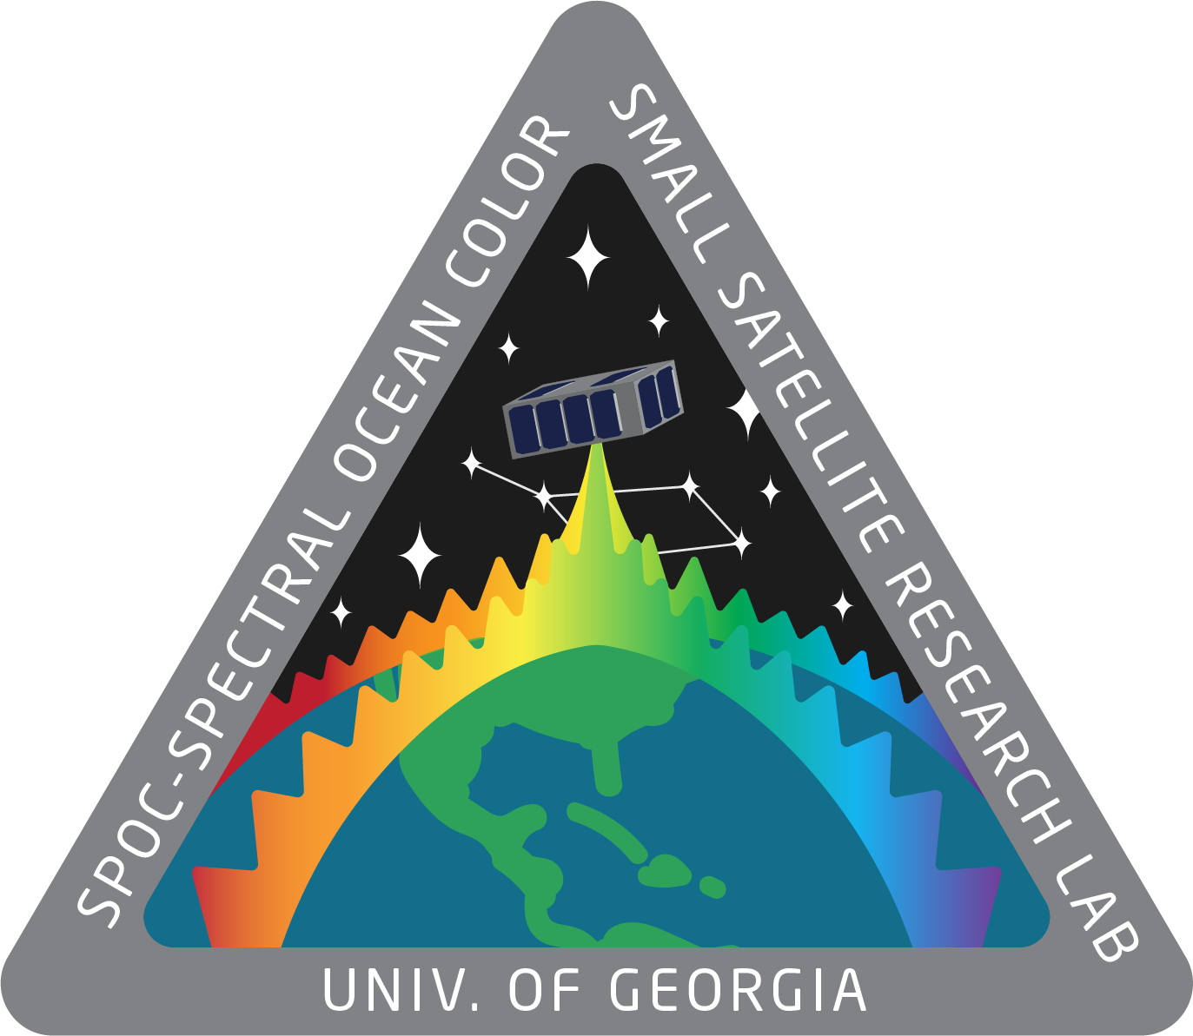
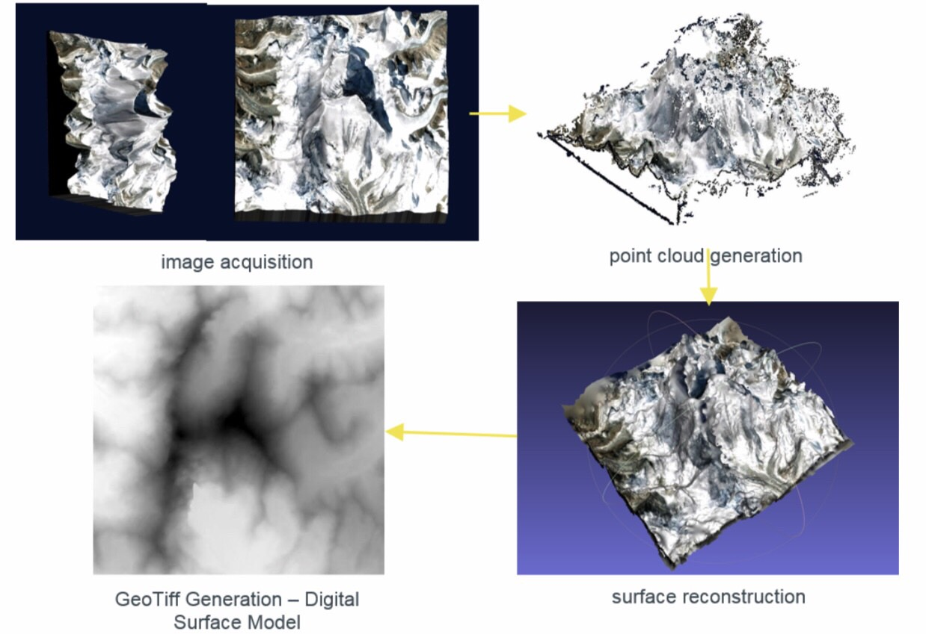
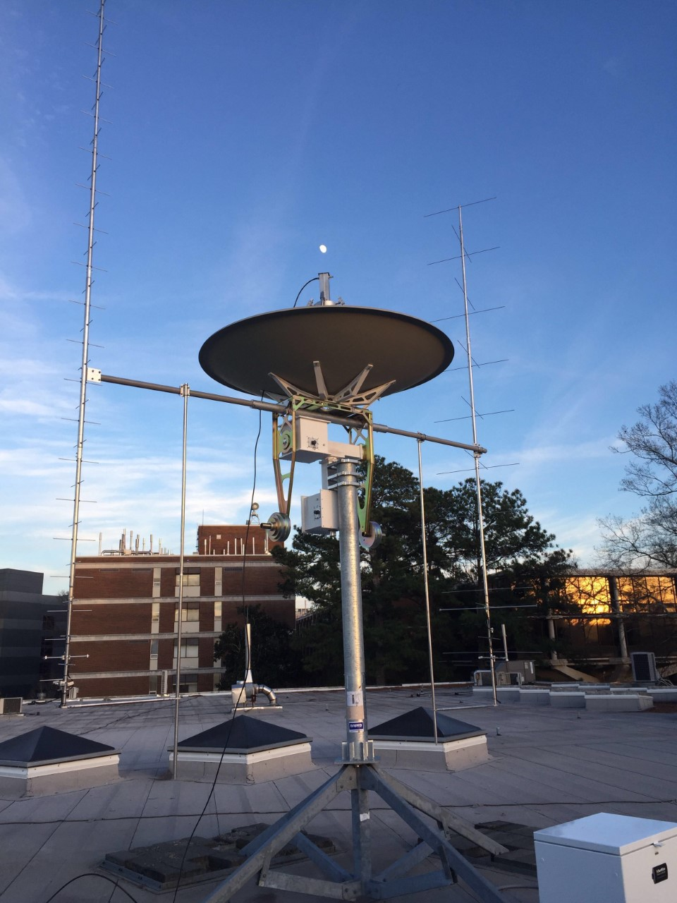
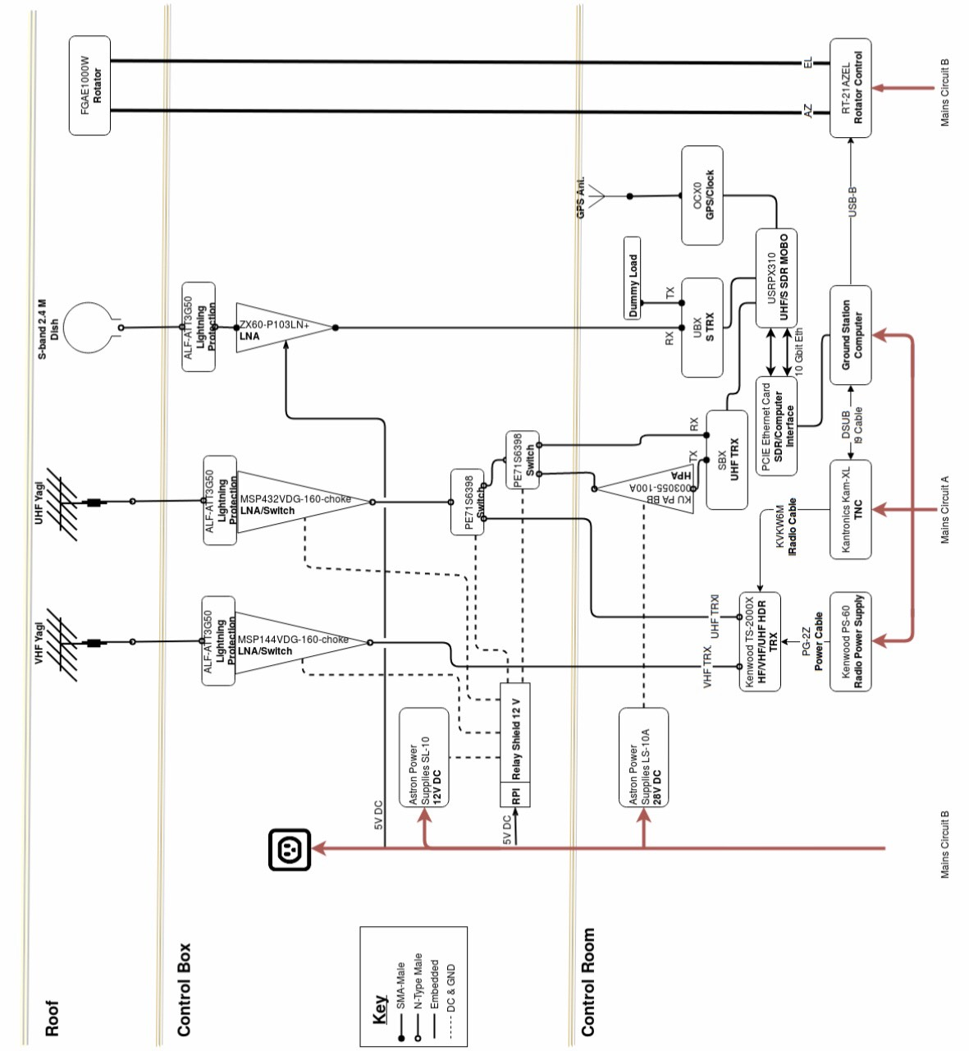
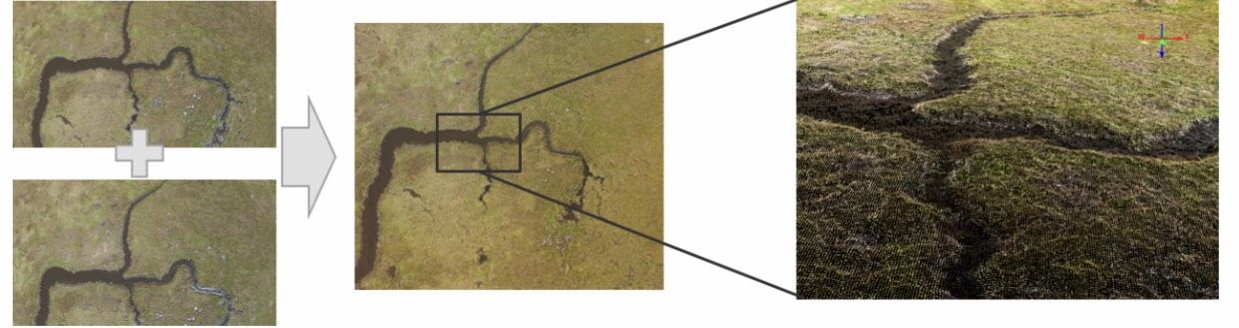
Small Satellite Communications:
Functionality and Testing
Claire Venenga*, David L. Cotten
*cav48861@uga.edu, dcotte1@uga.edu, Small Satellite Research Laboratory, University of Georgia,
Fig. 2
Overview
Communication is crucial for mission success. Within the University of Georgia’s Small Satellite Research Laboratory’s Mission Operations Team, a main focus is to keep the two satellites actively operable while they are in orbit. As each satellite passes overhead within a specific conical range, the opportunity for the data retrieval and transmitting arises. Through the packaging of data on the ground, custom mode management software is needed and utilized so that it may be integrated into deployments with the purpose of reading commands tailored to set potential operations with commands or receive specific telemetry that has been collected from the satellite itself. These occurrences are scheduled for execution with each of the satellites through planned data packet up-linking. In preparation for achieving the goal of successful data sharing, flight software must be created and managed through the practice of building and testing deployments for various, on-board components.
user screens are the next important contributor to successful communication, leading towards mission success. Targets are required within COSMOS so that a command can be sent to change the specified duty of interest. Once the target is appropriately named, its interface must be connected as a TCP/IP client. The client script is to be executed through socket communication as the TCP socket is listening and waiting for COSMOS to interact with it. Commands, such as “get frequency” and “set position” are capable of interacting as planned once the connection has been established and as long as the format of the telemetry packet has been created. This packet contains the appropriate frequency for communication. It is vital for errors to have been checked for and corrected so that the transmission and receiving of data is efficient. As long as there are none, the operator is able to open the Command & Telemetry Server offered by COSMOS. This is the site of the operable user interface screens that are designed to be easily operable for any member of the research laboratory to ensure no mistakes can or will be made during the time of communication. The target is displayed on the screen that is opened with an open connection stated. The Command Sender interface may be checked to ensure the desired target has been chosen. User screens designed by the Mission Operation’s team are accessible and serve as a simpler layout that is much safer to use. On these screens, not only can information be sent, but received information is readily displayed. Below is a figure displaying the interaction between COSMOS and its components, along with the Ground Station Computer,
the computer which will display the user screens designed based upon use cases that are either mission specific or take the environment and possible impacts or occurrences into consideration, once again, helping to ensure mission success. This intercommunication allows the orbiting satellites to send data for analyzing. The figure below displays cloud computing capabilities that the satellite may be capable of capturing with the high-resolution images taken from the spacecraft at specific angles, enabling a better viewpoint of the desired target.
Component and Ground Station Communication
Creation of deployments requires thorough understanding of the Bright Ascension Flight Software Development Kit, a component library that allows for a strong telecommand structure through the assembly of mission-specific communication architecture. Avoidance of errors during code implementation is vital as these can ultimately lead to communication failure; therefore, repeated trials through TMTCLab, a graphical user interface used to interact with the spacecraft database, and testing the deployments on the actual satellite components will ensure their functionality. Along with the component’s data packets on-board
Fig. 1
Application of Results
With the returned data from the satellites, Spectral Ocean Color (SPOC) and Multi-View Onboard Computation Imager (MOCI), coastal stresses will be monitored and onboard computing will provide compiled 3D mapping of the Earth’s surface for analysis. Below is another figure serving as an example of surface reconstruction using algorithms that permit the satellite to use onboard process, providing as a more efficient method of image processing. As a result of the satellites’ missions, advancements in DoD technologies will occur with the usage of the algorithms that make up three dimensional points near real time while also processing at high speeds.
the satellites and mainly handled by the research laboratory’s electrical engineering team, the ground station requires its own software which potentially gives an operator the ability to communicate. COSMOS is the user interface used for the commanding and controlling of embedded systems, and this provides the abilities to test operations, test automation, display data, graphs and more. This is where the ground station is also broken down into hardware components to develop software for too. Components, such as the rotator, are programmed so that the operator may control its capabilities, like the ground station’s azimuth and elevation. After the software for these capabilities has been programmed on the Mission Operation’s computer,
For more information about CubeSats, the Small Satellite Research Laboratory (SSRL), our missions, visit www.smallsat.uga.edu.
Notes:
1

