Slide 1
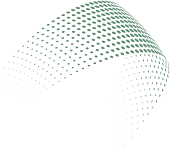

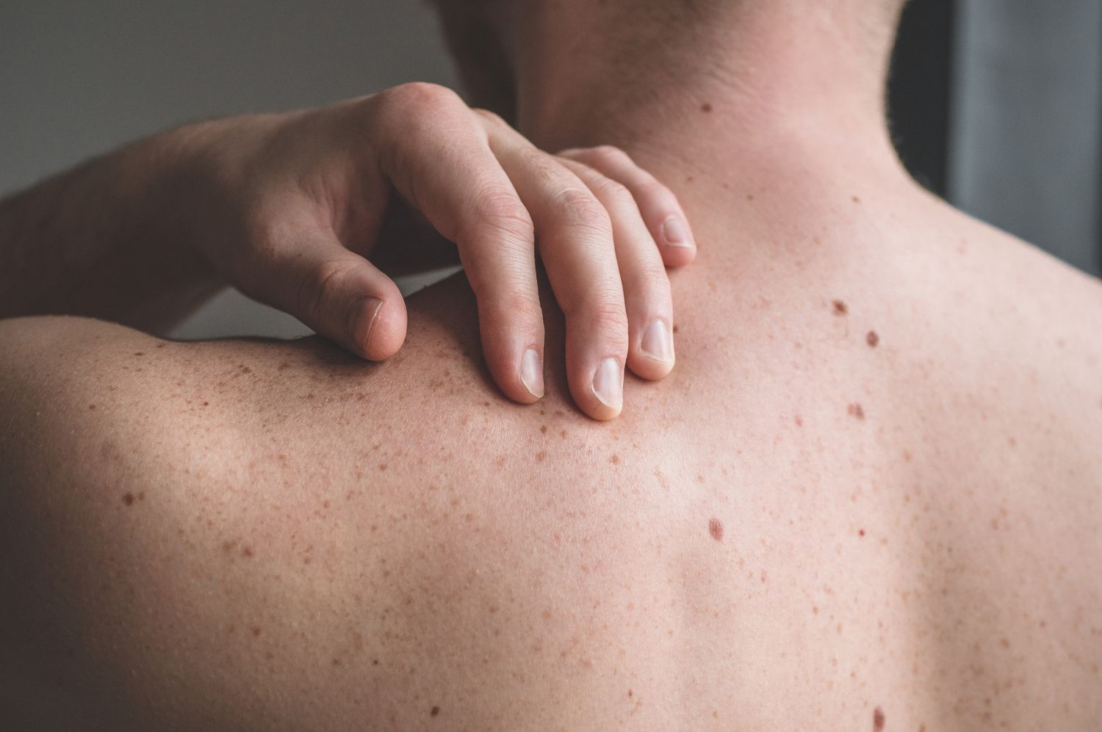
Skin Lesion Classification
Three deep-learning approaches on a 14-class image dataset
Sokha Marady | Batch 13, Software Engineering
Lecturer: Mr. Soklong HIM | Deep Learning Final Project

Slide 2

Problem and motivation
Given one photo of skin, predict which of 14 classes it shows.
8
5
1
Skin lesion types
Viral skin diseases
Healthy skin
Melanoma, melanocytic nevi, basal cell and squamous cell carcinoma, actinic keratoses, benign keratosis-like, dermatofibroma, vascular lesions
Chickenpox, cowpox, HFMD, measles, monkeypox
Normal skin, so the model can say "nothing here"
Research question: how much does pretrained knowledge help, compared with training a network from scratch?
2

Slide 3
Dataset and split
Kaggle dataset ahmedxc4/skin-ds: 36,656 images, 14 classes, official train / val / test folders
29,322
3,660
3,674
Train (80%)
Validation (10%)
Test (10%)
  Loaded with torchvision ImageFolder from the official folders as provided; we did not re-split
  All images resized to 224 x 224; test images use the same preprocessing as validation
3

Slide 4
Heavy class imbalance
10,300
191
about 54x
Melanocytic nevi
(train images)
more images
Dermatofibroma
(train images)
Weighted cross-entropy
Macro-F1 as the main metric
Rare classes count more in the loss, so the model cannot ignore them.
Every class counts equally, unlike accuracy, which the big classes dominate.
4

Slide 5
Three approaches compared
1
2
3
Custom CNN from scratch
ResNet-18, frozen
ResNet-18, fine-tuned
392,974
7,182
11,183,694
trainable parameters
trainable parameters
trainable parameters
Small CNN, random start. Learns everything from skin images only.
ImageNet weights kept fixed. Only the final linear layer is trained (linear probe).
ImageNet weights as the starting point. Every layer is trained at a low learning rate.
5

Slide 6
Experimental setup
Setting | CNN scratch | ResNet frozen | ResNet fine-tuned
Learning rate | 1e-3 | 1e-3 | 1e-4
Weight decay | 1e-4 | 1e-4 | 1e-4
Max epochs | 25 | 15 | 15
Training time (min) | 160.6 | 98.0 | 99.9
Shared by all three
  Adam optimiser
  ReduceLROnPlateau scheduler
  Batch size 32, input 224 x 224
  Weighted cross-entropy, seed 42
Best checkpoint
Metrics and hardware
Saved at the lowest validation loss, then evaluated once on the test set.
Accuracy, macro-F1, macro-precision, macro-recall. Tesla T4 GPU, PyTorch.
6

Slide 7
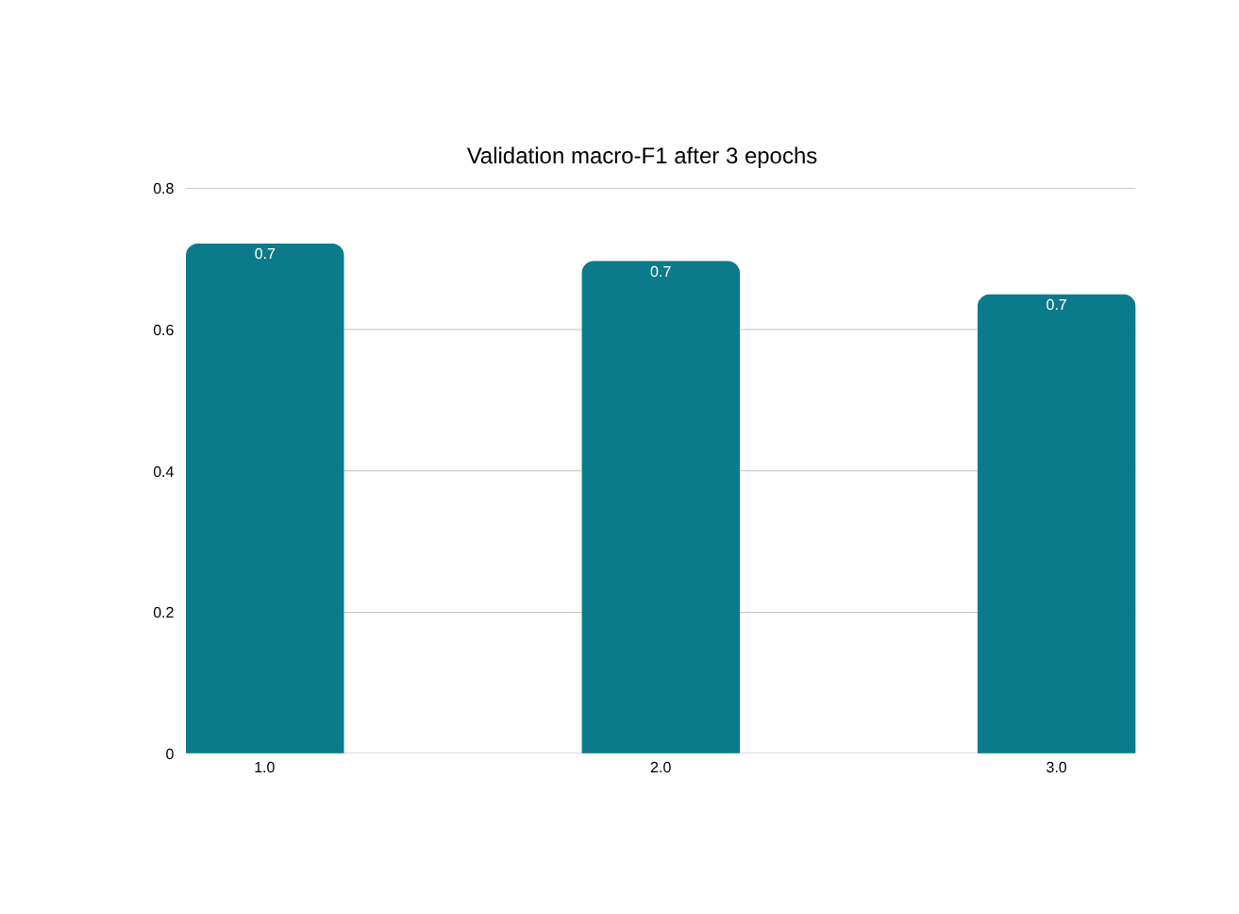
Hyperparameter tuning
What we learned
  Best: lr 1e-4 with weight decay 1e-4 (0.722)
  Removing weight decay lowered the score
  A smaller lr of 1e-5 learned too slowly in 3 epochs
7

Slide 8
Results on the test set
Approach | Accuracy | Macro-F1 | Macro-Prec. | Macro-Recall | Trainable params | Time (min)
1. CNN from scratch | 0.5822 | 0.5205 | 0.5053 | 0.6123 | 392,974 | 160.6
2. ResNet-18 frozen | 0.6184 | 0.5415 | 0.5179 | 0.6074 | 7,182 | 98.0
3. ResNet-18 fine-tuned | 0.8419 | 0.8330 | 0.8117 | 0.8607 | 11,183,694 | 99.9
+22 pts
+29 pts
~100 min
accuracy vs frozen ResNet
macro-F1 vs frozen ResNet
same cost as frozen on a T4
8

Slide 9
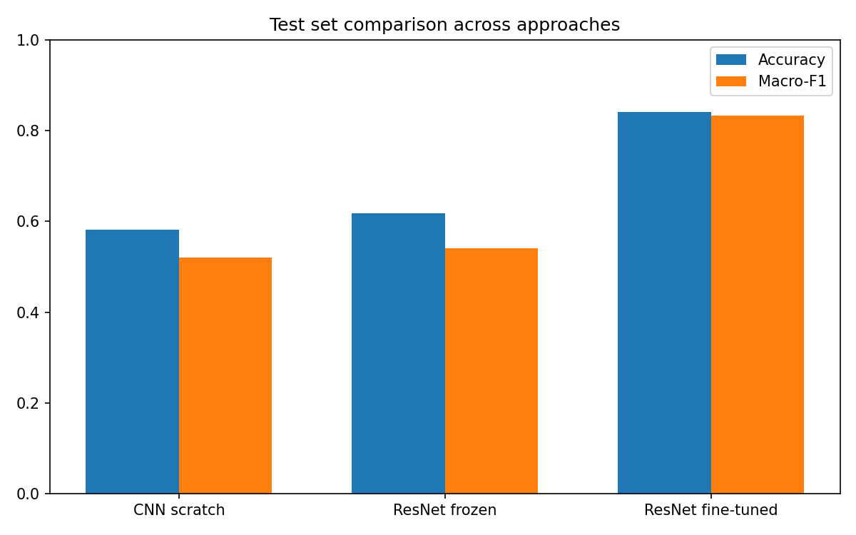
Fine-tuning clearly wins
  Fine-tuned: 0.842 accuracy, 0.833 macro-F1
  Frozen and scratch models both stay near 0.6 accuracy
  The scratch CNN was the slowest to train (160.6 min)
  The fine-tuned model has a small gap between accuracy and macro-F1, so rare classes are handled better
Figure: test accuracy and macro-F1
9

Slide 10
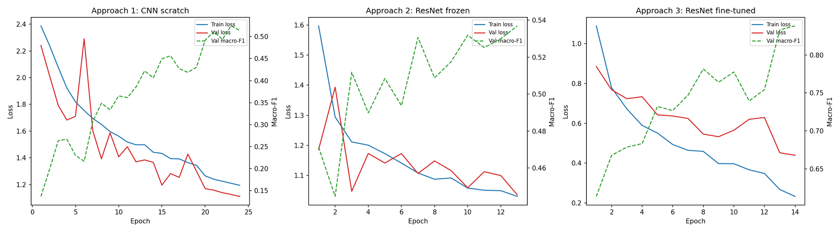
Learning curves: overfitting and underfitting
CNN scratch: underfitting
Frozen ResNet: plateau
Fine-tuned: mild overfitting
Loss is still falling at the end, so it is undertrained or capacity-limited.
Plateaus early with a noisy validation curve. Limited by the fixed features.
Train loss 0.23 vs val loss 0.44. Val loss is still lowest at the saved best epoch.
10

Slide 11
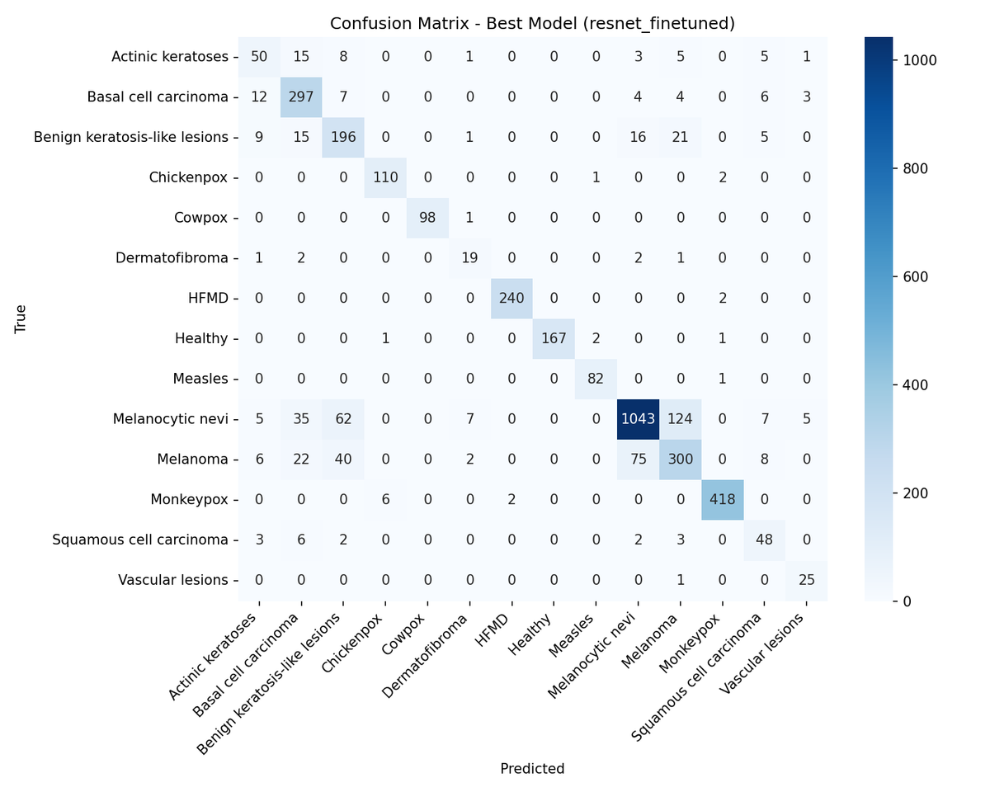
Error analysis: confusion matrix
Nevi and melanoma mix up
124 nevi predicted as melanoma, 75 melanoma predicted as nevi
Actinic keratoses (F1 0.57)
Only 50 of 88 correct; the rest spread to basal cell, benign keratosis, SCC
Viral classes are strong
Chickenpox, cowpox, HFMD, measles, monkeypox and healthy: F1 0.96 to 0.99
11

Slide 12
Why fine-tuning won, and an informal ensembling check
Why it won
Informal ensembling check
1
Frozen ImageNet features transfer poorly
Domain gap: skin photos differ from ImageNet, so a linear head on fixed features tops out at 0.618.
99.62%
fine-tuned model alone, one example photo
2
Every layer adapts to skin images
Pretrained start plus 11.2M trainable weights, versus 393k for the scratch CNN.
56.68%
equal-weight ensemble of all three, same photo
3
A tuned, gentle learning rate
lr 1e-4 won the tuning runs and keeps pretrained knowledge intact.
Here the weak CNN diluted the strong model. Not tested on the full test set.
12

Slide 13
Limitations and future work
Limitations
Future work
  Domain shift: can fail on random internet photos (informal tests), since it learned one dataset's photo style
  Multi-source acquisition bias: image source can leak into what the model learns
  Rare, look-alike classes stay weak: actinic keratoses, melanoma, dermatofibroma, SCC
  Not a diagnostic tool
  Data augmentation and more samples for rare classes
  Weighted or learned ensembling instead of equal weights
  Test on external datasets to measure domain shift
  Try larger pretrained backbones
13

Slide 14
Conclusion
  Fully fine-tuned ResNet-18 reached 0.842 accuracy and 0.833 macro-F1
  Frozen features and a scratch CNN both stayed near 0.6 accuracy
  Main errors: nevi vs melanoma and other look-alike lesions
  Next: rare-class data and external validation
github.com/Smarady67/
skin-lesion-classification

Slide 15
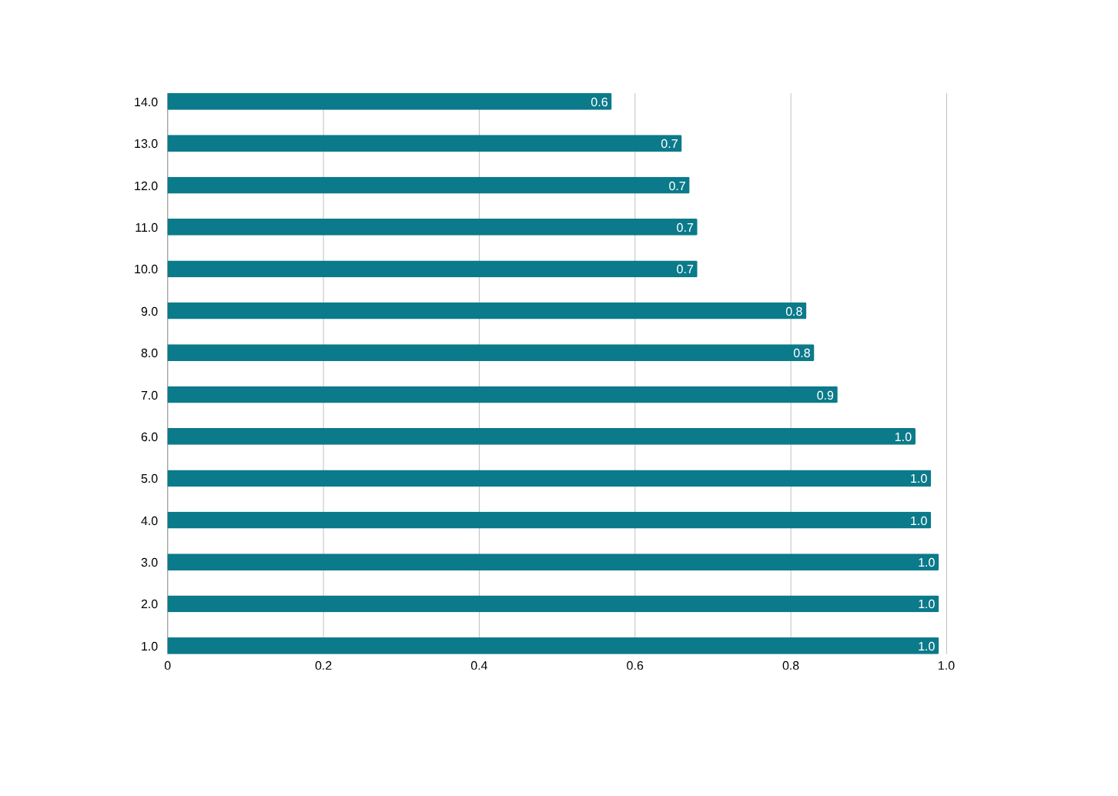
Appendix A: per-class F1, fine-tuned ResNet
Reading the chart
  Coral: F1 below 0.70
  Weak classes are rare and look alike
  Viral classes: 0.96 to 0.99
15

Slide 16
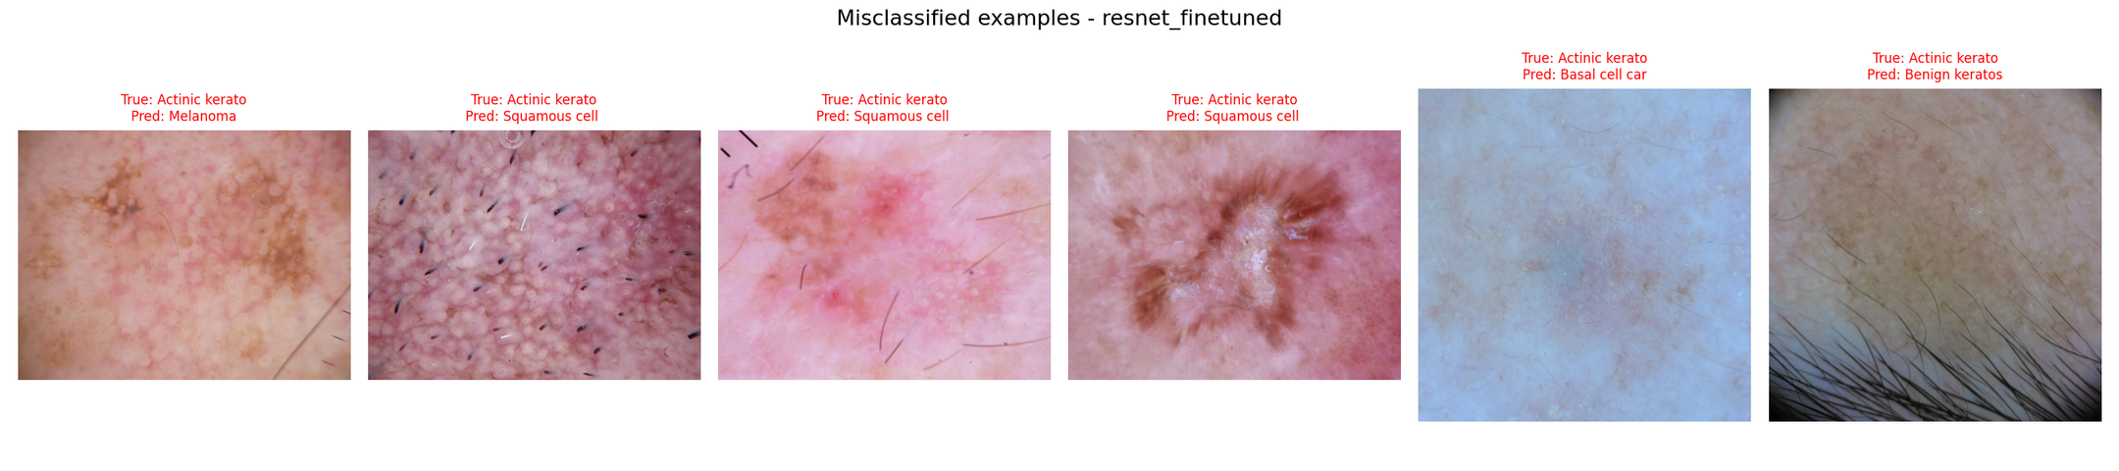
Appendix B: misclassified examples
  All six shown are actinic keratoses, predicted as melanoma, squamous cell carcinoma, basal cell carcinoma or benign keratosis
  These classes share colour and texture, so even a strong model confuses them
16

