Slide 1
A Bayesian mixture model for the analysis of allelic expression in single cells
Kwangbom Choi, Narayanan Raghupathy & Gary A. Churchill
Presenters: Marina Panteli, Smaragda Dimitrikapoulou, Sneha Sundar
STA426 Journal Club
30.11.2020

Slide 2
Outline
Background and Motivation
The method: scBASE
Results
Critique

Slide 3
Outline
Background and Motivation
The method: scBASE
Results
Critique

Slide 4
Motivation
Characterize the stochasticity of gene expression and its regulation
How does this stochasticity affect phenotypic variation?
Notes:
Gene expression is a stochastic process. If you take two genetically identical cells that are present in the same environment and measure their gene expression levels , you will find that the gene expression levels are not identical.

Slide 5
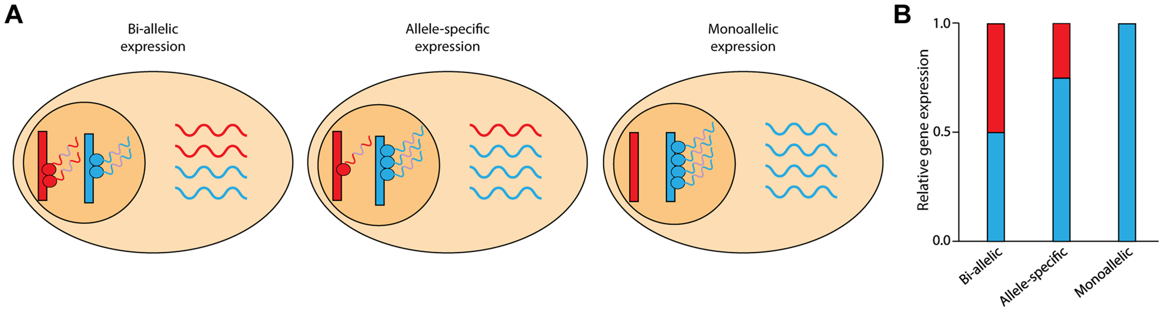
Allele-Specific-Expression (ASE)
Notes:
This paper focuses on one source of this stochasticity in gene expression which is at the level of alleles? Alleles are different forms of the same gene. In diploid organisms (such as humans , mice ) we inherit two copies of gene – one from the mother , one from the father. If there are genetic differences between these two copies, we say that we have two different alleles for this gene. When a gene is transcribed, what proportion of the transcripts come from the maternal allele and what proportion comes from the father? – explain the picture

Slide 6
Moving beyond the mean – scRNA Seq to characterize ASE in single cells
Requirement: Allele-specific alignments
Challenges:
Low depth of sequencing coverage per cell
Drop-out events
Separating technical variability from actual biological variability
Notes:
How are allele specific alignments created? - A diploid transcriptome was created from CAST and B6- specific sequences of each annotated transcript and aligned reads from each cell to obtain allele specific alignments
Dropout events: data we capture is only small fraction of transcriptome of cell due to technical failure to capture the RNA transcripts or stochastic bursting nature of transcription

Slide 7
Types of reads in ASE analysis
Unique reads
Allelic multiread
Genomic multiread
Complex multiread
Typically only unique reads are used for allele specific alignment
What authors claim : By discarding the multi-mapping reads, we are losing valuable information leading to higher variability in estimated allelic proportions -> allelic expression seems more dynamic than it actually is
Multi-mapping reads
Notes:
Unique reads -> unambiguous mapping to one allele of one gene
Allelic multiread -> map to both alleles of the same gene
Genomic multiread -> map to different genes but only one allele of each gene
Complex multiread -> map to multiple genes and to both alleles of any of those genes
Use multimapping reads to estimated expected distribution of alignments of all the reads using weighted allocation

Slide 8
The solution : scBASE
Reduce statistical variability by retaining and disambiguating multi-mapping reads -> weighted allocation of read counts
Improve estimates of allelic proportions by sharing information across cells in the same ASE states -> partial pooling estimator

Slide 9
Outline
Background and Motivation
The method: scBASE
Results and validation
Critique

Slide 10
scBASE Overview
Main Goal: Compute the expected proportion of maternal counts p_{gk} for each gene g in each cell k.
Three steps:
1.Read Counting
Estimate the expected maternal read counts x_{gk}
EM algorithm
2. Classification
Estimate the allelic expression state z_{gk}
Mixture model of Binomial Distributions
Estimate parameters with MCMC
3. Partial Pooling
Hierarchical Model
Partial pooling estimator p_{gk}
Iteratively

Slide 11
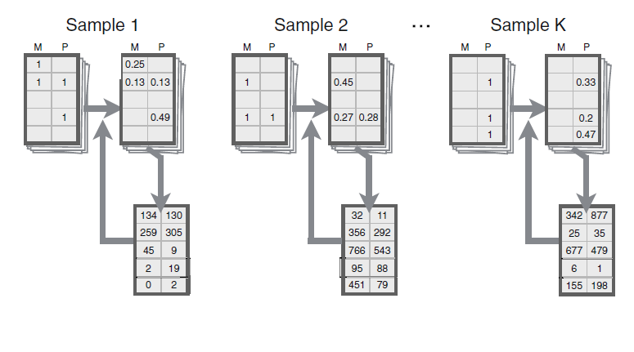
Read Counting
Estimation- Maximization Algorithm
Using the current estimate of allele specific gene expression, compute the probability of each possible alignment
Sum the probabilities across reads to re-estimate the allele specific gene expression
Repeat until convergence

Slide 12
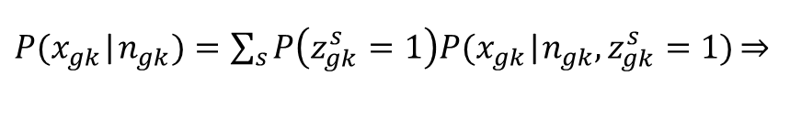

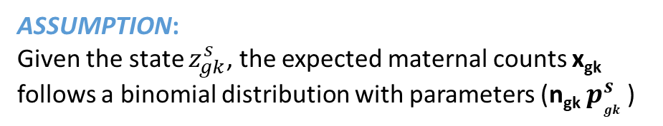


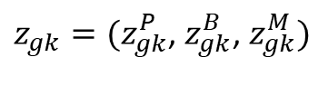


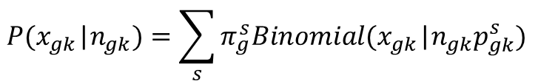
Classification
ASSUMPTION:
Each cell k is in one of three states with respect to the expression of gene g
Paternal Monoallelic (P)
Maternal Monoallelic (M)
Bi-allelic (B)
ASSUMPTION:
Given the state $z_{gk}^{s}$, the expected maternal counts x_{gk}
follows a binomial distribution with parameters (n_{gk} $p_{gk }^{s}$)
Mixture Model
For each cell we introduce an indicator vector:
$z_{gk}=(z_{gk}^{P}$, $z_{gk}^{B}$, $z_{gk}^{M})$
$P(x_{gk}$|$n_{gk})=\sum_{s}{P\left(z_{gk}^{s}=1\right)P(x_{gk}\text{|}n_{gk},z_{gk}^{s}=1)\underset{⇒}{}}$
$$z_{gk}^{s}=\left\{\begin{aligned}1 \\ 0\end{aligned}\right.$$
$$if gene G is in expression state s$$
$$otherwise$$
$$P(x_{gk}\text{|}n_{gk})=\sum_{s}{π_{g}^{s}Binomial(x_{gk}\text{|}n_{gk}p_{gk}^{s}) }$$
with
$$\sum_{s}{z_{gk}^{s}}=1$$
${(p}_{gk}^{p}=p_{g}^{P}{, p}_{gk}^{M}=p_{g}^{M}$)

Slide 13
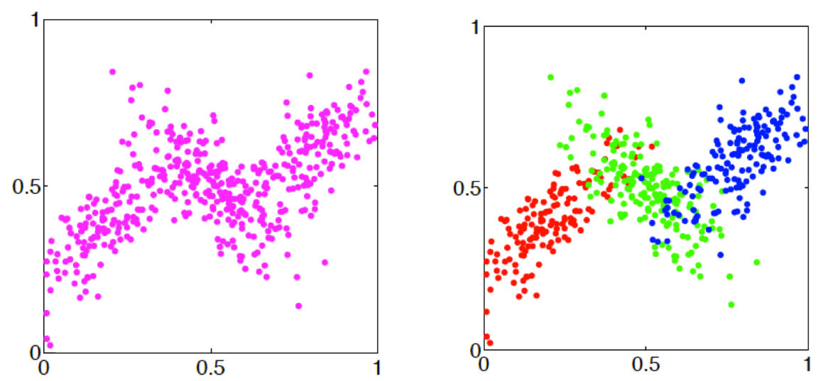
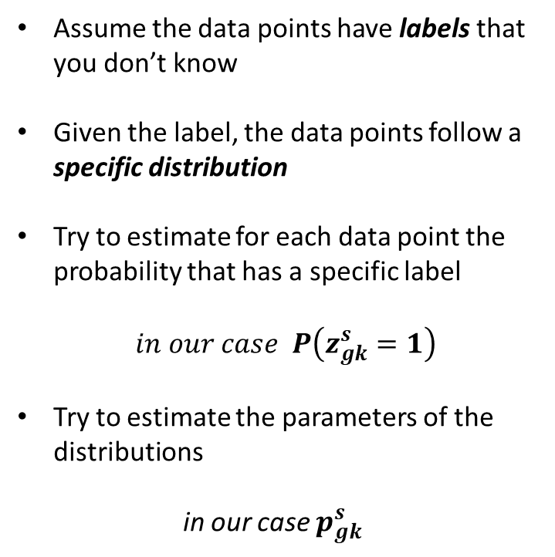
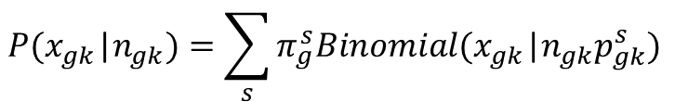
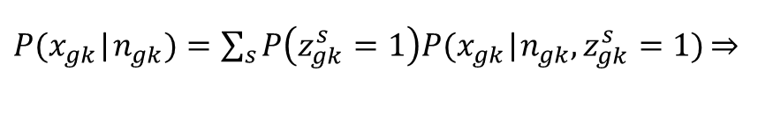
Mixture Models
Assume the data points have labels that you don’t know
Given the label, the data points follow a specific distribution
Try to estimate for each data point the probability that has a specific label
$in our case P\left(z_{gk}^{s}=1\right)$
Try to estimate the parameters of the distributions
in our case $p_{gk}^{s}$
$P(x_{gk}$|$n_{gk})=\sum_{s}{P\left(z_{gk}^{s}=1\right)P(x_{gk}\text{|}n_{gk},z_{gk}^{s}=1)\underset{⇒}{}}$
$$P(x_{gk}\text{|}n_{gk})=\sum_{s}{π_{g}^{s}Binomial(x_{gk}\text{|}n_{gk}p_{gk}^{s}) }$$

Slide 14
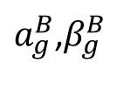




Partial Pooling
Hierarchical Modeling
Problems:
$$a_{g}^{mono}$$
$a_{g}^{B}$,$β_{g}^{B}$
Many parameters per gene
Thousands of genes
Large number of parameters
~Beta
~Beta
~Beta
$$p_{g}^{P}$$
$$p_{g}^{M}$$
$$p_{gk}^{B}$$
Low read counts
Sampling Variation
Limited data for reliable estimation
x_{g1}
x_{g2}
…..
x_{gK}

Slide 15
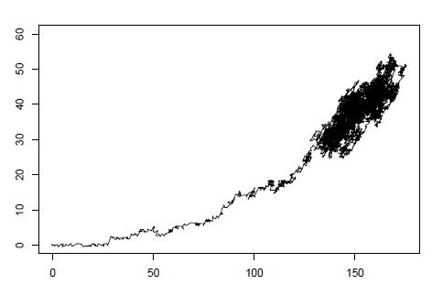
Estimation of parameters
Random walk in a 2D space
Analytical solution to the maximum likelihood estimators does not exist
Use MCMC to randomly sample parameter values from their conditional posterior distributions
Provides the full posterior distribution
Information about the uncertainty of the parameters

Slide 16
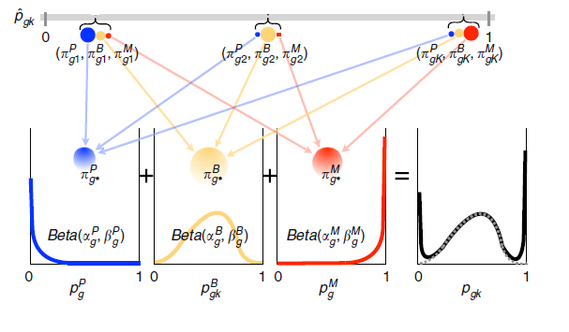
Partial pooling estimator
For each sampled parameters from the MCMC:
We estimate the classification probabilities ${ π}_{gk}^{P},π_{gk}^{B}$, $π_{gk}^{M}$
We estimate the expected proportion of maternal counts p_{gk} as a weighted average:
The average value across many iterations is the partial pooling estimator
$p_{gk}$= $π_{gk}^{P}p_{g}^{P}$+$π_{gk}^{B}p_{gk}^{B}$+$π_{gk}^{M}p_{g}^{M}$

Slide 17
Outline
Background and Motivation
The method: scBASE
Results and validation
Critique

Slide 18
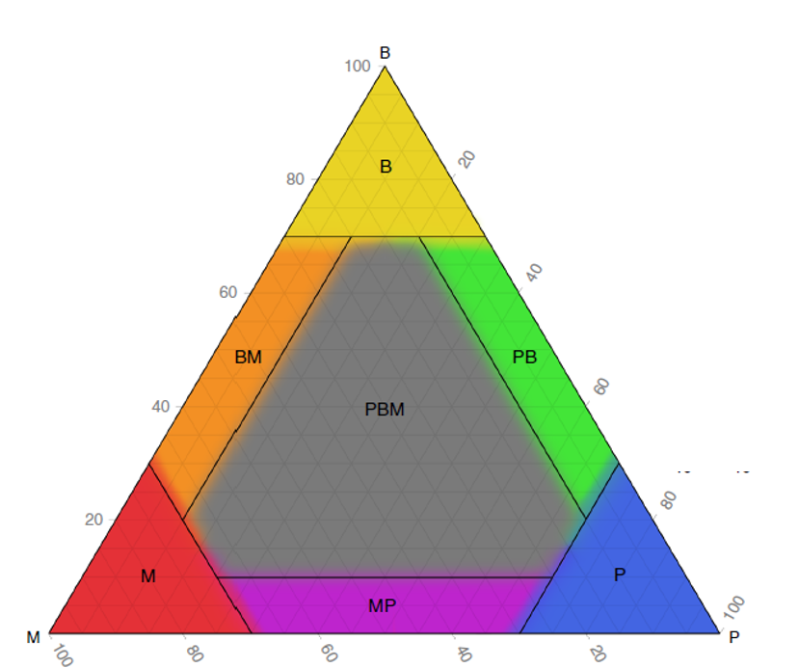
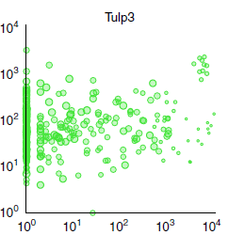
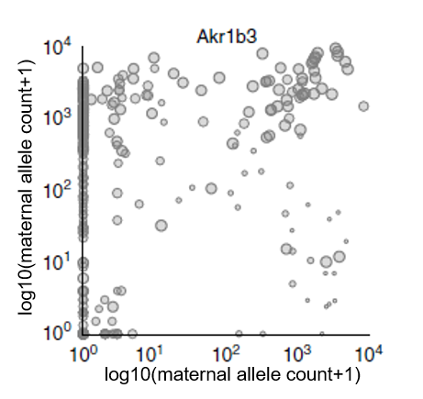
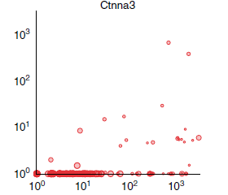
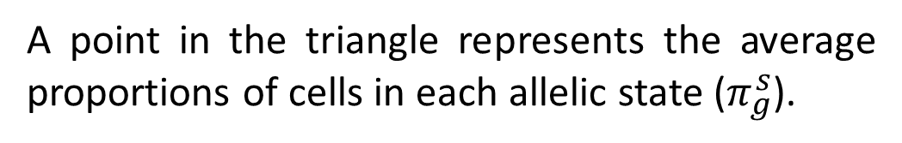
Representation of allelic expression
log10(paternal allele count+1)
log10(maternal allele count+1)
log10(paternal allele count+1)
log10(maternal allele count+1)
A point in the triangle represents the average proportions of cells in each allelic state ($π_{g}^{s}$).

Slide 19
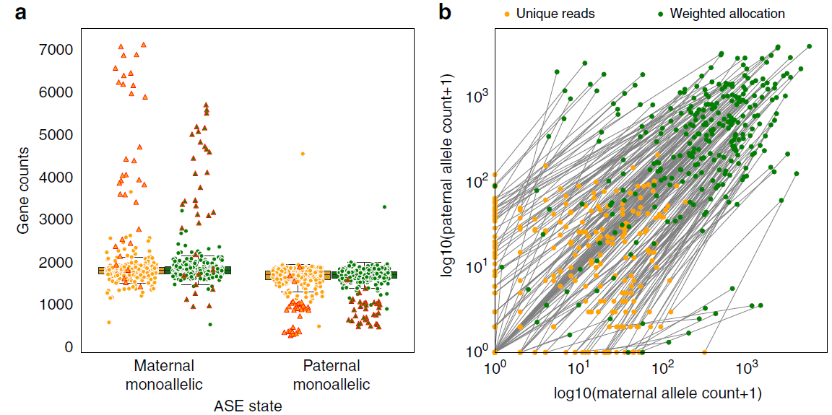
Results: Unique Reads vs Weighted Allocation
Unique reads finds more monoallelic expression than Weighted allocation.
Weighted allocation detects bi-allelic expression in more cells than Unique reads.

Slide 20
Truth standard and Data
Truth standard: 122 mature blastocyst cells (~14.8M reads/cell)
Downsampling
148k reads/cell
Mature blastocyst cells are chosen so that their allelic expression does not vary as much as blastocyst cells in their earliest stages.

Slide 21
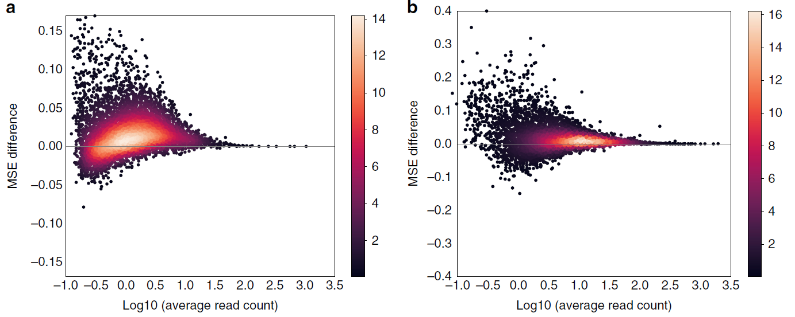
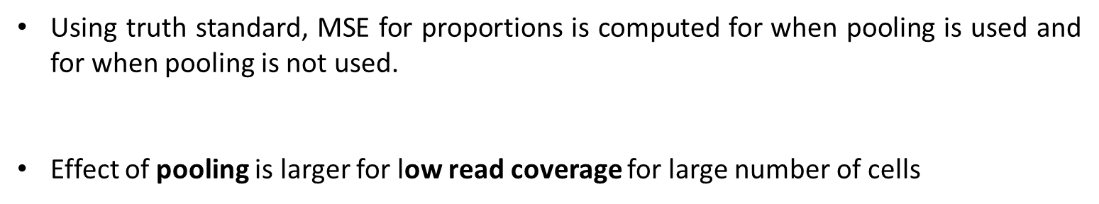
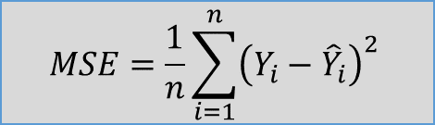


Results: Effect of Partial Pooling
Using truth standard, MSE for proportions is computed for when pooling is used and for when pooling is not used.
Effect of pooling is larger for low read coverage for large number of cells
$$MSE=\frac{1}{n}\sum_{i=1}^{n}{{\left(Y_{i}−{\hat{Y}}_{i}\right)}^{2}}$$
Unique Reads
Weighted Allocation
$$\overline{MSE}=0.018$$
$$\overline{MSE}=0.016$$

Slide 22
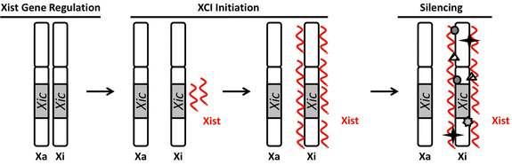
Special case: X chromosome
All X chromosomes have XIC site Xist transcript mmm Inactivation of the X chromosome that produced the Xist transcript
At blastocyst stage of a female the inactivation for each cell happens to one of two X chromosomes.
Partial Pooling reinforces the expected pattern of expression, as verified from different datasets.

Slide 23
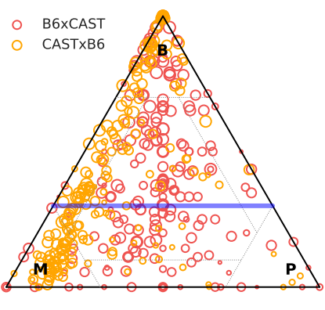
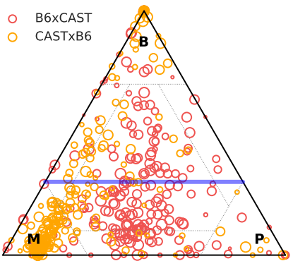

Visualization of Results
Partial Pooling
CASTxB6 cells: Xist expressed from the paternal allele Genes expressed from M allele
B6xCAST cells: Xist expressed from either allele Genes expressed from in the MP class

Slide 24
Outline
Background and Motivation
The method: scBASE
Results and validation
Critique

Slide 25
Critique
The effect of sequencing depth on the estimates were not actually characterized
Study done on data from cells in early development state -> gene expression dynamic by nature .
A more thorough validation needed with other types of datasets and other types of cells.
No comparison done with other algorithms in the field such as SCALE
Notes:
the approach to providing experimental design guidelines is shared among all: given a deeply sequenced dataset with a predefined number of cells, how much subsampling can a given method tolerate? An example of this conventional approach is also evident in the mathematical model used in a recent work¹¹ to study the effect of sequencing depth on PCA. Although practically relevant, this line of work does not provide a comprehensive solution to the underlying experimental design question because of three reasons: (1) the number of cells is fixed and implicitly assumed to be enough for the biological question at hand; (2) the deeply sequenced dataset is considered to be the ground truth; (3) the corresponding estimation method is chosen a priori and is tied to the experiment. https://www.nature.com/articles/s41467-020-14482-y

Slide 26
References
Kukurba KR, Zhang R, Li X, Smith KS, Knowles DA, et al. (2014) Allelic Expression of Deleterious Protein-Coding Variants across Human Tissues. PLOS Genetics 10(5): e1004304. https://doi.org/10.1371/journal.pgen.1004304
Jiang, Y., Zhang, N.R. & Li, M. SCALE: modeling allele-specific gene expression by single-cell RNA sequencing. Genome Biol 18, 74 (2017). https://doi.org/10.1186/s13059-017-1200-8
Single-Cell RNA-Seq Reveals Dynamic, Random Monoallelic Gene Expression in Mammalian Cells - https://science.sciencemag.org/content/343/6167/193
Reinius, B., Mold, J., Ramsköld, D. et al. Analysis of allelic expression patterns in clonal somatic cells by single-cell RNA–seq. Nat Genet 48, 1430–1435 (2016). https://doi.org/10.1038/ng.3678
Kim, J., Kolodziejczyk, A., Ilicic, T. et al. Characterizing noise structure in single-cell RNA-seq distinguishes genuine from technical stochastic allelic expression. Nat Commun 6, 8687 (2015). https://doi.org/10.1038/ncomms9687

Slide 27
Distribution of reads in dataset
Type of reads | Percentage of total number of reads (%)
Unique reads | 14.9
Allelic multi-reads | 59.3
Genomic multi-reads | 2.5
Complex multi-reads | 23.3

