Slide 1
BIOLOGICAL
What is an allele
Allele specific expression
Extreme example: X chromosome
Why it matters
Allele specific expr. ->transcriptional regulation, cancer, metabolic diseases

Slide 2
Other methods and why scBASE
Unique reads, multimapping reads
Role of partial pooling

Slide 3
scBASE Overview
Main Goal: Compute the expected proportion of maternal counts p_{gk} for each gene g in each cell k.
Three steps:
1.Read Counting
Estimate the expected maternal read counts x_{gk}
EM algorithm
2. Classification
Estimate the allelic expression state z_{gk}
Mixture model of Binomial Distributions
Estimate parameters with MCMC
3. Partial Pooling
Hierarchical Model
Partial pooling estimator p_{gk}
Iteratively

Slide 4
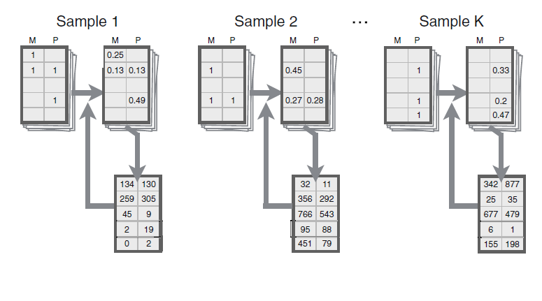
Read Counting
Estimation- Maximization Algorithm
Using the current estimate of allele specific gene expression, compute the probability of each possible alignment
Sum the probabilities across reads to re-estimate the allele specific gene expression
Repeat until convergence

Slide 5
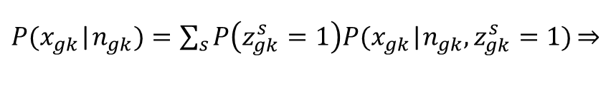

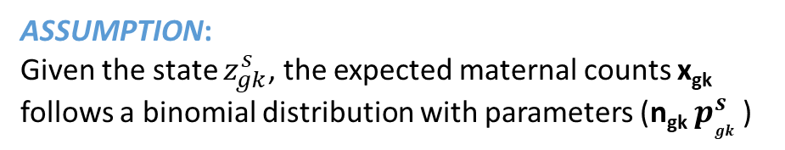


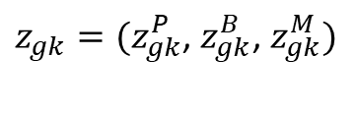


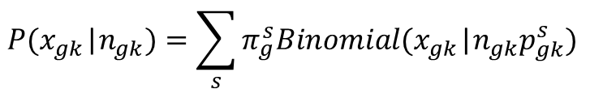
Classification
ASSUMPTION:
Each cell k is in one of three states with respect to the expression of gene g
Paternal Monoallelic (P)
Maternal Monoallelic (M)
Bi-allelic (B)
ASSUMPTION:
Given the state $z_{gk}^{s}$, the expected maternal counts x_{gk}
follows a binomial distribution with parameters (n_{gk} $p_{gk }^{s}$)
Mixture Model
For each cell we introduce an indicator vector:
$z_{gk}=(z_{gk}^{P}$, $z_{gk}^{B}$, $z_{gk}^{M})$
$P(x_{gk}$|$n_{gk})=\sum_{s}{P\left(z_{gk}^{s}=1\right)P(x_{gk}\text{|}n_{gk},z_{gk}^{s}=1)\underset{⇒}{}}$
$$z_{gk}^{s}=\left\{\begin{aligned}1 \\ 0\end{aligned}\right.$$
$$if gene G is in expression state s$$
$$otherwise$$
$$P(x_{gk}\text{|}n_{gk})=\sum_{s}{π_{g}^{s}Binomial(x_{gk}\text{|}n_{gk}p_{gk}^{s}) }$$
with
$$\sum_{s}{z_{gk}^{s}}=1$$
${(p}_{gk}^{p}=p_{g}^{P}{, p}_{gk}^{M}=p_{g}^{M}$)

Slide 6
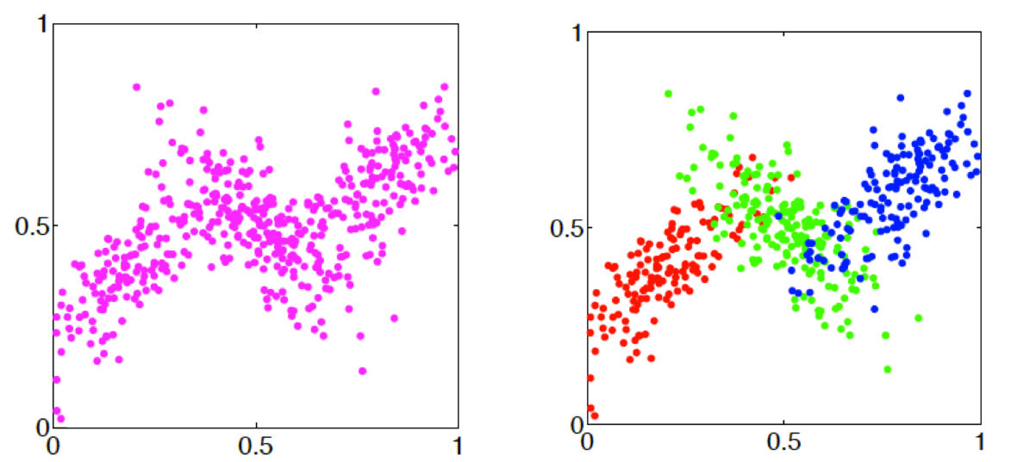
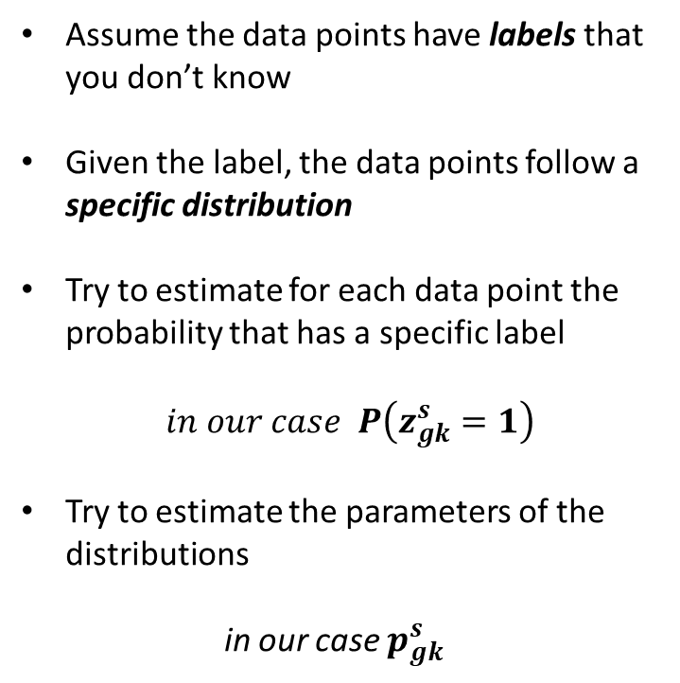
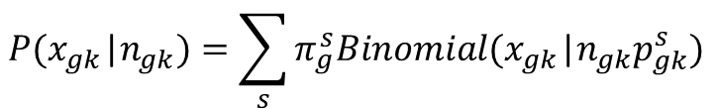
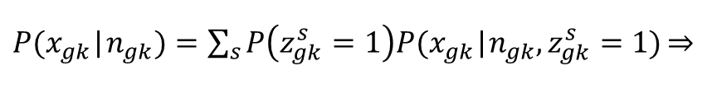
Mixture Models
Assume the data points have labels that you don’t know
Given the label, the data points follow a specific distribution
Try to estimate for each data point the probability that has a specific label
$in our case P\left(z_{gk}^{s}=1\right)$
Try to estimate the parameters of the distributions
in our case $p_{gk}^{s}$
$P(x_{gk}$|$n_{gk})=\sum_{s}{P\left(z_{gk}^{s}=1\right)P(x_{gk}\text{|}n_{gk},z_{gk}^{s}=1)\underset{⇒}{}}$
$$P(x_{gk}\text{|}n_{gk})=\sum_{s}{π_{g}^{s}Binomial(x_{gk}\text{|}n_{gk}p_{gk}^{s}) }$$

Slide 7
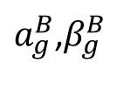




Partial Pooling
Hierarchical Modeling
Problems:
$$a_{g}^{mono}$$
$a_{g}^{B}$,$β_{g}^{B}$
Many parameters per gene
Thousands of genes
Large number of parameters
~Beta
~Beta
~Beta
$$p_{g}^{P}$$
$$p_{g}^{M}$$
$$p_{gk}^{B}$$
Low read counts
Sampling Variation
Limited data for reliable estimation
x_{g1}
x_{g2}
…..
x_{gK}

Slide 8
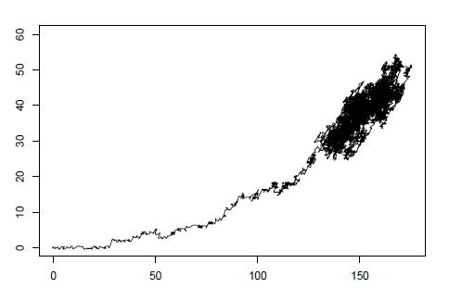
Estimation of parameters
Random walk in a 2D space
Analytical solution to the maximum likelihood estimators does not exist
Use MCMC to randomly sample parameter values from their conditional posterior distributions
Provides the full posterior distribution
Information about the uncertainty of the parameters
MCMC methods: create a reversible Markov chain whose stationary distribution is the
desired probability distribution.

Slide 9
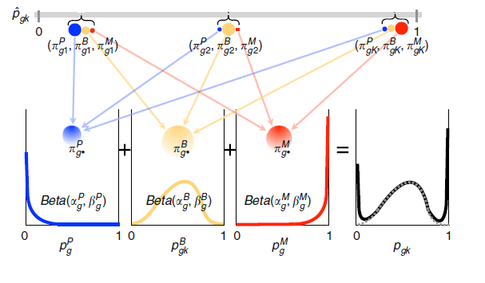

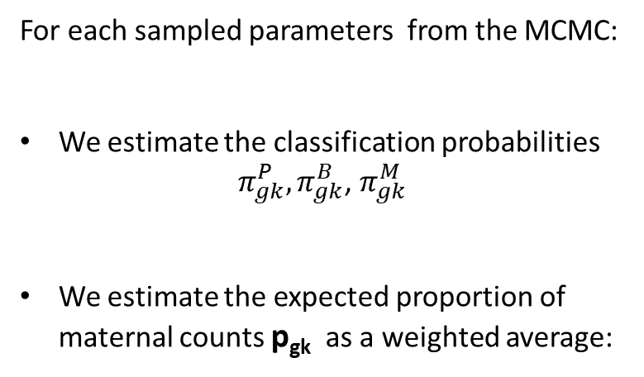
Partial pooling estimator
For each sampled parameters from the MCMC:
We estimate the classification probabilities ${ π}_{gk}^{P},π_{gk}^{B}$, $π_{gk}^{M}$
We estimate the expected proportion of maternal counts p_{gk} as a weighted average:
The average value across many iterations is the partial pooling estimator
$p_{gk}$= $π_{gk}^{P}p_{g}^{P}$+$π_{gk}^{B}p_{gk}^{B}$+$π_{gk}^{M}p_{g}^{M}$

Slide 10
Results
Figure 2
Figure 6

Slide 11
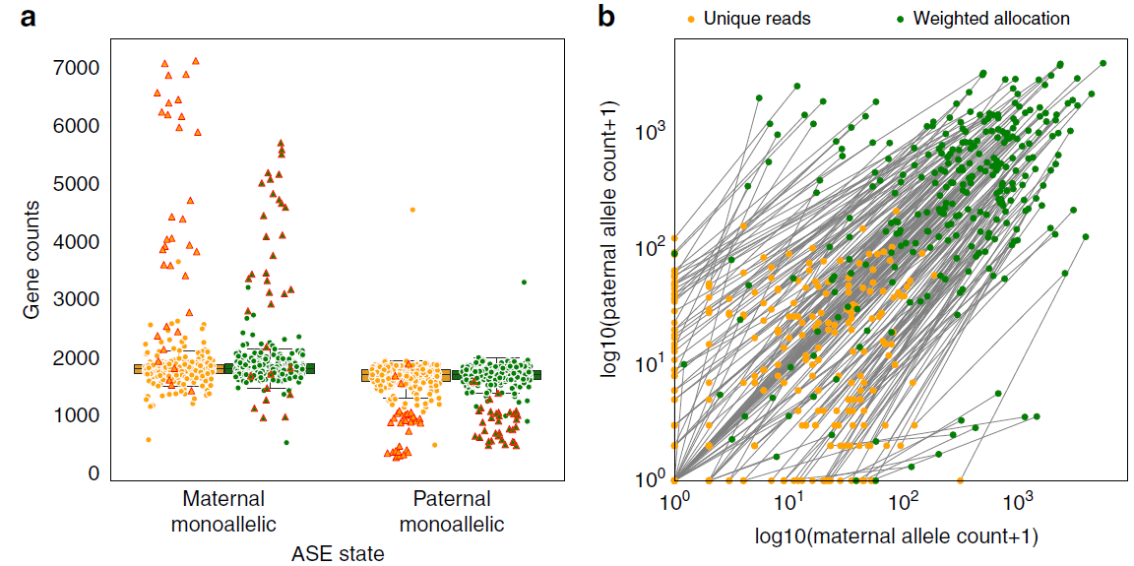
Results: Unique Reads vs Weighted Allocation
Unique reads finds more monoallelic expression than Weighted allocation.
Weighted allocation detects bi-allelic expression in more cells than Unique reads.

Slide 12
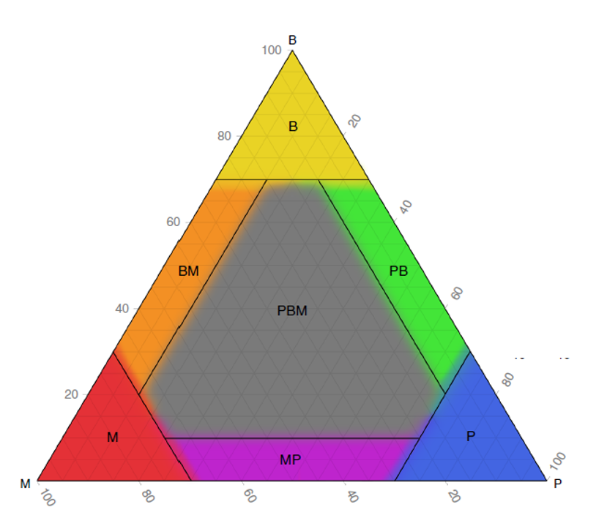
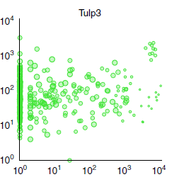
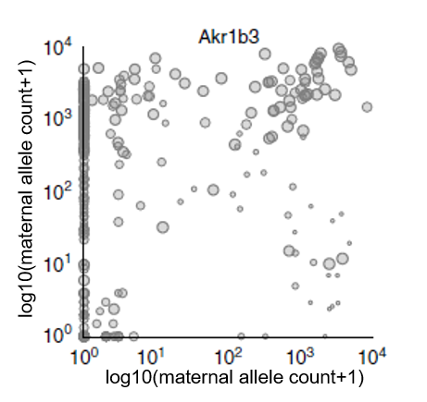
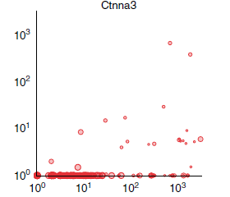
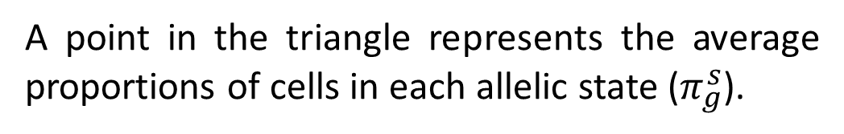
Representation of allelic expression
log10(paternal allele count+1)
log10(maternal allele count+1)
log10(paternal allele count+1)
log10(maternal allele count+1)
A point in the triangle represents the average proportions of cells in each allelic state ($π_{g}^{s}$).

Slide 13
Truth standard and Data
Truth standard: 122 mature blastocyst cells (~14.8M reads/cell)
Downsampling
148k reads/cell
Mature cells are chosen so that their allelic expression does not vary too much.

Slide 14
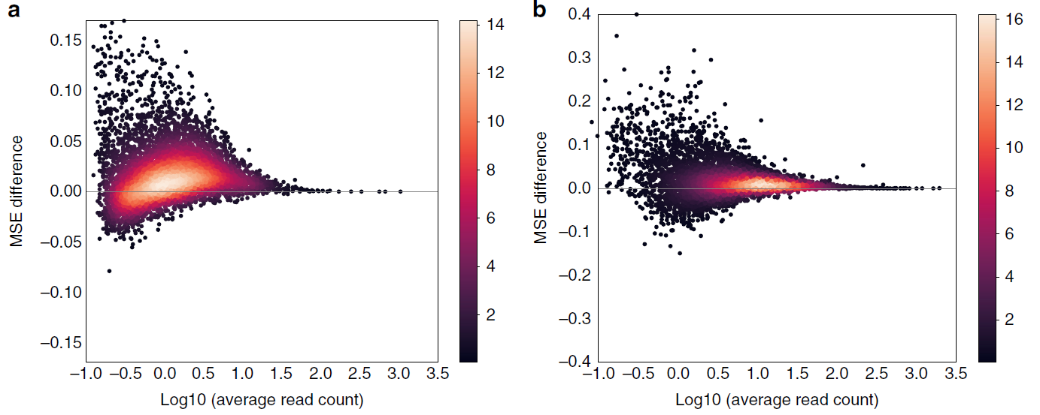


Results: Effect of Partial Pooling
Using truth standard, MSE for proportions is computed for when pooling is used and for when pooling is not used.
Effect of pooling is larger for low read coverage for large number of cells
Unique Reads
Weighted Allocation
$$\overline{MSE}=0.018$$
$$\overline{MSE}=0.016$$

Slide 15
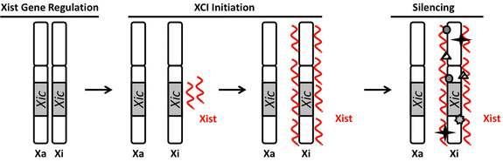
Special case: X chromosome
All X chromosomes have XIC site Xist transcript mmm Inactivation of the X chromosome that produced the Xist transcript
At blastocyst stage of a female the inactivation for each cell happens to one of two X chromosomes.
Partial Pooling reinforces the expected pattern of expression, as verified from different datasets.

Slide 16
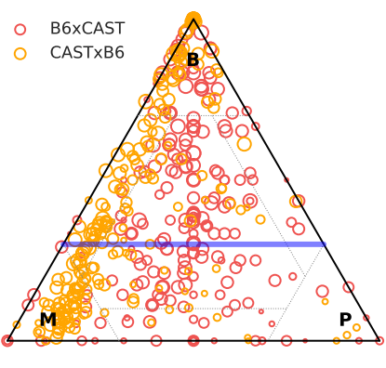
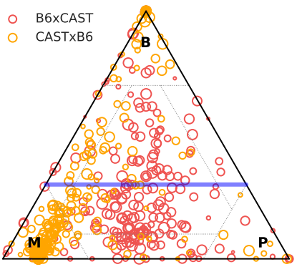

Visualization of Results
Partial Pooling
CASTxB6 cells: Xist expressed from the paternal allele Genes expressed from M allele
B6xCAST cells: Xist expressed from either allele Genes expressed from in the MP class

Slide 18
Validation
Validate 2 things (1)
What the truth is, how they down sampled
Figure3
Chromosome X case -> dataset
Result of chromosomes

Slide 19
Conclusions and Critic
Biological assumptions
No comparison
Validation-> Better dataset + random threshold

