Slide 1
BIOLOGICAL
What is an allele
Allele specific expression
Extreme example: X chromosome
Why it matters
Allele specific expr. ->transcriptional regulation, cancer, metabolic diseases

Slide 2
Other methods and why scBASE
Unique reads, multimapping reads
Role of partial pooling

Slide 3
scBASE Overview
Main Goal: Compute the expected proportion of maternal counts p_{gk} for each gene g in each cell k.
Three steps:
1.Read Counting
Estimate the expected maternal read counts x_{gk}
EM algorithm
2. Classification
Estimate the allelic expression state z_{gk}
Mixture model of Binomial Distributions
Estimate parameters with MCMC
3. Partial Pooling
Hierarchical Model
Partial pooling estimator p_{gk}
Iteratively

Slide 4
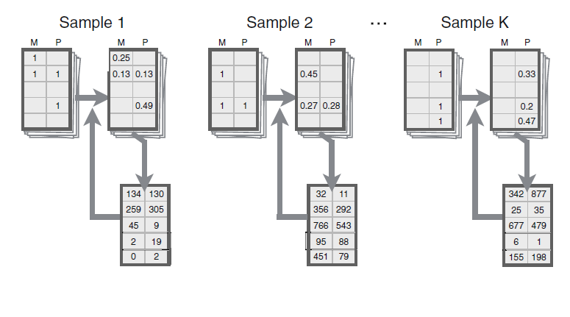
Read Counting
Estimation- Maximization Algorithm
Using the current estimate of allele specific gene expression, compute the probability of each possible alignment
Sum the probabilities across reads to re-estimate the allele specific gene expression
Repeat until convergence

Slide 5
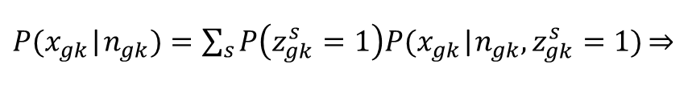

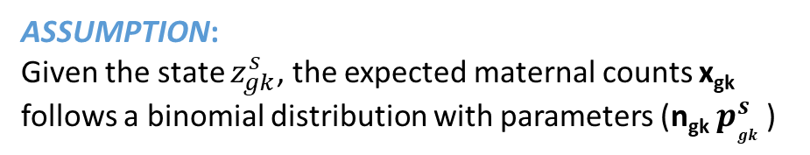


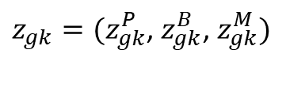


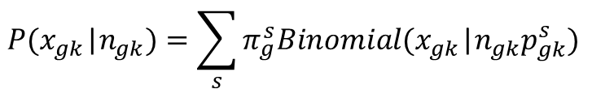
Classification
ASSUMPTION:
Each cell k is in one of three states with respect to the expression of gene g
Paternal Monoallelic (P)
Maternal Monoallelic (M)
Bi-allelic (B)
ASSUMPTION:
Given the state $z_{gk}^{s}$, the expected maternal counts x_{gk}
follows a binomial distribution with parameters (n_{gk} $p_{gk }^{s}$)
Mixture Model
For each cell we introduce an indicator vector:
$z_{gk}=(z_{gk}^{P}$, $z_{gk}^{B}$, $z_{gk}^{M})$
$P(x_{gk}$|$n_{gk})=\sum_{s}{P\left(z_{gk}^{s}=1\right)P(x_{gk}\text{|}n_{gk},z_{gk}^{s}=1)\underset{⇒}{}}$
$$z_{gk}^{s}=\left\{\begin{aligned}1 \\ 0\end{aligned}\right.$$
$$if gene G is in expression state s$$
$$otherwise$$
$$P(x_{gk}\text{|}n_{gk})=\sum_{s}{π_{g}^{s}Binomial(x_{gk}\text{|}n_{gk}p_{gk}^{s}) }$$
with
$$\sum_{s}{z_{gk}^{s}}=1$$
${(p}_{gk}^{p}=p_{g}^{P}{, p}_{gk}^{M}=p_{g}^{M}$)

Slide 6
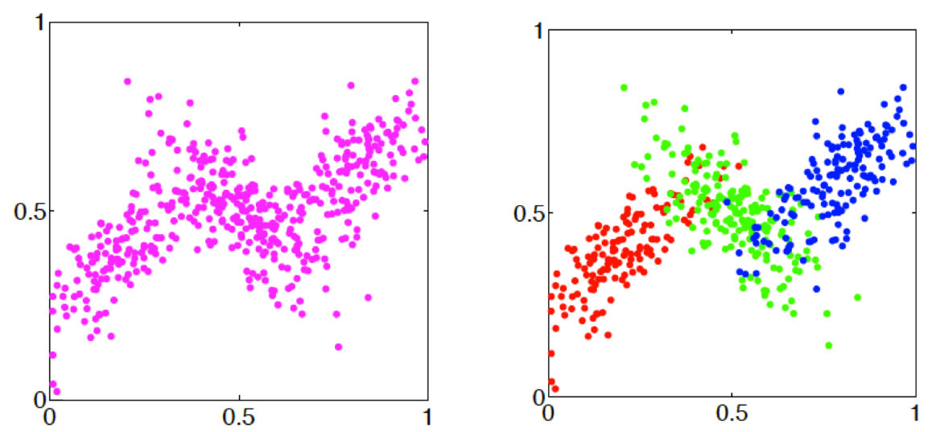
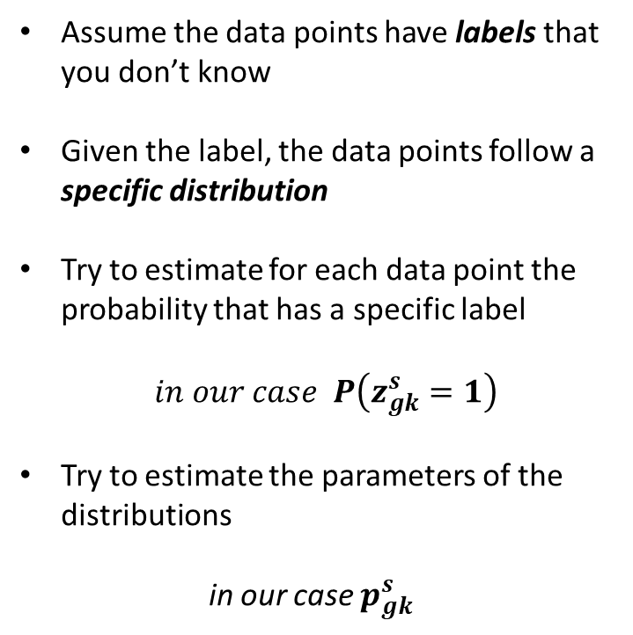
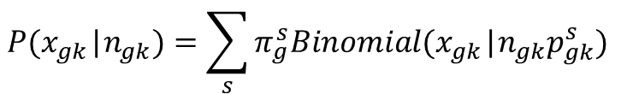
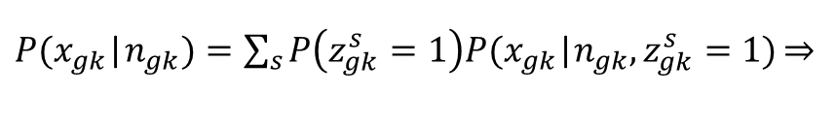
Mixture Models
Assume the data points have labels that you don’t know
Given the label, the data points follow a specific distribution
Try to estimate for each data point the probability that has a specific label
$in our case P\left(z_{gk}^{s}=1\right)$
Try to estimate the parameters of the distributions
in our case $p_{gk}^{s}$
$P(x_{gk}$|$n_{gk})=\sum_{s}{P\left(z_{gk}^{s}=1\right)P(x_{gk}\text{|}n_{gk},z_{gk}^{s}=1)\underset{⇒}{}}$
$$P(x_{gk}\text{|}n_{gk})=\sum_{s}{π_{g}^{s}Binomial(x_{gk}\text{|}n_{gk}p_{gk}^{s}) }$$

Slide 7
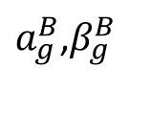




Partial Pooling
Hierarchical Modeling
Problems:
$$a_{g}^{mono}$$
$a_{g}^{B}$,$β_{g}^{B}$
Many parameters per gene
Thousands of genes
Large number of parameters
~Beta
~Beta
~Beta
$$p_{g}^{P}$$
$$p_{g}^{M}$$
$$p_{gk}^{B}$$
Low read counts
Sampling Variation
Limited data for reliable estimation
x_{g1}
x_{g2}
…..
x_{gK}

Slide 8
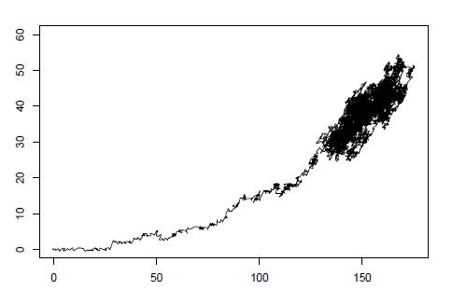
Estimation of parameters
Random walk in a 2D space
Analytical solution to the maximum likelihood estimators does not exist
Use MCMC to randomly sample parameter values from their conditional posterior distributions
Provides the full posterior distribution
Information about the uncertainty of the parameters
MCMC methods: create a reversible Markov chain whose stationary distribution is the
desired probability distribution.

Slide 9
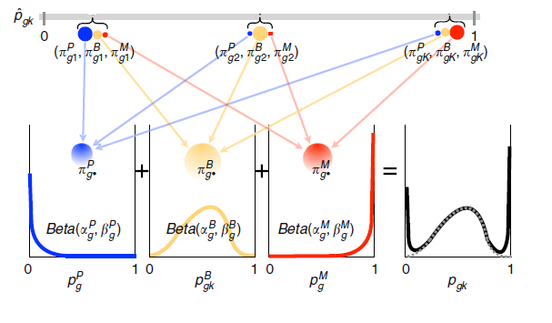

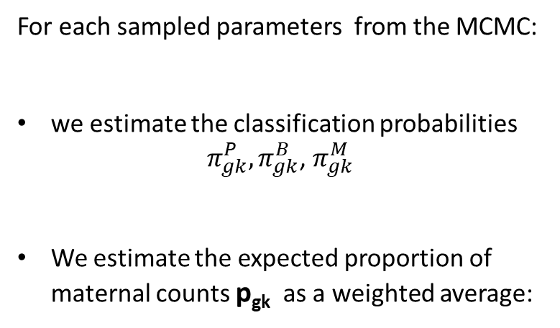
Partial pooling estimator
For each sampled parameters from the MCMC:
we estimate the classification probabilities ${ π}_{gk}^{P},π_{gk}^{B}$, $π_{gk}^{M}$
We estimate the expected proportion of maternal counts p_{gk} as a weighted average:
The average value across many iterations is the partial pooling estimator
$p_{gk}$= $π_{gk}^{P}p_{g}^{P}$+$π_{gk}^{B}p_{gk}^{B}$+$π_{gk}^{M}p_{g}^{M}$

Slide 10
Results
Figure 2
Figure 6

Slide 11
Validation
Validate 2 things (1)
What the truth is, how they down sampled
Figure3
Chromosome X case -> dataset
Result of chromosomes

Slide 12
Conclusions and Critic
Biological assumptions
No comparison
Validation-> Better dataset + random threshold

