Slide 1


DOCTOR WORKING SESSION · SYNTHETIC DATA
Every follow-up
begins with the full
patient story in
view.
Smaran Health · a doctor-led clinical memory vision
AI organizes what was documented.
The doctor decides what becomes the record.
SMARAN HEALTH · 2026
Notes:
Open with the desired follow-up experience, not with a feature list. Explain that the deck uses synthetic data and separates current prototype screens from future product directions.
[Sources]
- /Users/Neelesh/Documents/Smaran Health/PROJECT_MEMORY.md — product thesis and doctor-control boundary
- /Users/Neelesh/Documents/Smaran Health/tmp/presentations/smaran-doctor-vision-2026/assets/cover-doctor-patient-v4-no-portal.png — generated square editorial visual with the marked cream portal and coral node removed; desktop monitor, keyboard, mouse and mint memory ribbon retained; prompt recorded in source-notes.txt
- /Users/Neelesh/Documents/Smaran Health/apps/website/public/favicon.svg — Smaran brand mark
[/Sources]

Slide 2
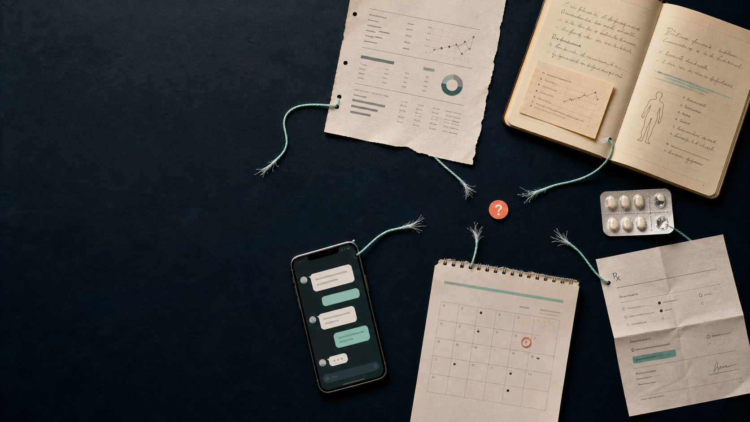
SMARAN HEALTH
WORKFLOW HYPOTHESIS
THE FOLLOW-UP PROBLEM
The hardest part of follow-up is rebuilding context from fragments.
Previous notes, reports, patient recollection, messages, pending tests and medication changes can live in different places.
The opportunity is not more data. It is one trustworthy thread.
Clinical memory for specialist follow-ups
02
Notes:
Treat these as workflow hypotheses to validate with doctors. The visual metaphor is one story dispersed across common clinic artifacts.
[Sources]
- /Users/Neelesh/Documents/Smaran Health/PRODUCT.md — doctor jobs-to-be-done and patient-memory requirements
- /Users/Neelesh/Documents/Smaran Health/PROJECT_MEMORY.md — longitudinal patient-story thesis
- /Users/Neelesh/Documents/Smaran Health/tmp/presentations/smaran-doctor-vision-2026/assets/fragmented-story.png — generated editorial visual; prompt recorded in source-notes.txt
[/Sources]

Slide 3
SMARAN HEALTH
PRODUCT THESIS
Smaran turns approved encounters into memory
A clinical-memory layer—not a diagnostic or prescribing system.
01
02
03
04
05
Consent &
record
Structured
draft
Doctor review
& approval
Approved
timeline
Next-visit
memory
Visible recording or manual path
Evidence, confidence, uncertainty
The only gate into clinical truth
Drafts and rejections stay out
What changed and what remains open
AI can organize and retrieve. It cannot diagnose, prescribe, alter medication, or finalize a record.
Clinical memory for specialist follow-ups
03
Notes:
Make the approval gate the center of the explanation. Every downstream memory object comes only from doctor-approved records.
[Sources]
- /Users/Neelesh/Documents/Smaran Health/PROJECT_MEMORY.md — core workflow and safety invariants
- /Users/Neelesh/Documents/Smaran Health/AGENTS.md — AI pipeline and clinical note state machine
- /Users/Neelesh/Documents/Smaran Health/PRODUCT.md — AI responsibilities and prohibited actions
[/Sources]

Slide 4

SMARAN HEALTH
PRODUCT VISION
The clinic day stays familiar. The record becomes continuous.
Find / onboard
Consent
Consult
Review & approve
Share approved output
Return with context
A single thread runs beyond the visit into the next visit.
Notes:
Walk left to right. The patient journey includes patient onboarding, consent, recording, doctor approval, approved sharing, and a context-rich return visit.
[Sources]
- /Users/Neelesh/Documents/Smaran Health/PRODUCT.md — core consultation workflow and future sharing direction
- /Users/Neelesh/Documents/Smaran Health/PROJECT_MEMORY.md — approved-memory workflow
- /Users/Neelesh/Documents/Smaran Health/tmp/presentations/smaran-doctor-vision-2026/assets/patient-journey.png — generated journey visual; prompt recorded in source-notes.txt
[/Sources]

Slide 5
SMARAN HEALTH
PRODUCT DIRECTION
Onboarding should feel like lookup—not paperwork
Search first. Create only when needed. Keep identity clinic-scoped and consent scopes separate.
PATIENT LOOKUP
Who is in front of you?
Minimal demographics and a clear clinic identity
Search name · phone · clinic ID
Language and contact preference visible at the start
Ananya S.
43 years · Pune · DEMO-PN-1042
AS
Open profile
Assistant actions stay permission-based
No match? Add a patient with only the fields needed for today’s workflow.
+ New patient
Illustrative future workflow · synthetic data
Clinical memory for specialist follow-ups
05
Notes:
This is an illustrative future workflow, not a shipped onboarding screen. Emphasize minimal effort and clinic-scoped identity rather than a long registration form.
[Sources]
- /Users/Neelesh/Documents/Smaran Health/PRODUCT.md — patient creation, roles, dashboard and consent requirements
- /Users/Neelesh/Documents/Smaran Health/AGENTS.md — clinic-scoped access and assistant permissions
- /Users/Neelesh/Documents/Smaran Health/apps/website/app/prototype/mock-data.ts — synthetic patient Ananya S.
[/Sources]

Slide 6
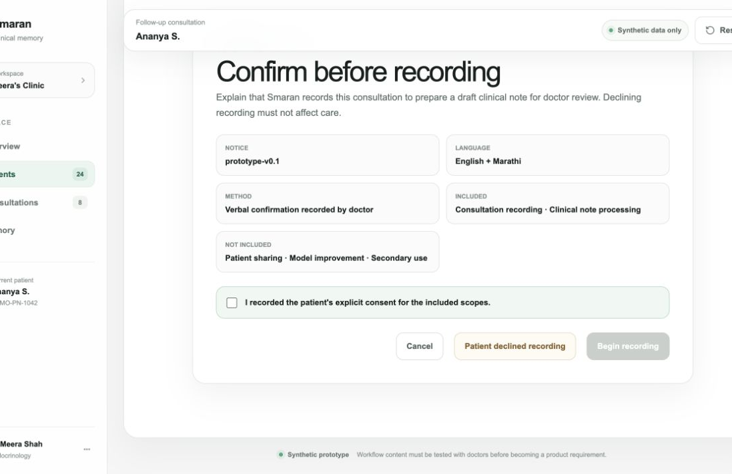
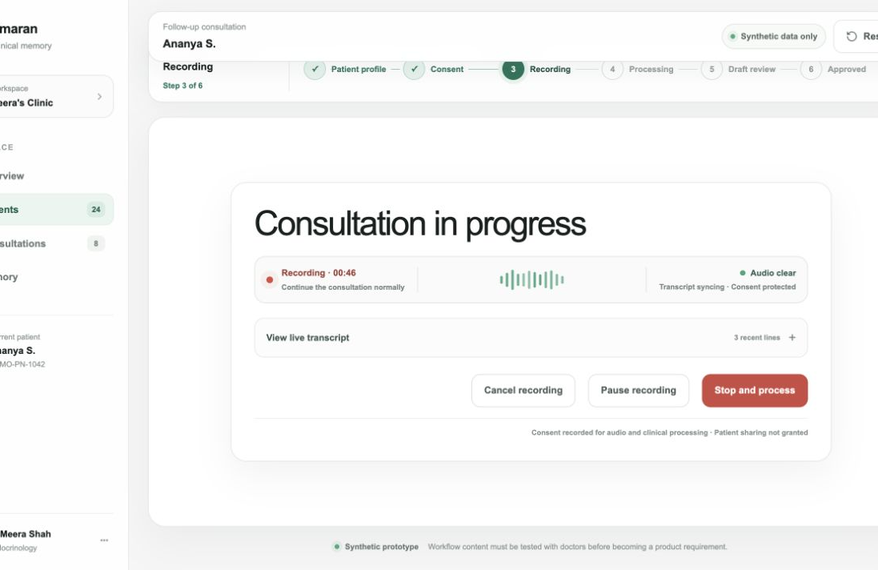
SMARAN HEALTH
SYNTHETIC PROTOTYPE
Recording stays visible, consented, and optional
Declining recording does not affect care; a manual note path remains available.
SEPARATE SCOPES
VISIBLE CONTROL
Recording and clinical processing do not automatically include patient sharing or model improvement.
The doctor can pause, stop, cancel or continue without recording. Consent stays visible in the workflow.
Clinical memory for specialist follow-ups
06
Notes:
These are current synthetic prototype screens. Point out the separate consent scopes and explicit recording controls. No real patient data is used.
[Sources]
- /Users/Neelesh/Documents/Smaran Health/docs/prototype/task-10-workflow.md — consent and recording state contract
- /Users/Neelesh/Documents/Smaran Health/docs/prototype/task-14-doctor-test.md — moderated workflow test
- /Users/Neelesh/Documents/Smaran Health/apps/website/app/prototype/page.tsx — synthetic prototype implementation
- /Users/Neelesh/Documents/Smaran Health/tmp/presentations/smaran-doctor-vision-2026/assets/prototype-consent.png and prototype-recording.png — local prototype screenshots
[/Sources]

Slide 7
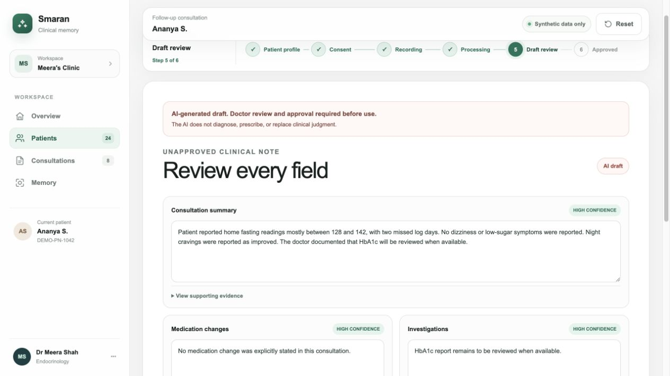
SMARAN HEALTH
SYNTHETIC PROTOTYPE
AI prepares the draft. The doctor makes the record.
Every high-risk field remains editable, evidence-linked and unapproved until the doctor acts.
REVIEW COCKPIT
Editable fields
The note can be corrected before approval.
Source evidence
The doctor can inspect the supporting transcript for each field.
Uncertainty stays visible
Only explicit approval can add the note to memory.
Clinical memory for specialist follow-ups
07
Notes:
Use this slide to establish doctor control as a product feature. Rejected drafts never enter the patient timeline.
[Sources]
- /Users/Neelesh/Documents/Smaran Health/docs/prototype/task-10-workflow.md — draft review, rejection and approval state contract
- /Users/Neelesh/Documents/Smaran Health/AGENTS.md — clinical note state machine and AI output validation
- /Users/Neelesh/Documents/Smaran Health/apps/website/app/prototype/page.tsx — synthetic draft-review implementation
- /Users/Neelesh/Documents/Smaran Health/tmp/presentations/smaran-doctor-vision-2026/assets/prototype-draft-review.png — local prototype screenshot
[/Sources]

Slide 8
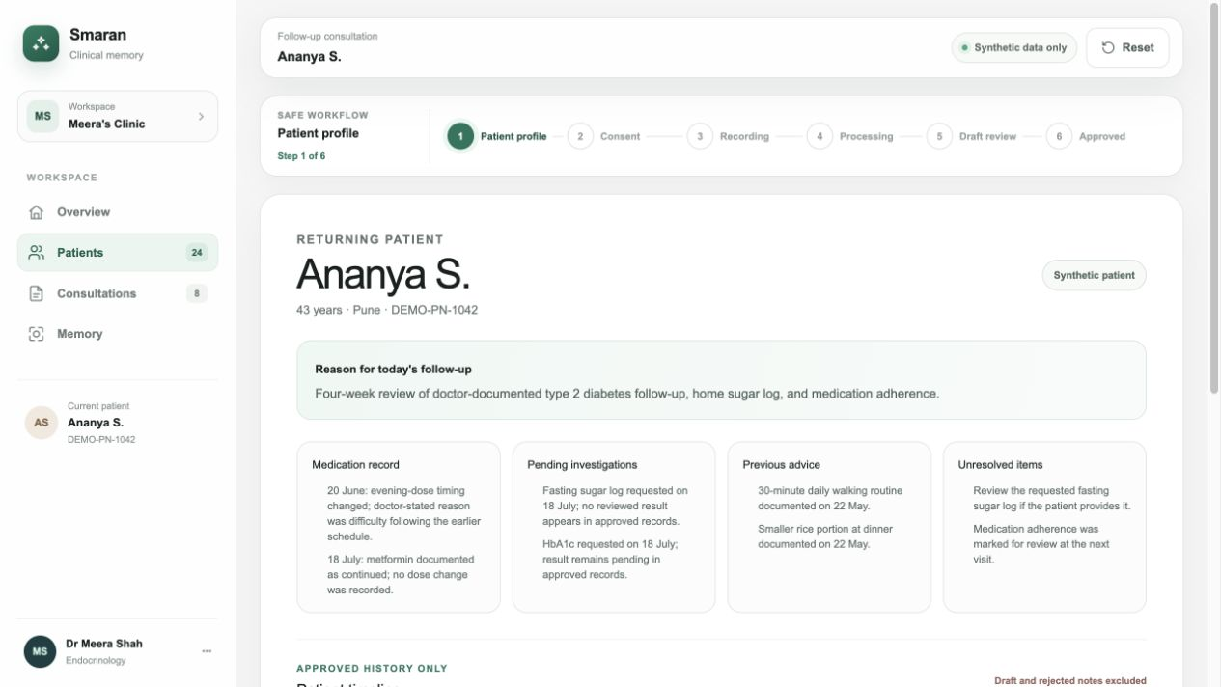
SMARAN HEALTH
SYNTHETIC PROTOTYPE
One patient view holds the whole approved story
The next visit starts with approved context—not a reconstruction exercise.
APPROVED HISTORY ONLY
Reason for today
Why the patient is returning, as documented in the record.
What changed
Medication changes, investigations reviewed, symptoms and prior advice.
What remains open
Pending reports and unresolved items from approved records.
Drafts and rejected notes stay out
Clinical memory for specialist follow-ups
08
Notes:
Explain the memory view in three questions: why is the patient here, what changed, and what remains open? The visible patient is fully synthetic.
[Sources]
- /Users/Neelesh/Documents/Smaran Health/PRODUCT.md — patient profile, timeline and follow-up-memory requirements
- /Users/Neelesh/Documents/Smaran Health/apps/website/app/prototype/mock-data.ts — synthetic Ananya S. approved history
- /Users/Neelesh/Documents/Smaran Health/docs/prototype/task-10-workflow.md — approved-history-only rule
- /Users/Neelesh/Documents/Smaran Health/tmp/presentations/smaran-doctor-vision-2026/assets/prototype-patient-profile.png — local prototype screenshot
[/Sources]

Slide 9
SMARAN HEALTH
PRODUCT DIRECTION
Blood reports can become trends—with source and verification attached
Values become easier to review over time. Interpretation remains with the doctor.
SYNTHETIC TREND EXAMPLE
PROVENANCE LANE
HbA1c · last 5 follow-ups
Report accepted
01
Date, file and page retained
02
Value extracted
Shown as unverified
03
Doctor checks
Units and source confirmed
04
Trend eligible
Verified value enters the view
Synthetic values · no autonomous interpretation
Future concept · not a live lab integration
Clinical memory for specialist follow-ups
09
Notes:
This is a future concept, not a live lab integration. The five-point HbA1c series is illustrative: the sourced synthetic example provides the 8.4% and 7.1% endpoints, while the three intermediate values were added only to demonstrate how the last five follow-ups could be visualized. Dates, units, source and verification should remain attached to every value.
[Sources]
- /Users/Neelesh/Documents/Smaran Health/PRODUCT.md — examination findings, investigation values and future dashboard direction
- /Users/Neelesh/Documents/Smaran Health/docs/sample-transcripts/SYN-DM-001-improved-hba1c-followup.txt — synthetic 8.4% to 7.1% example
- /Users/Neelesh/Documents/Smaran Health/PROJECT_MEMORY.md — no inference, provenance and explicit verification requirements
[/Sources]

Slide 10
SMARAN HEALTH
SYNTHETIC PROTOTYPE
The next visit opens with what changed—and what remains open
A concise brief is derived only from approved records.
PRE-VISIT MEMORY
LAST APPROVED VISIT
OPEN LOOPS
Ananya S.
Home fasting readings were documented mostly between 128 and 142. No dizziness or low-sugar symptoms were reported.
Pending investigation
43 years · Pune
Diabetes / Endocrinology
HbA1c report remains to be reviewed when available.
Reason for return
DOCUMENTED CHANGE
Unresolved item
Four-week review of the home sugar log and adherence.
No medication change was explicitly stated in the current consultation.
The dates of the two missed log entries were not stated.
✓ Derived only from doctor-approved synthetic records
Clinical memory for specialist follow-ups
10
Notes:
This brief answers three questions before the next consultation: why the patient is returning, what changed, and what remains open. Avoid using AI-generated clinical suggestions.
[Sources]
- /Users/Neelesh/Documents/Smaran Health/apps/website/app/prototype/mock-data.ts — synthetic follow-up memory and transcript
- /Users/Neelesh/Documents/Smaran Health/docs/prototype/task-10-workflow.md — approved-memory contract
- /Users/Neelesh/Documents/Smaran Health/PROJECT_MEMORY.md — use unresolved items from approved records
[/Sources]

Slide 11
SMARAN HEALTH
PRODUCT DIRECTION
The approved plan should leave the clinic as clearly as it was explained
Print and PDF first; secure WhatsApp handoff later—only after approval and separate sharing consent.
1
2
3
Doctor-approved documents
Review content
Confirm recipient
+ channel consent
Deliberate send
SUMMARY.PDF
Visit summary
Patient instructions
Share only doctor-approved material
PRESCRIPTION COPY
Doctor-authored
or explicitly approved
Patient summary + doctor-authored or explicitly approved prescription copy. Never raw audio or transcript.
Ready to share
Illustrative concept · no automatic sending
Clinical memory for specialist follow-ups
11
Notes:
WhatsApp sharing is a future direction. The channel requires separate consent, a checked recipient and a deliberate send. Smaran must never independently generate or modify a prescription.
[Sources]
- /Users/Neelesh/Documents/Smaran Health/PRODUCT.md — WhatsApp after the first pilot and no automated sharing before approval
- /Users/Neelesh/Documents/Smaran Health/PROJECT_MEMORY.md — patient-facing sharing requires doctor approval and scoped consent
- /Users/Neelesh/Documents/Smaran Health/AGENTS.md — no prescribing, prescription modification or unapproved export
[/Sources]

Slide 12
SMARAN HEALTH
PRODUCT DIRECTION
A calm dashboard can make follow-up work visible
Administrative visibility—never clinical risk scoring or treatment recommendation.
TODAY
CLINIC FLOW
FOLLOW-UP CONTINUITY
Meera’s Clinic
09:00
A.S.
Follow-up · memory ready
Due this week
Illustrative synthetic counts
Doctor-defined return windows
09:20
R.K.
New patient · onboarding
4
Overdue
Drafts waiting
09:40
M.P.
Follow-up · report pending
Appropriate re-engagement queue
7
Follow-ups due
S.N.
Draft awaits approval
Pending report
10:00
Open loop before next review
3
Reports pending
No autonomous alerts · no clinical prioritisation
Clinical memory for specialist follow-ups
12
Notes:
This future dashboard makes administrative work visible: drafts awaiting approval, doctor-defined follow-ups and pending reports. Counts and initials are illustrative synthetic data.
[Sources]
- /Users/Neelesh/Documents/Smaran Health/PRODUCT.md — Today dashboard, missed follow-ups, pending investigations and future clinic metrics
- /Users/Neelesh/Documents/Smaran Health/AGENTS.md — role permissions, privacy and no autonomous clinical decisions
- /Users/Neelesh/Documents/Smaran Health/PROJECT_MEMORY.md — dashboard and follow-up effects remain unvalidated directions
[/Sources]

Slide 13
SMARAN HEALTH
PILOT HYPOTHESIS
Continuity may strengthen follow-ups. Practice growth must be measured.
Footfall is not the mechanism. Better continuity is the hypothesis.
01
02
03
MEASURE BASELINE → PILOT
Less documentation
and retrieval work
Visible doctor-defined
follow-up loops
Clear approved
take-home communication
After-hours documentation
Consultations per session
Eligible follow-ups completed
may recover attention and appointment capacity
may improve completed return visits
may strengthen continuity and trust
Appropriate overdue recovery
No promise of more footfall. No guaranteed follow-up lift. Compare explicit baselines, denominators and doctor-defined windows.
Clinical memory for specialist follow-ups
13
Notes:
Present each causal path as a hypothesis. Smaran is not a lead-generation engine, and the repository contains no evidence of increased footfall or follow-up counts yet.
[Sources]
- /Users/Neelesh/Documents/Smaran Health/PROJECT_MEMORY.md — pilot measurement rules and current maturity
- /Users/Neelesh/Documents/Smaran Health/PRODUCT.md — doctor jobs, clinic jobs and pilot success metrics
- /Users/Neelesh/Documents/Smaran Health/ROADMAP.md — controlled-pilot measurement expectations
[/Sources]

Slide 14
SMARAN HEALTH
SAFETY INVARIANT
Trust is a workflow, not a disclaimer
The patient-memory thread must pass through four non-negotiable gates.
01
02
03
04
Consent
Clinic access
Provenance
Doctor approval
Version, language, method and scope
Every patient record scoped to the clinic
Evidence and uncertainty stay visible
Only approved content enters memory or sharing
Private audio · No clinical content in analytics logs · Immutable approved records with attributable amendments
Clinical memory for specialist follow-ups
14
Notes:
The safety model is operational: consent, access control, provenance, explicit approval, private storage, safe analytics and attributable amendments.
[Sources]
- /Users/Neelesh/Documents/Smaran Health/PROJECT_MEMORY.md — safety and privacy invariants
- /Users/Neelesh/Documents/Smaran Health/AGENTS.md — clinic_id scoping, private audio, no sensitive logs and approval rules
- /Users/Neelesh/Documents/Smaran Health/PRODUCT.md — doctor control, consent and auditability principles
[/Sources]

Slide 15
SMARAN HEALTH
PLANNED PILOT
This future should be earned—doctor by doctor
Synthetic workflow → controlled evidence
01
Synthetic walkthrough
No real patient data
THE PRODUCTIVE QUESTIONS
What do you need to see first before a follow-up?
02
Specialist usability review
Fix blocking safety and comprehension issues
Privacy, legal & security gates
What would make reviewing a draft faster and safer?
03
Approve consent, retention and incident gates
04
Controlled consented pilot
Which follow-up loop most often breaks today?
Workflow evidence with explicit measurements
Workflow evidence—not broad clinical-safety validation.
Planned scope: 2–5 doctors · 2–3 clinics · 50–150 consented consultations
The future is not an AI doctor. It is a doctor who never loses the patient story.
15
Notes:
Close by asking for doctor input, not by asking for a purchase. The planned pilot scope is a roadmap target and is intended to produce workflow evidence, not broad clinical-safety validation.
[Sources]
- /Users/Neelesh/Documents/Smaran Health/ROADMAP.md — controlled-pilot sequence and proposed scope
- /Users/Neelesh/Documents/Smaran Health/PROJECT_MEMORY.md — safety gates, current repository maturity and pilot measurement caution
- /Users/Neelesh/Documents/Smaran Health/docs/prototype/task-14-doctor-test.md — specialist walkthrough questions
[/Sources]

