Slide 1


| Tech Management, SRI-B
CLAWS
CLASH OF THE
WarDaddy
Full-Stack Research Intelligence Dashboard
Srujan Nadig - Smaran Nadig - Sohan Sridhar - Yuvaraj Gopi
R V College of Engineering

Slide 2
Full-Stack Research Intelligence Dashboard
Problem Statement
Problem Overview
Research and technical information today are distributed across multiple platforms, including research paper archives, GitHub repositories, benchmark websites, engineering blogs, model hubs, and news feeds. Although information is widely accessible, the process of comparing, evaluating, and analyzing it remains fragmented and requires significant manual effort. Users often face difficulty in performing efficient comparative analysis and obtaining structured insights from diverse sources.
Challenges Faced by Users
Searching across multiple platforms
Manual comparison of papers and repositories
Verification of code and dataset availability
Identification of active real-world adoption
Tracking recent developments independently
Time-consuming research workflow

Slide 3
Full-Stack Research Intelligence Dashboard
Problem Statement
Stakeholders Affected:
Researchers - Faster identification of relevant work, Access to trustworthy research sources , Reduced manual analysis effort
Students - Easier discovery of useful learning resources , Better understanding of implementations and datasets , Improved research guidance
Startups / Product Teams - Monitoring emerging technologies , Tracking industry adoption trends
Motivation : The GenAI research and productivity theme was selected to address the growing fragmentation of research information across multiple platforms. Existing tools mainly support search and retrieval, with limited capabilities for structured comparison and analysis. The goal is to reduce manual effort and improve the efficiency of research discovery and evaluation.

Slide 4
Full-Stack Research Intelligence Dashboard
Current Solution & Gaps
Current Platforms: | Main Purpose:
Google Scholar | Academic paper search
Semantic Scholar | Citation-based discovery
arXiv | Research paper hosting
Papers With Code | Benchmarks and implementations
GitHub | Repository hosting
Hugging Face | Models and datasets
Limitations of Existing Systems
Focus on a single type of source
Lack of integration between research and industry signals
Limited explainability of results
Dependence on manual cross-platform comparison

Slide 5
Full-Stack Research Intelligence Dashboard
Current Solution & Gaps
Observed Gap:
Difficulty in verifying reproducibility
Limited visibility of supporting code availability
Challenges in tracking active research evolution
Lack of insights into industry adoption
Difficulty in identifying cross-domain similarities
Need for unified research workflow management
Opportunity:
There is a growing need for systems that can integrate multiple research sources into a unified workflow. Such systems can provide structured comparison, explainable ranking, and consolidated insights while reducing the manual effort required for research exploration and evaluation.

Slide 6
Full-Stack Research Intelligence Dashboard
Current Solution & Gaps
Observed Gap:
Difficulty in verifying reproducibility
Limited visibility of supporting code availability
Challenges in tracking active research evolution
Lack of insights into industry adoption
Difficulty in identifying cross-domain similarities
Need for unified research workflow management
Opportunity:
There is a growing need for systems that can integrate multiple research sources into a unified workflow. Such systems can provide structured comparison, explainable ranking, and consolidated insights while reducing the manual effort required for research exploration and evaluation.

Slide 7
Full-Stack Research Intelligence Dashboard
Proposed Solution
PRISM:
PRISM is a full-stack research intelligence system designed to aggregate and analyze technical information from multiple sources. The system collects technical signals from diverse platforms, converts them into a unified structured format, links related research items, stores searchable semantic memory, performs analytical scoring using multiple evaluation engines, and presents insights through an interactive dashboard interface.
Core Objective:
Compare research items more efficiently
Identify important trends
Explore related work
Understand supporting evidence behind rankings

Slide 8

Full-Stack Research Intelligence Dashboard
Proposed Solution
input
Multi-Source Ingestion
arXiv
OpenAlex
Semantic Scholar
GitHub
Hugging Face
Papers With Code
RSS feeds
analytics
Scoring & Analysis
Novelty analysis
Trust and reproducibility scoring
Contradiction risk analysis
Adoption gap detection
Cross-domain relevance evaluation
dashboard
Dashboard Interface
• Ranked research items
• Evidence panels & analytics
• Research comparisons
• Semantic relationship links

Slide 9
Full-Stack Research Intelligence Dashboard
Demo/Product Walkthrough
Step 1 — User Query
The workflow begins with the user entering a broad research topic into the system. PRISM is designed to perform more effectively with broader technical queries, allowing multiple sources to contribute relevant results and insights.
Example : “Multimodal agents benchmark tool use”
Step 2 — Data Ingestion
PRISM retrieves information from multiple data adapters, including research papers, repositories, models, benchmarks, and RSS feeds. The ingestion pipeline is designed to remain operational even if a particular source fails or returns limited results, ensuring robustness and continuity.

Slide 10
Full-Stack Research Intelligence Dashboard
Demo/Product Walkthrough
Step 3 — Processing Pipeline
The collected data is normalized into a unified format, linked with related research items, embedded into semantic memory, and analyzed using multiple scoring engines for structured evaluation.
Step 4 — Score Fusion
Each research item is evaluated using multiple scoring engines, including Signal, Trust, Debate, Gap, and Cross-Domain analysis. These individual evaluations are combined to generate a final PRISM score for ranking and comparison.
Step 5 — Dashboard Visualization
The frontend dashboard presents the processed results through ranked research queues, source distribution analytics, evidence traces, adoption-gap visualizations, cross-domain radar analysis, and an interactive paper chat interface.

Slide 11
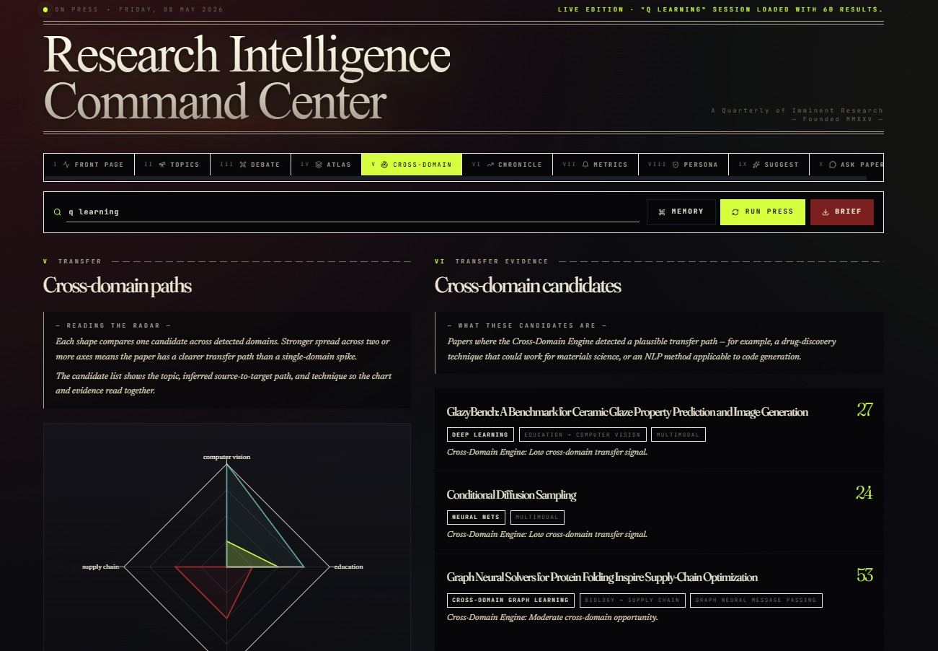
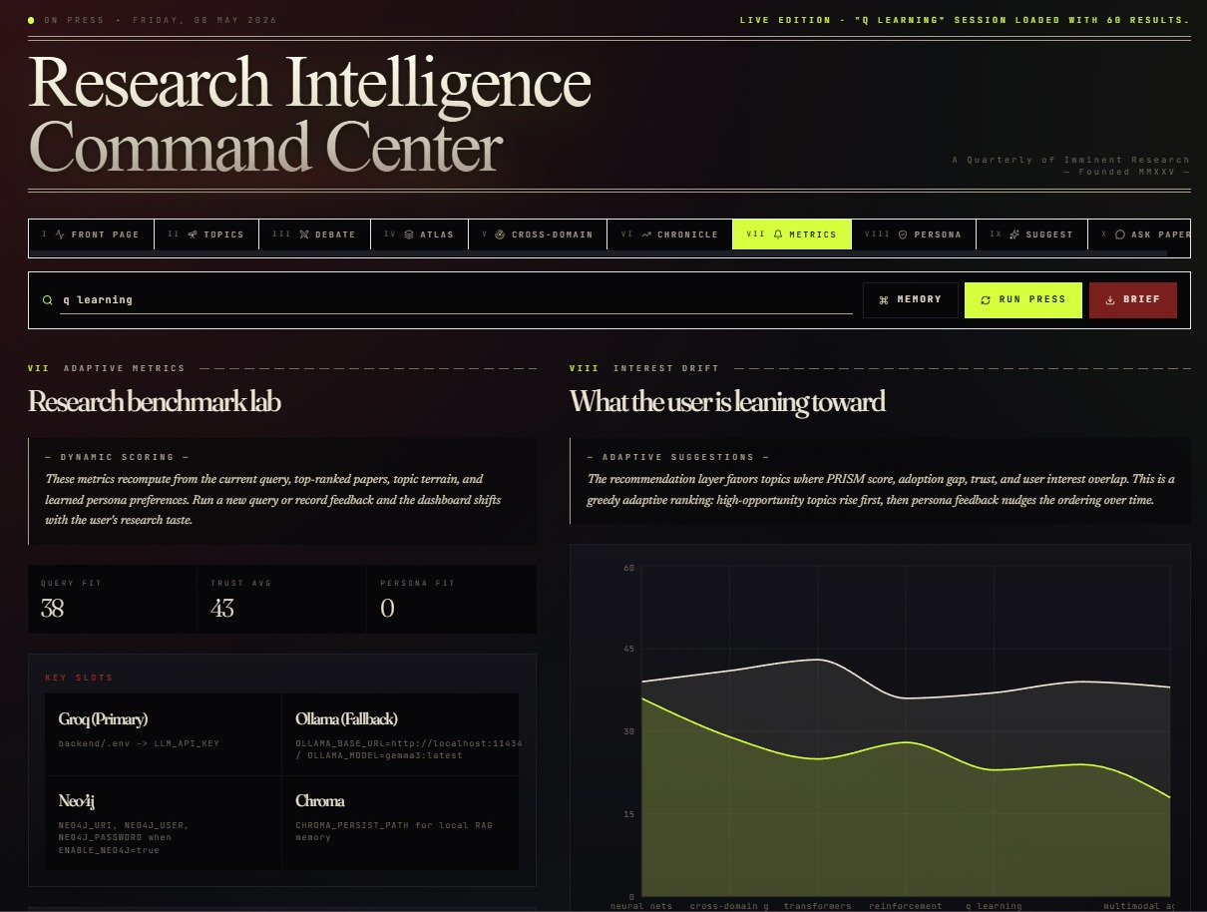
Full-Stack Research Intelligence Dashboard
Dashboard

Slide 12
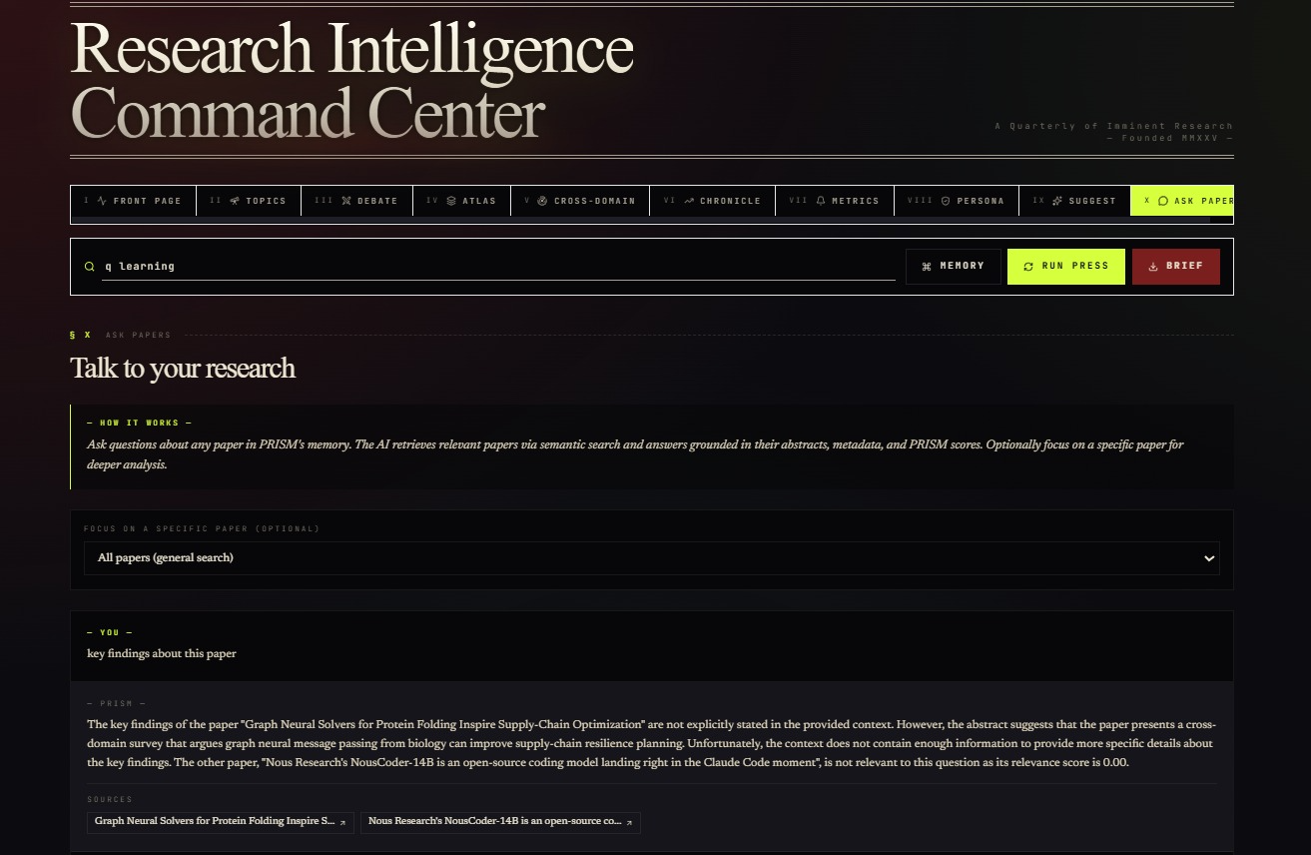
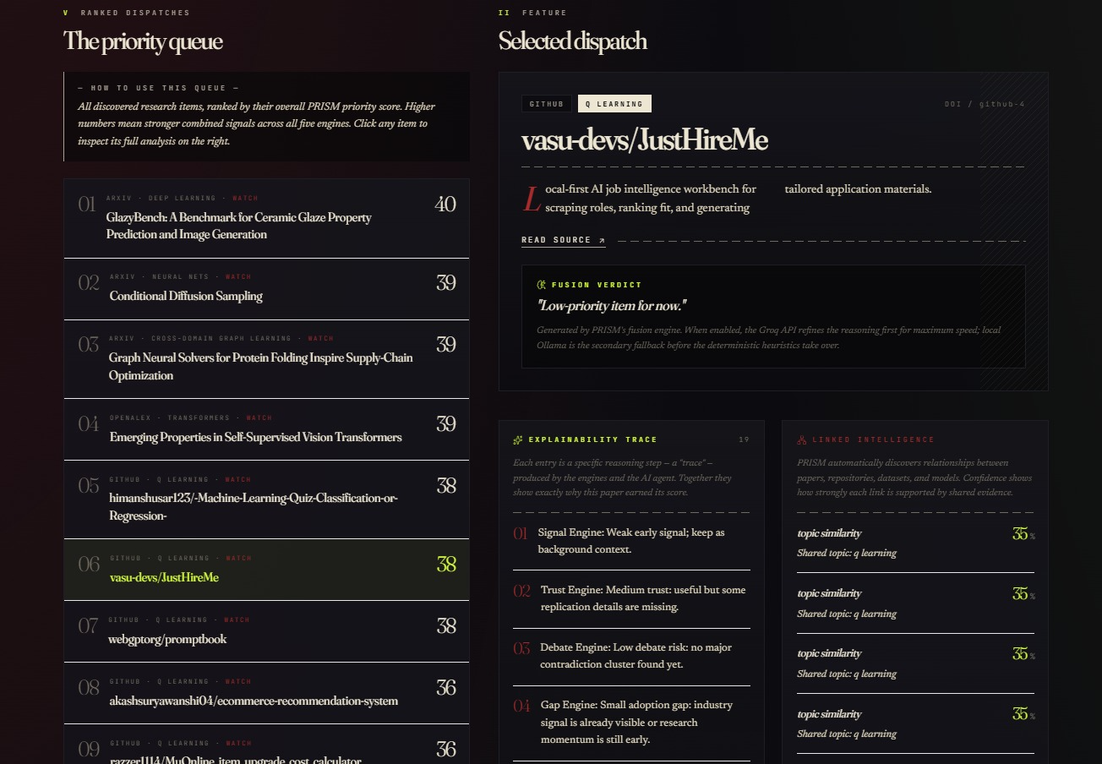
Full-Stack Research Intelligence Dashboard
Dashboard

Slide 13
Full-Stack Research Intelligence Dashboard
Tech Stack
Backend
Frontend
AI & Analysis
FastAPI
SQLAlchemy
SQLite
Pydantic
APScheduler
React
Vite
TypeScript
Tailwind CSS
Recharts
Framer Motion
Groq API
Ollama Fallback
ChromaDB
Embedding Retrieval

Slide 14
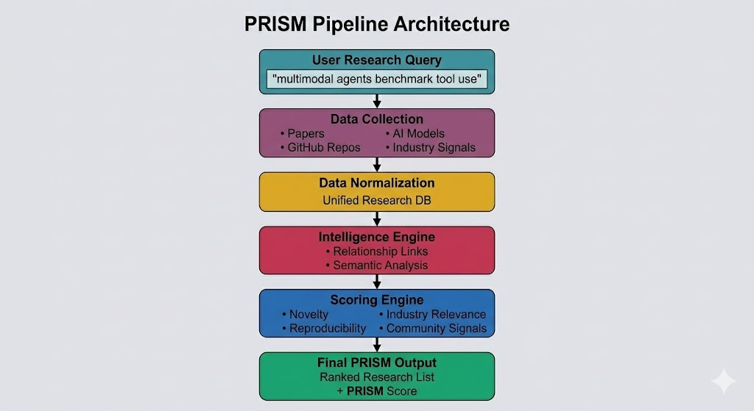
Full-Stack Research Intelligence Dashboard
Architecture

Slide 15
Full-Stack Research Intelligence Dashboard
Impact & Use cases
Use Case 1 — Research Exploration
Researchers can utilize the platform to systematically explore and evaluate scientific literature by comparing related publications, verifying implementation availability, identifying highly active research areas, and examining supporting evidence associated with specific methodologies or claims.
Use Case 2 — Technology Monitoring
Product, research, and innovation teams can employ the system to monitor technological trends, identify emerging techniques, and analyze adoption signals across multiple domains to support strategic decision-making and technology assessment.
Use Case 3 — Learning & Education
Students and learners can leverage the platform to discover related academic resources, navigate complex research topics more efficiently, and identify influential repositories, datasets, and benchmark systems relevant to their area of study.

Slide 16
Full-Stack Research Intelligence Dashboard
Impact & Use cases
Use Case 4 — Cross-Domain Analysis
The system enables cross-domain knowledge exploration by identifying relationships between distinct research areas, thereby assisting users in understanding how concepts, techniques, or methodologies from one domain may be transferable to another.
Potential Extensions
Future enhancements to the platform may include citation graph visualization, intelligent recommendation systems, collaborative research workspaces, real-time monitoring agents, and advanced trend forecasting capabilities for deeper analytical insights.

Slide 17
Full-Stack Research Intelligence Dashboard
Differentiation
What Makes PRISM Different
While many existing research platforms primarily emphasize information retrieval, PRISM is designed to provide a broader analytical framework that supports aggregation, structured analysis, explainable ranking, and cross-source comparison within a unified system.
Key Differentiators
Multi-Engine Scoring
PRISM evaluates research artifacts using multiple independent scoring dimensions rather than relying solely on a single popularity-based metric. This enables a more balanced and interpretable assessment of relevance, impact, and technical significance.
Multi-Source Linking
The platform integrates papers, repositories, models, and additional technical indicators into a connected workflow, allowing users to analyze relationships across multiple forms of research evidence and implementation resources.

Slide 18
Full-Stack Research Intelligence Dashboard
Differentiation
Explainability
Instead of presenting only final rankings, PRISM provides transparent score breakdowns and supporting evidence, enabling users to understand the reasoning behind recommendations and analytical outcomes.
Modular Architecture
The system follows an adapter-based modular architecture, making it extensible and allowing new data sources, scoring engines, and analytical modules to be integrated with minimal structural changes.
Practical Design Decisions:
Offline fallback support for improved reliability
Mock demonstration signals for testing and evaluation
Deterministic scoring mechanisms for reproducible outputs
Modular API-based integration layers for extensibility and flexibility

Slide 19
Full-Stack Research Intelligence Dashboard
Demo Link
Github Repo: https://github.com/SmaranNadig/openclawhackathon.git
Video Link : https://drive.google.com/file/d/1Aa865vZT10bvfQaSYPnY8jEtyCLHJ0ZA/view?usp=drivesdk
Document submitted: https://drive.google.com/file/d/1EzH9WiTC--oTVELWRN55V--h83zvthMX/view?usp=sharing

