Slide 1
Industrial Human Resource Geo-Visualization
Problem Statement, Tools, Approach, and EDA Insights

Slide 2
Tools Used
- Python (pandas, plotly)
- Streamlit
- Modular PEP8 codebase

Slide 3
Approach
• Merge CSVs
• Clean & Normalize
• NLP-based Industry Grouping
• EDA & Dashboard

Slide 4
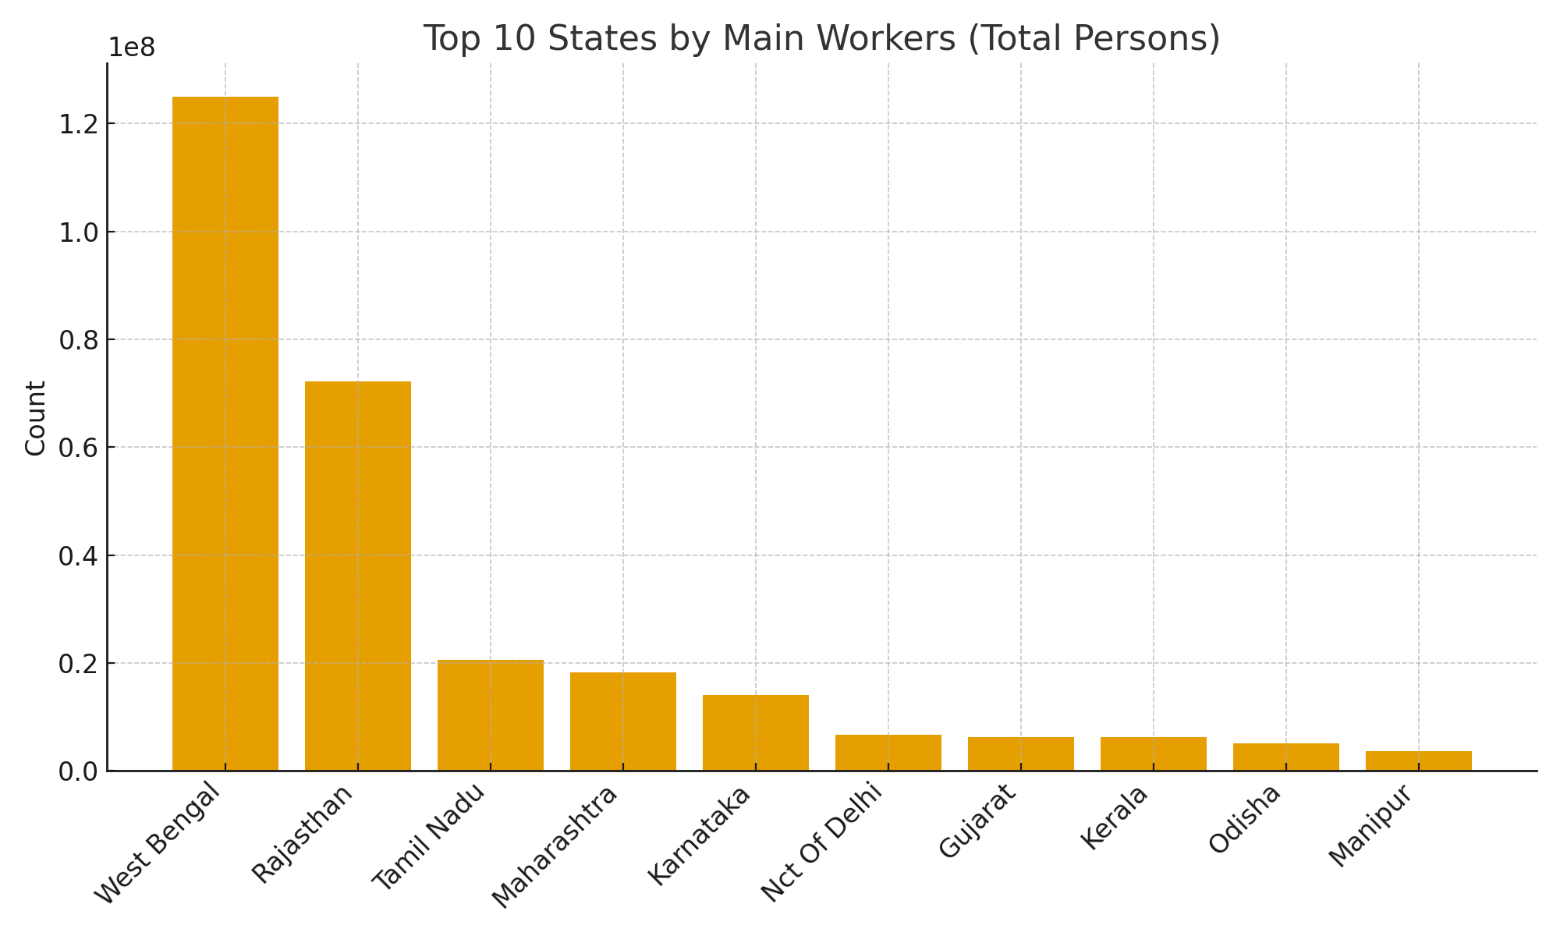
Top States Main Workers

Slide 5
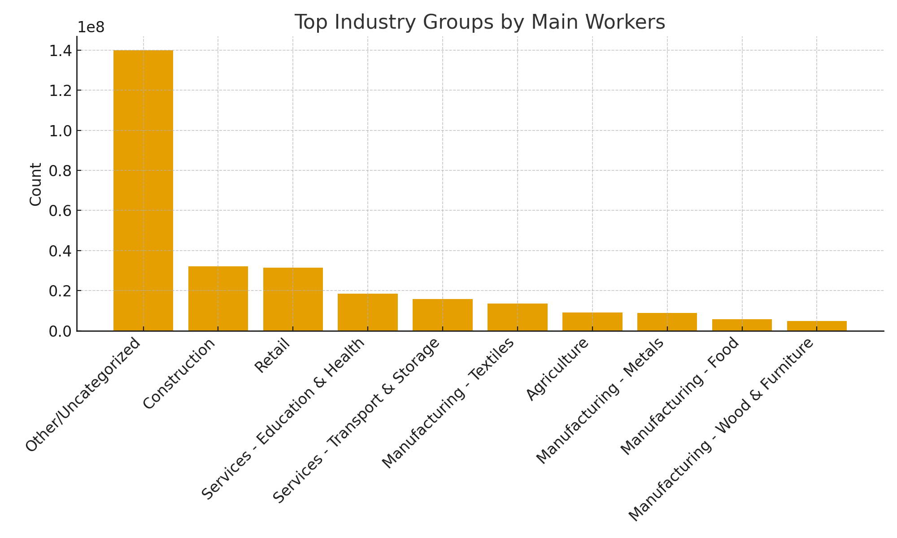
Top Industries Main Workers

