Slide 1
Transport Demand Prediction Analysis
Insights & Modeling Overview

Slide 2
Project Objective
To analyze transportation data and identify demand trends and build a regression model that can predict the number of seats that will be sold for each ride (ride_id), based on:
Route details (travel_from, car_type, etc.)
Schedule info (travel_date, travel_time)
Capacity of the vehicle (max_capacity)
Temporal patterns (e.g., weekdays, month, time of day)

Slide 3
Key Insights
Total Demand: A total of 52K seats were sold with an average of 8.26 seats per ride.
Peak Demand: Highest seat sales occurred in months 2 and 12, reaching over 12K.
Low Demand: Months 9 to 11 saw the lowest demand, nearing zero sales.
Top Route: Kisii had the highest seat sales among all routes.
Weekly Trend: Weekdays 10 and 19 recorded the highest seat bookings.

Slide 4
Key Insights (continued)
Weekday Pattern: Friday (weekday 5) showed consistently high seat sales across weeks.
Prediction Accuracy: Model predictions closely match actual values.
Diagonal Trend: Points aligned to diagonal indicate accurate predictions.
Model Comparison: XGBoost showed slightly higher accuracy than Random Forest.

Slide 5
Methods used
The project utilized a mix of descriptive analytics, data visualization, and predictive modeling methods to study transport demand. Descriptive analysis was first carried out to see the general trends in the data, such as the total seat sales, average seats per ride, and determining peak and off-peak demand times over months and weeks. Power BI was utilized to establish interactive visualizations like line charts, bar graphs, and scatter plots, revealing fundamental patterns like the most demanded routes (e.g., Kisii) and weekday trends (e.g., Friday high sales). For predictive modeling, machine learning algorithms like Random Forest and XGBoost regressors were implemented to predict seat demand. The performance of these models was examined through the comparison of actual and predicted values, where close alignment of points to the diagonal line showed high prediction accuracy. Between the models, XGBoost performed slightly better than Random Forest, implying more generalization for this dataset. These techniques collectively gave a complete picture of demand behavior and enabled strong forecasting.

Slide 6
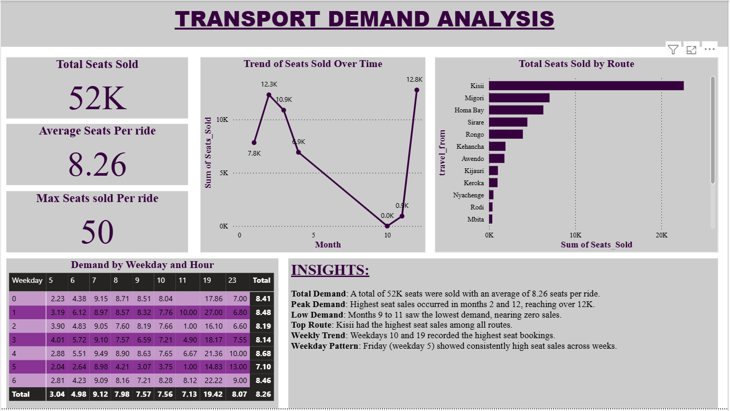
Visualisation using power bi
1. For Raw data:

Slide 7
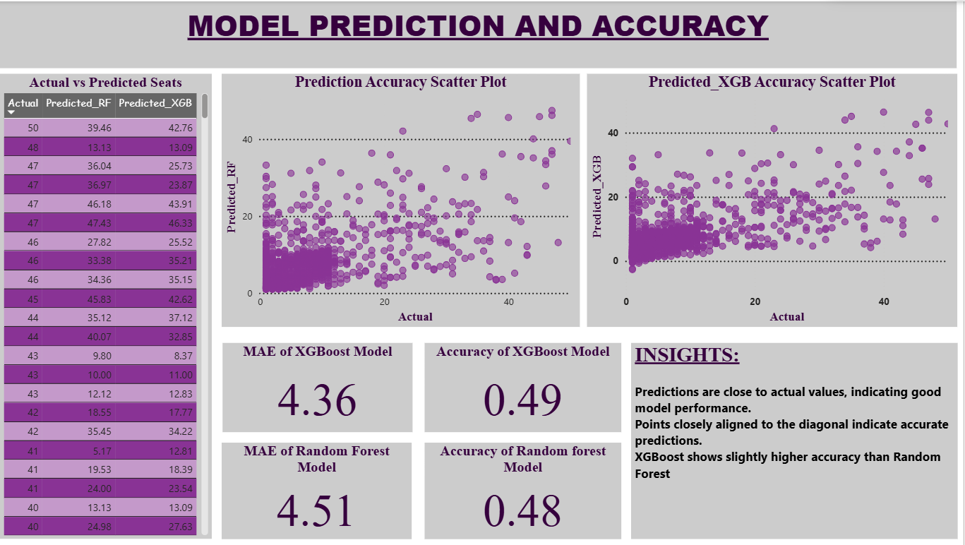
2. For the Predicted data:

Slide 8
Conclusion
The transport analysis reveals significant trends and provides accurate predictions. These insights support operational improvements and strategic planning in transportation services.

