Slide 1
Flood-it!
Evan Dreher, Micah Nicodemus

Slide 2
Heuristics
Must not overestimate cost to goal.
“Dominant” Heuristics
2 heuristics for “flood-it”

Slide 3
Heuristic 1: “Longest shortest path”
How it works
Why it works
Issues

Slide 4
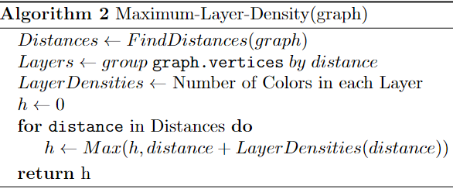
Heuristic 2: “Maximum Layer Density”
How it works
Why it works
Example

Slide 5
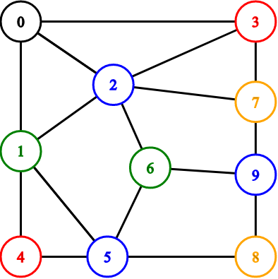

Heuristic 2: “Maximum Layer Density”
How it works
Why it works
Example
$Max\left(3, 5, 4\right)=5$
3 + 1 - 1
3
2 + 3 - 1
2
4
4 + 2 - 1

Slide 6
Beam Stack Search: Overview
Depth-First Beam Search
Sacrifices memory for completeness

Slide 7
A*

Slide 8
Beam Stack Search Results

Slide 9
A* Search Results
2 different implementations
State 1
Graph
Path
h-value
State 2
Action
Parent
h-value

Slide 10
Heuristic 1 vs Heuristic 2

