Slide 1


Cyber Squad - Explorers
Lost & Found Tracker
Name: Ayaan Hussain Class: 9A Roll. No: 13
*Prototype Only

Slide 2





Why Do We Need This System?
Students often lose items like bottles, jackets, stationery, etc.
Difficult to find owners for found items
Objective: To create a user-friendly interface for reporting, browsing, and claiming lost items

Slide 3
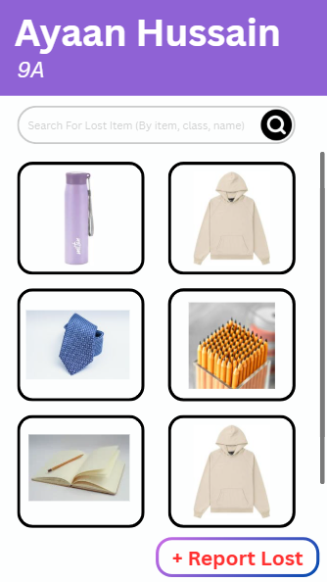
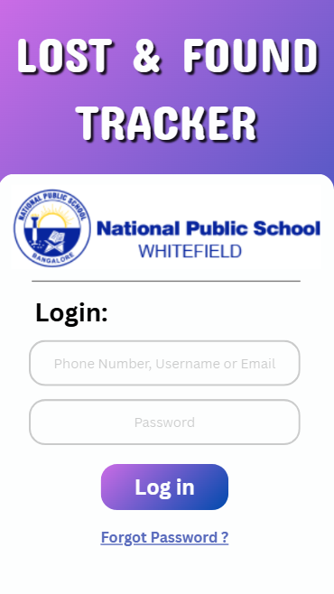
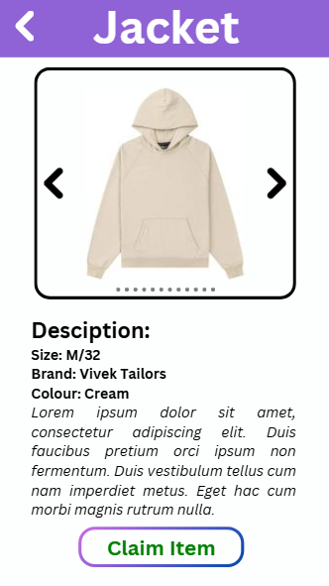
Main Screens of the UI
Home Screen – With “Report Lost” and Lost Items
Item Detail Page – Full description, image, claim button
Login Screen – Login with student’s school ID
Image Link: Images
Video Link: Video
Home Page
login
Item View

Slide 4




UI Features & Design Highlights
Clean and minimal layout with school-friendly colors
Large buttons for easy navigation
Organized by categories (Clothing, Electronics, Stationery)
Responsive design
Optional image uploads for better identification

Slide 5
Summary & Next Steps
The Lost & Found Tracker UI is designed to make it easier for students and staff to report, track, and claim items in a fast and organized way.
It provides a simple, user-friendly interface that reduces confusion and saves time.
This UI can be developed into a real web or mobile app with database support, notifications, and admin controls.
Future Possibilities:
Notification System – Auto-alerts when a lost item is found
Mobile App Integration – Use from anywhere on campus
Smart Match Suggestions – AI-based item matching
Claim History & Receipts – For tracking returned items
"A smarter way to reunite students with their belongings – one click at a time!"

