Slide 1

Spark Streaming Twitter
Stephanie Marker

Slide 2
Workshop
5 challenges
Groups of 4-5
Coding in Scala on a team shared notebook
Set up twitter stream, read from EventHub, operate on twitter statuses

Slide 3
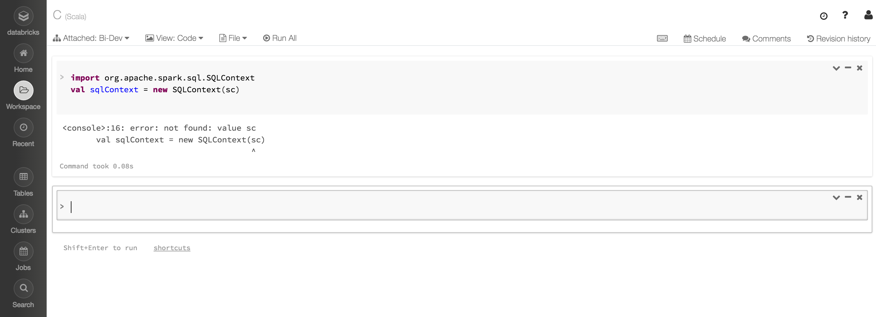
Databricks
Notebooks need to be connected to a cluster to execute code
Shift + Enter to execute code

Slide 4
Scala
Object oriented and functional programming language
Runs on the JVM
val items = List(1, 2, 3, 4, 5)
items.map(x => x*2)
Result: List[Int] = List(2, 4, 6, 8, 10)
Scala Cheat Sheet

Slide 5
Spark
Open-source cluster computing framework for data processing
Structured spark streaming runs on top of spark
val lines = spark.readStream
.format(“socket”)
.option(“host”, “localhost”)
.option(“port”, 9999)
.load()
val words = lines.as[String].flatMap(_.split(“ “))
Structured Spark Streaming Programming Guide
Notes:
Create a streaming DataFrame of text data from a server listening on localhost:9999.
Transform DataFrame.

Slide 6
EventHub
Capable of receiving and processing many events (twitter statuses in our case)
Twitter statuses will be temporarily stored in EventHub
We will use spark streaming to collect twitter statuses from EventHub

Slide 7
codess2018@outlook.com
mowalte123!
https://github.com/Smarker/codess2018

