Slide 1
INFO8106 Sec1 System Development Project Week 2
Instructor: Regan Benner
rbenner@conestogac.on.ca
Class Room: WA-WMB-1F07

Slide 2
Attendance Check
Notes:
Attendance!

Slide 3
Last Week
Capstone Requirements
Build a multi-tier web application w/ user friendly frontend, a database, and a backend
Minimum requirements:​
7 significant database tables​
7 use cases ​​
Projects can be entrepreneurial, or you can have a client
Projects need to adhere to the theme

Slide 4
Project Theme
"Sustainability solutions as they relate to small, medium and large businesses and government and inter-governmental services."
Notes:
- The web application you create has to relate to this years theme
- think of an original idea that hasn’t been done before that could be a successful business/web application
You can address any of the three pillars of sustainability: social, economic and environmental. The concept could apply to preserving wildlife, reducing emissions, reducing use of plastics and other wastes. It could include preserving language, culture or historical sites. It could involve reducing the carbon footprint of businesses or employees or recycling strategies. Please target organizational rather than consumer applications.
- **Note: every semester, we get quite a few restaurant, food delivery, ubering and dog walking apps as students seem to want to do something they can understand easily. In a vacuum, those ideas might be OK, but when judges and visitors are reviewing multiple projects on Capstone Judging Day with those topics, they start to seem rather repetitive. So, I would avoid those topics, and, of course, they don’t really fit the current theme.

Slide 5
Last Week
Tips
Think about the business problem – the “why” your app matters. How will it help people? What are the intended user groups and roles of those using the app?
Be original and unique
Think about your market competitors

Slide 6
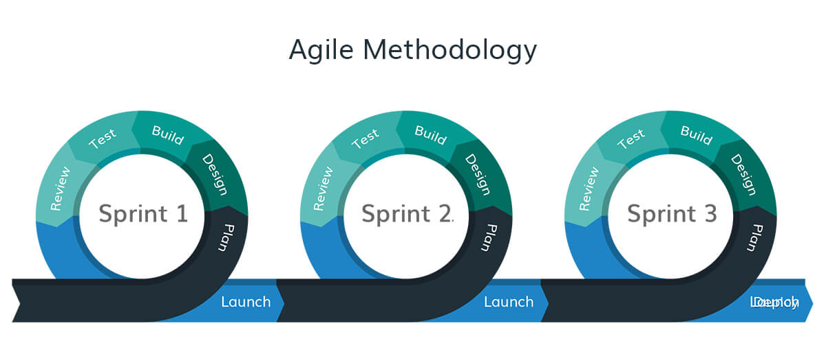
Last Week
Agile Methodology and Iterative Development
Notes:
- you will be using agile development – continuous delivery of software, work in self organizing groups, adaptable to changes and feedback
- there will be three iterations otherwise known as sprints in this course to actually code and create your web application
- each sprint is about 2-3 weeks long
- each sprint will have the same cycles repeated for each iteration
- You will start off by planning and setting goals for what you hope to accomplish in the up-coming iteration
- then you will begin the coding work and complete whatever is necessary to achieve the goals you set out at the beginning
- you will do UAT and test each function completed in an iteration
- then at the end of the iteration you will reflect on what you were able to achieve and if you were able to meet your goals or not

Slide 7
Last Week
Formed Capstone Groups
Started thinking about your business purpose and solution
Started thinking about the roles and responsibilities of team members
Brainstormed initial feature list for your web app
Discussed technologies you will use when creating your web app
Notes:
- Are there any questions regarding the video recording that was posted last week?

Slide 8
Today’s Agenda
Team Set-up/Structure
Weekly Meeting Minutes/Agenda
Weekly Individual Status Reports
Inception Deliverables
Iteration Plan & Agile Backlog 1

Slide 9
Reminders
Please ensure you have a reliable way to communicate with group members & you are scheduling weekly team meetings that everyone is responsible for attending
WhatsApp Chat or email for example for communication

Slide 10
Team Set-up
Determine how you will all have access to up to date shared documentation amongst your team to collaborate on
For example, google docs/google drive
Determine what you will use for source code version control
Set up your repo: all team members can access and contribute to the code. This ensures everyone works with the same codebase. (GitHub, BitBucket)
Define a branching strategy: Use branches to separate features, bug fixes, or releases. This allows team members to work independently without affecting the main codebase (usually named "main" or "master").
Commit regularly: Encourage team members to commit small, focused changes frequently. This helps track progress, reduces conflicts, and makes it easier to identify issues.

Slide 11
Team Set-up
Weekly team meetings – ensure you are setting these up outside of class time and document your meeting minutes (meeting minutes/agenda & individual status report to be submitted weekly by each Monday at 11:59pm) starting this Monday the 20th
Notes:
- set a time to meet with your group each week that everyone will be able to attend

Slide 12
Week 2 Deliverables Due Monday the 20^{th,} 11:59pm
Meeting minutes and agenda (submitted by 1 team member per group)
Your team will conduct weekly meetings that require meeting minutes to be taken. At your first team meeting assign one group member or rotate who will complete meeting minutes each week.
Each week your team will determine a meeting agenda. An agenda is a brief list of key topics for discussion that will occur during the next meeting.
Individual status report (submitted individually by each team member)
This provides a clear understanding of the individual tasks you are completing, and the time taken to complete them
Notes:
- these templates can ALL be found in econestoga!
- you get 1 mark for either it being complete or incomplete

Slide 13
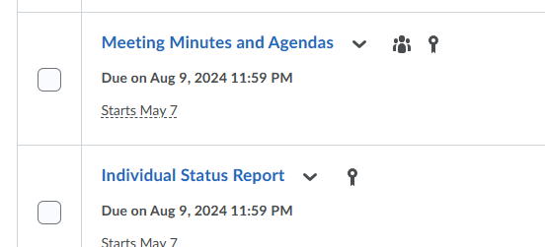
Notes:
Templates found in econestoga
You either get a mark for completing these or 0 for being incomplete

Slide 14

Inception Phase
During this phase of the SDLC, you determine the vision, scope, and system users.
You identify key features and requirements.
You decide on the architecture and its feasibility.
Notes:
- Extending this deadline to the 31st

Slide 15
Inception Phase Deliverables Due May 24
Inception Documents (reminder: templates in eConestoga for each)
Client letter
Team charter
Project charter (stakeholders description)
IP contract: client and team members or only team members (entrepreneur project)
Project plan
Draft presentation (picture of team, names, business purpose, project name).
Web search and rationale report.

Slide 16
Client Letter
A letter you would use to reach out to a potential client to introduce your team
Once again, real clients are not a requirement for the project, although this document still needs to be submitted as a part of inception phase docs (pretend as though you are working with a client, what wording would you use in this letter to communicate your project to them?)

Slide 17
Team Charter
It should provide details of what happens to team members if expectations, that you as a team created, are not met, and what the consequences will be.
Everyone must sign and date the document.
This is to hold yourself and others accountable on your team and to define roles & responsibilities
Discuss when to escalate issues

Slide 18
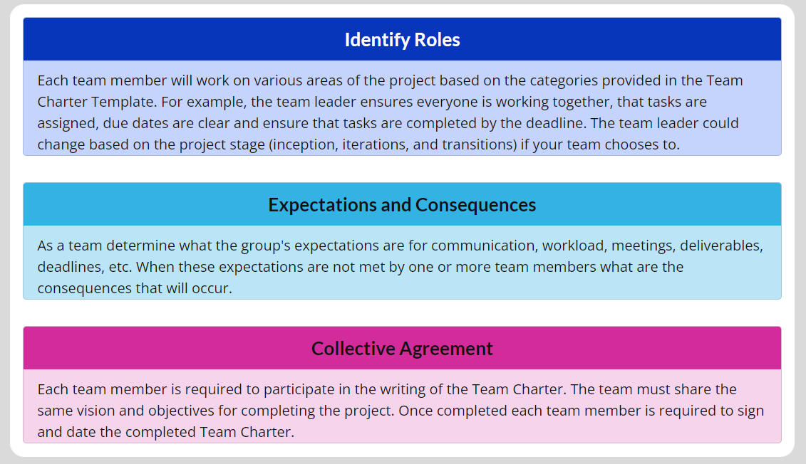
Team Charter

Slide 19
Project Charter
A project charter is a way to maintain control of the project, so your team knows when things need to be accomplished & by when.
Include business purpose, project roles & responsibilities
Feature List
This is a list of abilities/capabilities that the solution will have
System Objectives
Project Critical Success Factors
Preliminary Technical Architecture
Event Table
A catalogue of use cases that lists events in rows and key pieces of information about each event in columns
Notes:
- Min of 7 features

Slide 20
Intellectual Property Document
IP is protected in law by, for example, patents, copyright and trademarks, which enable people to earn recognition or financial benefit from what they invent or create
This includes:
Copyrights: protecting the web app's code, content, and visual elements (e.g., graphics, logos).
Trademarks: protecting the web app's brand identity, logos, and slogans.
Patents: protecting innovative features, algorithms, and technical solutions.
Trade Secrets: protecting confidential and proprietary information, such as business methods and technical know-how.
Industrial Design Rights: protecting the web app's user interface, layout, and design.
Database Rights: protecting the web app's databases and data collections.
Domain Names: protecting the web app's online identity and branding.

Slide 21
Intellectual Property Document
All team members must participate in the development of the contract and sign it upon completion. The contract will state how the intellectual property will be owned by one or more team members.

Slide 22
Project Plan
Goals,
Success metrics,
Stakeholders and roles,
Scope and budget,
Milestones and deliverables,
Timeline and schedule
Communication plan.
A software that is strongly recommended for developing a project plan and tracking its process is Microsoft Project or Atlassian Suites (Jira)
Timeline feature
Sprint board
Backlog items & tasks

Slide 23
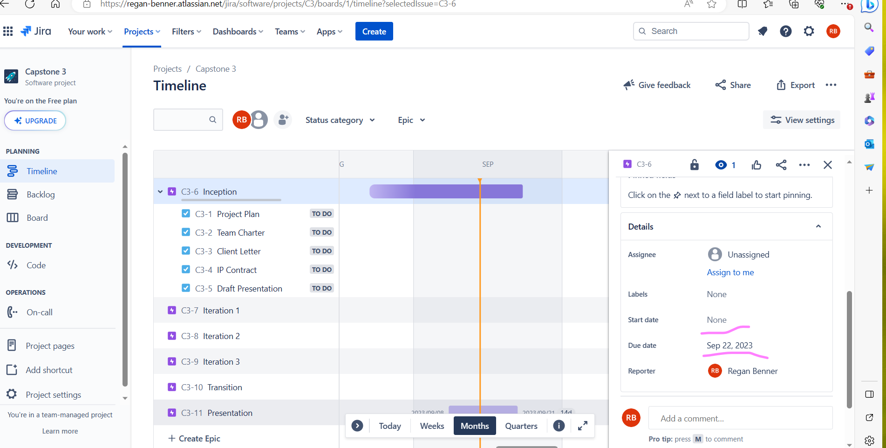
Project Plan
Timeline & due dates for each deliverable iteration
Notes:
- create different epics with due dates
- add your tasks to each epic to track deliverables

Slide 24
Draft Presentation
The presentation slides will be used as the basis for your final presentation in the end
For this week's submission, your presentation slides will be a maximum of 5 to 12 slides.
Final presentation will have about 25 slides

Slide 25
Draft Presentation
Title Slide that includes:
Appropriate image or PowerPoint-style applied,
Team names,
Project advisors name (faculty name), and
Client name.
Team Members
Insert an individual photo of each team member labelled with their name.
Agenda (Optional)
A list of topics covered in your presentation.
Provide company background information or Entrepreneur project context
What industry is the company from?
What products or services do they offer?
If an entrepreneur project, provide background on what your team will be developing and why.

Slide 26
Draft Presentation
Project description
Explain the scope of the project.
Design View
Class diagrams
Sequence diagrams
Navigation
Entity-relationship diagramNote: Only certain sections of the design view will be ready at this time and the remaining items will be provided later in the semester.
Business Benefits
How does the solution assist the company in meeting its needs?
How does it compare from the old to the new process?
Technologies Used
Provide brief explanations (1 to 3 words per technology) or images of technology architecture.
Summary/Conclusion
Closing statements that bring together the key topics of your project.
Note: Your conclusion bullet points will be very limited at this stage.
Questions from the audience

Slide 27
Web Search & Rationale Report
Ensure you have done your research
Are there similar applications/competitors in the market? What features sets your web app apart?
Do the logistics of the web application make sense in the real world?
Have you interviewed anyone or had experience in the area that this web app would be used?

Slide 28
Web Search & Rationale Report
Competitor Identification: List the competitors identified, including their names, URLs, and brief descriptions.
Competitor Analysis: For each competitor, provide:
Overview: Summary of their web app, features, and target audience.
Strengths and Weaknesses: Analysis of their advantages and disadvantages.
Unique Selling Points (USPs): Identification of their differentiators.
Marketing Strategies: Overview of their marketing tactics and channels.
User Experience: Evaluation of their user interface, navigation, and overall experience.
Features and Functionality: Comparison of their features and functionality with your web app.
Pricing and Business Model: Analysis of their pricing strategy and revenue streams.
Market Gap Analysis: Identify areas where your web app can differentiate itself or fill a gap in the market.

Slide 29

Iteration Plan & Agile Backlog 1

Slide 30
Iteration 1 Project Plan & Backlog
First, build a backlog list of items, tasks & stories for iteration 1 (stories can include: development work, documentation work, research, testing/QA) that your team will work on
Backlog items should be specific and broken down into stand alone items
Prioritize the backlog/put it in order
What absolutely needs to be completed first?
Plan what items you will complete in the upcoming iteration
How much work will your team be able to take on? Don’t plan for too little or for too much
Would recommend Microsoft Project for tracking backlogs or Jira
Include screenshots of your backlog for the iteration

Slide 31
End of Class ☺
Next Week
Going over Jira backlog creation
Questions?

