Slide 1
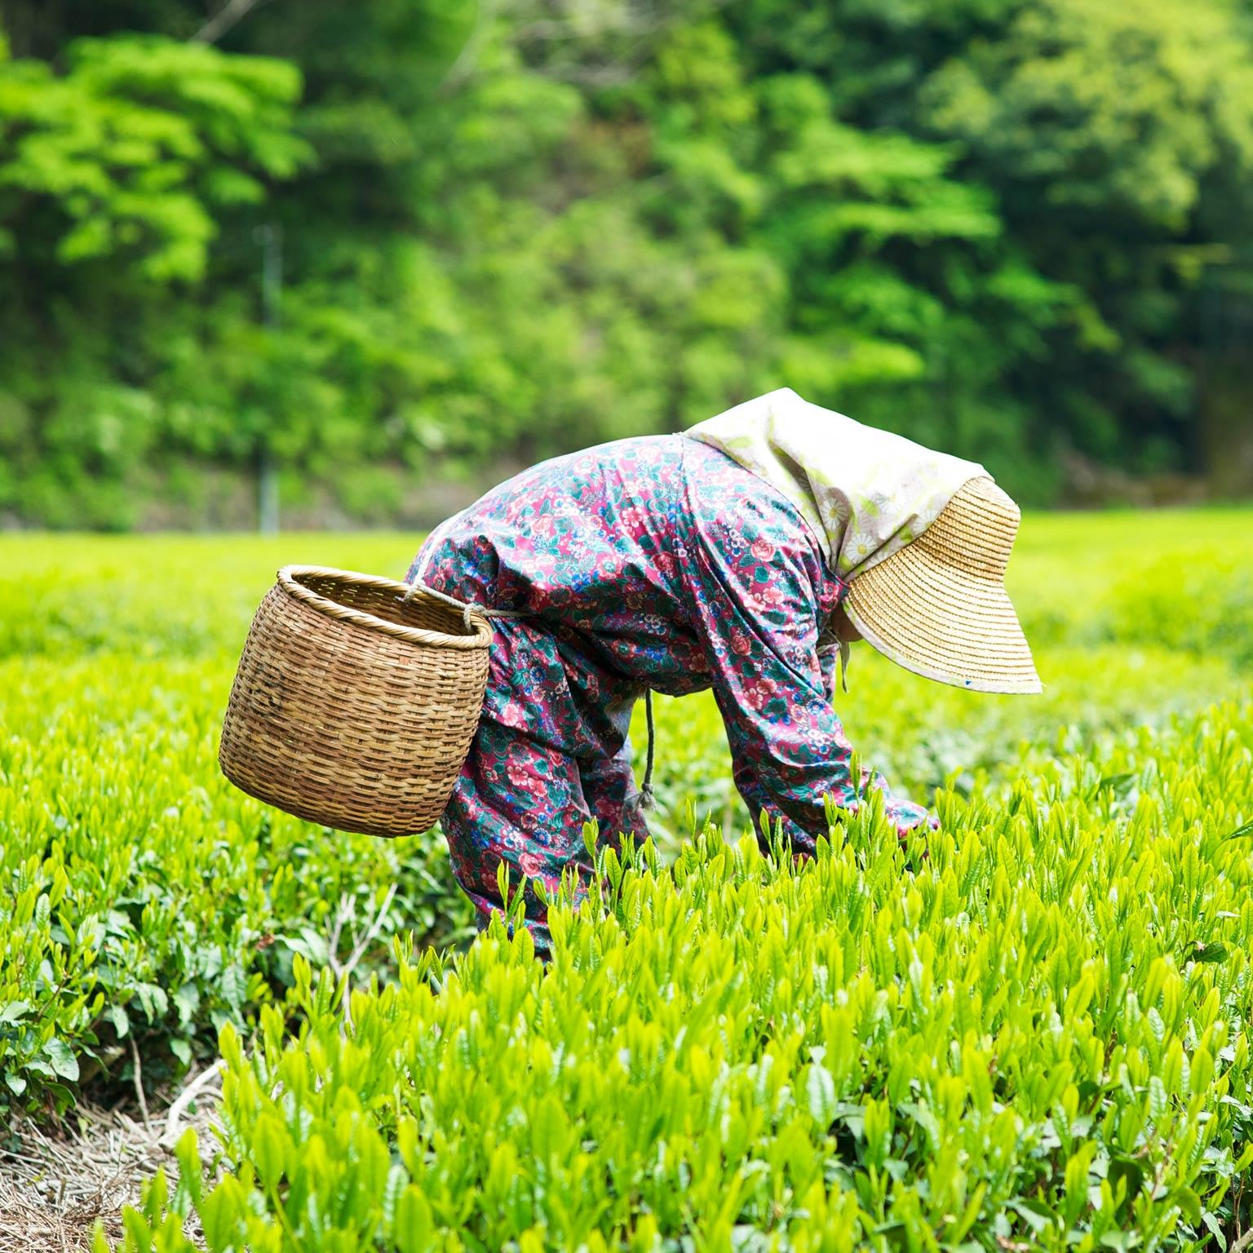
SMART AGRICULURE

Slide 2
Issues with current system
Outdated technologies
Dependence on external factors (climate, weather, etc.)
Seasonality

Slide 3
Our feature
Soil monitoring system
Current temperature and humidity monitoring system
Proper comparison between current crop situation and ideal situation
User friendly interface to represent the same

Slide 4
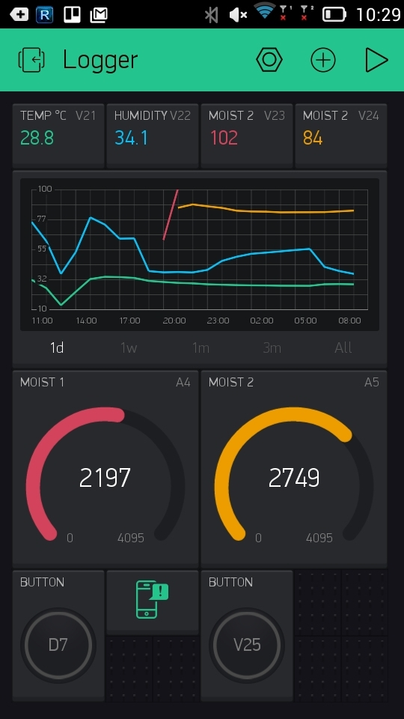
User interface
Give complete details about the present conditions
Gives comparison between required and present state
User friendly

Slide 5
OUR MAIN IDEA
KEY PARTNERS
1.FARMERS
2.GOVERNMENT
3.AGRICULTURE ORGANISATIONS
AUDIENCE RELATIONS
TO PROVIDE EASY MONITORING SYSTEM TO FARMERS
REDUCING THE PROBABILTY OF CROP FAILURE
KEY RESOURCES
ROBUST SOLUTIONS TO FIND FASTEST WAY TO HAVE BETTER CULTIVATIONTHIS
KEY ACTIVITIES
THIS JUST DOESN’T REDUCES PRBABILTY OF CROP FAILURE , BUT ALSO HELP FARMERS TO PREDICT THE CONDITIONS AND CHOOSE THE CROPS ACCORDINGLY

Slide 6
OUR VALUES
COST OF OUR IDEA
TIME INVESTMENT
CLOUD SERVICE
DATA ANALYSIS
VALUE
REDUCED CROP FAILURE
BETTER ANALYSIS
INCREASING THE ECONOMICAL CONDITIONS OF FARMERS

Slide 7

ABOUT US
KAUSHIKI AGRAWAL
KUMAR HARHIL
TAPASWIN PADHY
NAMAN KEDIA

