Slide 1
Advanced Computer Architecture (ACA2020)
Dr. ZHANG Chun-yuan
College of Computer, NUDT
Fall, 2020

Slide 2
Lecture 02 Instruction Set Architecture (ISA)
October 21, 2020

Slide 3

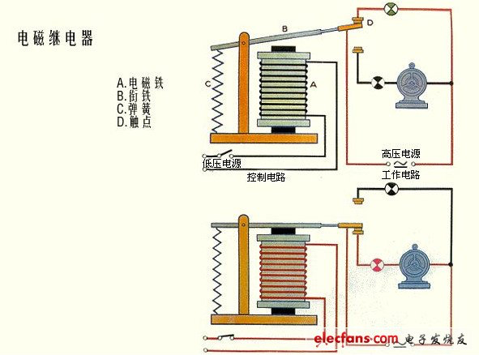
主观题
10分
Quiz 1 - Functions of X Y Z … 2min
作答

Slide 4
投票
最多可选1项
Memory
32-bit address
8-bit cell
Register
32 32-bit
Program
Add the number in memory address 0 and 1 to address 3
Load r1, #0
Load r2, #1
Add r3, r1, r2
Store r3, #3
A
完成了，结果不错
B
完成了，结果不对
C
完成了，结果不明
D
没完成
提交

Slide 5
Objects Today
Storage
Memory
Regesters
Operands操作数
Operations操作
Format of instructions
Addressing访问，寻址方式
Compiler

Slide 6
What Is a Memory?
A container of binary number
How to specify a memory?
How many binary cells (bits) can be accessed in one time? -- the object size
8 bits in our book and most computer
8 bits == a byte
How many bytes in all? -- the memory size
Where is the cell position? -- the address

Slide 7
Accessing Mode
Bytes (8 bits)
Half words (16 bits)
Words (32 bits)
Double words (64 bits)
How to access these units?
Programming in your code
Test
suggestion: in procedures

Slide 8
The Little and Big Endian(大端小端)
bit | 0 | 7 | 8 | 15 | 16 | 23 | 24 | 31
 | byte #0 |  | byte #1 |  | byte #2 |  | byte #3
 | 16-bit integer #0 |  |  |  | 16-bit integer #1
 | 32-bit integer
0x | 1 | 2 | 3 | 4 | 5 | 6 | 7 | 8
big-endian | 0001 | 0010 | 0011 | 0100 | 0101 | 0110 | 0111 | 1000
 | Most-S |  |  |  | Least-S
little-endian | Least-S |  |  |  | Most-S
 | 0111 | 1000 | 0101 | 0110 | 0011 | 0100 | 0001 | 0010

Slide 9
Byte Aligned
An access to an object of size s bytes at byte address A is aligned if
A mod s = 0
Figure A.5/page A8
Width of object | 0 | 1 | 2 | 3 | 4 | 5 | 6 | 7
Byte
Half word
Word
Double word

Slide 10
Registers
Another forms of storage internal to the CPU
Three Types of Register File
Accumulator architecture
Stack architecture
Register Architecture
Notes:
累加器, 堆栈, 寄存器

Slide 11
Structure of a Copmuter
Storage
Memory
Registers
Operands
Operations
Addressing
Format of instructions
Compiler

Slide 12
Type and Size of Common Operands
Character | (1 byte)
Integer | Half word (16-bit short integer) Word (32-bit integer) Long word (64-bit integer)
Floating point (Real) | Word (32-bit single-precision number) Double word (64-bit double-precision number)
Decimal小数 | Unpacked decimal A decimal characters string Packed decimal 4-bit to encode values 0-9, usually based on BCD code A two decimal digits packed into each byte

Slide 13
Structure of a Copmuter
Storage
Memory
Registers
Operands
Operations
Addressing
Format of instructions
Compiler

Slide 14
Operations: Types of Instructions
Operations | Examples
Arithmetic & logical | Integer: ADD, AND, OR, etc.
Data transfer | LOADS and STORES
Control | JUMP, CALL, RETURN TRAPS, etc.
System | OS call, virtual memory instructions
Floating point | Floating point: ADD, AND, OR, etc.
Decimal | Decimal: ADD, AND, conversion, etc.
String | String: MOVE, COMP, SEARCH, etc.
Graphics | Pixel operations, compression, etc.

Slide 15
Top 10 Instructions for x86 (SPECint92)
Rank | 80x86 instruction | Integer average( % total executed)
1 | load | 22%
2 | conditional branch | 20%
3 | compare | 16%
4 | store | 12%
5 | add | 8%
6 | and | 6%
7 | sub | 5%
8 | move register-register | 4%
9 | call | 1%
10 | return | 1%
total |  | 96%

Slide 16
Branch Instructions
Conditional branch -- branch
Unconditional branch -- jump
Call
Return

Slide 17
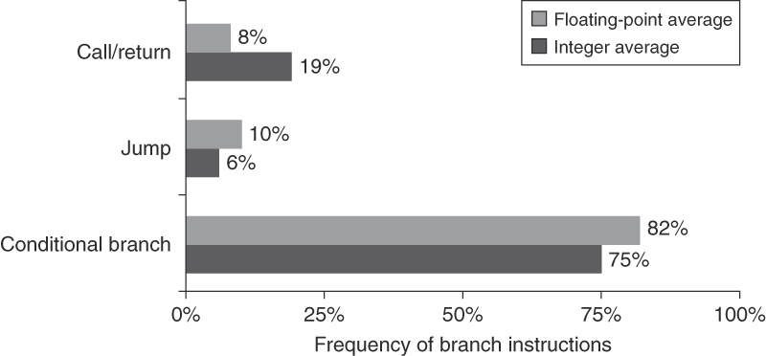
The Frequencies of Control Flow Instructions

Slide 18
Methods to Evaluation Branch Conditions
Name | How condition is tested
Condition code (CC) | Special bits are set by ALU operations
Condition register | Set arbitrary register with the result of a comparison
Compare and branch | Branch is part of the compare

Slide 19
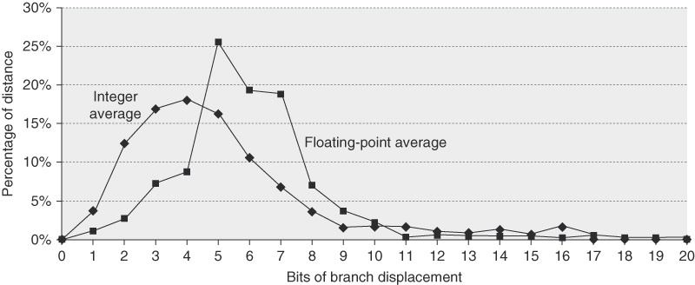
Branch Distances
Branch distances in terms of number of instructions between the target and the branch instruction

Slide 20
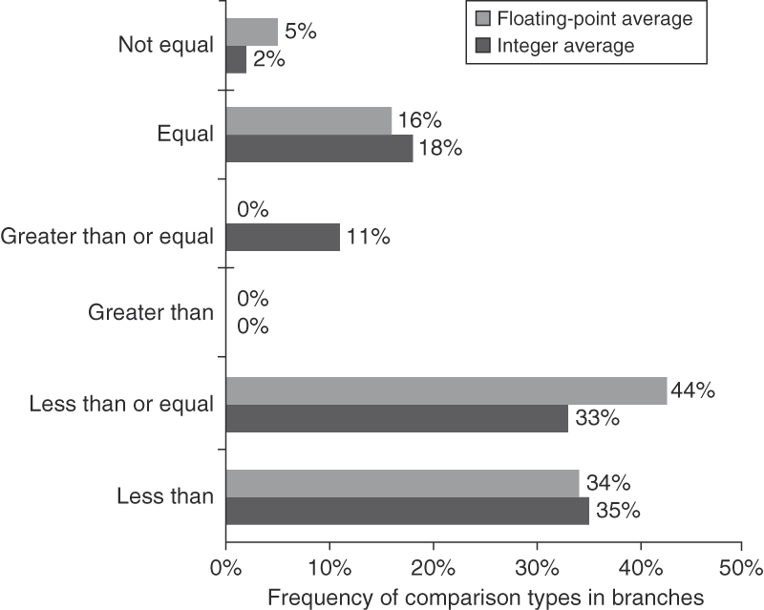
Frequency of Conditional Branches

Slide 21
Structure of a Copmuter
Storage
Memory
Registers
Operands
Operations
Addressing
Format of instructions
Compiler

Slide 22
The Pop Addressing Modes
Addressing mode | Example instruction | Usage
Register | ADD R3,R4 | Value is in register
Immediate | ADD R4,#3 | Constants
Displacement | ADD R4,100(R1) | Local variables
Register indirect | ADD R4,(R1) | Pointers
Indexed | ADD R3,(R1+R2) | Array
Direct or absolute | ADD R1,(1001) | Static data
Mem. Indirect | ADD R1,@(R3) | Pointers
Auto increment | ADD R1,(R2)+ | Stepping
Auto decrement | ADD R1,-(R2) | As inc.
Scaled | ADD R1,100(R2)(R3) | To index array

Slide 23
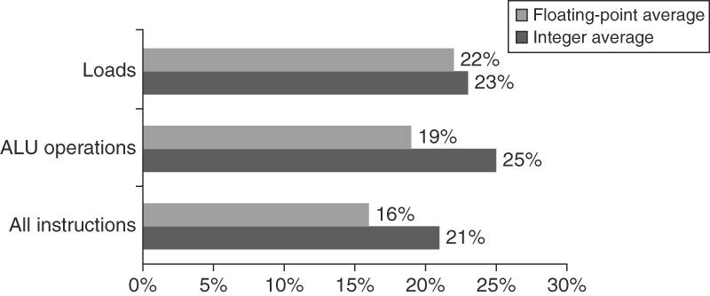
Immediate Operand
About one-quarter of data transfers and ALU operations have an immediate operand

Slide 24
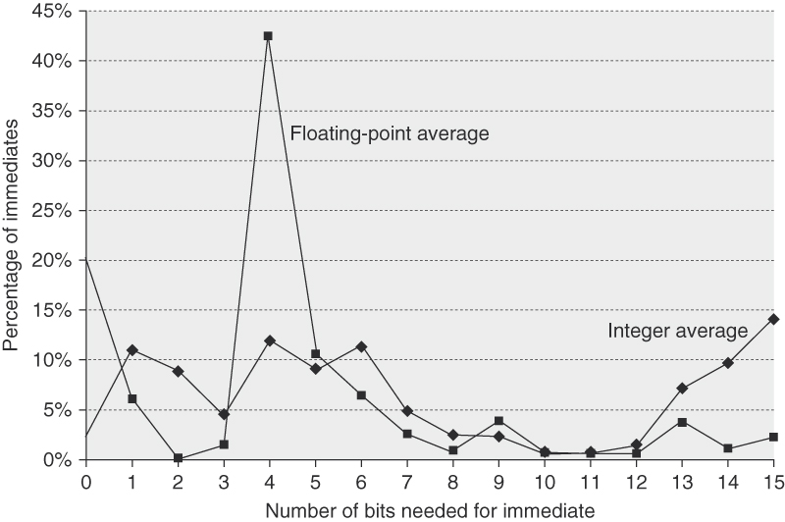
Immediate Values
16 bits would capture about 80% and 8 bits about 50% of immediates
about 20% to 25% were longer than 16 bits

Slide 25
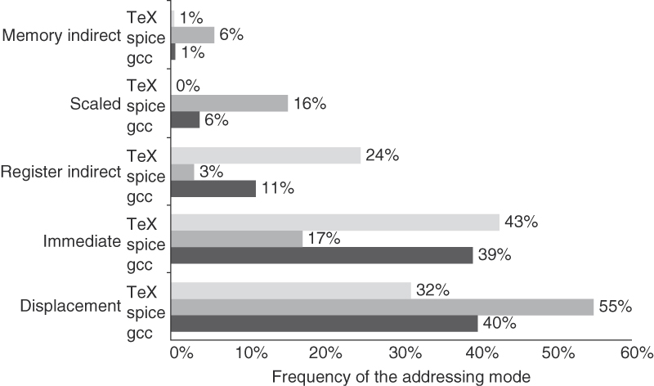
Use of Memory Addressing Modes
Almost all the memory indirect references use displacement mode as the base
Displacement mode includes all displacement lengths (8, 16, and 32 bits)

Slide 26
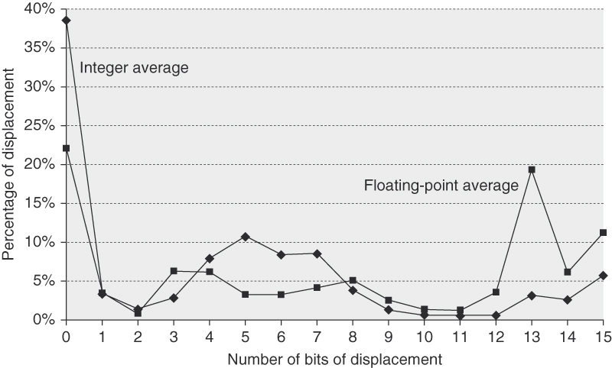
Displacement Values Distributions
These data were taken on the Alpha architecture with full optimization for SPEC CPU2000, showing the average of integer programs (CINT2000) and the average of floating-point programs (CFP2000)

Slide 27
Structure of a Copmuter
Storage
Memory
Regesters
Operands
Operations
Addressing
Format of instructions
Compiler

Slide 28
How to Encoding an Instruction Set
What fields must a instruction has?
How big the operations fields?
How many address fields must it has?
How long a address field ought to be?
Something else?

Slide 29
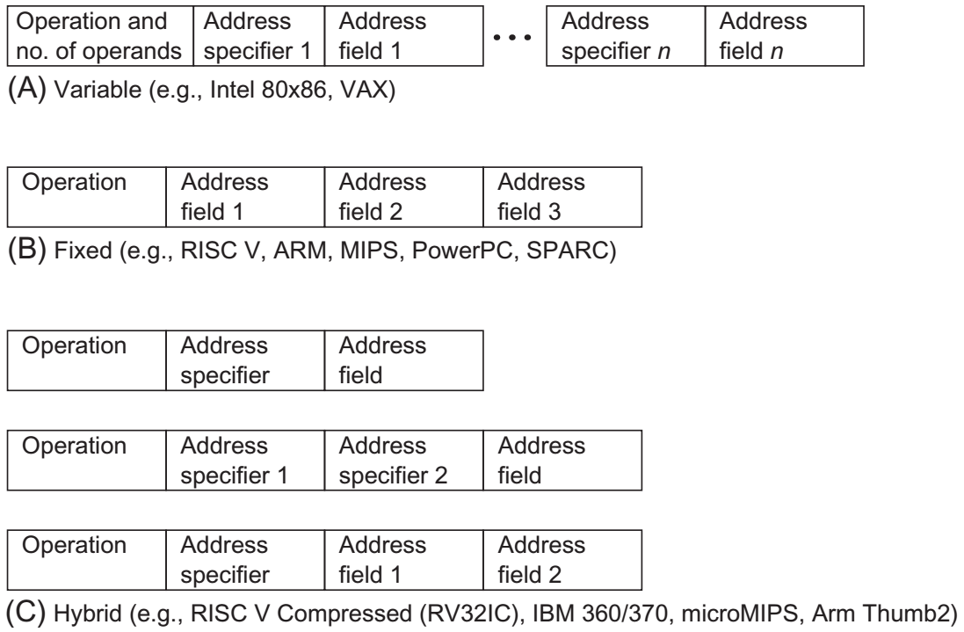
Three Basic Variations in Instruction Encoding

Slide 30
Reduced Code Size in RISCs
Several manufacturers offered a new hybrid version of their RISC instruction sets
With both 16-bit and 32-bit instructions, even 64-bit
The narrow instructions support
Fewer operations
Smaller address and immediate fields
Fewer registers
Two-address format

Slide 31
Reduced Code Size in RISCs
The ARM Thumb and MIPS MIPS16, which both claim a code size reduction of up to 40%
Instruction caches act as if they are about 25% larger
IBM's CodePack: compresses its standard instruction set
An overall performance cost of 10%, resulting in a code size reduction of 35% to 40%
Hitachi invented a fixed 16-bit RISC instruction set, called SuperH

Slide 32
A "Typical" RISC ISA
32-bit fixed format instruction
32 32-bit GPR (R0 == 0, DP takes pair)
3-address, reg-reg arithmetic instruction
Single address mode for load/store
Simple branch conditions
Delayed branch
SPARC, MIPS, HP PA, DEC Alpha, IBM PowerPC, CDC6600, CDC7600, Cray-1, Cray-2...

Slide 33
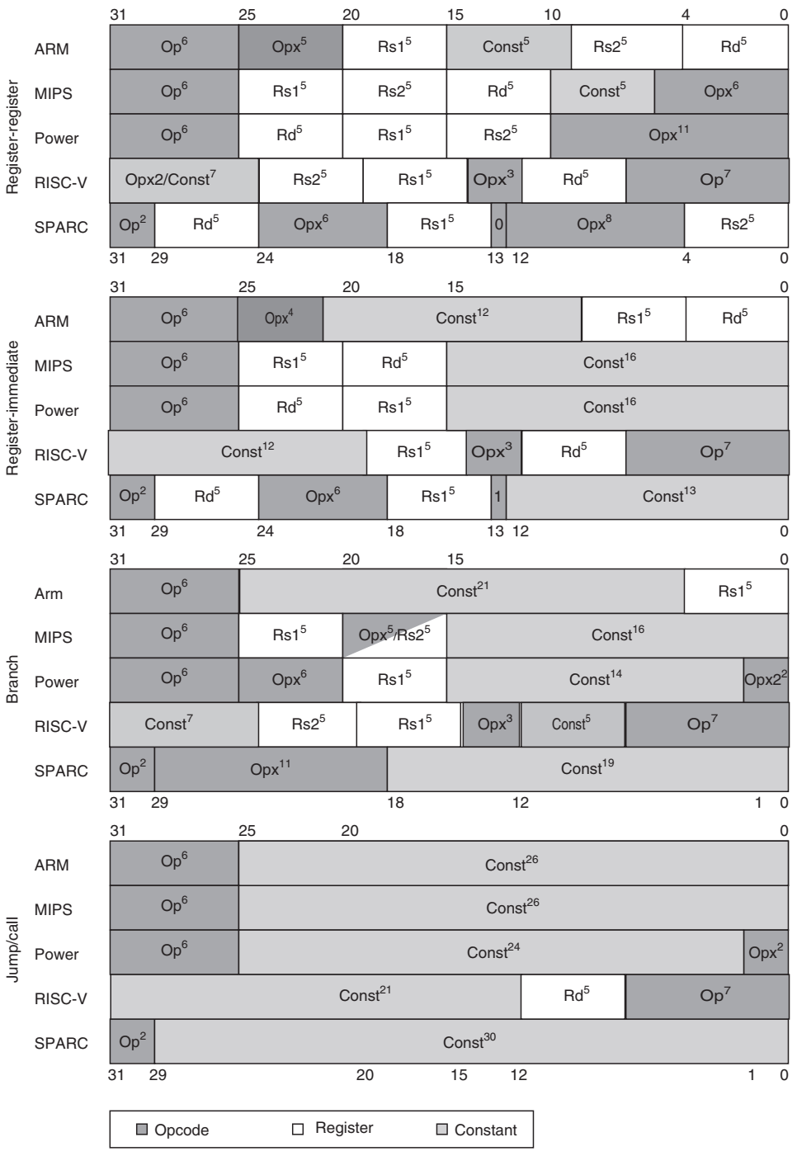
Instruction Format
These four formats are found in all five architectures
Op = the main opcode
Opx = an opcode extension
Rd = the destination register
Rs1 = source register 1
Rs2 = source register 2
Const = a constant
used as an immediate, address, mask, or sift amount

Slide 34
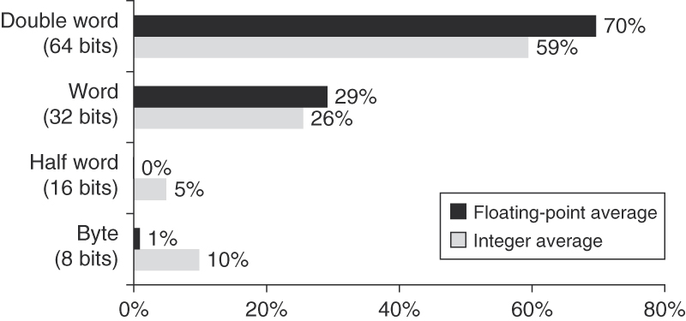
Distribution of Data Accesses by Size

Slide 35
Structure of a Copmuter
Storage
Memory
Regesters
Operands
Operations
Addressing
Format of instructions
Compiler

Slide 36
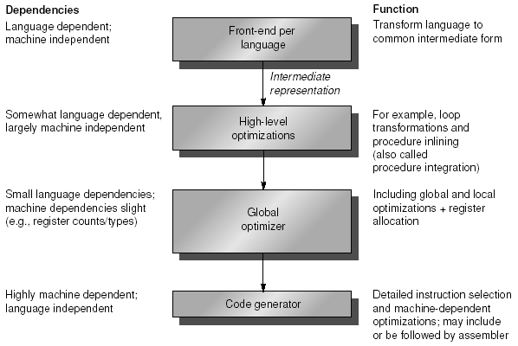
The Structure of Compilers

Slide 37
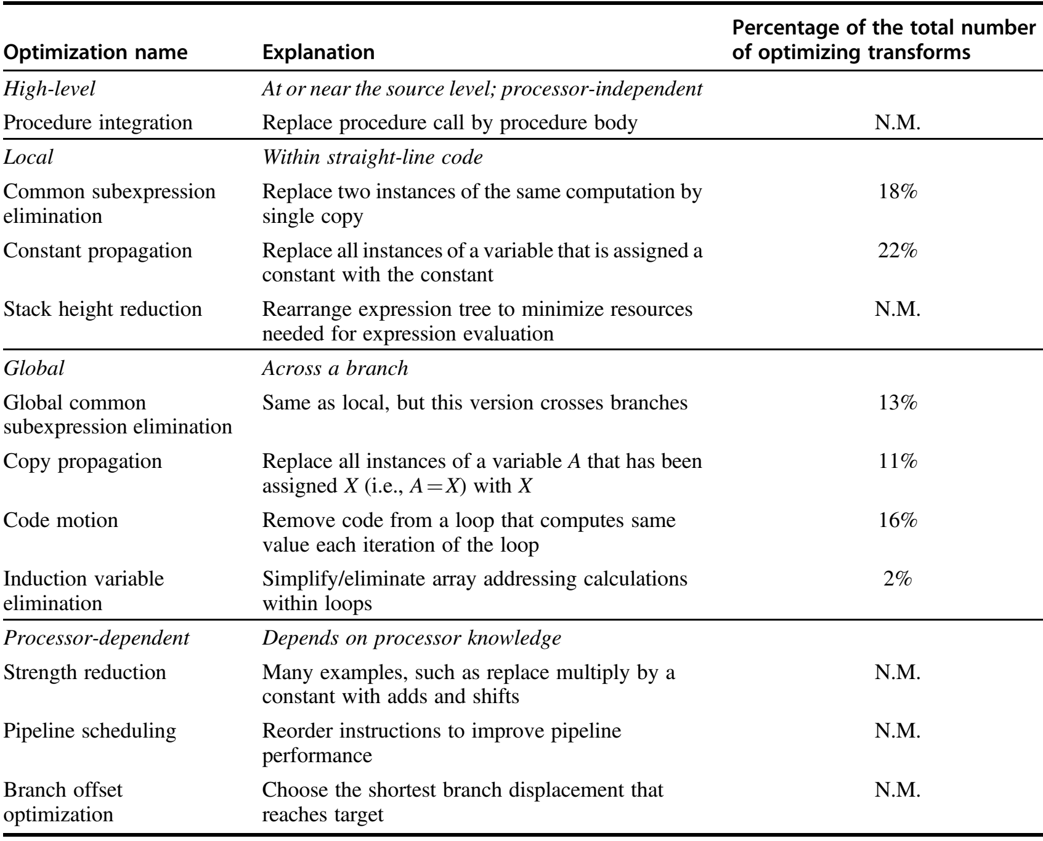
Major Types of Optimizations and Examples

Slide 38
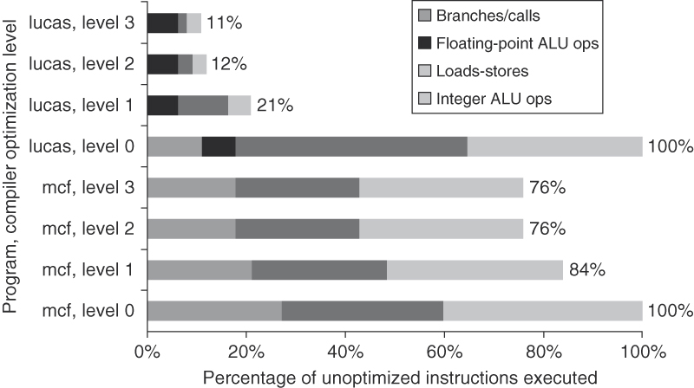
Change in ICs: Compiler Optimization Levels

Slide 39
The Lineage of RISC Instruction Sets

Slide 40
Berkeley New ISA, RISC-V
RISC-V is a new simple, clean, extensible ISA we developed at Berkeley for education and research
RISC-I/II, Berkeley RISC implementations
Berkeley research machines SOAR/SPUR considered RISC-III/IV
Both of the dominant ISAs (x86 and ARM) are too complex to use for teaching
RISC-V ISA manual available on web page
Full GCC-based tool chain available
Version 1.0 published on March 28, 2012

Slide 41
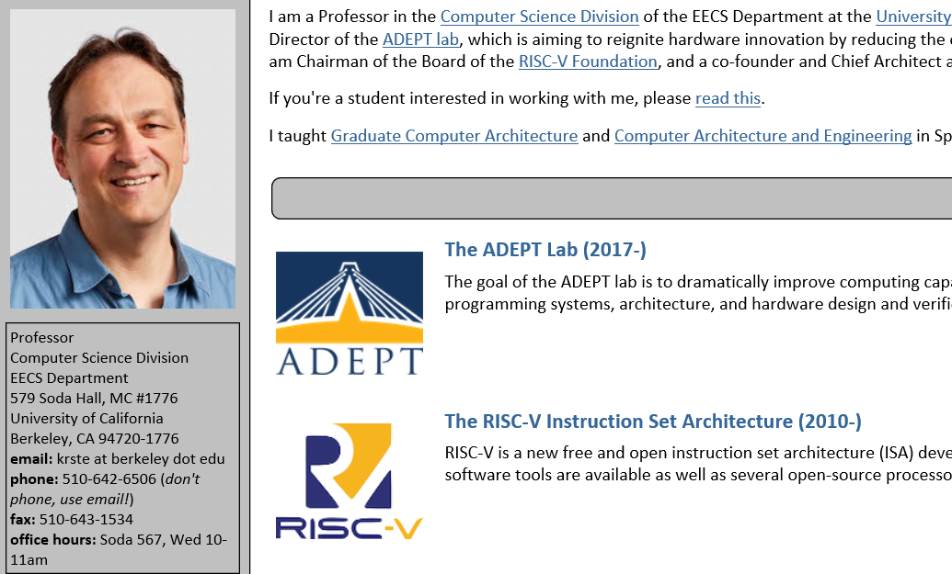
Originator: Professor Krste Asanovic

Slide 42
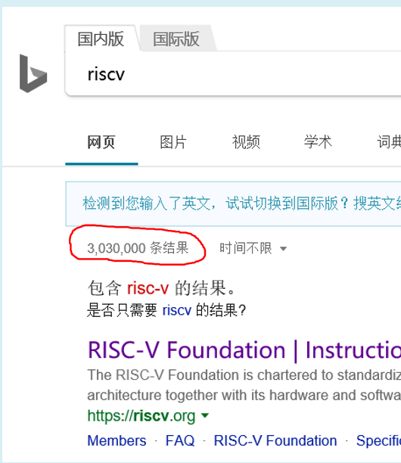
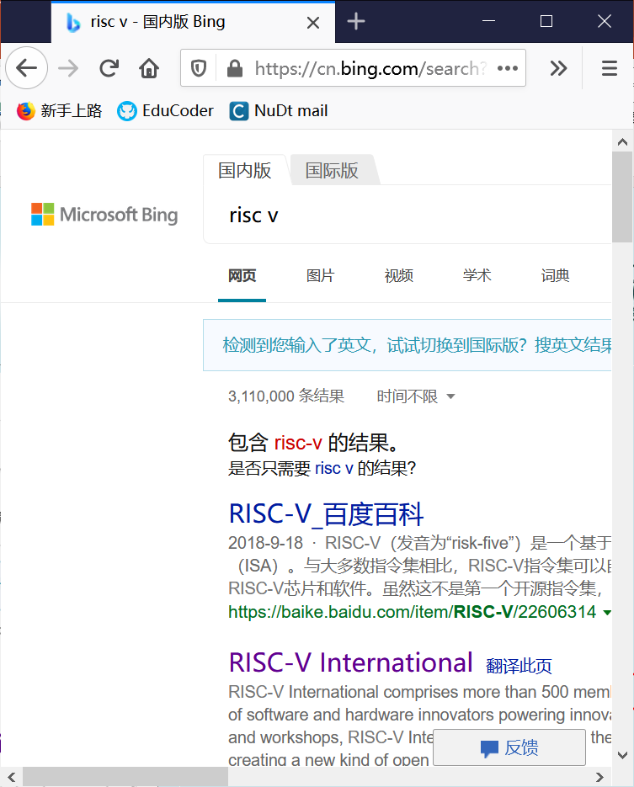

How Hot It Is?

Slide 43


RISC-V Summit 2019 and 2020

Slide 44
The RISC-V Instruction Set Manual
RISC-V is a new ISA designed to support computer architecture research and education
Our goals in defining RISC-V include:
Provide a realistic but open ISA that captures important details of commercial general-purpose ISA designs and that is suitable for direct hardware implementation.
Provide a small but complete base ISA that avoids “over-architecting” for a particular microarchitecture style (e.g., microcoded, in-order, decoupled, out-of-order) or implementation technology (e.g., full-custom, ASIC, FPGA), but which allows efficient implementation in any of these
Support both 32-bit and 64-bit address space variants for applications, operating system kernels, and hardware implementations.
Support highly-parallel multicore or manycore implementations, including heterogeneous multiprocessors.
Support an efficient dense instruction encoding with variable-length instructions, improving performance and reducing energy and code size.
Support the revised 2008 IEEE 754 floating-point standard.
Be fully virtualizable.
Be simple to subset for educational purposes and to reduce complexity of bringing up new implementations.
Support experimentation with user-level ISA extensions and specialized variants.
Support independent experimentation with new supervisor-level ISA designs

Slide 45
RISC-V ISA
New fifth-generation RISC design from UC Berkeley
Realistic & complete ISA, but open & small
Not over-architected for a certain implementation style
Both 32-bit (RV32) and 64-bit (RV64) address-space variants
Designed for multiprocessing
Efficient instruction encoding
Easy to subset/extend for education/research
Techreport with RISC-V spec available on class website
Increasing momentum with industry adoption

Slide 46
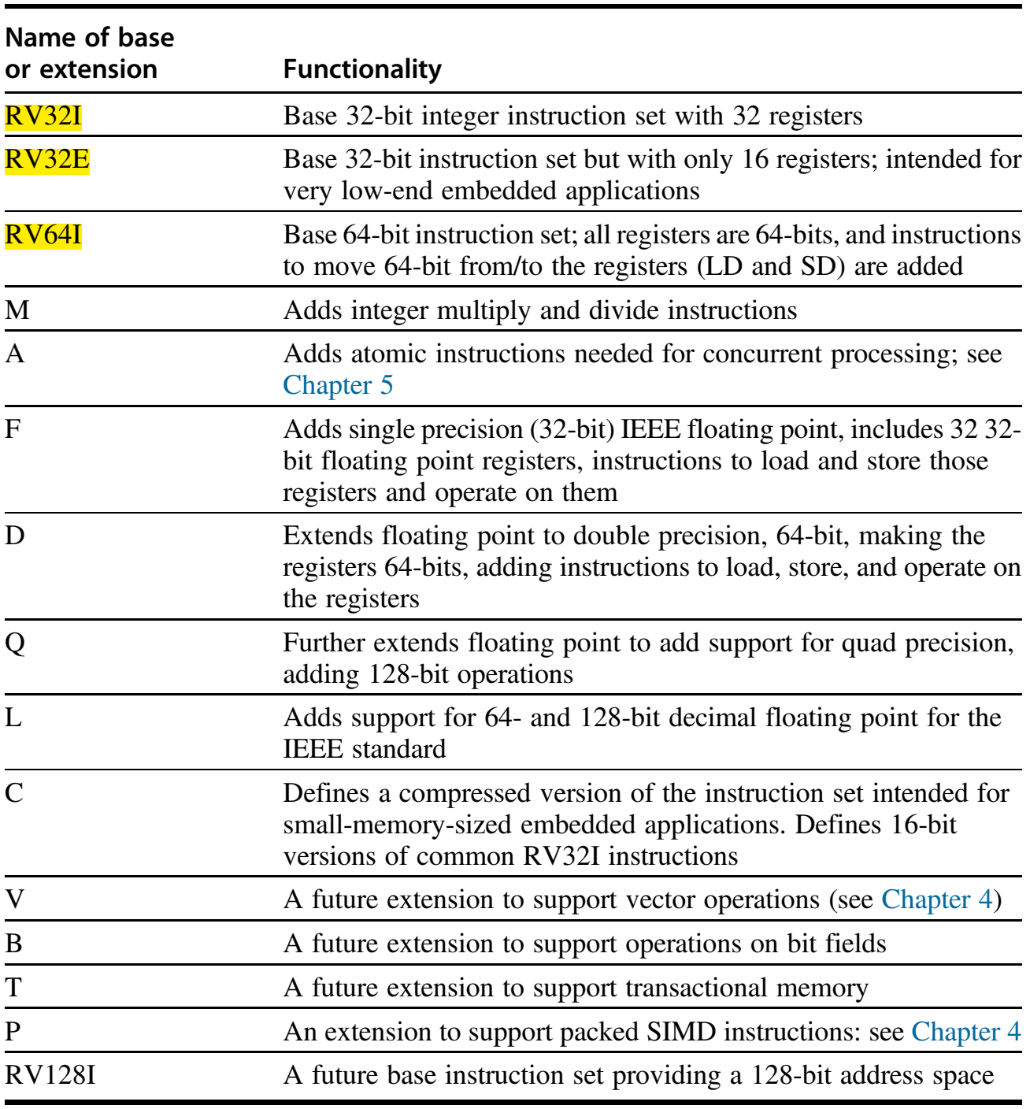
RISC-V Has Three Base Instructions Sets

Slide 47
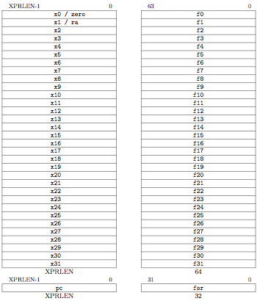
RV32 Processor State
Program counter (pc)
32x32-bit integer registers (x0-x31)
x0 always contains a 0
32 floating-point (FP) registers (f0-f31)
each can contain a single- or double-precision FP value (32-bit or 64-bit IEEE FP)
FP status register (fsr), used for FP rounding mode & exception reporting

Slide 48
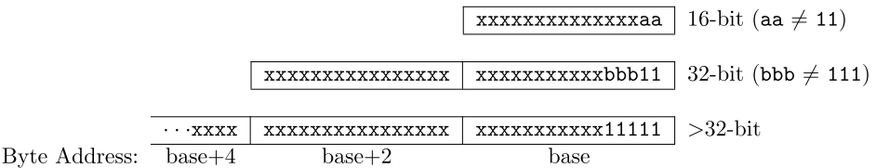
RISC-V Instruction Length Encoding
All the 32-bit instructions in the base ISA have their lowest two bits set to 11
The compressed 16-bit instruction-set extensions have their lowest two bits equal to 00, 01, or 10
Instruction-set extensions encoded with more than 32 bits have additional low-order bits set to 1

Slide 49
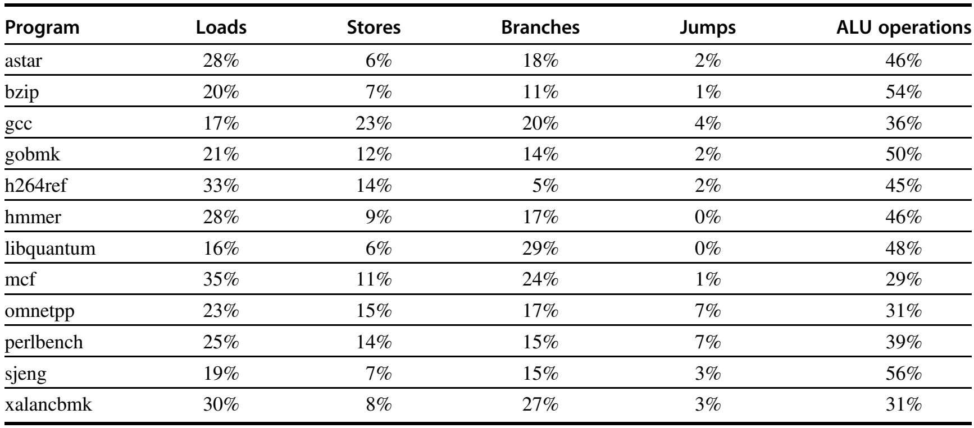
RISC-V Dynamic Instruction for SPECint2006

Slide 50
Reading and Presentations
Textbook
Appendix A
Two papers: point view arguing
Two pages of ISA maps in educoder.net
Coding
Design your own ISA
Reasonably simple
Describe all instructions in your ISA in Python
Homeworks

Slide 51
Next…
A Processor

