Slide 1
Advanced Computer Architecture (ACA2020)
Dr. ZHANG Chun-yuan
College of Computer, NUDT
Fall, 2020

Slide 2
Lecture 03 Instruction Set Simple Implementations

Slide 3

Poll
1 answer(s) at most
Papers reading
A
The 1st
B
The 2nd
C
The 3rd
D
Questions?
Submit

Slide 4
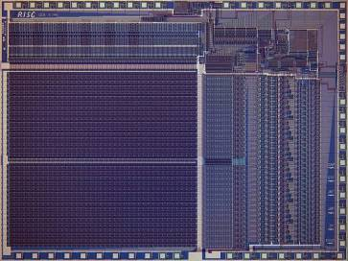
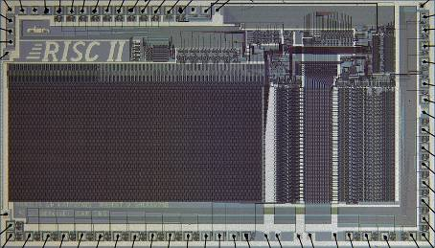
Berkeley RISC Chips
RISC-I (1982)
Contains 44,420 transistors
Fabbed in 5 µm NMOS, ran at 1 MHz with a die area of 77 mm2
This chip is probably the first VLSI
RISC RISC-II (1983)
Contains 40,760 transistors
Fabbed in 3 µm NMOS, ran at 3 MHz, and the die size is 60 mm2

Slide 5
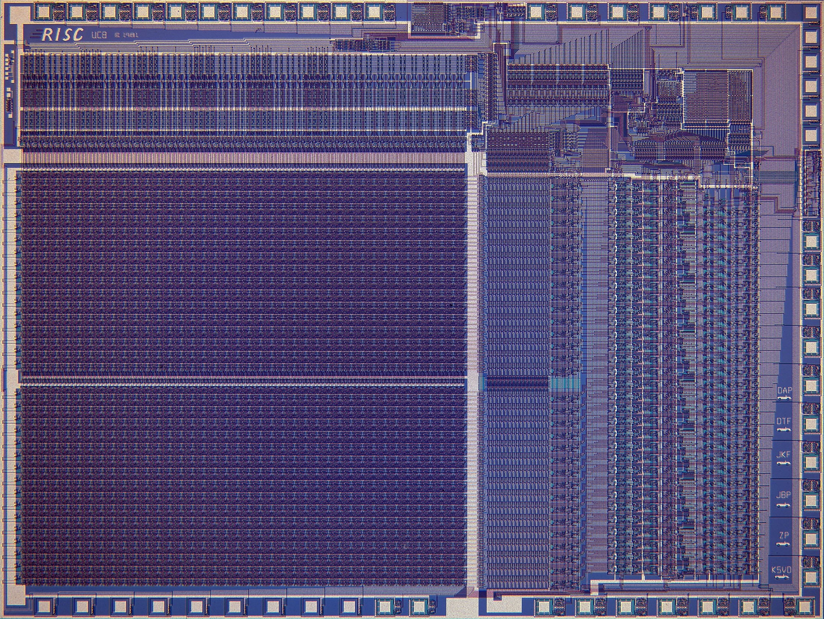

Slide 6
Big PIC of RISC II

Slide 7
Fields of all Instructions
Operation
Operands
Operand 1
Operand 2
Operand 3

Slide 8
Instruction Execution Phases
Instruction Fetch
Instruction Decode
Register Fetch
ALU Operations
Optional Memory Operations
Optional Register Writeback
Calculate Next Instruction Address

Slide 9
5 Phrases of Datapath
Instruction
Fetch
Instr. Decode
Reg. Fetch
Execute
Addr. Calc
Memory
Access
Write
Back
Next PC
MUX
Next SEQ PC
Adder
4
RS1
Zero?
Address
RS2
Reg File
MUX
Memory
Inst
RD
ALU
Data
Memory
L
M
D
MUX
MUX
Imm
Sign
Extend
IR <= mem[PC];
PC <= PC + 4
WB Data
Reg[IR_{rd}] <= Reg[IR_{rs}] op_{IRop} Reg[IR_{rt}]

Slide 10
Inst. Processing
Ifetch
Mem <= [PC]
IR <= mem[PC];
PC <= PC + 4
opFetch-DCD
A <= Reg[IR_{rs}];
B <= Reg[IR_{rt}]
Br
if bop(A,b)
PC <= PC+IR_{im}
J
PC <= IR_{jaddr}
RR
r <= A op_{IRop} B
WB <= r
Reg[IR_{rd}] <= WB
RI
r <= A op_{IRop} IR_{im}
WB <= r
Reg[IR_{rd}] <= WB
LD(ST)
r <= A + IR_{im}
WB <= Mem[r]
Reg[IR_{rd}] <= WB

Slide 11
Pipelined Datapath : Original
0x4
Add
rs1
we
rs2
rd1
we
addr
rdata
ws
addr
wd
rd2
ALU
GPRs
rdata
Inst.
Memory
Data
Memory
Imm
Ext
wdata

Slide 12
Pipelined with Latches and Stages
0x4
Add
rs1
we
rs2
rd1
we
PC
addr
rdata
IR
ws
addr
wd
rd2
ALU
GPRs
rdata
Inst.
Memory
Data
Memory
Imm
Ext
wdata
write
-back
phase
fetch
phase
decode & Reg-fetch
phase
execute
phase
memory
phase
Clock period can be reduced by dividing the execution of an instruction into multiple cycles
t_{C} > max {t_{IM}, t_{RF}, t_{ALU}, t_{DM}, t_{RW}} (= t_{DM} probably)

Slide 13
Hazards
Next

Slide 14
Limits to pipelining: Hazards and Types
HAZARDS prevent next instruction from executing during its designated clock cycle
Three classes of hazards
STRUCTURAL hazards
DATA hazards
CONTROL hazards

Slide 15
Structural Hazards: One Port Mem.
Time (clock cycles)
Cycle 1
Cycle 2
Cycle 3
Cycle 4
Cycle 5
Cycle 6
Cycle 7
I
n
s
t
r.
O
r
d
e
r
Load
Ifetch
Reg
ALU
DMem
Reg
Instr 1
Ifetch
Reg
ALU
DMem
Reg
Instr 2
Ifetch
Reg
ALU
DMem
Reg
Instr 3
Ifetch
Reg
ALU
DMem
Reg
Instr 4
Ifetch
Reg
ALU
DMem
Reg

Slide 16
Structural Hazards: Stall
Time (clock cycles)
Cycle 1
Cycle 2
Cycle 3
Cycle 4
Cycle 5
Cycle 6
Cycle 7
I
n
s
t
r.
O
r
d
e
r
Load
Ifetch
Reg
ALU
DMem
Reg
Instr 1
Ifetch
Reg
ALU
DMem
Reg
Instr 2
Ifetch
Reg
ALU
DMem
Reg
Stall
Bubble
Bubble
Bubble
Bubble
Bubble
Instr 3
Ifetch
Reg
ALU
DMem
Reg

Slide 17
Data Hazard on R1
Time (clock cycles)
IF
ID/RF
EX
MEM
WB
I
n
s
t
r.
O
r
d
e
r
add r1,r2,r3
Ifetch
Reg
ALU
DMem
Reg
Ifetch
Reg
ALU
DMem
Reg
sub r4,r1,r3
Ifetch
Reg
ALU
DMem
Reg
and r6,r1,r7
Ifetch
Reg
ALU
DMem
Reg
or r8,r1,r9
xor r10,r1,r11
Ifetch
Reg
ALU
DMem
Reg

Slide 18
Types of Data Hazards
RESULTS depends on in the pipeline
Read after write
Write after read
Write after write
Read after read (?)

Slide 19
Data Hazards of “r1”
Read After Write (RAW)
I: add r1,r2,r3
J: sub r4,r1,r3
Write After Read (WAR)
I: sub r4,r1,r3
J: add r1,r2,r3
Write After Write (WAW)
I: sub r1,r4,r3
J: add r1,r2,r3

Slide 20
Forwarding to Avoid Data Hazard
Time (clock cycles)
I
n
s
t
r.
O
r
d
e
r
add r1,r2,r3
Ifetch
Reg
ALU
DMem
Reg
sub r4,r1,r3
Ifetch
Reg
ALU
DMem
Reg
and r6,r1,r7
Ifetch
Reg
ALU
DMem
Reg
or r8,r1,r9
Ifetch
Reg
ALU
DMem
Reg
xor r10,r1,r11
Ifetch
Reg
ALU
DMem
Reg

Slide 21
HW Change for Forwarding
NextPC
ID/EX
EX/MEM
MEM/WR
Registers
mux
ALU
Data
Memory
mux
mux
Immediate

Slide 22
Data Hazard Even with Forwarding
Time (clock cycles)
I
n
s
t
r.
O
r
d
e
r
lw r1, 0(r2)
Ifetch
Reg
ALU
DMem
Reg
sub r4,r1,r6
Ifetch
Reg
ALU
DMem
Reg
and r6,r1,r7
Ifetch
Reg
ALU
DMem
Reg
or r8,r1,r9
Ifetch
Reg
ALU
DMem
Reg
Notes:
MIPS actutally didn’t interlecok: MPU without Interlocked Pipelined Stages

Slide 23
Data Hazard Even with Forwarding
Time (clock cycles)
I
n
s
t
r.
O
r
d
e
r
lw r1, 0(r2)
Ifetch
Reg
ALU
DMem
Reg
sub r4,r1,r6
Ifetch
Reg
Bubble
ALU
DMem
Reg
Ifetch
Bubble
Reg
ALU
DMem
Reg
and r6,r1,r7
Bubble
Ifetch
Reg
ALU
DMem
or r8,r1,r9

Slide 24
The Revised Pipelined
Instruction
Fetch
Instr. Decode
Reg. Fetch
Execute
Addr. Calc
Memory
Access
Write
Back
Next PC
Next SEQ PC
ID/EX
EX/MEM
MEM/WB
MUX
IF/ID
Adder
Adder
Zero?
4
RS1
Address
Memory
RS2
Reg File
ALU
Data
Memory
MUX
MUX
Sign
Extend
Imm
WB Data
RD
RD
RD

Slide 25
Branch Penalties
Next…

Slide 26
Four Branch Hazard Alternatives
#1: Stall until branch direction is clear
#2: Predict Branch Not Taken
#3: Predict Branch Taken
#4: Delayed Branch

Slide 27
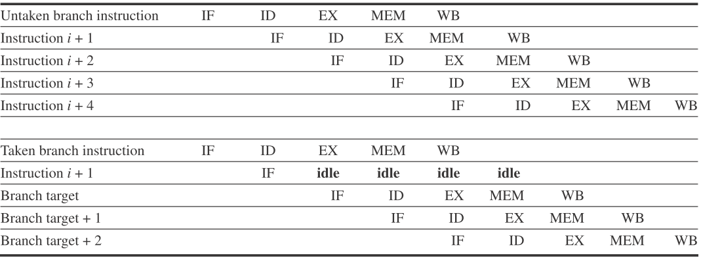
Untaken and Taken in a Predicted-not-taken
untaken
taken

Slide 28
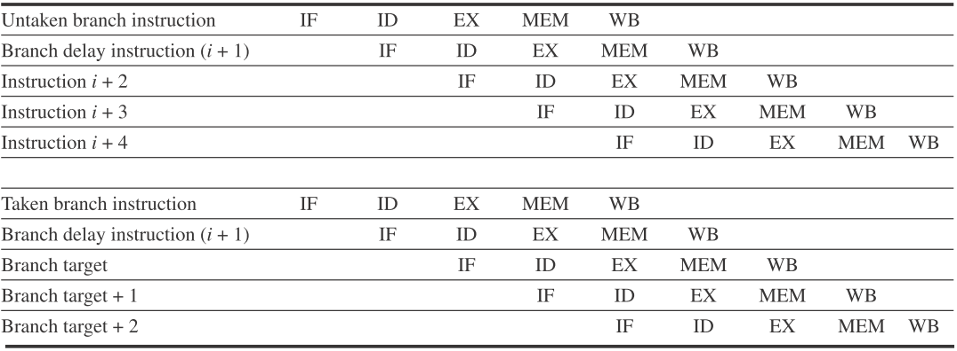
The Behavior of A Delayed Branch
untaken
taken

Slide 29
The Simplest Scheme: Predict as TAKEN
Average misprediction rate
TAKEN = UNTAKEN
For the SPEC programs is 34%
The misprediction rate for the SPEC ranges
From not very accurate (59%) to highly accurate (9%)

Slide 30
Direction-based Prediction
Predict on the basis of branch direction
Backward-going branches to be TAKEN
Forward-going branches to be NOT TAKEN
Misprediction rate: 30% ~ 40%
An enhanced direction-based prediction
Uses program context information
Using previous branch information

Slide 31
Profile-based Prediction
Predict branches on the basis of profile information collected from earlier runs
An individual branch is often highly biased toward taken or untaken
INPUT sensitive
Varies widely
The FP, an average rate of 9% with a standard deviation of 4%
The integer, an average rate of 15% with a standard deviation of 5%

Slide 32
Profile-based Predictor : Misprediction

Slide 33
Instructions Between Misprediction

Slide 34
Next …
The Simplest Dynamic Branch Prediction – Branch-Prediction Buffer (BPB)

Slide 35
A General Dynamic Branch Prediction
Branch
Predictor
Incoming Branches
{ Address }
Prediction
{ Address, Value }
History
Information
Corrections
{ Address, Value }

Slide 36
BPB Principles
 | Predictor 0
 | Predictor 1
lower
bits
of the
branch
PC
 | Predictor 2^{n}-1

Slide 37
1-bit BPB Scheme
Prediction accuracy is about 80%
Almost all loop will predict incorrectly twice

Slide 38
2-bit Scheme
Taken
Not taken
Predict taken
11
Predict taken
10
Taken
Taken
Not taken
Not taken
Predict not taken
01
Predict not taken
00
Taken
Not taken

Slide 39
BPB Prediction Accuracy
Accuracy: 4K-entry 2-bits BPB, SPEC89, IBM Power
Accuracy: 82% ~ 99%
Integer average 11%
gcc, espresso, eqntott, li
FP average 4%
nasa7, matrix300, tomcatv
Why they are deference?

Slide 40
Mispredictions

Slide 41
The 2-bit Scheme: an Alternative
Taken
Not taken
Predict taken
11
Predict taken
10
Taken
Taken
Not taken
Not taken
Predict not taken
01
Predict not taken
00
Taken
Not taken

Slide 42
Entries Mis : 4K vs. Unlimited, 2bit/entry

Slide 43
Next: BPB
A Faster Branch Prediction Processing

Slide 44
BPB: Typical Implementations
As a “cache”
Accessed with the instruction address during the IF
Attached to instruction cache
If the instruction is decoded as a branch -> the bits fetched predict it as
Taken -> fetching begins from the target as soon as the PC is known
Not taken -> sequential fetching continues

Slide 45
BPB: an Instruction Address
Fetch PC
0
0

Slide 46
BPB: IFatch and 2^{k} 2 bits Predicter Select
Fetch PC
0
0
I-Cache
k
2^{k}-entry
BPB,
2 bits/entry
BPB Index
Instruction
Opcode
offset
Taken/¬Taken?

Slide 47
BPB: Decode & Target PC
Fetch PC
0
0
I-Cache
k
2^{k}-entry
BPB,
2 bits/entry
BPB Index
Instruction
Opcode
offset
+
Branch?
Target PC
Taken/¬Taken?
2^{K}-entry BPB, 2 bits/entry, ~80-90% correct predictions

Slide 48
Next ...
Piplining Problems

Slide 49
Exception and Interrupt
Exception
An unusual event happens to an instruction during its execution
Examples: divide by zero, undefined opcode
Interrupt
Hardware signal to switch the processor to a new instruction stream
Example: a key pressed

Slide 50
Problem
It must appear that the exception or interrupt must appear between 2 instructions (Ii and Ii+1)
The effect of all instructions up to and including Ii is totally complete
No effect of any instruction after Ii can take place
The interrupt (exception) handler either aborts program or restarts at instruction Ii+1

Slide 51
Safely Steps
Force a trap instruction into the pipeline on the next IF
Until the trap is taken, turn off all writes for the faulting instruction
The following exception-handling routine immediately saves the PC of the faulting instruction

Slide 52
Precise Exceptions
If the pipeline can be stopped just before the faulting instruction are completed and those after it can be restarted from scratch
Any processor with demand paging or IEEE arithmetic trap handlers must make its exceptions precise

Slide 53
Next ...
Multicycle Operations

Slide 54
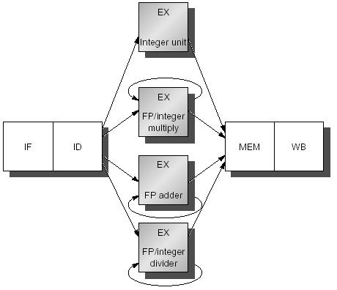
Four Separate FUs In Our MIPS

Slide 55
Latency and Initiation Interval
Functional unit | Latency | Initiation interval
Integer ALU | 0 | 1
Data memory (int & FP loads) | 1 | 1
FP add | 3 | 1
FP multiply (also int. multiply) | 6 | 1
FP divide (also integer divide) | 24 | 25

Slide 56
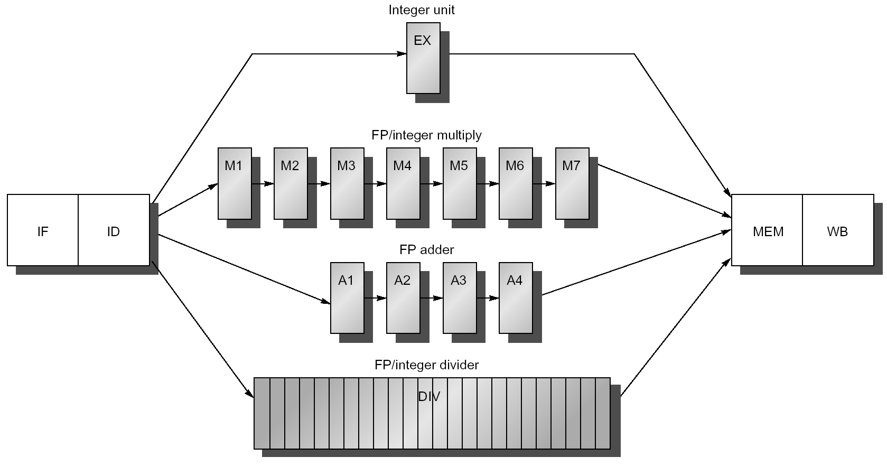
The Pipelines

Slide 57
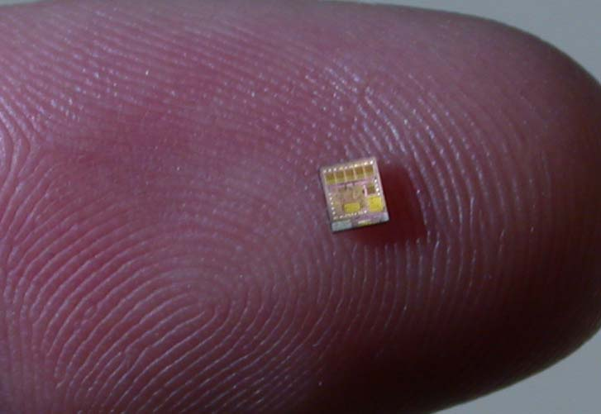
How Big a Chip

Slide 58

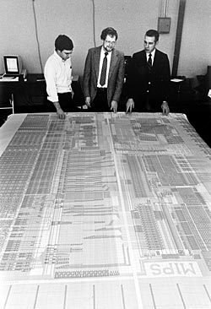
John L. Hennessy
John Hennessy served as Stanford's tenth president from 2000 – 2016
Stanford MIPS processor

Slide 59
Homeworks
Book reading
Appendix C
Reading papers
Performance from architecture: comparing a RISC and CISC with similar hardware organization, Bhandarkar, Clark, 1991
Implementation of Precise Interrupts in Pipelined Processors, James E. Smith, Andrew R. Pleszkun, 1985
Open question: topic of next week
If you implement the RISC-V, which instructions will you select?
Why?

Slide 60
Next…
Scoreboarding

