Slide 1
Advanced Computer Architecture (ACA2020)
Dr. ZHANG Chun-yuan
College of Computer, NUDT
Fall, 2020

Slide 2
Scoreboard
Dynamically Scheduled Pipelines

Slide 3
CDC 6600: designed by Seymore Cray
Control Data Corporation, CEO, William Norris
CDC 6600 Released: 1964
Fastest machine in world for 5 years (until 7600)
over 100 sold ($7-10M each)
OS: COS, SCOPE, MACE, KRONOS
Processor: One 60-bit CPU
The fastest clock speed for its day (100 ns, 10Mhz)
FP add in 4 clocks
Memory: 128K 60-bit words
Ten shared-logic 12-bit peripheral I/O processors
Display: Printer, plotter and dual video display console
Storage: 2MB extended core storage, magnetic disk, magnetic drum
400,000 transistors
Over 100 miles of wiring (done by hand)
Freon refrigerant cooling

Slide 4
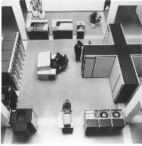
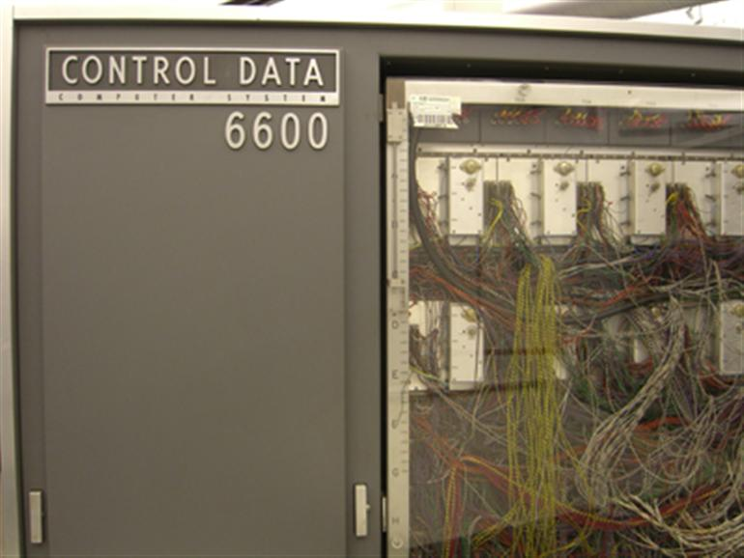
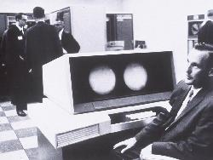
Some Photos (from Internet)

Slide 5
IBM Internal Memo
"Last week, Control Data ... announced the 6600 system. I understand that in the laboratory developing the system there are only 34 people including the janitor. Of these, 14 are engineers and 4 are programmers... Contrasting this modest effort with our vast development activities, I fail to understand why we have lost our industry leadership position by letting someone else offer the world's most powerful computer."
Thomas Watson Jr., IBM CEO, August 1963
To which Cray replied: “It seems like Mr. Watson has answered his own question.”

Slide 6
Review: Scoreboard (CDC 6600)
FP Mult
FP Mult
FP Divide
Registers
Functional Units
FP Add
Integer
SCOREBOARD
Memory
Notes:
FP 浮点数

Slide 7
Scoreboard Implications
Solutions for WAR
Stall writeback until registers have been read
Read registers only during Read Operands stage
Solution for WAW
Detect hazard and stall issue of new instruction until other instruction completes
Need to have multiple instructions in execution phase
=> multiple execution units or pipelined execution units

Slide 8
The 1st Stages: Issue
Issue -- Decode instructions & check for structural hazards (ID1)
Instructions issued in program order (for hazard checking)
Don’t issue if structural hazard
Don’t issue if instruction is output dependent on any previously issued but uncompleted instruction (no WAW hazards)

Slide 9
The 2nd Stages: Read Operands
Read Operands -- Wait until no data hazards, then read operands (ID2)
All real dependencies resolved in this stage, since we wait for instructions to write back data (RAW hazards)
No forwarding of data in this model !
Data can not be used until in registers

Slide 10
The 3rd Stages: Execution
Execution -- operate on operands (EX)
The functional unit begins execution upon receiving operands
When the result is ready, it notifies the scoreboard that it has completed execution

Slide 11
The 4th Stages: Write Result
Write result -- finish execution (WB)
Stall until no WAR hazards with previous instructions

Slide 12
Three Parts of the Scoreboard
Instruction status
Which of 4 steps the instruction is in
Register result status
Indicates which functional unit will write each register, if one exists
Blank when no pending instructions will write that register
Functional unit status
Indicates the state of the FU
9 fields for each functional unit
Notes:
What you might have thought
1. 4 stages of instruction executino
2.Status of FU: Normal things to keep track of (RAW & structura for busyl):
Fi from instruction format of the mahine (Fi is dest)
Add unit can Add or Sub
Rj, Rk - status of registers (Yes means ready)
Qj,Qk - If a no in Rj, Rk, means waiting for a FU to write result; Qj, Qk means wihch FU waiting for it
3.Status of register result (WAW &WAR)s:
which FU is going to write into registers
Scoreboard on 6600 = size of FU
6.7, 6.8, 6.9, 6.12, 6.13, 6.16, 6.17
FU latencies: Add 2, Mult 10, Div 40 clocks

Slide 13
9 Fields for Each Functional Unit
Busy: Indicates the unit is busy or not
Op: Operation to perform in the unit (e.g., + or –)
Fi: Destination register
Fj, Fk: Source-register numbers
Qj, Qk: Functional units producing source registers Fj, Fk
Rj, Rk: Flags indicating when Fj, Fk are ready
Notes:
What you might have thought
1. 4 stages of instruction executino
2.Status of FU: Normal things to keep track of (RAW & structura for busyl):
Fi from instruction format of the mahine (Fi is dest)
Add unit can Add or Sub
Rj, Rk - status of registers (Yes means ready)
Qj,Qk - If a no in Rj, Rk, means waiting for a FU to write result; Qj, Qk means wihch FU waiting for it
3.Status of register result (WAW &WAR)s:
which FU is going to write into registers
Scoreboard on 6600 = size of FU
6.7, 6.8, 6.9, 6.12, 6.13, 6.16, 6.17
FU latencies: Add 2, Mult 10, Div 40 clocks

Slide 14
How It Works
L.D F6, 34(R2)
L.D F2, 45(R3)
MUL.D F0, F2, F4
SUB.D F8, F2, F6
DIV.D F10, F0, F6
ADD.D F6, F8, F2

Slide 15
Where Are the RAWs?
L.D F6, 34(R2)
L.D F2, 45(R3)
MUL.D F0, F2, F4
SUB.D F8, F2, F6
DIV.D F10, F0, F6
ADD.D F6, F8, F2

Slide 16
RAWs
L.D F6, 34(R2)
L.D F2, 45(R3)
MUL.D F0, F2, F4
SUB.D F8, F2, F6
DIV.D F10, F0, F6
ADD.D F6, F8, F2

Slide 17
Where WARs?
L.D F6, 34(R2)
L.D F2, 45(R3)
MUL.D F0, F2, F4
SUB.D F8, F2, F6
DIV.D F10, F0, F6
ADD.D F6, F8, F2

Slide 18
WARs
L.D F6, 34(R2)
L.D F2, 45(R3)
MUL.D F0, F2, F4
SUB.D F8, F2, F6
DIV.D F10, F0, F6
ADD.D F6, F8, F2

Slide 19
EX Cycle Latencies
EX cycle latencies for the FP function units
ADD is 2 clock cycles
MULTIPLY is 10 cycles
DIVIDE is 40 cycles

Slide 20
Scoreboard Example

Slide 21
Scoreboard Example: Cycle 1

Slide 22
Scoreboard Example: Cycle 2

Slide 23
Scoreboard Example: Cycle 2
Issue 2nd LD?

Slide 24
Scoreboard Example: Cycle 3

Slide 25
Scoreboard Example: Cycle 3
Issue MULT?
Notes:
上一条指令没有发出，则当前指令不发出？

Slide 26
Scoreboard Example: Cycle 4

Slide 27
Scoreboard Example: Cycle 5

Slide 28
Scoreboard Example: Cycle 6

Slide 29
Scoreboard Example: Cycle 7

Slide 30
Scoreboard Example: Cycle 7
Read multiply operands?

Slide 31
Cycle 8a (First half of clock)
Read operands for MULT & SUB?

Slide 32
Cycle 8b (Second half of clock)
Notes:
一拍拆成了两半，前一半写寄存器，后一半写。。。

Slide 33
Scoreboard Example: Cycle 9
Note
Remaining
Notes:
附加计数器，记录乘法的进行情况

Slide 34
Scoreboard Example: Cycle 9
Self learning
Issue ADDD?
Note
Remaining
Notes:
Functional unit add只有一个

Slide 35
Scoreboard Example: Cycle 10
Self learning

Slide 36
Scoreboard Example: Cycle 11
Self learning

Slide 37
Scoreboard Example: Cycle 12
Self learning

Slide 38
Scoreboard Example: Cycle 12
Self learning
Read operands for DIVD?
Issue ADDD?

Slide 39
Scoreboard Example: Cycle 13
Self learning

Slide 40
Scoreboard Example: Cycle 14
Self learning

Slide 41
Scoreboard Example: Cycle 15
Self learning

Slide 42
Scoreboard Example: Cycle 16
Self learning

Slide 43
Scoreboard Example: Cycle 17
Self learning

Slide 44
Scoreboard Example: Cycle 17
Self learning
Why not write result of ADDD?

Slide 45
Scoreboard Example: Cycle 17
Self learning
Why not write result of ADDD?
WAR Hazard!

Slide 46
Scoreboard Example: Cycle 18
Self learning

Slide 47
Scoreboard Example: Cycle 19
Self learning

Slide 48
Scoreboard Example: Cycle 20
Self learning

Slide 49
Scoreboard Example: Cycle 21
Self learning

Slide 50
Scoreboard Example: Cycle 21
Self learning
WAR Hazard is now gone...

Slide 51
Scoreboard Example: Cycle 22
Self learning

Slide 52
Faster than light computation
Self learning
(skip a couple of cycles)

Slide 53
Scoreboard Example: Cycle 61
Self learning

Slide 54
Scoreboard Example: Cycle 62
Self learning
Notes:
指令顺序流出，乱序结束

Slide 55
Review: Scoreboard Status

Slide 56
Review: Scoreboard Status
In-order issue
Out-of-order execute
Out-of-order WR

Slide 57
Issue
Self learning
not Busy[FU] and not Result [D]
Bookkeeping
Busy[FU] ← yes; OP[FU] ← Op;
Fi[FU] ← D; Fj[FU] ← S1; Fk[FU] ← S2;
Qj ← Result[S1]; Qk ← Result[S2];
Rj ← not Qj; Rk ← not Qk;
Result[D] ← FU;

Slide 58
Read operands
Self learning
Rj and Rk
//operands are ready, check RAW
Bookkeeping
Rj ← No; Rk ← No;
//Rj, Rk have been used
Qj ← 0; Qk ← 0;
//no FU results are waited

Slide 59
Execution
Self learning
Execution complete
Functional unit done

Slide 60
Write Result
Self learning
Wait until ∀f((Fj[f] ≠ Fi[FU] or Rj[f] = no) & (Fk[f] ≠ Fi[FU] or Rk[f] = no));
Bookkeeping
∀f(if Qj[f] = FU then Rj[f] ← yes);
//all Fjs are OK
∀f(if Qk[f] = FU then Rk[f] ← yes);
//all Fks are OK
Result [Fi[FU]] ← 0;
Busy[FU] ← No;

Slide 61
Scoreboard on the CDC 6600
CDC 6600
No software pipeline scheduling
No semiconductor main memory
No caches (lower memory-access time)
Cost of scoreboard on the CDC 6600 is surprisingly low
About as much logic as one of the FU
The main cost is large number of buses (data trunk) that is about four times as many as executing in order

Slide 62
The CDC6600 Benefits
Improvement | Cede Type
1.7 | FORTRAN
2.5 | hand-coded assembly

Slide 63
Limitations of 6600 Scoreboard
No forwarding hardware
Limited to instructions in basic block
Small window
Small number of functional units
Structural hazards
Especially integer/load store units
Do not issue on structural hazards
Wait for WAR hazards
Prevent WAW hazards

Slide 64
Summary
Hazards limit performance
Structural: need more HW resources
Data: need forwarding, compiler scheduling
Control: early evaluation & PC, delayed branch, prediction
ILP found either by compiler or hardware
Increasing length of pipe increases impact of hazards
Pipelining helps instruction bandwidth, not latency!

Slide 65
Ambitiously
Missing from 6600 Scoreboard?
Hardware renaming – name dependencies limiting our potential speedup on loops!
Can we rename in hardware? Of course – next time
Concurrent write result to destination register and read operands

Slide 66
Historical View: Pipelining Tech
At the 1980s, for
Supercomputers
Large multimillion dollar mainframes
By the mid-1980s
The first pipelined microprocessors
Microprocessors bypass minicomputers and mainframes
By the early 1990s
High-end embedded microprocessors
Desktops were dynamically scheduled, multiple-issue

Slide 67
Homework
Read C7
Algorithm and write the functional explanation to each statement (operation and result)
Project:
Coding for scoreboard
The proposals submitted in two weeks

Slide 68
Next…
Branches

