Slide 1
The Case for the Reduced Instruction Set Computer A Commentary
Jennifer Mifflin
Tom Sabanosh
Andy Snyder
Anthony Wood

Slide 2
Introduction
Reasons for increased complexity
Consequences of CISC implementations
RISC and VLSI
Supporting a high level language
Current RISC architectures
We will omit completely outdated information and editorialize old but still relevant information.

Slide 3
Reasons for Increased Complexity

Slide 4
Memory Speed vs. CPU Speed
As cores get faster, implementing functionality on the chip is faster than retrieving subroutines from main memory.
Initial decisions that added complex functionality on chips resulted in substantial gains on the 709 CPU.
Will iteratively adding more functionality as the need arises necessarily result in the similar speed increases?

Slide 5
Microcode and LSI Technology
Microprogramming control involves using small and simple instructions to synthesize the ISA.
Used as opposed to hardwired control.
Microprogramming allows for adding complexity with no additional hardware cost because there likely exists extra unused memory (to an extent).

Slide 6
Code Density
CISC programs are more compact
Memory is cheaper today, even more-so than at the time of the paper, such that code density isn’t all important in the context of other tradeoffs.
In addition development time of an architecture far exceeds memory costs.

Slide 7
Marketing Strategy
Results in complex architectures due to the misconception that bigger is better.
Additional functionality is more marketable than compact functionality.
Example: Pentium MMX and SSE extensions.

Slide 8
Upward Compatability
Upward compatability implies adding functionality without removing old functionality.
80x86: Latest pentium can run 386 code (albeit, way too fast).
Ex. Jeopardy

Slide 9
Support for High Level Languages
As HLL’s were being developed, architects tried to add instructions that would handle high level constructs.

Slide 10
Use of Multiprogramming
Tasks of computers are becoming increasingly more complex.
Are CISC’s necessarily the way to deal with this issue?

Slide 11
How have CISC’s been Used?
The most prevalent desktop processor… 80x86… is CISC
Compilers fail to utilize all features of architecture.
VMS Fortran compiler produces 80% of all VAX instructions.

Slide 12
Consequences of CISC Implementations

Slide 13
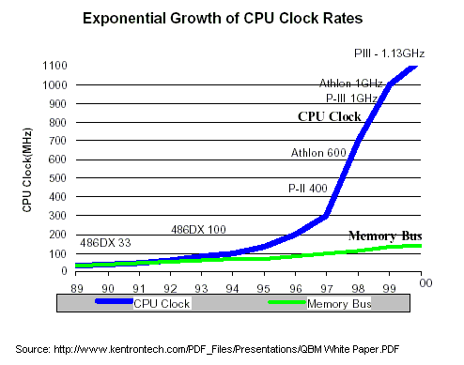
Faster Memory
Moore’s law: Transistor density doubles every 18 months.

Slide 14
Irrational Implementations
CISC instructions are not necessarily faster than an equivalent RISC implementation.
(VAX -11/780) INDEX instruction can be completed 45% faster by using 4 RISC instruction.

Slide 15
Lengthened Design Time
All aspects of development cost need to be considered.
CISC’s require a lengthier design time.
“Today [in RISC] we have large design teams and long design cycles,” he said “…The result is the current crop of complex RISC chips. “Superscalar and out-of-order execution are the biggest problem areas that have impeded performance [leaps]," Ditzel said. “So where is the advantage of RISC, if the chips aren't as simple anymore?”
--Ditzel courtesy http://www.arstechnica.com/cpu/4q99/risc-cisc/rvc-1.html

Slide 16
Increased Design Errors
Higher complexity = more bugs in design.
Fixing bugs often results in alternate bugs.
Example: FDIV bug

Slide 17
RISC and VLSI

Slide 18
Implementation Feasibility
A RISC design is more likely to fit on a single chip than a CISC design.
You are more likely to be able to implement a design if it fits on a single chip.
As chip size increases (Pentium III) this argument becomes less important.

Slide 19
Design Time
A simpler design can get to market faster
This implies that the simpler designs that are available to the market generally utilize more recent technology

Slide 20
Speed
Simpler can be faster
If leaving out an instruction can speed up the minor cycle by 10%, adding that instruction must speed up the machine by 10% to be cost effective.
Amdhahl’s Law

Slide 21
Better Use of Chip Area
Spare chip area implies flexibility for on-chip features
Caches
Complex branch prediction
Multiple functional units
RISCs are able to stay technologically one step ahead of the comparable CISCs

Slide 22
Supporting a High Level Language
The burden on compiler writers is eased when the instruction set is simple and uniform.
If the designers are wrong or if HLL changes, then the complexity will have been wasted.

Slide 23
Work on RISC Architectures
Pentium Pro uses micro-ops internally.
Implies realized value of RISC, however, we are locked in to IA32 instruction set
UltraSPARC MIPS & ARM are RISC systems.
"The MIPS R10,000 and HP PA-8000 seem much more complex to me than today's standard CISC architecture, which is the Pentium II. So where is the advantage of RISC, if the chips aren't as simple anymore?"
--Ditzel courtesy http://www.arstechnica.com/cpu/4q99/risc-cisc/rvc-1.html

Slide 24
Conclusion
Paper leaves you with the impression that as of 1980, RISC is the future.
Today, the distinction between CISC and RISC is blurred.

Slide 25

Questions?
Ditzel
Skadron
Patterson

