Slide 1
CMSC 611: Advanced Computer Architecture
Scoreboard
Some material adapted from Mohamed Younis, UMBC CMSC 611 Spr 2003 course slides
Some material adapted from Hennessy & Patterson / © 2003 Elsevier Science

Slide 2
Major Assumptions
Basic MIPS integer pipeline
Branches with one delay cycle
Functional units are fully pipelined or replicated (as many times as the pipeline depth)
An operation of any type can be issued on every clock cycle and there are no structural hazard

Slide 3
Inter-instruction Dependence
Determining how one instruction depends on another is critical not only to the scheduling process but also to determining how much parallelism exists
If two instructions are parallel they can execute simultaneously in the pipeline without causing stalls (assuming there is not structural hazard)
Two instructions that are dependent are not parallel and their execution cannot be reordered

Slide 4
Dependence Classifications
Data dependence (RAW)
Transitive: i  j  k = i  k
Easy to determine for registers, hard for memory
Does 100(R4) = 20(R6)?
From different loop iterations, does 20(R6) = 20(R6)?
Name dependence (register/memory reuse)
Anti-dependence (WAR): Instruction j writes a register or memory location that instruction i reads from and instruction i is executed first
Output dependence (WAW): Instructions i and j write the same register or memory location; instruction ordering must be preserved
Control dependence, caused by conditional branching

Slide 5
Example: Name Dependence
Loop: LD F0,x(R1)
ADDD F4,F0,F2
SD x(R1),F4
LD F0,x-8(R1)
ADDD F4,F0,F2
SD x-8(R1),F4
LD F0,x-16(R1)
ADDD F4,F0,F2
SD x-16(R1),F4
LD F0,x-24(R1)
ADDD F4,F0,F2
SD x-24(R1),F4
SUBI R1,R1,#32
BNEZ R1,Loop
Loop: LD F0,x(R1)
ADDD F4,F0,F2
SD x(R1),F4
LD F6,x-8(R1)
ADDD F8,F6,F2
SD x-8(R1),F8
LD F10,x-16(R1)
ADDD F12,F10,F2
SD x-16(R1),F12
LD F14,x-24(R1)
ADDD F16,F14,F2
SD x-24(R1),F16
SUBI R1,R1,#32
BNEZ R1,Loop
Register
renaming
Again Name Dependencies are Hard for Memory Accesses
Does 100(R4) = 20(R6)?
From different loop iterations, does 20(R6) = 20(R6)?
Compiler needs to know that R1 does not change  0(R1)≠ -8(R1)≠ -16(R1)≠ -24(R1) and thus no dependencies between some loads and stores so they could be moved

Slide 6
HW Schemes: Instruction Parallelism
Why in HW at run time?
Works when can’t know real dependence at compile time
Compiler simpler
Code for one machine runs well on another
Key idea: Allow instructions behind stall to proceed
DIVD F0,F2,F4
ADDD F10,F0,F8
SUBD F12,F8,F14
Enables out-of-order execution => out-of-order completion
ID stage checks for structural and data hazards

Slide 7
Out of Order Execution
Out-of-order execution divides ID stage:
Issue—decode instructions, check for structural hazards
Read operands—wait until no data hazards, then read operands
Scoreboards allow instruction to execute whenever 1 & 2 hold, not waiting for prior instructions
CDC 6600: In order issue, out of order execution, out of order commit / completion

Slide 8
Scoreboard Implications
Out-of-order completion  WAR, WAW hazards
Example: DIVID F0, F2, F4
ADDD F10, F0, F8
SUBD F8, F8, F8
Solutions for WAR
Queue both the operation and copies of its operands
Read registers only during Read Operands stage
For WAW, must detect hazard: stall until other completes
Scoreboard keeps track of dependencies, state or operations
Replace ID, EX, WB with 4 stages

Slide 9
Four Stages of Scoreboard
Issue—decode instructions & check for structural hazards (ID1).
If a functional unit for the instruction is free and no other active instruction has the same destination register (WAW), the scoreboard issues the instruction to the functional unit and updates its internal data structure.
If a structural or WAW hazard exists, then the instruction issue stalls, and no further instructions will issue until these hazards are cleared.
Read operands—wait until no data hazards, then read operands (ID2).
A source operand is available if no earlier issued active instruction is going to write it, or if the register containing the operand is being written by a currently active functional unit.
When the source operands are available, the scoreboard tells the functional unit to proceed to read the operands from the registers and begin execution.
The scoreboard resolves RAW hazards dynamically in this step, and instructions may be sent into execution out of order.
Execution—operate on operands (EX)
The functional unit begins execution upon receiving operands. When the result is ready, it notifies the scoreboard that it has completed execution.
Write result—finish execution (WB)
Once the scoreboard is aware that the functional unit has completed execution, the scoreboard checks for WAR hazards. If none, it writes results, otherwise it stalls

Slide 10
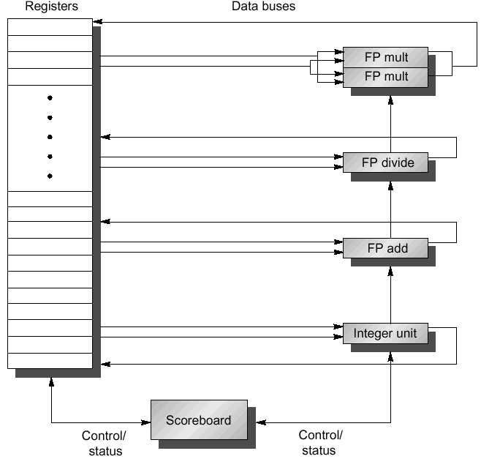
MIPS Processor with Scoreboard
Given the small latency of integer operations, it is not worth the scoreboard complexity
2 Multiplier, 1 divider, 1 adder and one integer unit
Major cost driven by data buses
The scoreboard control function units
The scoreboard enables out-of-order execution to maximize parallelism

Slide 11
Three Parts of the Scoreboard
Instruction status—which of 4 steps for instruction
Functional unit status—Indicates the state of the functional unit (FU). 9 fields for each functional unit
Busy—Indicates whether the unit is busy or not
Op—Operation to perform in the unit (e.g., + or –)
Fi—Destination register
Fj, Fk—Source-register numbers
Qj, Qk—Functional units producing source registers Fj, Fk
Rj, Rk—Flags indicating when Fj, Fk are ready
Register result status—Indicates which functional unit will write each register, if any. Blank when no pending instructions will write that register
Notes:
What you might have thought
1. 4 stages of instruction executino
2.Status of FU: Normal things to keep track of (RAW & structura for busyl):
Fi from instruction format of the mahine (Fi is dest)
Add unit can Add or Sub
Rj, Rk - status of registers (Yes means ready)
Qj,Qk - If a no in Rj, Rk, means waiting for a FU to write result; Qj, Qk means wihch FU waiting for it
3.Status of register result (WAW &WAR)s:
which FU is going to write into registers
Scoreboard on 6600 = size of FU
6.7, 6.8, 6.9, 6.12, 6.13, 6.16, 6.17
FU latencies: Add 2, Mult 10, Div 40 clocks

Slide 12
CDC Scoreboard
Speedup 1.7 from compiler; 2.5 by hand BUT slow memory (no cache)
Limitations of 6600 scoreboard:
No forwarding hardware
Limited to instructions in basic block (small window)
Small number of functional units (causes structural hazards)
Do not issue on structural hazards
Wait for WAR hazards and prevent WAW hazards

Slide 13
Scoreboard Example

Slide 14
Scoreboard Example Cycle 1

Slide 15
Scoreboard Example Cycle 2
Issue 2nd LD?

Slide 16
Scoreboard Example Cycle 3

Slide 17
Scoreboard Example Cycle 4

Slide 18
Scoreboard Example Cycle 5

Slide 19
Scoreboard Example Cycle 6

Slide 20
Scoreboard Example Cycle 7
Read multiply operands?

Slide 21
Scoreboard Example Cycle 8a

Slide 22
Scoreboard Example Cycle 8b

Slide 23
Scoreboard Example Cycle 9
Read operands for MULT & SUBD?
Issue ADDD?

Slide 24
Scoreboard Example Cycle 11

Slide 25
Scoreboard Example Cycle 12
Read operands for DIVD?

Slide 26
Scoreboard Example Cycle 13

Slide 27
Scoreboard Example Cycle 14

Slide 28
Scoreboard Example Cycle 15

Slide 29
Scoreboard Example Cycle 16

Slide 30
Scoreboard Example Cycle 17
Write result of ADDD?

Slide 31
Scoreboard Example Cycle 18

Slide 32
Scoreboard Example Cycle 19

Slide 33
Scoreboard Example Cycle 20

Slide 34
Scoreboard Example Cycle 21

Slide 35
Scoreboard Example Cycle 22

Slide 36
Scoreboard Example Cycle 61

Slide 37
Scoreboard Example Cycle 62

