Slide 1
Advanced Computer Architecture (ACA 2019)
Dr. ZHANG Chun-yuan
College of Computer, NUDT
Fall, 2019

Slide 2
Lecture 04 pipelining problems

Slide 3
Branch-Prediction Buffer (BPB)
The Simplest Dynamic Branch Prediction

Slide 4
A General Dynamic Branch Prediction
Branch
Predictor
Incoming Branches
{ Address }
Prediction
{ Address, Value }
History
Information
Corrections
{ Address, Value }

Slide 5
BPB Principles
 | Predictor 0
 | Predictor 1
lower
bits
of the
branch
PC
 | Predictor 2^{n}-1

Slide 6
1-bit BPB Scheme
Prediction accuracy is about 80%
Almost all loop will predict incorrectly twice

Slide 7
2-bit Scheme
Taken
Not taken
Predict taken
11
Predict taken
10
Taken
Taken
Not taken
Not taken
Predict not taken
01
Predict not taken
00
Taken
Not taken

Slide 8
BPB Prediction Accuracy
Accuracy: 4K-entry 2-bits BPB, SPEC89, IBM Power
Accuracy: 82% ~ 99%
Integer average 11%
gcc, espresso, eqntott, li
FP average 4%
nasa7, matrix300, tomcatv
Why they are deference?

Slide 9
Mispredictions

Slide 10
The 2-bit Scheme: an Alternative
Taken
Not taken
Predict taken
11
Predict taken
10
Taken
Taken
Not taken
Not taken
Predict not taken
01
Predict not taken
00
Taken
Not taken

Slide 11
Entries Mis : 4K vs. Unlimited, 2bit/entry

Slide 12
BPB: Typical Implementations
As a “cache”
Accessed with the instruction address during the IF
Taken -> fetching begins from the target as soon as the PC is known
Not taken -> sequential fetching continues

Slide 13
BPB: an Instruction Address
Fetch PC
0
0

Slide 14
BPB: IFatch and 2^{k} 2 bits Predicter Select
Fetch PC
0
0
I-Cache
k
2^{k}-entry
BPB,
2 bits/entry
BPB Index
Instruction
Opcode
offset
Taken/¬Taken?

Slide 15
BPB: Decode & Target PC
Fetch PC
0
0
I-Cache
k
2^{k}-entry
BPB,
2 bits/entry
BPB Index
Instruction
Opcode
offset
+
Branch?
Target PC
Taken/¬Taken?
2^{K}-entry BPB, 2 bits/entry, ~80-90% correct predictions

Slide 16
Precise Piplining Problems
Next ...

Slide 17
Exception
Exception cover fault and exception
Page C-38 to C-43

Slide 18
Problem
It must appear between 2 instructions (Ii and Ii+1)
Up to and including Ii must complete
No effect after Ii
Handler
aborts
restarts at instruction Ii+1
Safe？

Slide 19
Precise Exceptions
stopped just before the faulting instruction are completed
those after it can be restarted from scratch
modern processor must make its exceptions precise
Why?

Slide 20
Exceptions May in the RISC V Pipeline
Pipeline stage | Problem exceptions occurring
IF | Page fault on instruction fetch; Misaligned memory access; Memory protection violation
ID | Undefined or illegal opcode
EX | Arithmetic exception
MEM | Page fault on data fetch; Misaligned memory access; Memory protection violation
WB | None

Slide 21
Multicycle Operations
Next ...

Slide 22
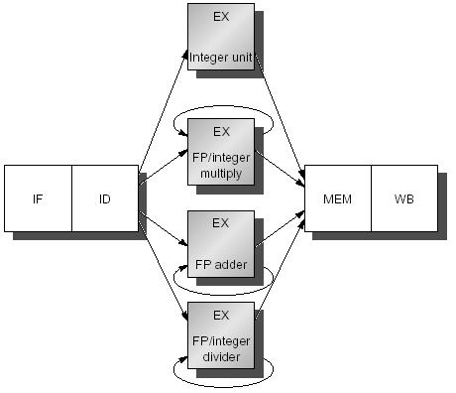
Four Separate FUs

Slide 23
Latency and Initiation Interval
Functional unit | Latency | Initiation interval
Integer ALU | 0 | 1
Data memory (int & FP loads) | 1 | 1
FP add | 3 | 1
FP multiply (also int. multiply) | 6 | 1
FP divide (also integer divide) | 24 | 25

Slide 24
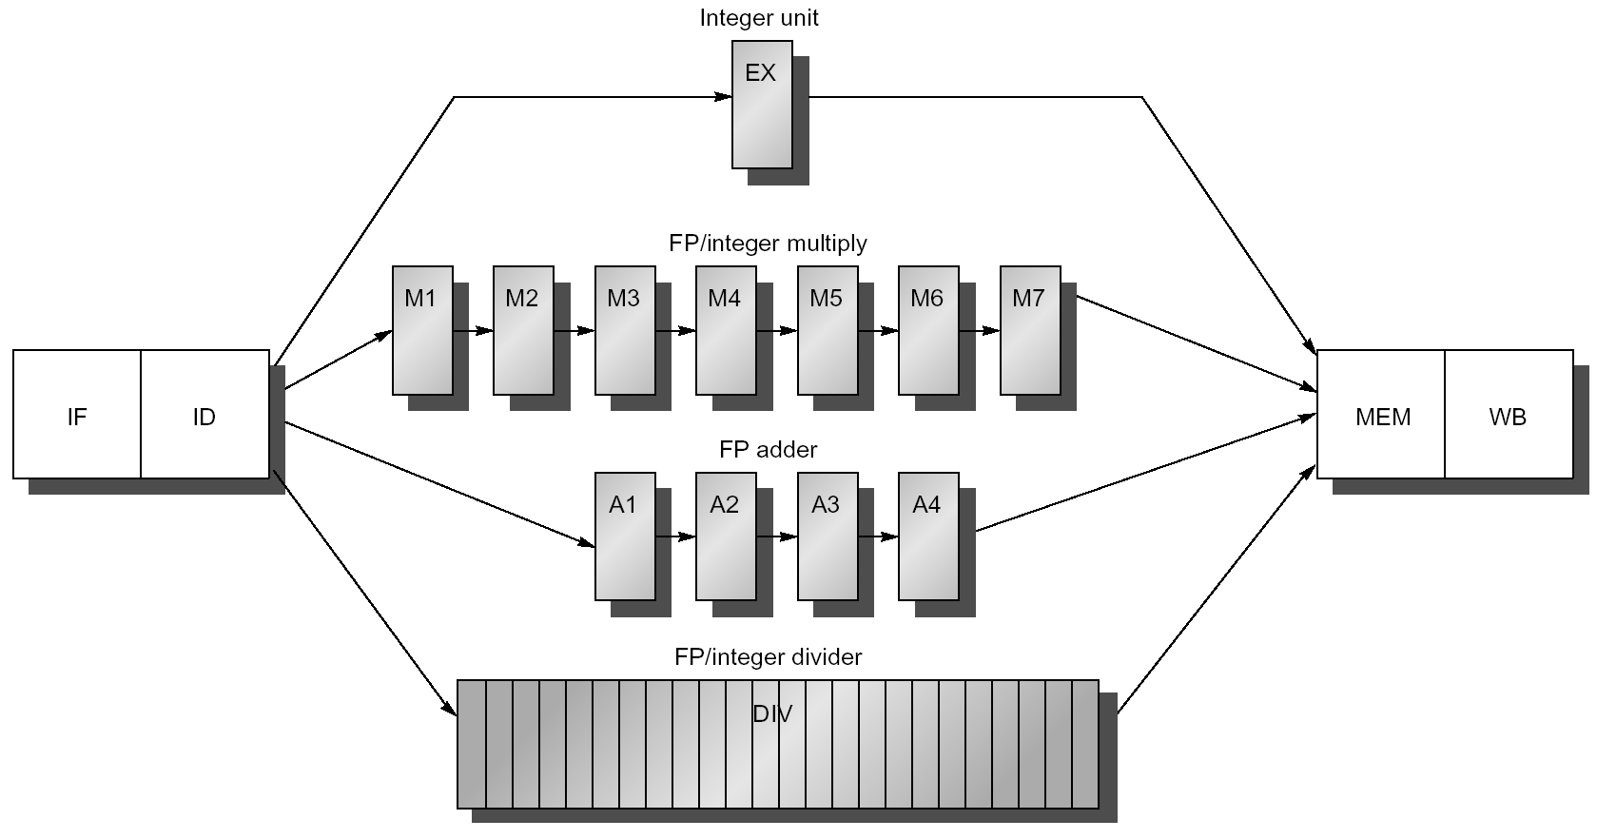
The Multiple Pipelines

Slide 25
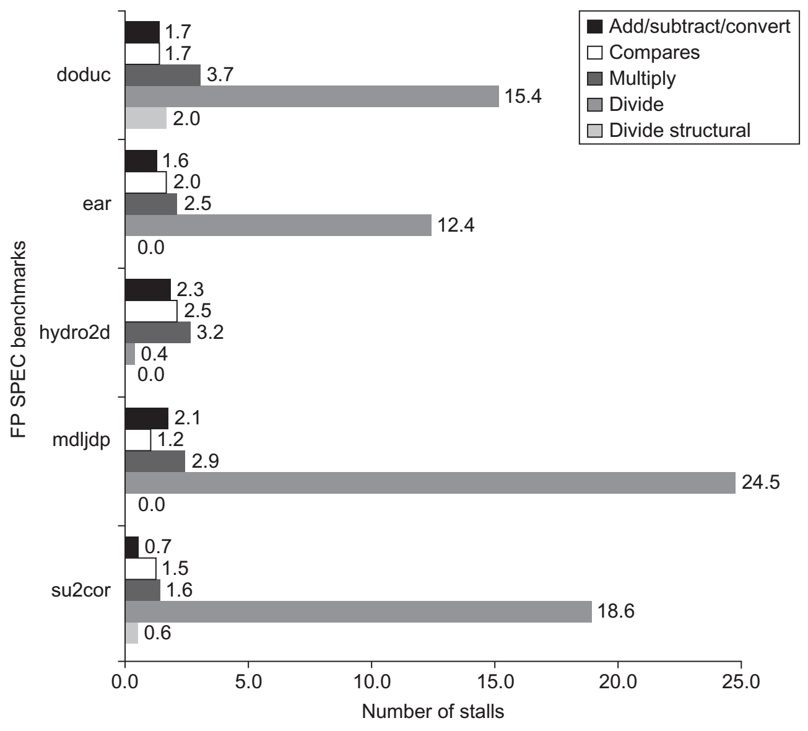
Stalls per FP Operation for SPEC89 FP

Slide 26
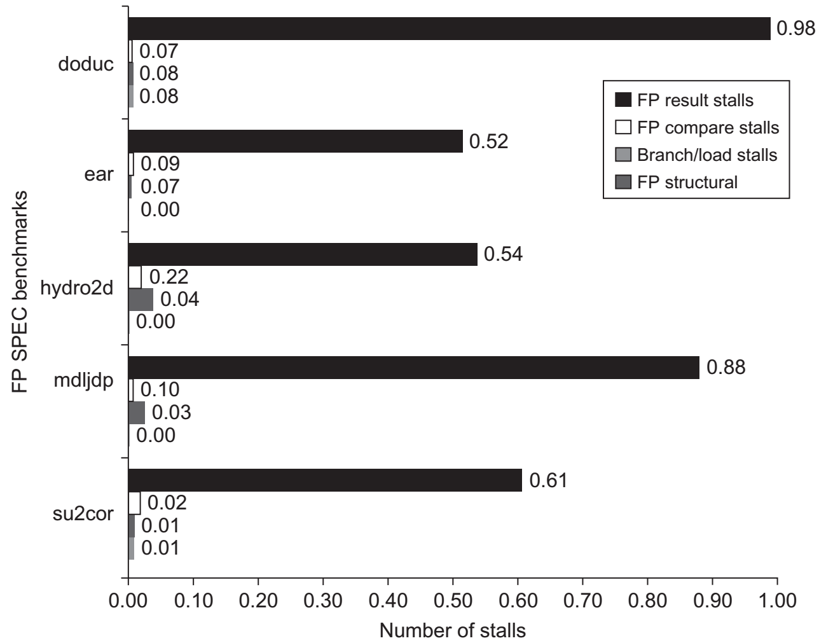
The stalls for FP pipeline for SPEC89 FP

Slide 27
Scoreboard
Dynamically Scheduled Pipelines

Slide 28
CDC 6600: designed by Seymore Cray
Control Data Corporation, CEO, William Norris
CDC 6600 Released: 1964
Fastest machine in world for 5 years (until 7600)
over 100 sold ($7-10M each)
OS: COS, SCOPE, MACE, KRONOS
Processor: One 60-bit CPU
The fastest clock speed for its day (100 ns, 10Mhz)
FP add in 4 clocks
Memory: 128K 60-bit words
Ten shared-logic 12-bit peripheral I/O processors
Display: Printer, plotter and dual video display console
Storage: 2MB extended core storage, magnetic disk, magnetic drum
400,000 transistors
Over 100 miles of wiring (done by hand)
Freon refrigerant cooling

Slide 29
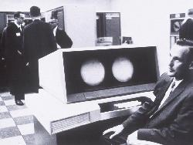
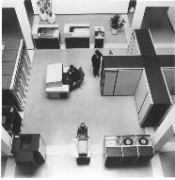
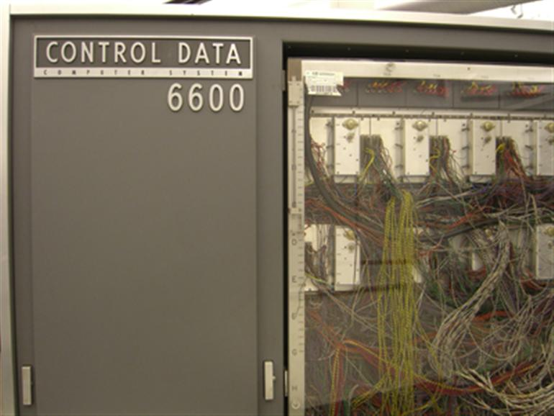
Some Photos (from Internet)

Slide 30
IBM Internal Memo
"Last week, Control Data ... announced the 6600 system. I understand that in the laboratory developing the system there are only 34 people including the janitor. Of these, 14 are engineers and 4 are programmers... Contrasting this modest effort with our vast development activities, I fail to understand why we have lost our industry leadership position by letting someone else offer the world's most powerful computer."
Thomas Watson Jr., IBM CEO, August 1963
To which Cray replied: “It seems like Mr. Watson has answered his own question.”

Slide 31
Review: Scoreboard (CDC 6600)
FP Mult
FP Mult
FP Divide
Registers
Functional Units
FP Add
Integer
SCOREBOARD
Memory

Slide 32
Scoreboard Implications
Solutions for WAR
Stall writeback until registers have been read
Read registers only during Read Operands stage
Solution for WAW
Detect hazard and stall issue of new instruction until other instruction completes
Need to have multiple instructions in execution phase
=> multiple execution units or pipelined execution units

Slide 33
The 1st Stages: Issue
Issue -- Decode instructions & check for structural hazards (ID1)
Instructions issued in program order (for hazard checking)
Don’t issue if structural hazard
Don’t issue if instruction is output dependent on any previously issued but uncompleted instruction (no WAW hazards)

Slide 34
The 2nd Stages: Read Operands
Read Operands -- Wait until no data hazards, then read operands (ID2)
All real dependencies resolved in this stage, since we wait for instructions to write back data (RAW hazards)
No forwarding of data in this model !
Data can not be used until in registers

Slide 35
The 3rd Stages: Execution
Execution -- operate on operands (EX)
The functional unit begins execution upon receiving operands
When the result is ready, it notifies the scoreboard that it has completed execution

Slide 36
The 4th Stages: Write Result
Write result -- finish execution (WB)
Stall until no WAR hazards with previous instructions

Slide 37
Three Parts of the Scoreboard
Instruction status
Which of 4 steps the instruction is in
Register result status
Indicates which functional unit will write each register, if one exists
Blank when no pending instructions will write that register
Functional unit status
Indicates the state of the FU
9 fields for each functional unit
Notes:
What you might have thought
1. 4 stages of instruction executino
2.Status of FU: Normal things to keep track of (RAW & structura for busyl):
Fi from instruction format of the mahine (Fi is dest)
Add unit can Add or Sub
Rj, Rk - status of registers (Yes means ready)
Qj,Qk - If a no in Rj, Rk, means waiting for a FU to write result; Qj, Qk means wihch FU waiting for it
3.Status of register result (WAW &WAR)s:
which FU is going to write into registers
Scoreboard on 6600 = size of FU
6.7, 6.8, 6.9, 6.12, 6.13, 6.16, 6.17
FU latencies: Add 2, Mult 10, Div 40 clocks

Slide 38
9 Fields for Each Functional Unit
Busy: Indicates the unit is busy or not
Op: Operation to perform in the unit (e.g., + or –)
Fi: Destination register
Fj, Fk: Source-register numbers
Qj, Qk: Functional units producing source registers Fj, Fk
Rj, Rk: Flags indicating when Fj, Fk are ready
Notes:
What you might have thought
1. 4 stages of instruction execution
2. Status of FU: Normal things to keep track of (RAW & structura for busyl):
Fi from instruction format of the mahine (Fi is dest)
Add unit can Add or Sub
Rj, Rk - status of registers (Yes means ready)
Qj,Qk - If a no in Rj, Rk, means waiting for a FU to write result; Qj, Qk means wihch FU waiting for it
3.Status of register result (WAW &WAR)s:
which FU is going to write into registers
Scoreboard on 6600 = size of FU
6.7, 6.8, 6.9, 6.12, 6.13, 6.16, 6.17
FU latencies: Add 2, Mult 10, Div 40 clocks

Slide 39
How It Works
L.D F6, 34(R2)
L.D F2, 45(R3)
MUL.D F0, F2, F4
SUB.D F8, F2, F6
DIV.D F10, F0, F6
ADD.D F6, F8, F2

Slide 40
Where Are the RAWs?
L.D F6, 34(R2)
L.D F2, 45(R3)
MUL.D F0, F2, F4
SUB.D F8, F2, F6
DIV.D F10, F0, F6
ADD.D F6, F8, F2

Slide 41
RAWs
L.D F6, 34(R2)
L.D F2, 45(R3)
MUL.D F0, F2, F4
SUB.D F8, F2, F6
DIV.D F10, F0, F6
ADD.D F6, F8, F2

Slide 42
Where WARs?
L.D F6, 34(R2)
L.D F2, 45(R3)
MUL.D F0, F2, F4
SUB.D F8, F2, F6
DIV.D F10, F0, F6
ADD.D F6, F8, F2

Slide 43
WARs
L.D F6, 34(R2)
L.D F2, 45(R3)
MUL.D F0, F2, F4
SUB.D F8, F2, F6
DIV.D F10, F0, F6
ADD.D F6, F8, F2

Slide 44
EX Cycle Latencies
EX cycle latencies for the FP function units
ADD is 2 clock cycles
MULTIPLY is 10 cycles
DIVIDE is 40 cycles

Slide 45
Scoreboard Example

Slide 46
Scoreboard Example: Cycle 1
Notes:
三个表三个类

Slide 47
Scoreboard Example: Cycle 2

Slide 48
Scoreboard Example: Cycle 2
Issue 2nd LD?

Slide 49
Scoreboard Example: Cycle 3

Slide 50
Scoreboard Example: Cycle 3
Issue MULT?

Slide 51
Scoreboard Example: Cycle 4
Notes:
第四个时钟结束后，该LD指令结束了
即Interger指令不处于busy状态？？

Slide 52
Scoreboard Example: Cycle 5
Notes:
第五个时钟到来时，第二个Integer指令被发射，而且此时的Rk寄存器是可以进行读数的，而且此时也没有来自生产所需寄存器的功能单元的限制，
于是下一个时钟会对应着读入操作数。

Slide 53
Scoreboard Example: Cycle 6
Notes:
在第六个时钟到来的时刻，第二个指令集对应的FU开始读入操作数，而且第三个指令开始issue，但此时该乘法指令还在等待第二个Integer指令的结果写入，
导致该乘法指令不能在下一时钟进行读数，所以将处于stall状态。

Slide 54
Scoreboard Example: Cycle 7
Notes:
Cycle7：
第二个指令进入到操作阶段，对应的功能单元开始进行运算，并且此时由于已经从R3中读完数据，所以对应的ready状态由yes到no（这是默认的）
由于integer功能单元还未将结果写入到F2中，所以第三个指令仍是处于stall状态
第四个指令此时发射，但由于第二个操作数所处的寄存器还需要等待第二个指令集写入后的结果，所以不能读出F2寄存器所对应的值，为了避免RAW冒险，
所以出于stall状态。

Slide 55
Scoreboard Example: Cycle 7
Read multiply operands?

Slide 56
Cycle 8a (First half of clock)
Read operands for MULT & SUB?
Notes:
Cycle8：
在前半个时钟内： 在第二个指令对应的FU没有将结果写入F2前不得从中读取数据即：第三条指令继续暂停，第四条也如此；
第五条指令进行发射，但由于第一个操作数所在的F0寄存器是需要等待第三个指令集所对应FU将结果写入到F0寄存器中，
所以下一时钟第五个FU将处于stall状态

Slide 57
Cycle 8b (Second half of clock)
Notes:
Cycle8：
在后半个时钟内：
F2的数据写入完毕，指令集处于not busy状态
第三个和第四个指令集进入到读数阶段，对应的乘法和加法FU也能分别从F2，F4和F6，F2中读取数据；

Slide 58
Scoreboard Example: Cycle 9
Note
Remaining
Notes:
cycle9算是读入数据，之后从cycle10开始就算是延迟了

Slide 59
Scoreboard Example: Cycle 9
Self learning
Issue ADDD?
Note
Remaining
Notes:
Cycle9： 由于第五个除法指令集所对应的FU的第一个操作数是需要从第三个指令集对应的乘法FU的写出结果中读取的，所以处于stall状态
此时第三个指令集将进入执行阶段，注意此时还需要10个cycle来完成这个部分。
此时第四个指令集也完成了读数阶段，之后还需要2个cycle来完成接下来的加法操作。？？？ 应该是说到执行阶段会存在10个，2个延迟吧？那具体到物理过程是什么，各类触发器所导致的延时，那运算就不需要么

Slide 60
Scoreboard Example: Cycle 10
Self learning
Notes:
Cycle10：
完成读数阶段后，对应的源寄存器的状态设为no
此时除法指令集对应FU还是处于stall状态

Slide 61
Scoreboard Example: Cycle 11
Self learning
Notes:
cycle11：
第九个时钟结束后的第二个时钟完成之时，第四个指令集对应的FU，完成了其读数操作，进入到了执行阶段，

Slide 62
Scoreboard Example: Cycle 12
Self learning
Notes:
cycle12：
一旦进入到WR阶段，指令集的Busy状态为No，

Slide 63
Scoreboard Example: Cycle 12
Self learning
Read operands for DIVD?
Issue ADDD?

Slide 64
Scoreboard Example: Cycle 13
Self learning

Slide 65
Scoreboard Example: Cycle 14
Self learning

Slide 66
Scoreboard Example: Cycle 15
Self learning

Slide 67
Scoreboard Example: Cycle 16
Self learning

Slide 68
Scoreboard Example: Cycle 17
Self learning

Slide 69
Scoreboard Example: Cycle 17
Self learning
Why not write result of ADDD?

Slide 70
Scoreboard Example: Cycle 17
Self learning
Why not write result of ADDD?
WAR Hazard!

Slide 71
Scoreboard Example: Cycle 18
Self learning

Slide 72
Scoreboard Example: Cycle 19
Self learning
Notes:
在从源寄存器中读取数据后的第十个时钟内，乘法指令对应FU进入到了执行阶段，对应其他FU的源寄存器标签马上随之变化

Slide 73
Scoreboard Example: Cycle 20
Self learning
Notes:
到cycle20时，乘法指令集进入到WR状态，那么此cycle结束时，对应的指令停止发射，

Slide 74
Scoreboard Example: Cycle 21
Self learning
Notes:
cycle21 则是消除RAW冒险后的第一个时钟，那么此时除法FU进入到读数阶段

Slide 75
Scoreboard Example: Cycle 21
Self learning
WAR Hazard is now gone...
Notes:
读数之后是40个时钟的延迟

Slide 76
Scoreboard Example: Cycle 22
Self learning
Notes:
在cycle22时，除法FU已经读取了源寄存器的数据，那么对应的加法FU可以在该时钟周期内完成其WR过程

Slide 77
Faster than light computation
Self learning
(skip a couple of cycles)

Slide 78
Scoreboard Example: Cycle 61
Self learning

Slide 79
Scoreboard Example: Cycle 62
Self learning

Slide 80
Review: Scoreboard Status

Slide 81
Review: Scoreboard Status
In-order issue
Out-of-order execute
Out-of-order WR

Slide 82
Issue
Self learning
not Busy[FU] and not Result [D]
Bookkeeping
Busy[FU] ← yes; OP[FU] ← Op;
Fi[FU] ← D; Fj[FU] ← S1; Fk[FU] ← S2;
Qj ← Result[S1]; Qk ← Result[S2];
Rj ← not Qj; Rk ← not Qk;
Result[D] ← FU;

Slide 83
Read operands
Self learning
Rj and Rk
//operands are ready, check RAW
Bookkeeping
Rj ← No; Rk ← No;
//Rj, Rk have been used
Qj ← 0; Qk ← 0;
//no FU results are waited

Slide 84
Execution
Self learning
Execution complete
Functional unit done

Slide 85
Write Result
Self learning
Wait until ∀f((Fj[f] ≠ Fi[FU] or Rj[f] = no) & (Fk[f] ≠ Fi[FU] or Rk[f] = no));
Bookkeeping
∀f(if Qj[f] = FU then Rj[f] ← yes);
//all Fjs are OK
∀f(if Qk[f] = FU then Rk[f] ← yes);
//all Fks are OK
Result [Fi[FU]] ← 0;
Busy[FU] ← No;

Slide 86
Scoreboard on the CDC 6600
CDC 6600
No software pipeline scheduling
No semiconductor main memory
No caches (lower memory-access time)
Cost of scoreboard on the CDC 6600 is surprisingly low
About as much logic as one of the FU
The main cost is large number of buses (data trunk) that is about four times as many as executing in order

Slide 87
The CDC6600 Benefits
Improvement | Cede Type
1.7 | FORTRAN
2.5 | hand-coded assembly

Slide 88
Limitations of 6600 Scoreboard
No forwarding hardware
Limited to instructions in basic block
Small window
Small number of functional units
Structural hazards
Especially integer/load store units
Do not issue on structural hazards
Wait for WAR hazards
Prevent WAW hazards

Slide 89
Summary
Hazards limit performance
Structural: need more HW resources
Data: need forwarding, compiler scheduling
Control: early evaluation & PC, delayed branch, prediction
ILP found either by compiler or hardware
Increasing length of pipe increases impact of hazards
Pipelining helps instruction bandwidth, not latency!

Slide 90
Ambitiously
Missing from 6600 Scoreboard?
Hardware renaming – name dependencies limiting our potential speedup on loops!
Can we rename in hardware? Of course – next time
Concurrent write result to destination register and read operands

Slide 91
Historical View: Pipelining Tech
At the 1980s, for
Supercomputers
Large multimillion dollar mainframes
By the mid-1980s
The first pipelined microprocessors
Microprocessors bypass minicomputers and mainframes
By the early 1990s
High-end embedded microprocessors
Desktops were dynamically scheduled, multiple-issue

Slide 92
Homework
Read C7
Algorithm and write the functional explanation to each statement (operation and result)
Project:
RISC V subset selection
For one week
Coding for scoreboard
The proposals must submitted in two weeks

Slide 93
Next…
ILP

